Slide 1
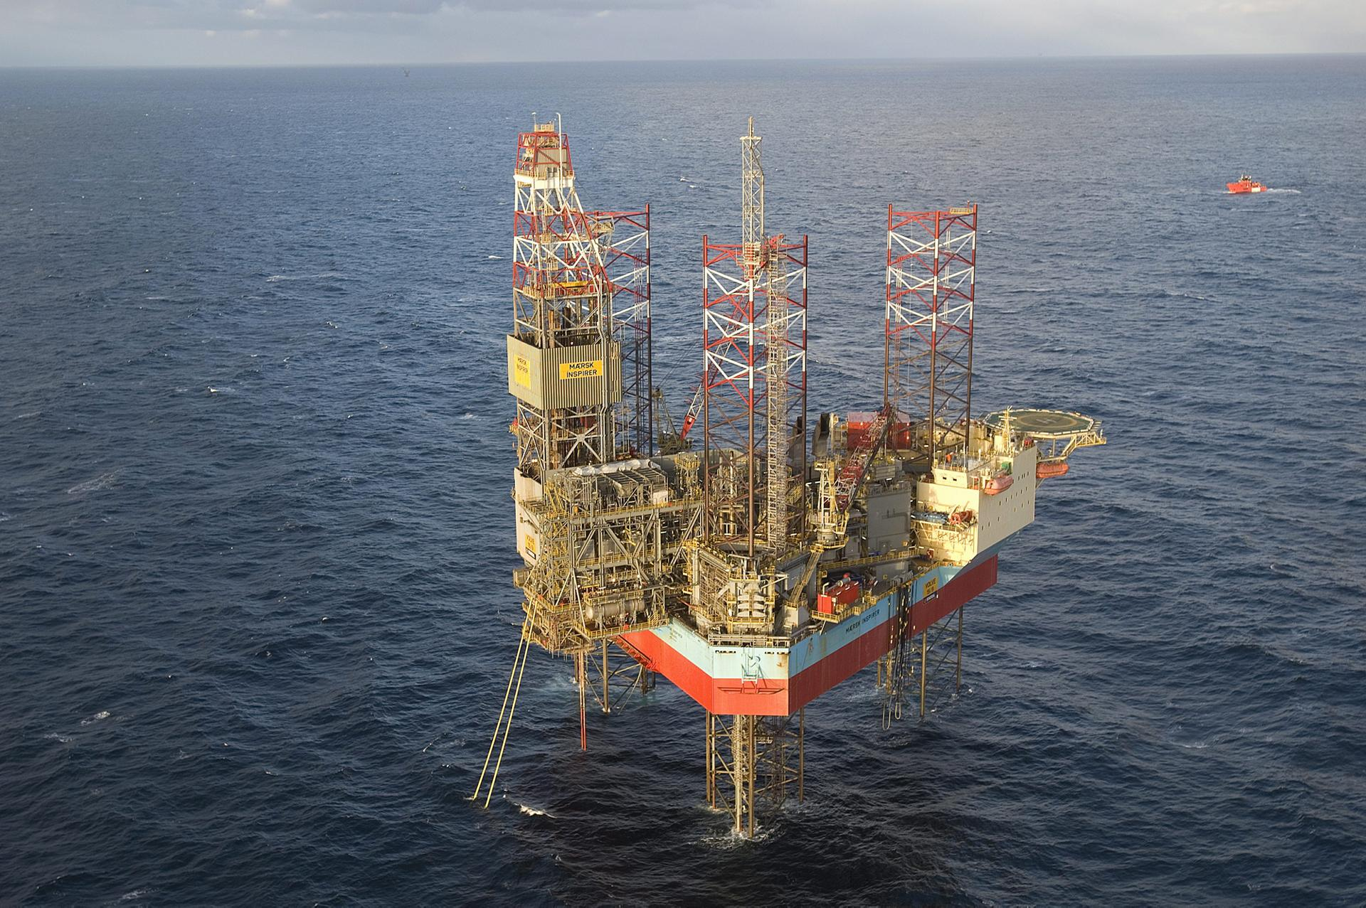
Group 4
Joseph C Sajan
Krishnan G Nair
Vahid Marashi

Slide 2
Contents
Volve field
Oil Recovery
Water Injection
Water Injection in Volve
Analysis

Slide 3
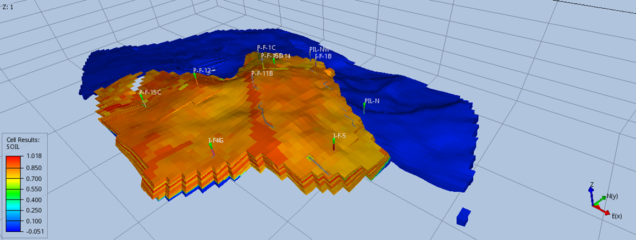
VOLVE FIELD

Slide 4
Location
Quadrant 15 in the Norwegian Continental Shelf (NCS)
Central part of the North Sea

Slide 5
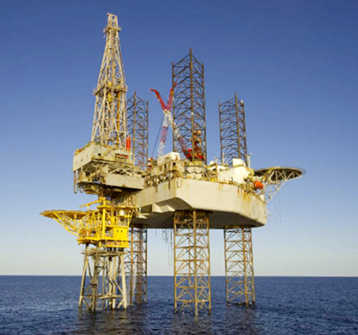
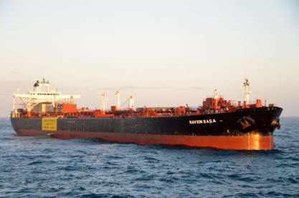
Details of the field
Discovered in 1993
Discovery well -15/9 – 19 SR
Viscosity - 0.55 mPa.s
Bubble point pressure -273.8 bar
Reservoir pressure at 3060 m – 340 bar
Plan for development and operation in 2005
Production started at 2008
Water depth of 80 m
Jack up drills were used for oil extraction
Vessel Navion Saga used for Storing stabilized oil

Slide 6
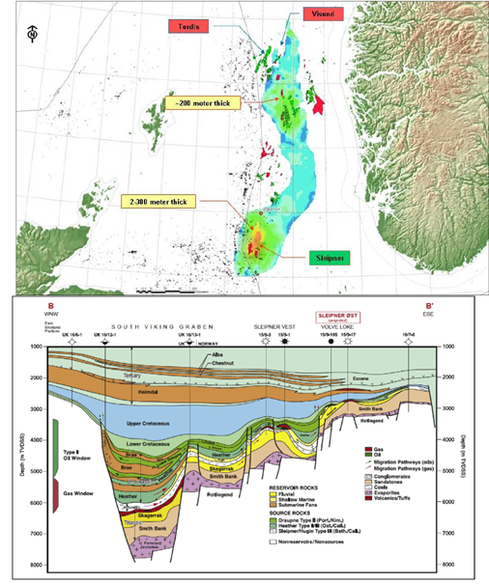
Formations
Volve field consists of two major formations
Utsira :
Large aquifer
Highly porous
Extremely permeable sand
Hugin :
Very fine to medium grained sandstones
Carbonaceous material and coal fragment
Volve field produced gas/condensate from Hugin

Slide 7
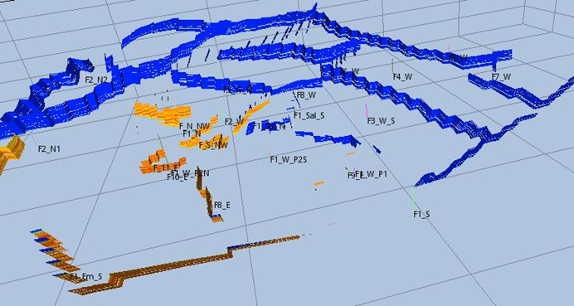
Fault:
Planar fracture or discontinuity in a volume of rocks
Major role in migration and Accumulation of hydrocarbons
30 faults in Volve field

Slide 8
Wells
Exploration well: 15/9-19 SR
Planned: 3 production well 3 injection well 2 water production well
Actual:
4 Injection wells: I-F-1B I-F-5 I-F-4 I-F4G
7 Production wells: P-F-12 P-F-14 P-F-15C P-F-11B P-F-15D P-F-1C PF-5
2 Water Producer well: PIL -N PIL -NW

Slide 9
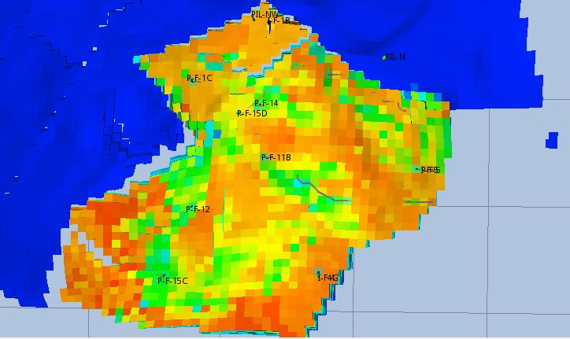
PIL-NW
I-F-1B
PIL-N
P-F-1C
P-F-14
P-F-15D
P-F-5
I-F-5
P-F-11B
P-F-12
4 Injection wells
7 Producer wells
2 Water Production wells
I-F-4
I-F-4G
P-F-15C

Slide 10
Oil Recovery Methods

Slide 11
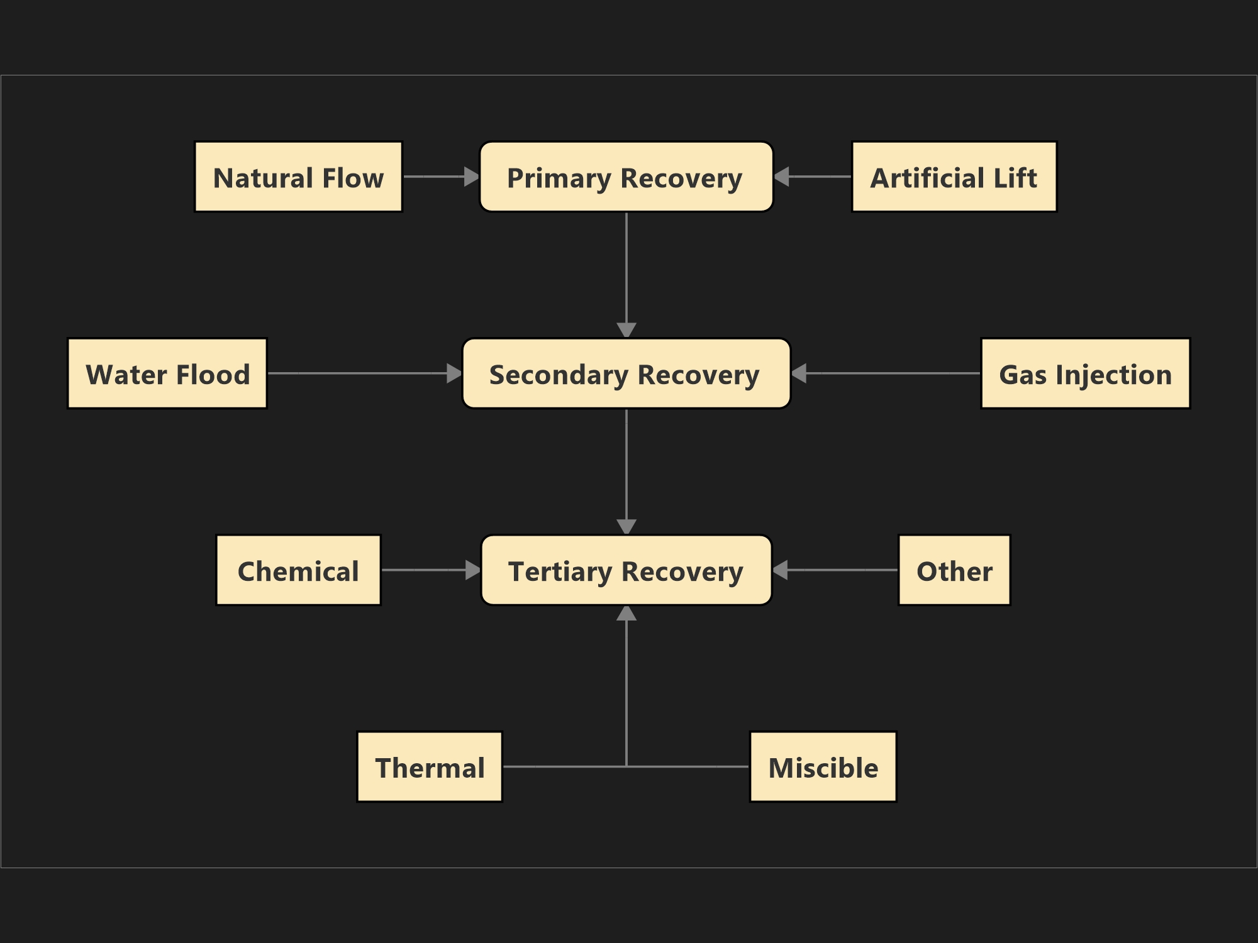

Slide 12
Oil Recovery Categories

Slide 13
Water Injection

Slide 14
Water injection in Volve
Two water production wells were drilled at Utsira Formation for Injection purposes
Establishing a drainage strategy for Volve using a simulation model.
Three Injectors were used on the flanks
Using Utsira formation's water as the injected fluid
Efficiency of water injection due to the slope of the reservoir (10º-20º)

Slide 15
Why Water Injection over Gas Injection?
Why water?
Why not gas?
Availability of water besides Volve
More economical
Fairly good reservoir permeability
Giving sufficiently oil recovery
Lack of availability of gas in Volve
Not very efficient WAG and SWAG
Expensive compressors for gas injection purposes

Slide 16
Which formation zones are the water injected?
Water Injection intervals with the help of Geophysical interpretation data
Injection Well Name | Perforated Interval (MD) | Formation
15/9-F-5 | 3605m-3712m | Hugin
15/9-F-1B | 3245m-3294m | Upper-Middle-Hugin
15/9-F-4 | 3395m-3422m | Hugin

Slide 18
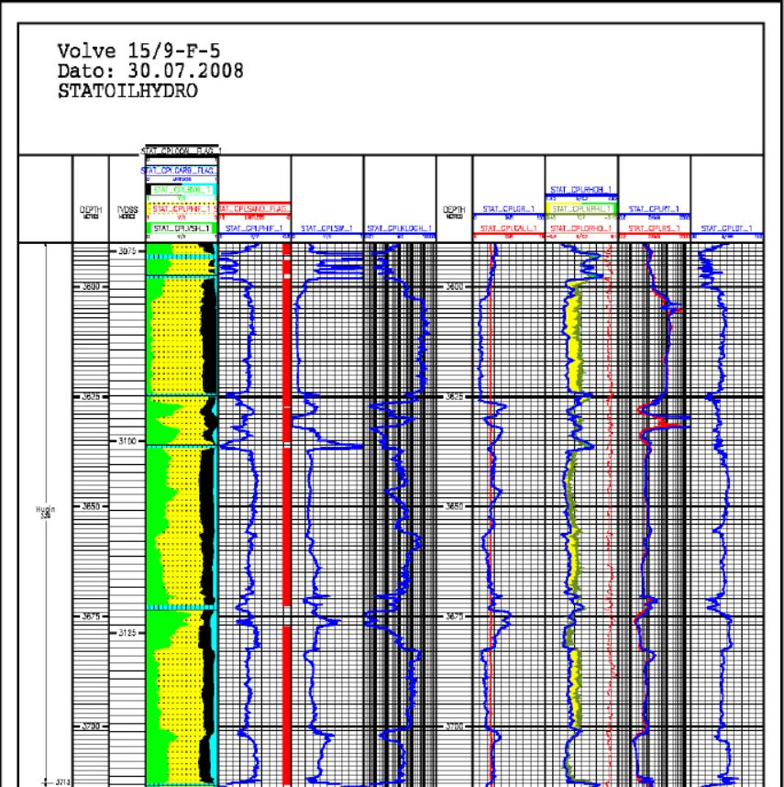

Slide 19
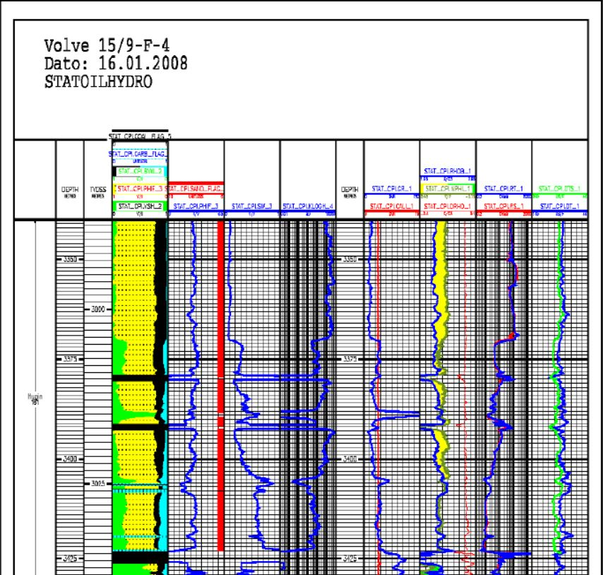

Slide 20
Analysis
Influence of Injection in oil production
How injected water behaves in the reservoir

Slide 21
Influence Of Injection In Oil Production

Slide 23
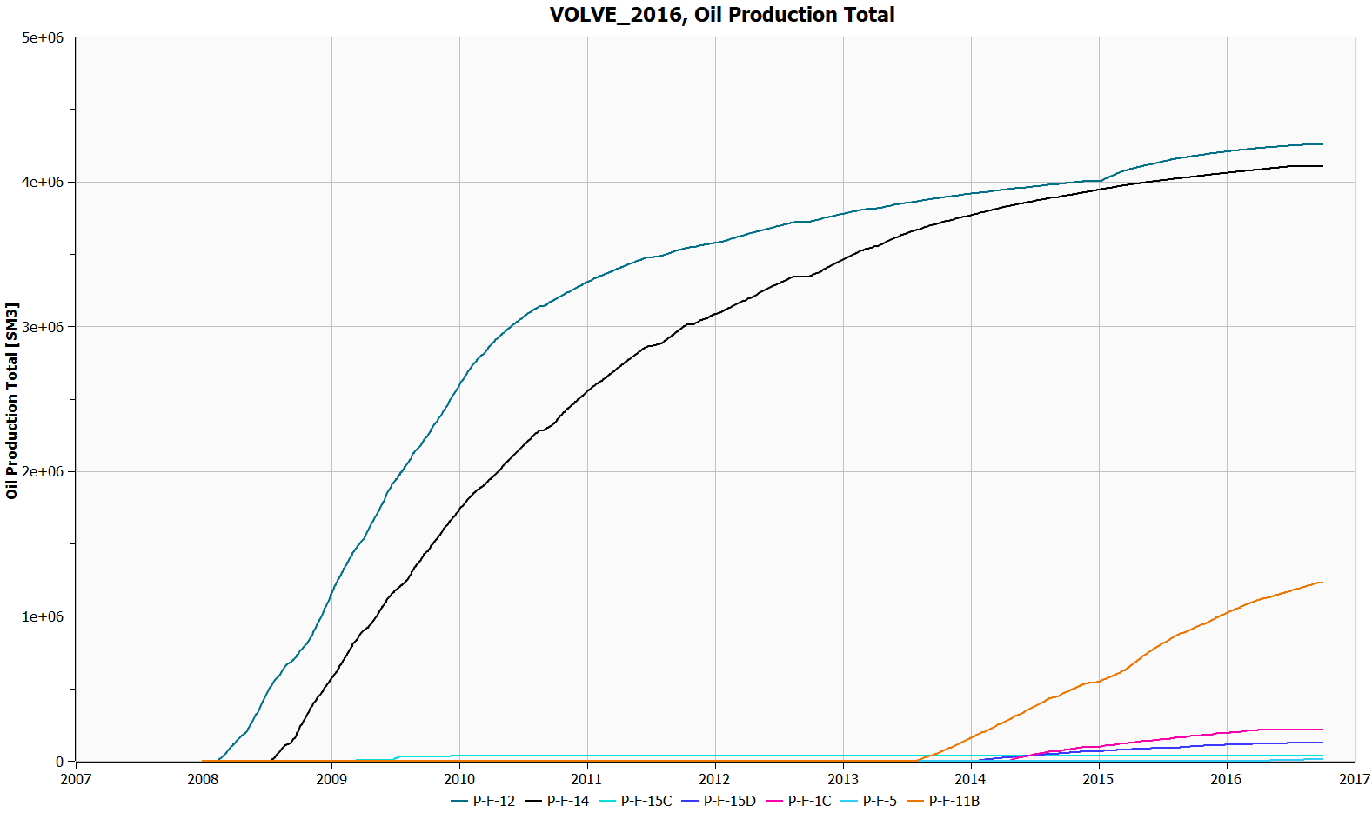

Slide 24
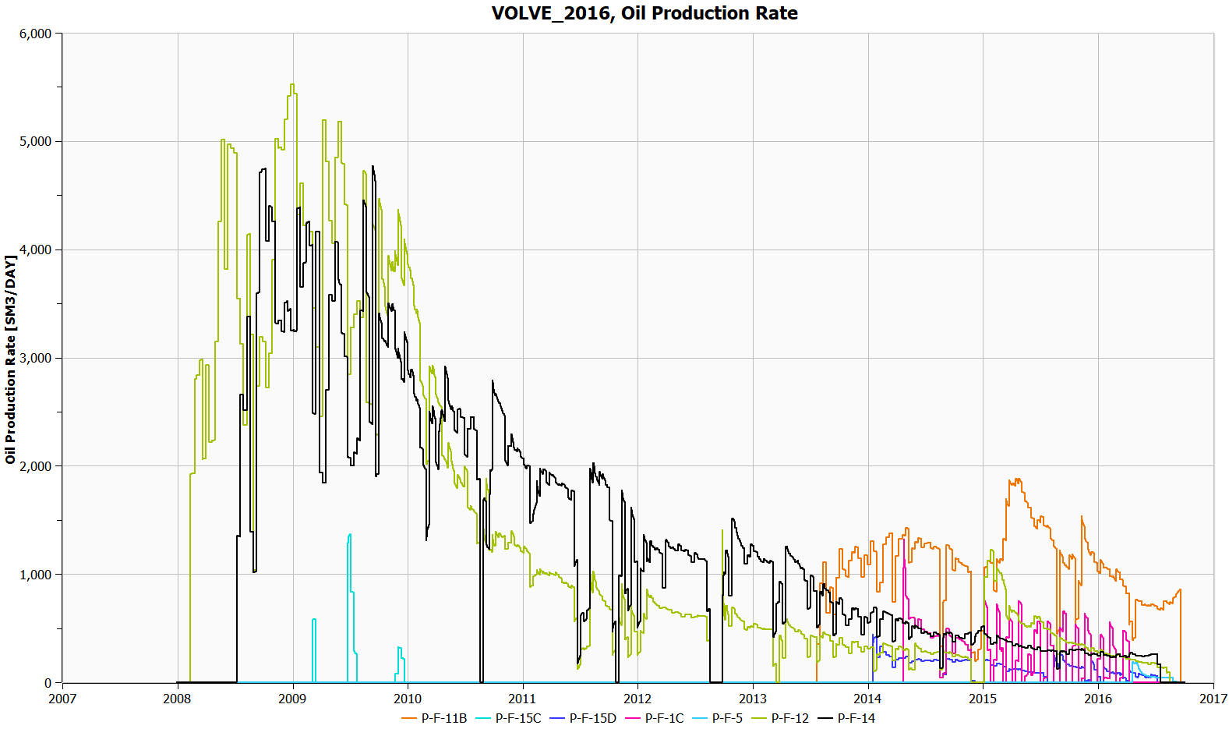

Slide 25
Production wells and injection wells influencing them
P-F-12 - I-F-4 I-F-5 I-F-1B
P-F-14 - I-F-4 I-F-5
P-F-15C - I-F-5 I-F-4
P-F-11B - I-F-1B I-F-4
P-F-15D - I-F-1B I-F-4
P-F-1C - I-F-4 I-F-5
P-F-5 - I-F-4

Slide 26
How injected water behaves in the reservoir

Slide 29
Reference
AHMED TAREK, Reservoir Engineering Handbook, Second Edition, Butterworth-Heinemann
https://www.norskpetroleum.no/en/interactive-map-quick-downloads/interactive-map/?mapv2ObjType=field&mapv2ObjId=3420717
https://www.equinor.com/en/what-we-do/norwegian-continental-shelf-platforms/volve.html
Equinor, "Volve Data Village," 14 9 2018. [Online]. Available: https://data.equinor.com/dataset/Volve. [Accessed 5 2 2019].
Equinor, "Volve Reservoir Model," 2016.
Statoil, Exxonmobil, Hydro, Total, "Plan for utbygging og drift av Volve (Utvinningstillatelse PL046," 2005.
Esso, Hydro, elf, Total, statoil, "DISCOVERY EVALUATION," Statoil, 1993.

Slide 30
Thank You
Tusen Takk
ممنون
നന്ദി

