Slide 1
Haltenbanken Village 2020
Group 2

Slide 2
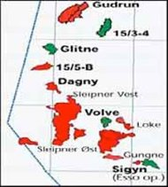
The Volve field Block 15/9
(NPD VOLVE PUD)

Slide 3
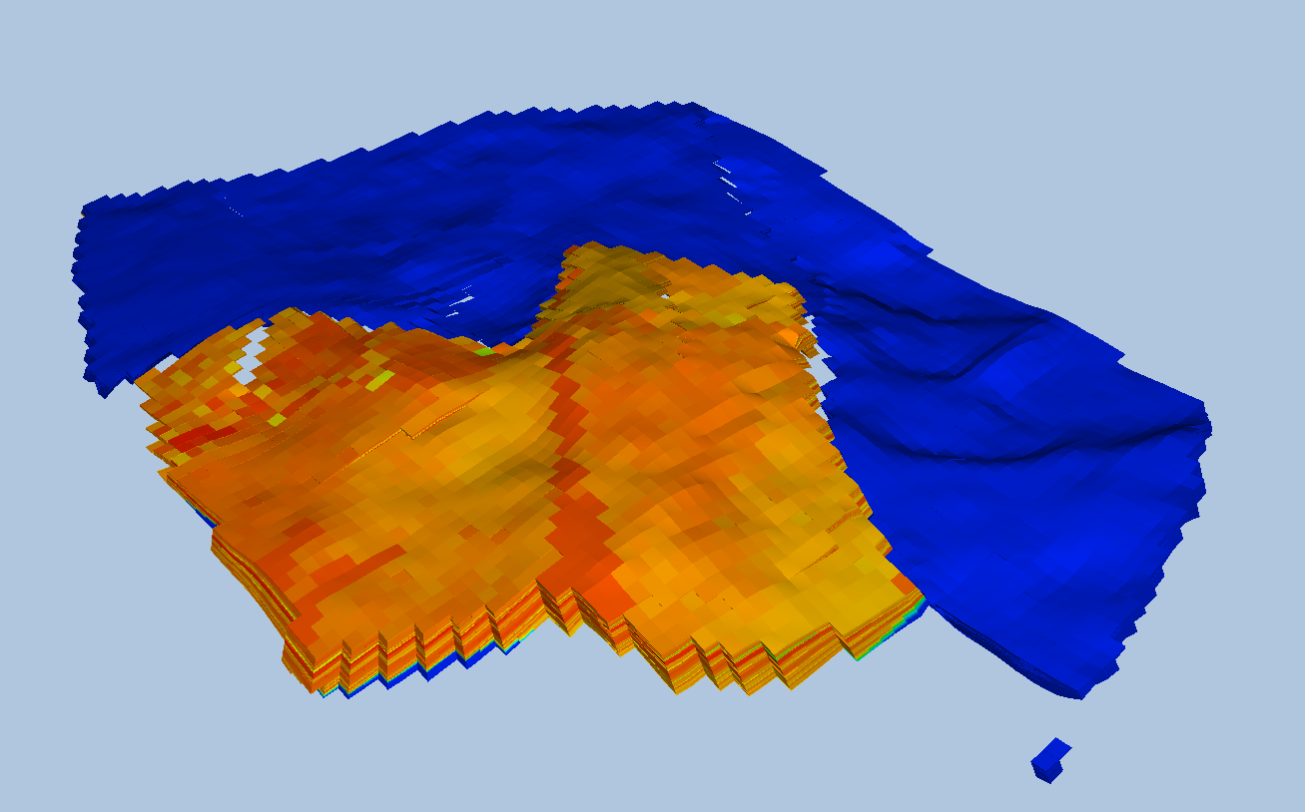
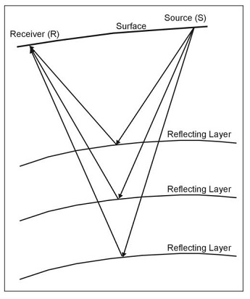
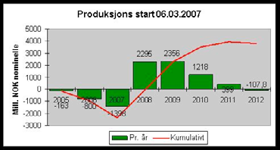
Decision making
Seismic survey
Model
Decision
Well log
Production data

Slide 4
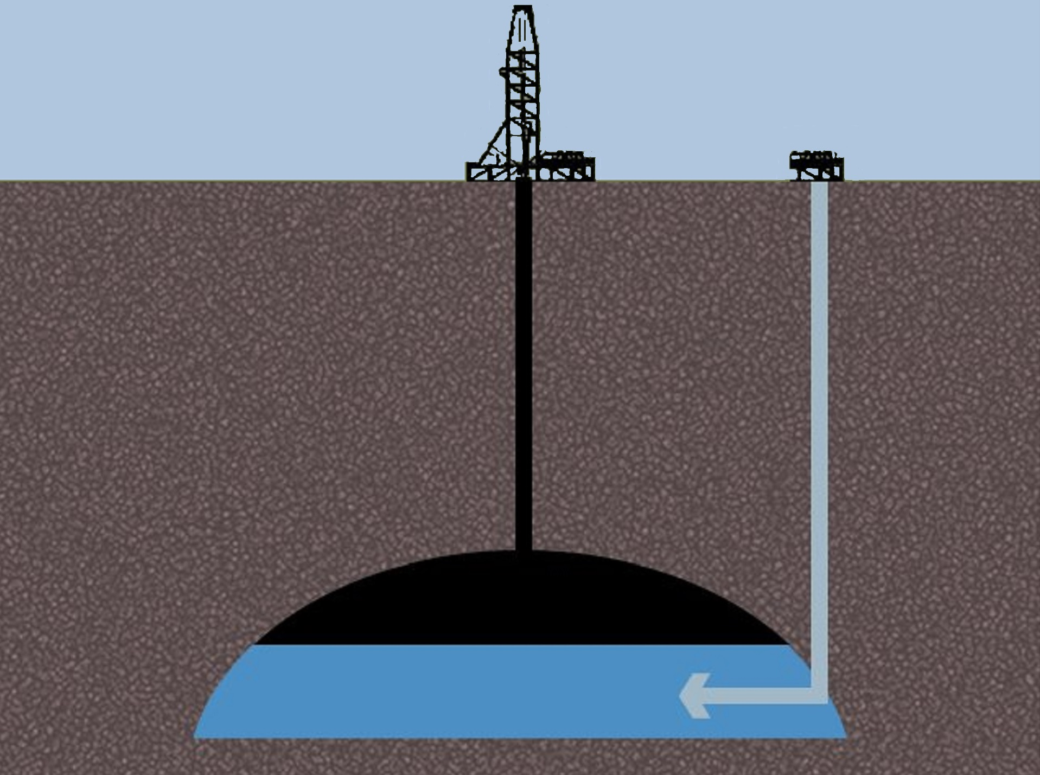
What is water injection?
Downstream water injection with production wells placed above the structure based on pressure maintenance.
Voidage replacement ratio (VRR)
Sweep oil towards the production wells
Hugin FM
WELL NO. | Perforation interval (m)
15_9-F-4 | 2962-3015 3016-3035
15_9-F-5 | 3039-3088 3090-3094 3106-3140
Adapted from: https://empedia.info/resource/698?set=maps%2F25 by Martin Skaugset

Slide 5
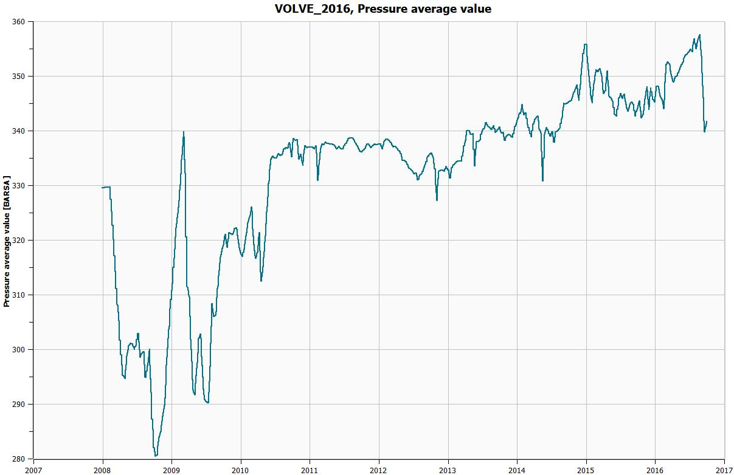
Stable pressure
Pressure rise
Initial drop

Slide 6
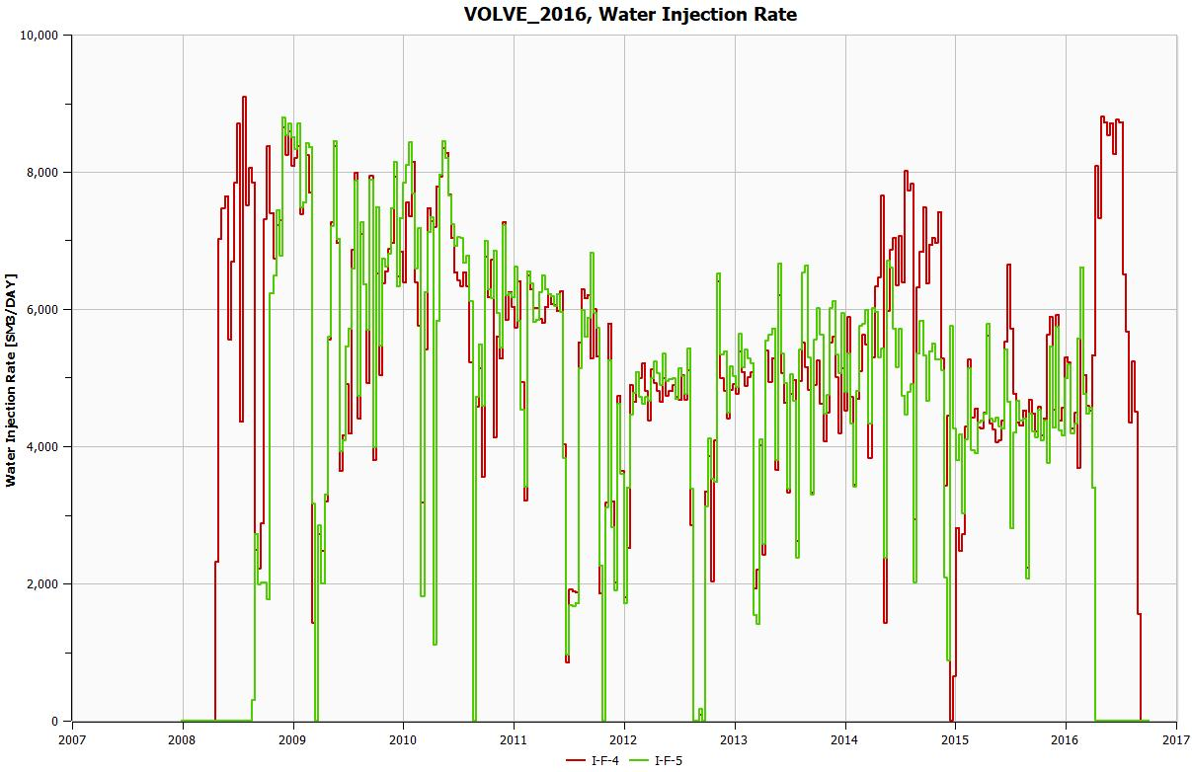

Slide 7
How does the injected water behave

Slide 8
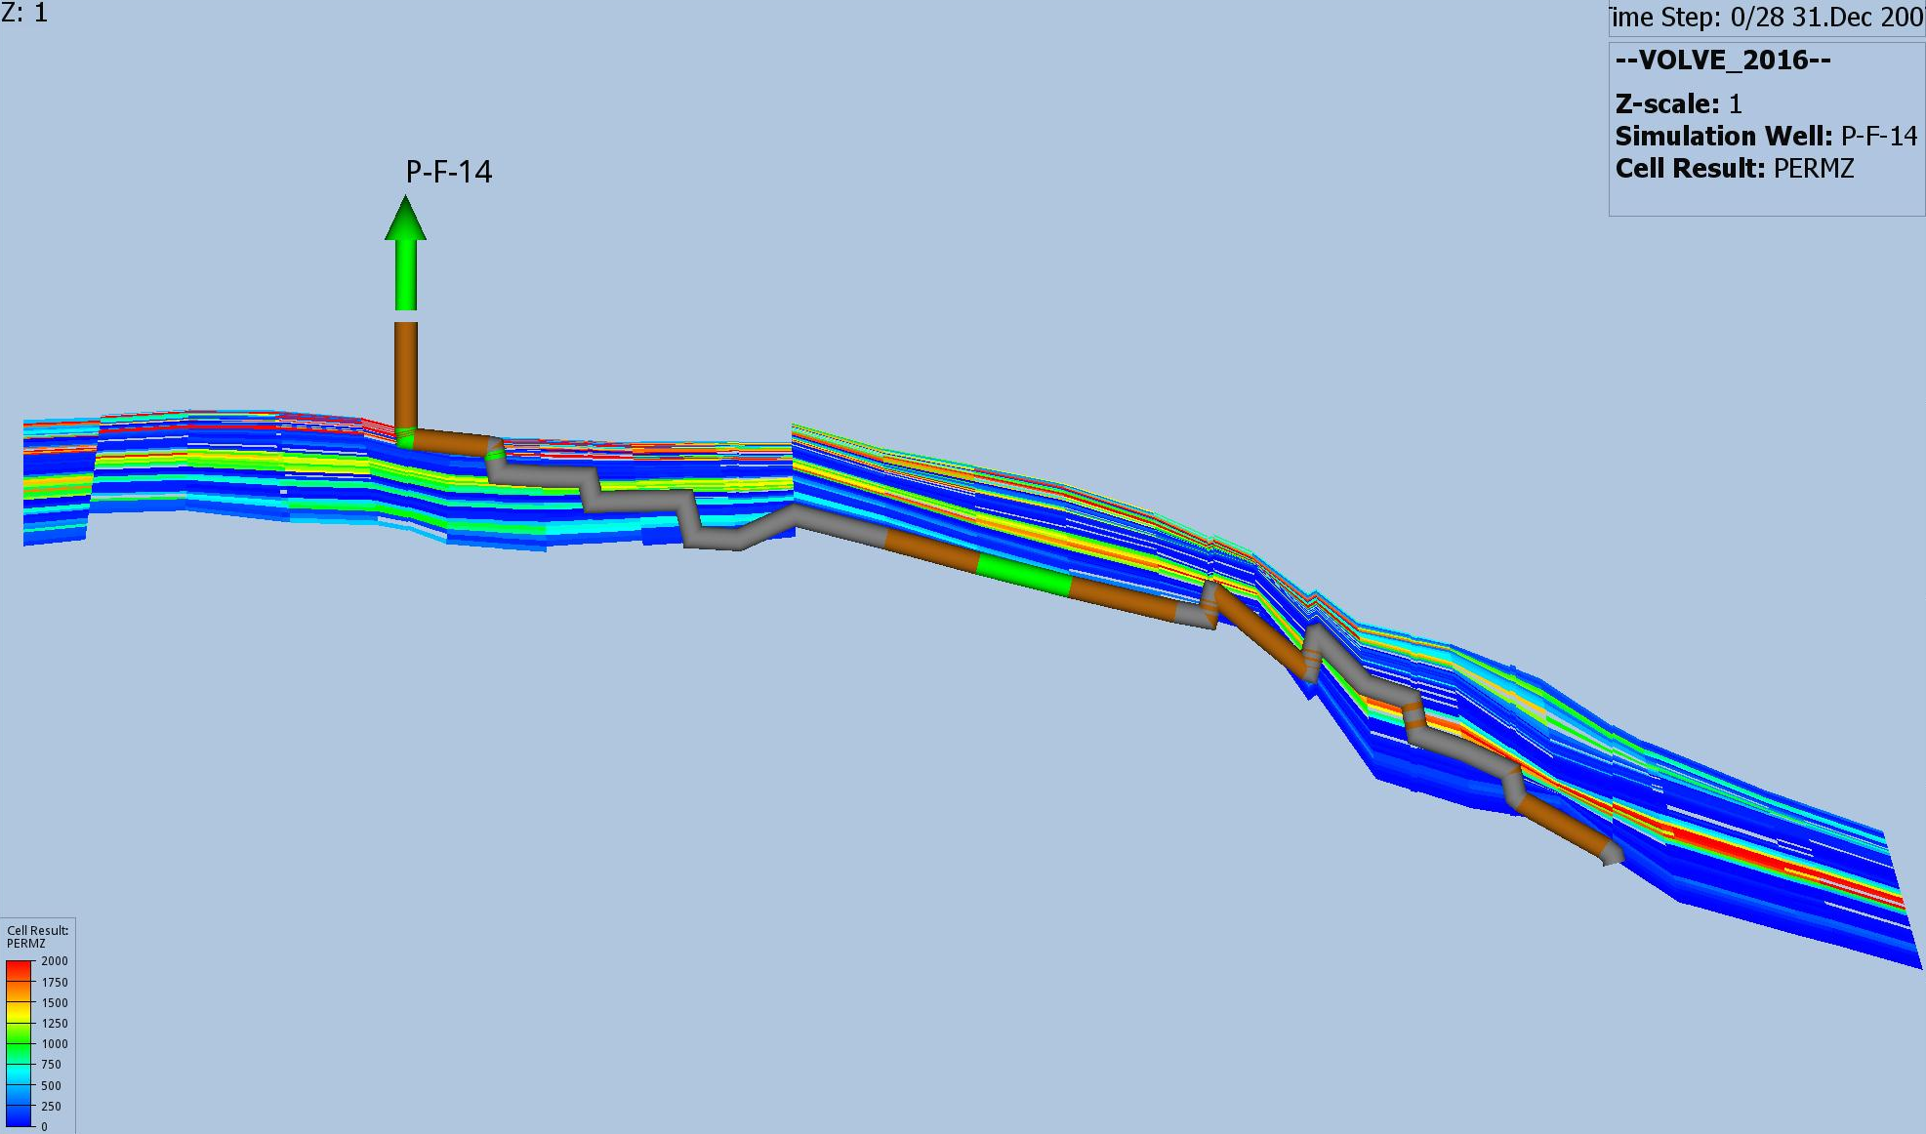
Permability in z-direction

Slide 9
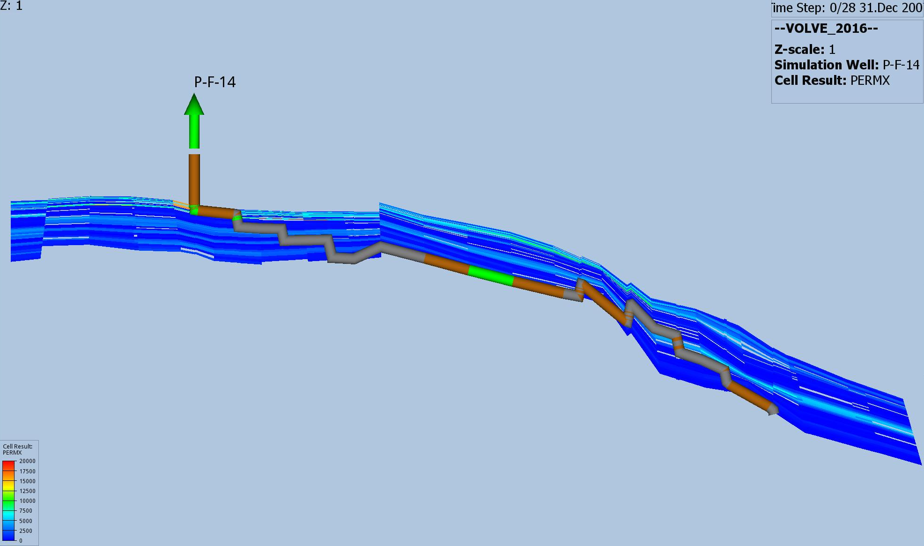
Permability in xy-direction

Slide 10
Permability in z-direction
I_F5
Permablity in xy-direction

Slide 11
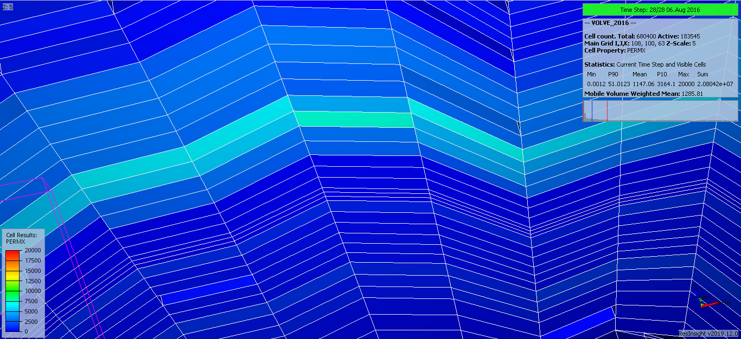
Thief-zone and water behavior

Slide 12
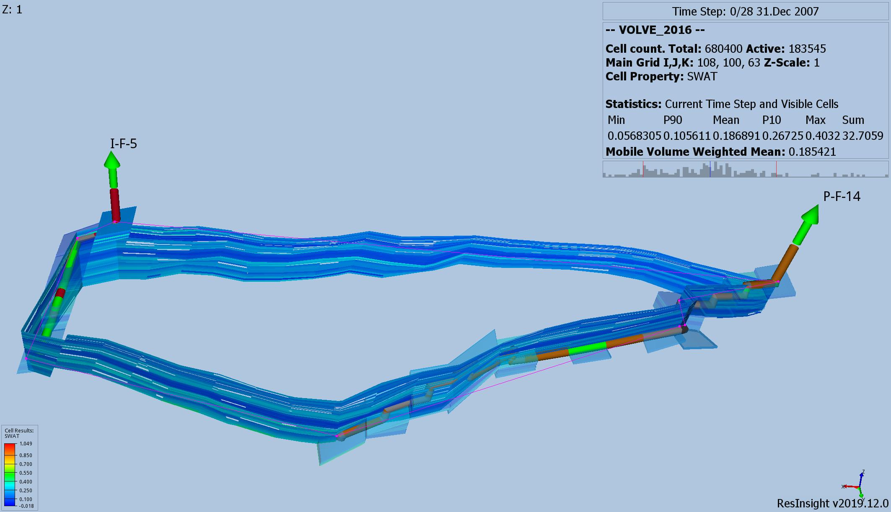

Slide 13
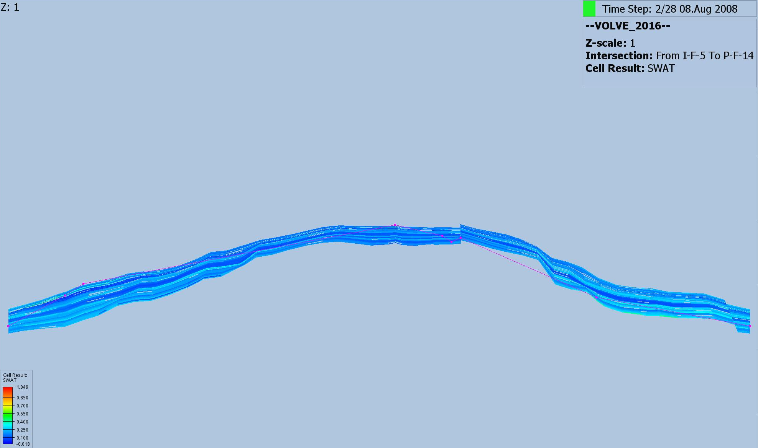
P-F-14 [Top]
P-I-5 [Top]
P-F-14 [Bottom]
P-I-5 [Bottom]
P-I-5 [Bottom]

Slide 14
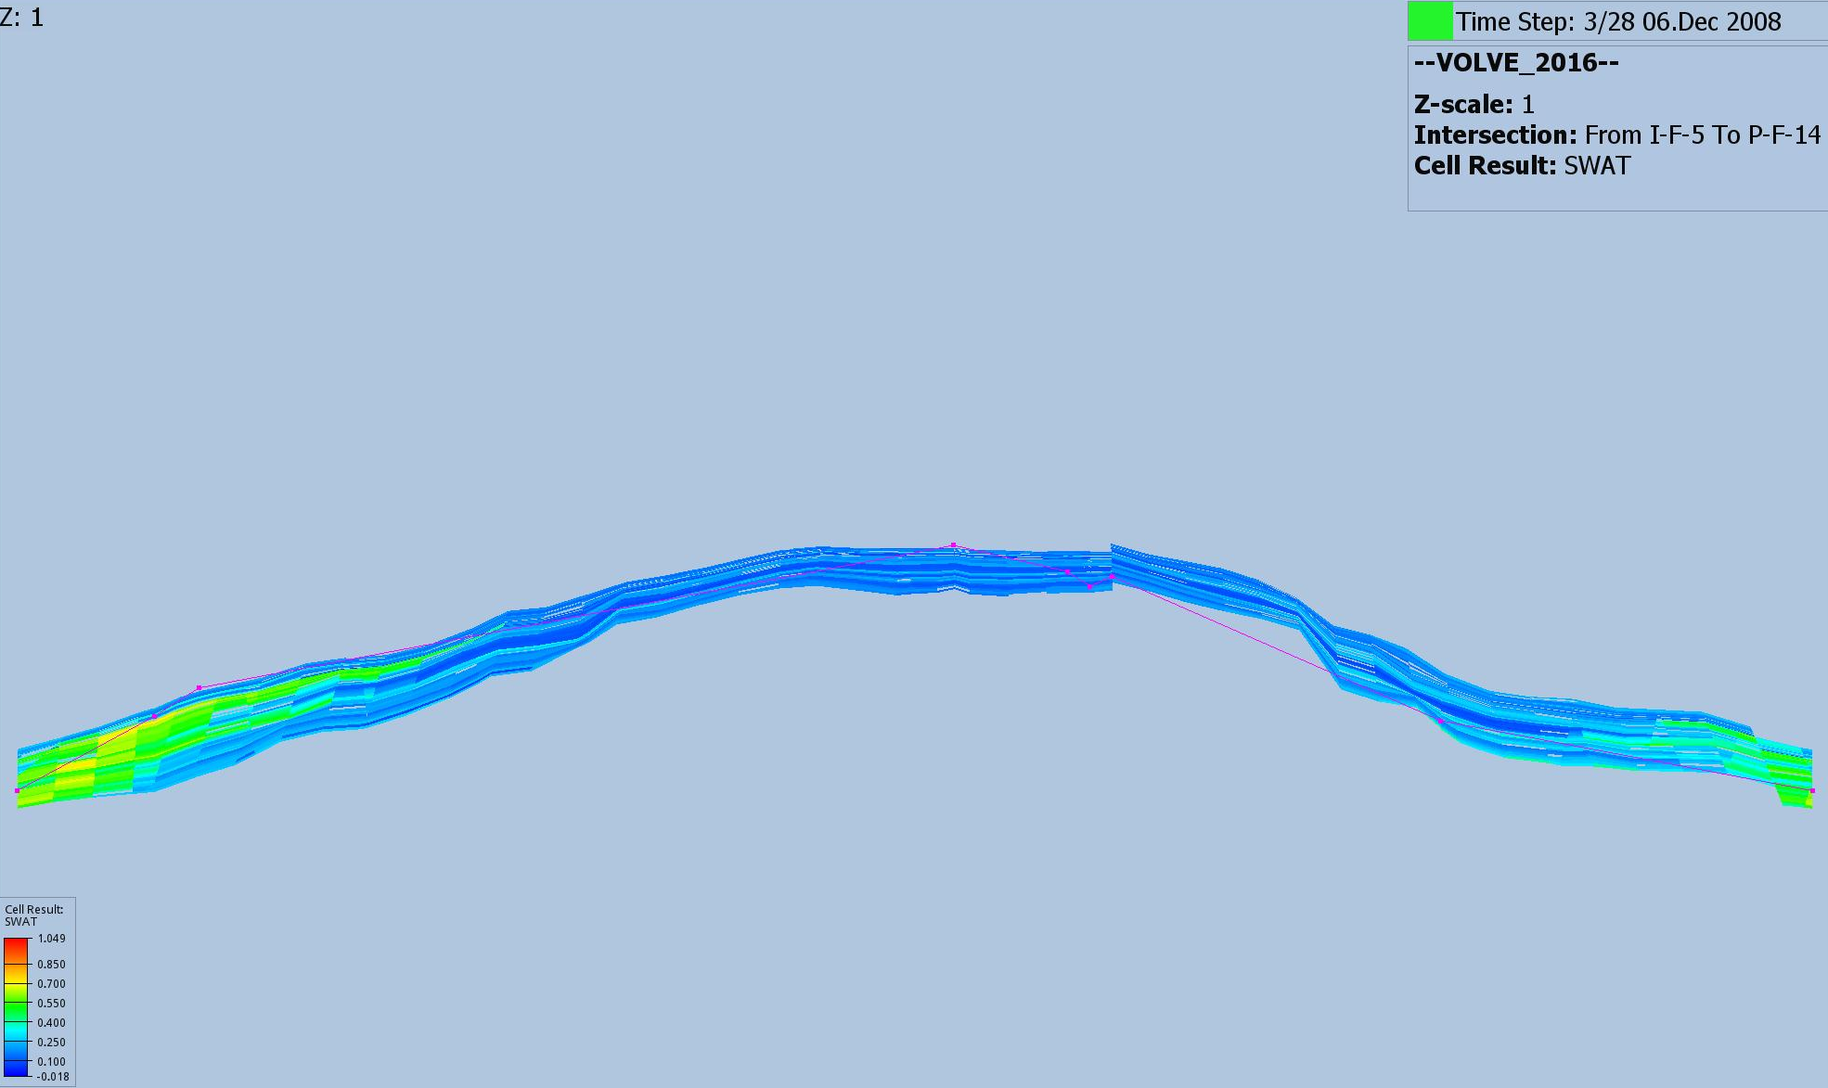
P-F-14 [Top]
P-I-5 [Top]
P-F-14 [Bottom]
P-I-5 [Bottom]
P-I-5 [Bottom]

Slide 15
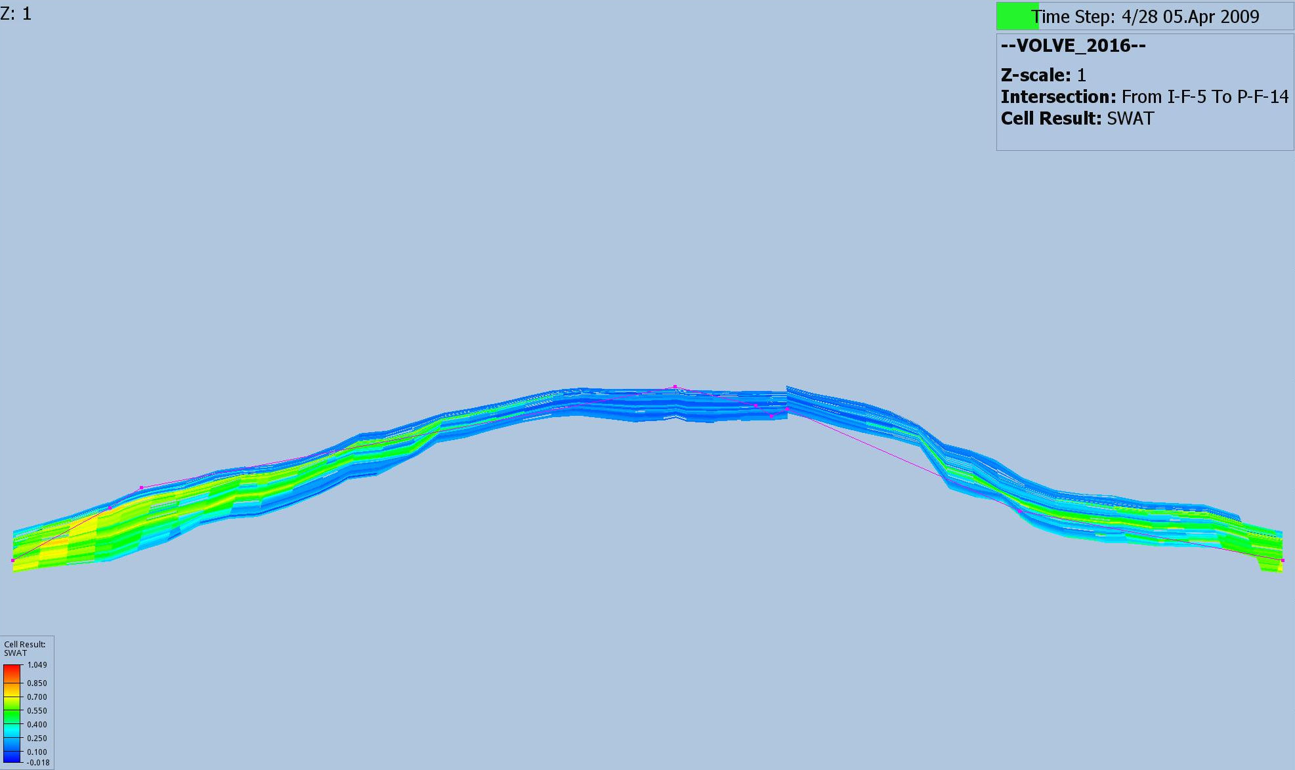
P-F-14 [Top]
P-I-5 [Top]
P-F-14 [Bottom]
P-I-5 [Bottom]
P-I-5 [Bottom]

Slide 16
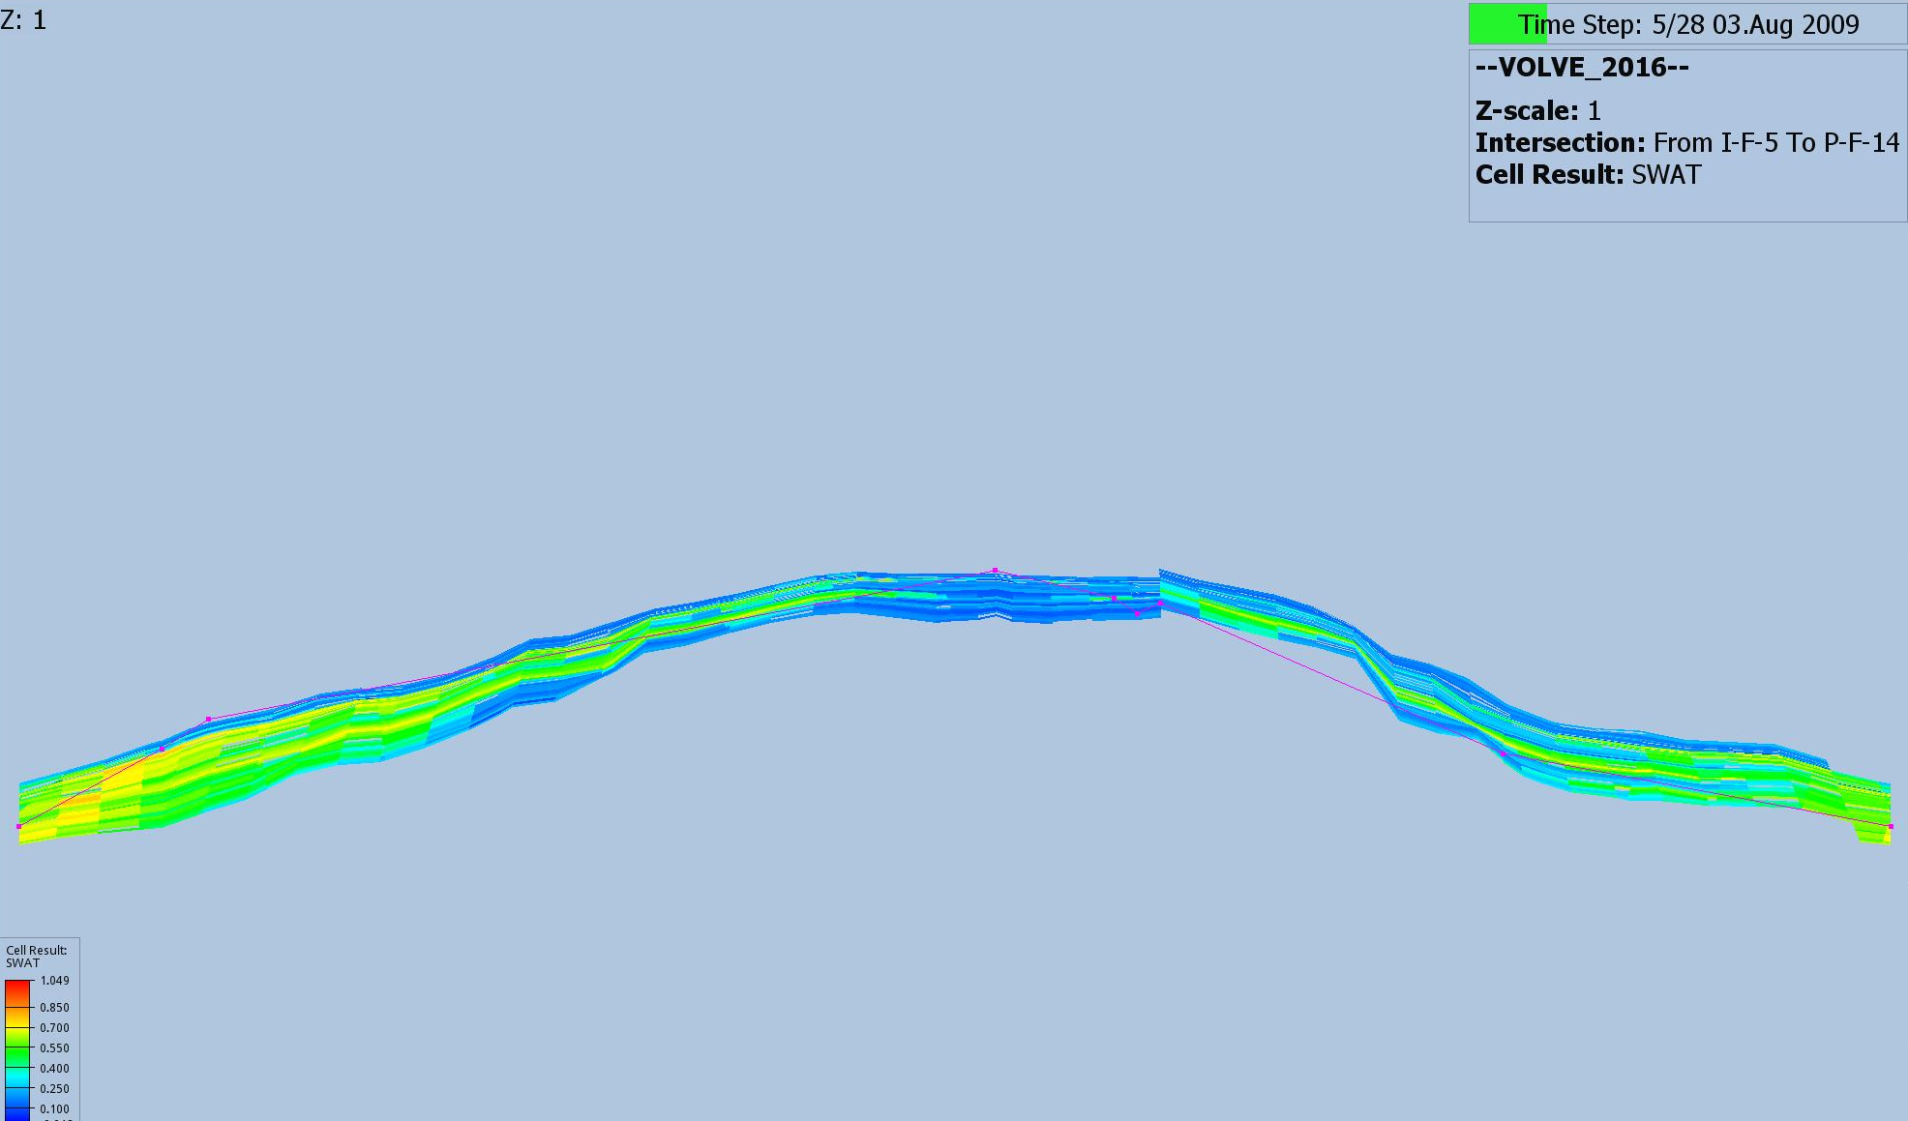
P-F-14 [Top]
P-I-5 [Top]
P-F-14 [Bottom]
P-I-5 [Bottom]
P-I-5 [Bottom]

Slide 17
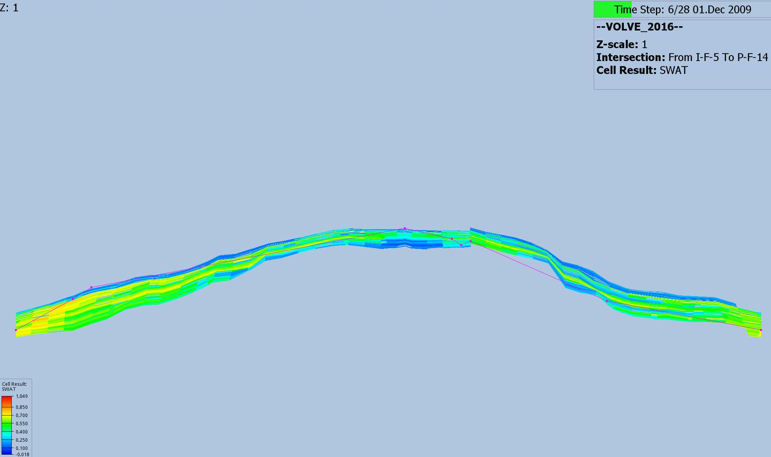
P-F-14 [Top]
P-I-5 [Top]
P-F-14 [Bottom]
P-I-5 [Bottom]
P-I-5 [Bottom]

Slide 18
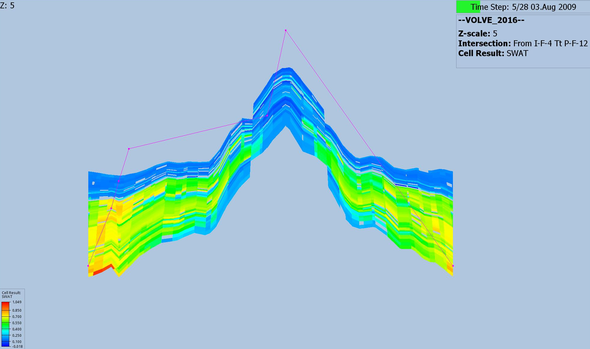
P-I-12 [Top]
P-I-4 [Top]
P-I-12 [Bottom]
P-I-4 [Bottom]
P-I-4 [Bottom]

Slide 19
After the area has been swept, there may be a need for drilling other wells to get out the oil in the areas not swept.
New seismic data, updated model, plan new wells ( 15 and 11)

Slide 20
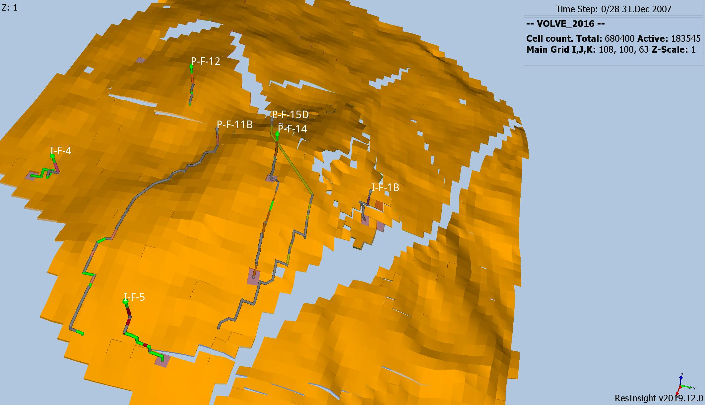

Slide 21
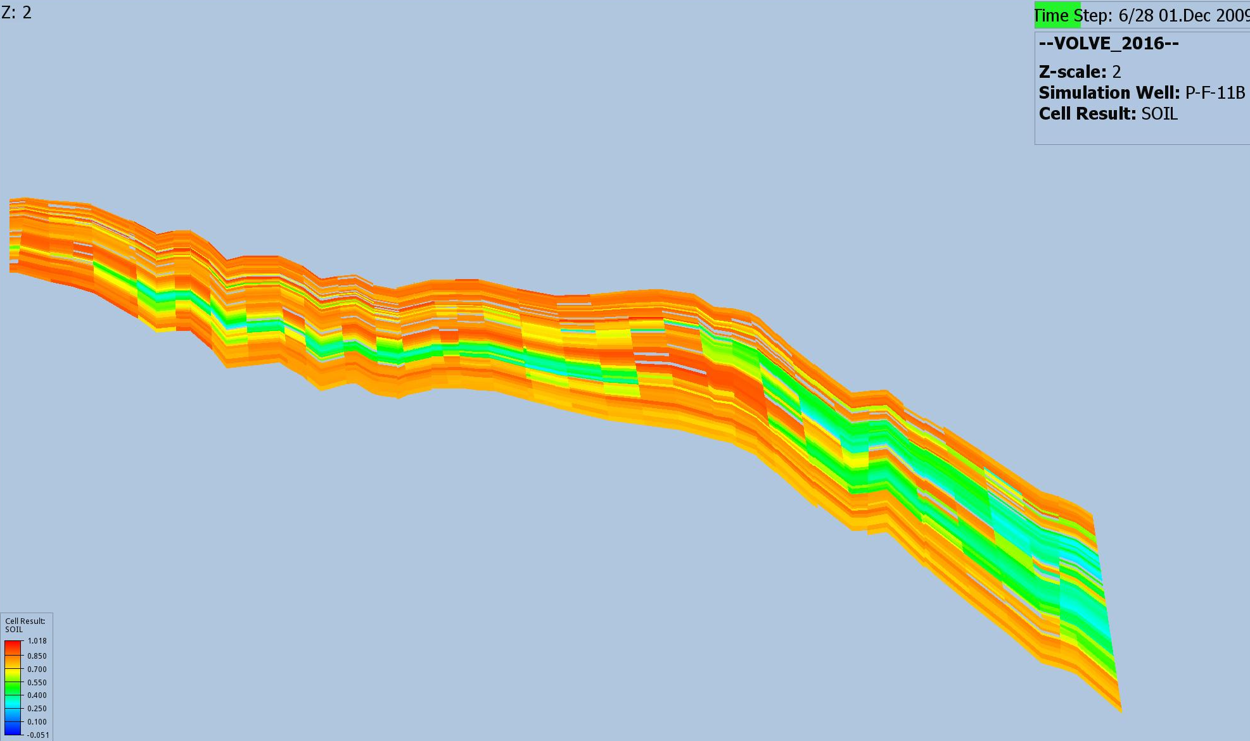

Slide 22
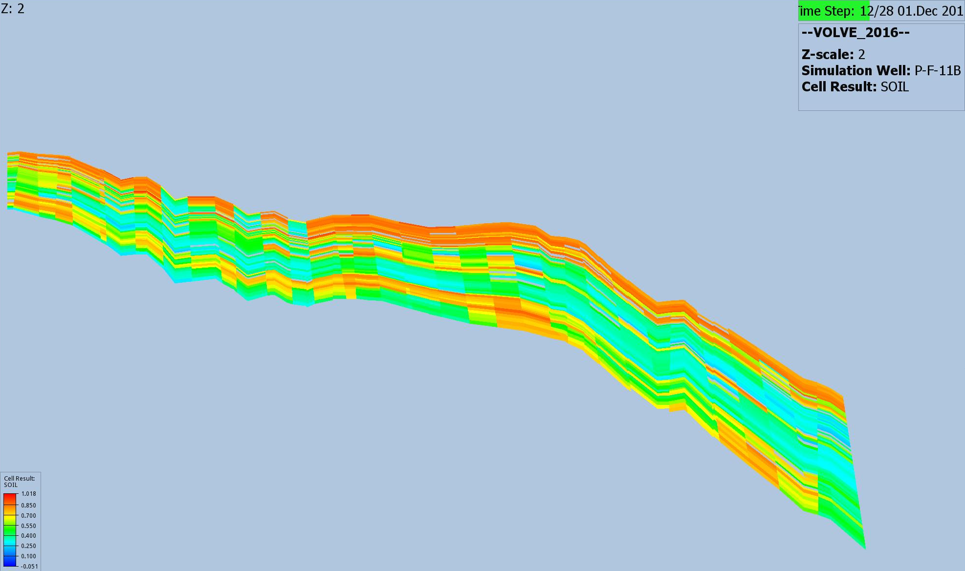

Slide 23
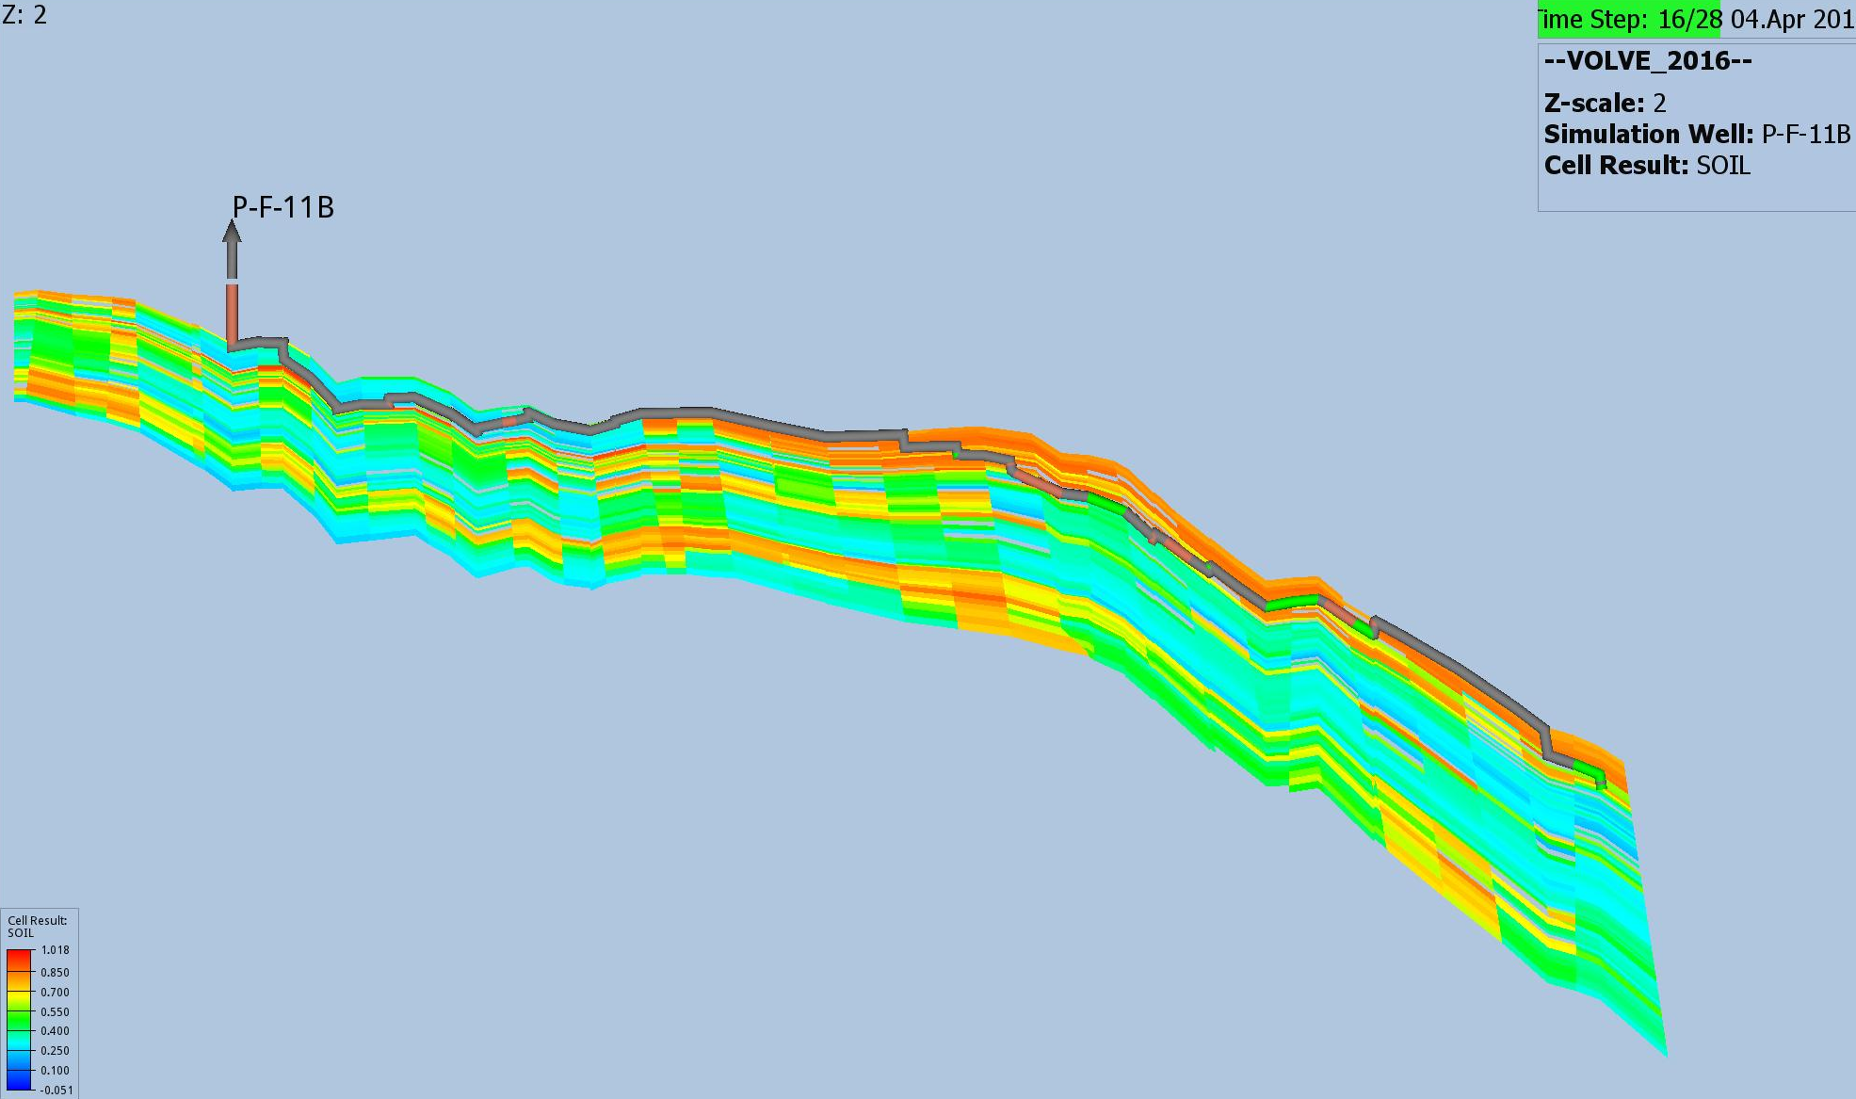

Slide 24
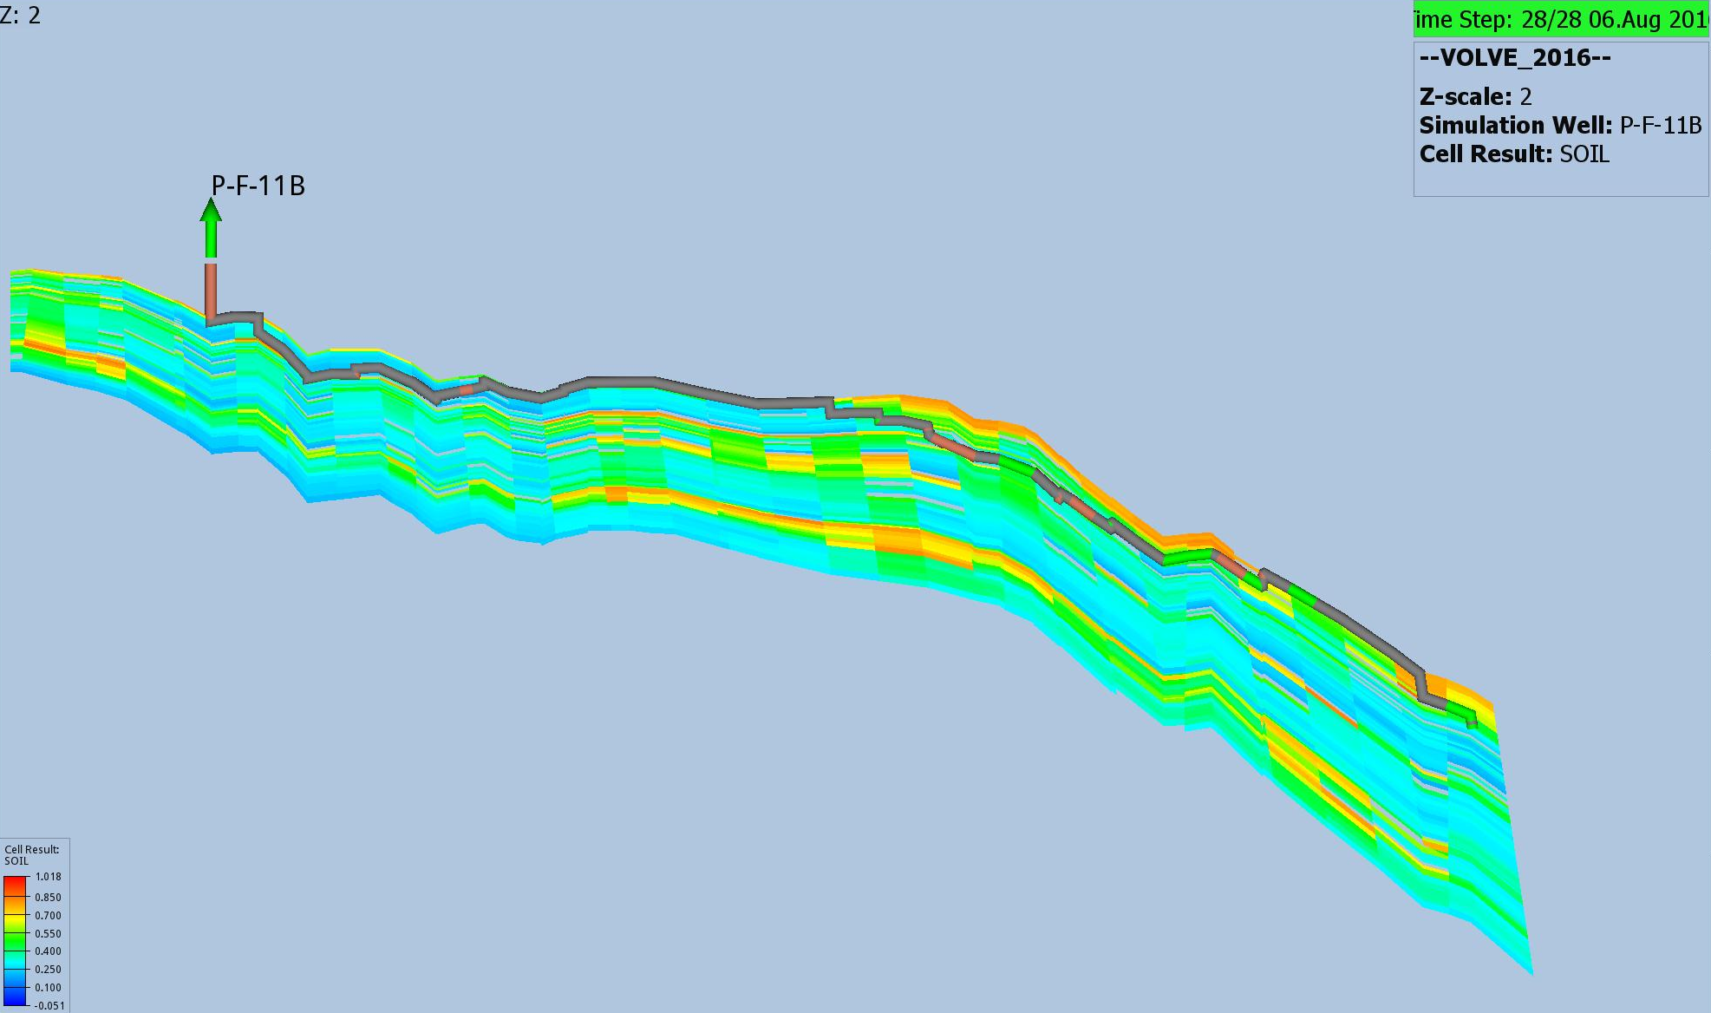

Slide 25
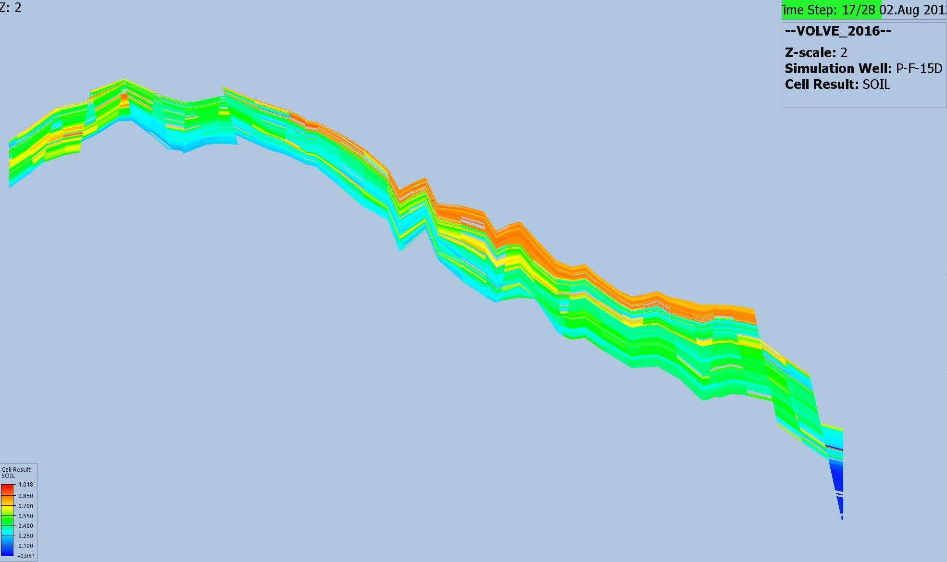

Slide 26
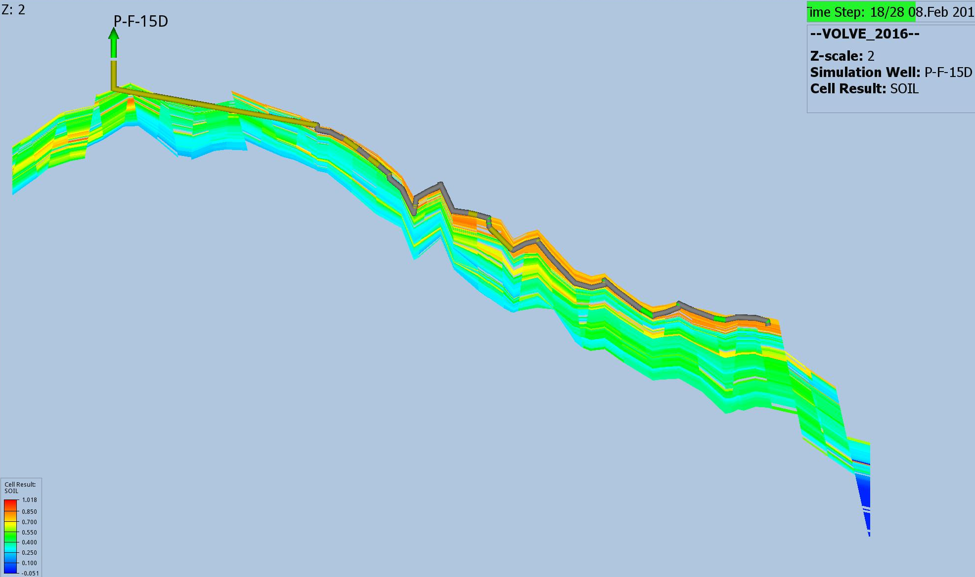

Slide 27
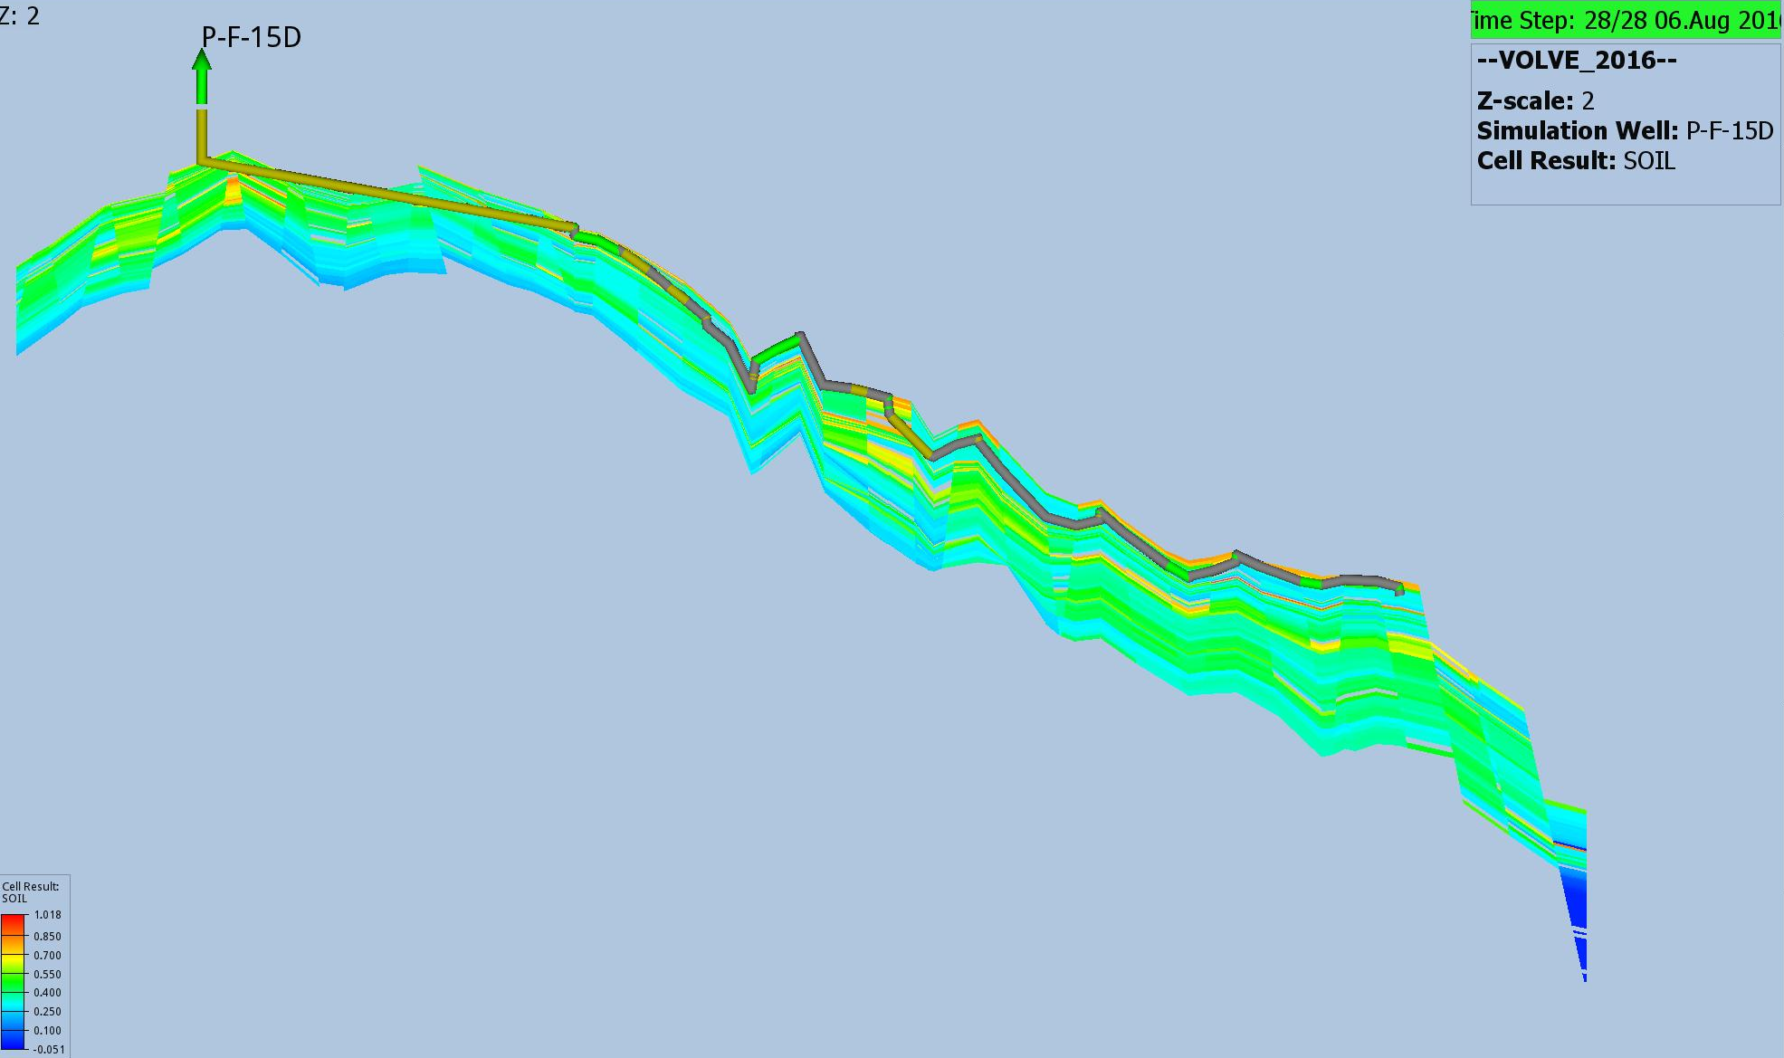

Slide 28
Tusen Takk
Questions???

