Slide 1
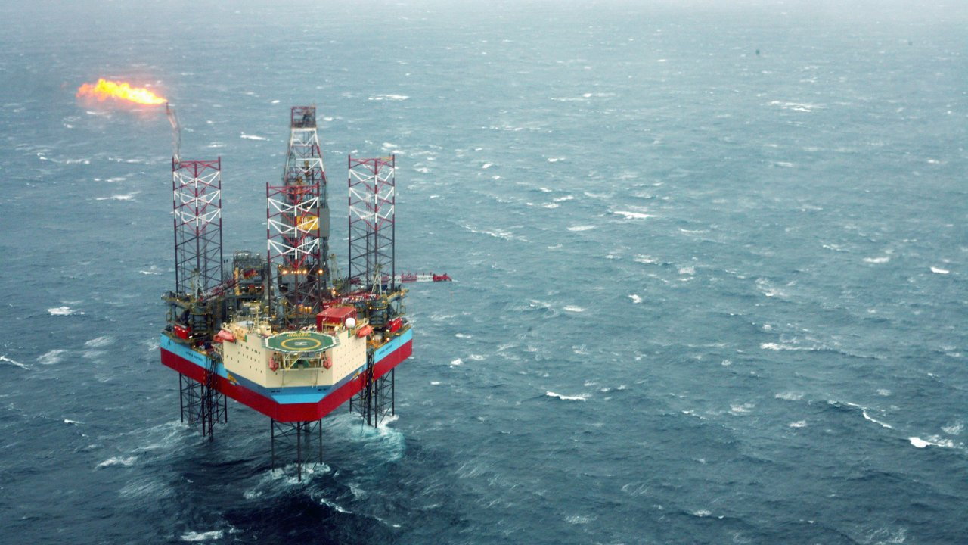
Volve field
Water injection challenges
Image source: equinor.com

Slide 2
Group 1
Shah
RAMS
Vladislava
ComTech
Ana
IndEcol
Sven
EE
Simon
Mech/PM
Joe
Petroleum

Slide 3
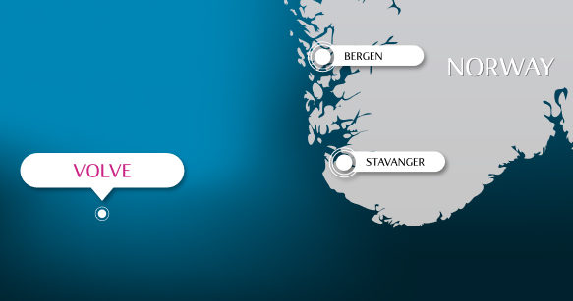
Volve basics
Reservoir rock: Hugin formation
Orig. oil in place: 18.7 mill Sm3 (as per factpages.npd.no)
Porosity: High
Permeability: High
Viscosity: Low
Faults: Numerous
Image source: equinor.com

Slide 4
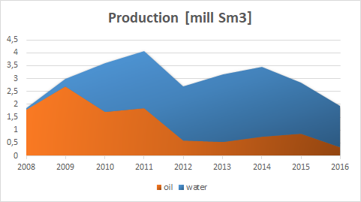
Production Statistics
Started 2008; shut down 2016
Water injection almost right away (2008)
Early water breakthrough (2009)
By the end of operation oil production had dropped more than 5 times
Orig. recoverable oil: 10.17 mill Sm3 (as per factpages.npd.no) or approx. 54%
Based on data from https://factpages.npd.no/

Slide 5
Water injection

Slide 6
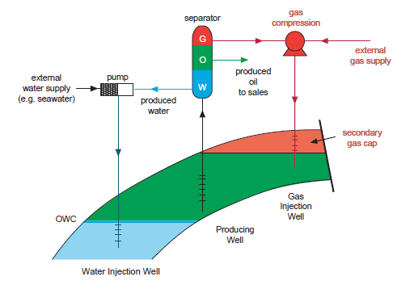
Water injection
Water is cheap
Readily available offshore
Water is effective at displacing oil in the reservoir
Can provide external pressure support
To stay above bubble point pressure
Voidage replacement
Image source: Jahn, F. et.al. (2008). Hydrocarbon exploration and production. 2 ed. Oxford: Elsevier

Slide 7
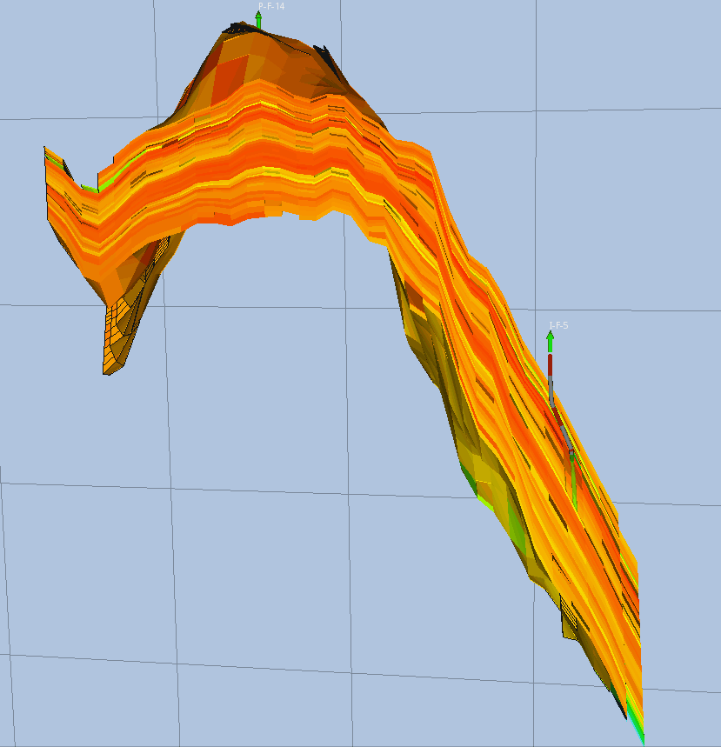
Why water injection in Volve
Little to no natural aquifer
Need for pressure support
Steeply dipping reservoir
Low viscous oil
Similar viscosity to water

Slide 8
Volve reservoir challenges

Slide 9
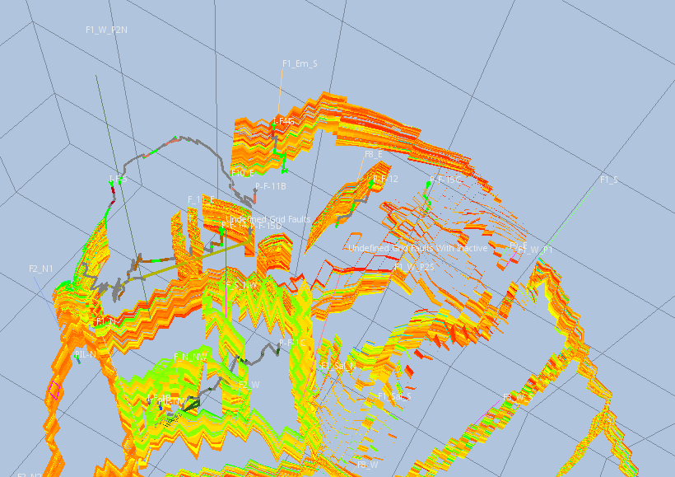
Volve Faults
Faults introduce total or partial impermeability
Reservoir split into isolated parts
Anticipated more permeable faults
10 producers instead of 3 planned initially
Based on https://data.equinor.com/dataset/Volve, Reservoir Model Eclipse

Slide 10
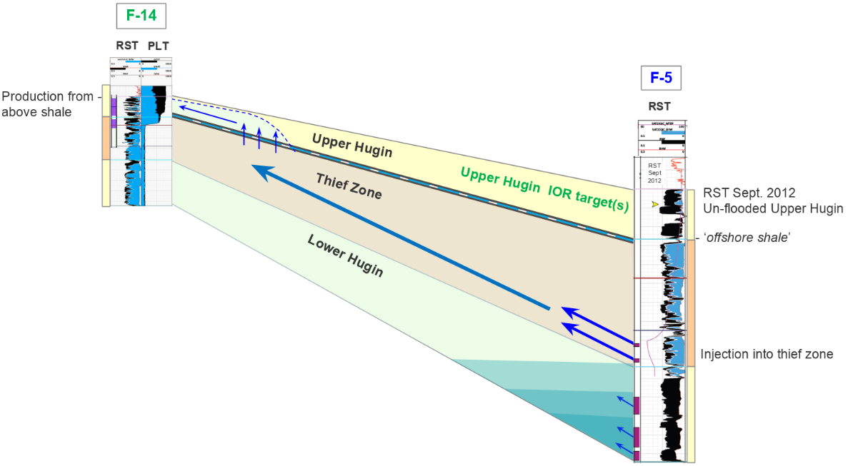
Thief zone
“Super permeability” or “speed ” zone
Mainly caused by areal or vertical absolute permeability heterogeneity
Problems: “Reduced oil recovery”
early water breakthrough causing uneven oil sweep off the reservoirs
impairs utilization efficiency of injected water
Possible solution: selective plugging
Source: Equinor (Jan 2016), ‘Volve Sim model and HM’ (Powerpoint presentation)

Slide 11
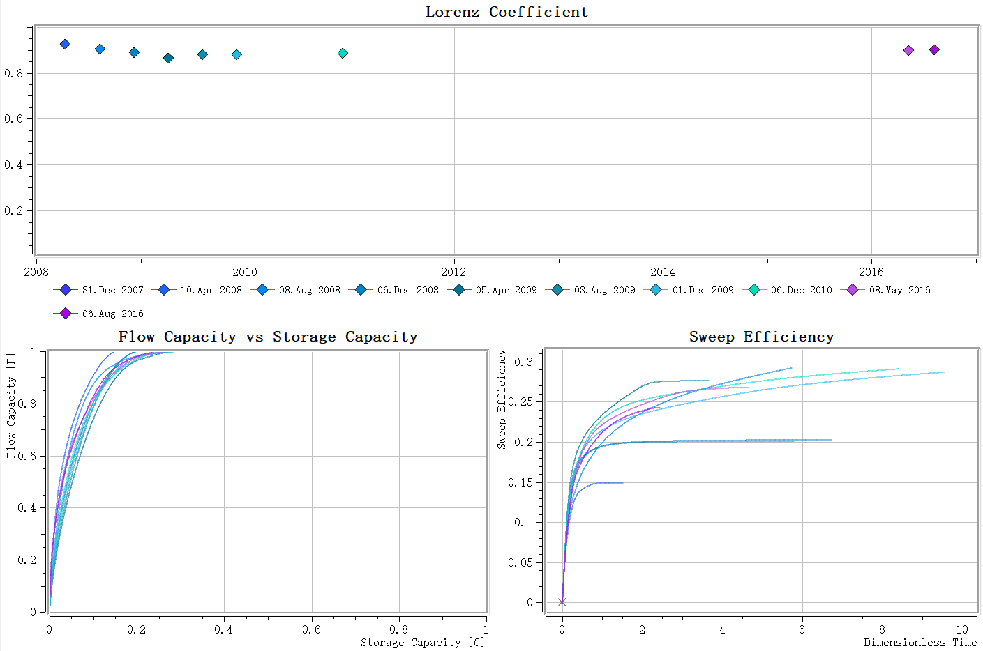
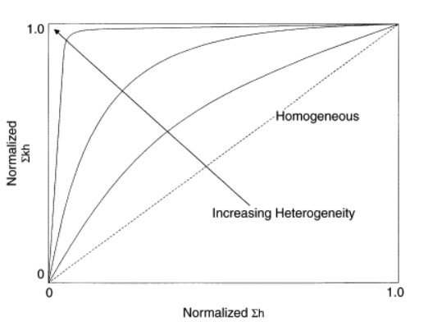
Reservoir heterogeneity
Based on https://data.equinor.com/dataset/Volve, Reservoir Model Eclipse
source:Tarek Ahmed, in Working Guide to Reservoir Rock Properties and Fluid Flow, 2010

Slide 12
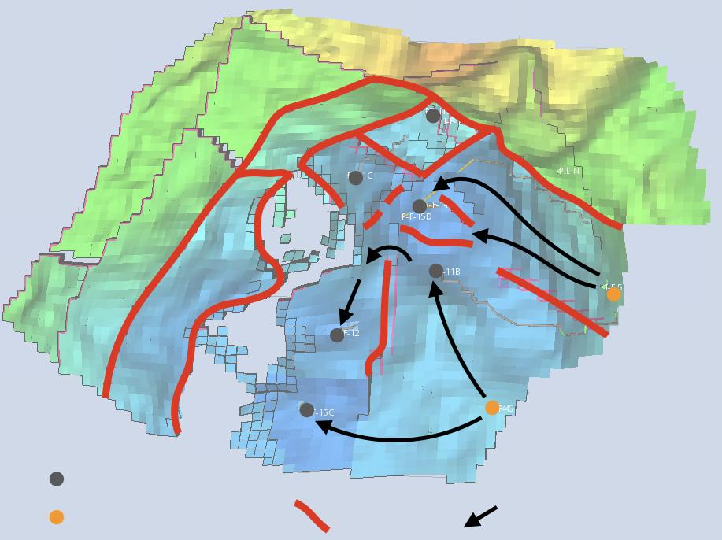
Water flooding
Late water breakthrough
Factors can affect the shape of flow 1. Gravity 2. Avoid going thief zone 3. mobility ratio (Capillary pressure) 4. Injecting speed
Measurements 1. Open interval should be lower than thief zone. 2. Same water breakthrough time 3. ‘Right’ water
Production wells
Injection wells
Faults
Water flow
Based on https://data.equinor.com/dataset/Volve, Reservoir Model Eclipse

Slide 13
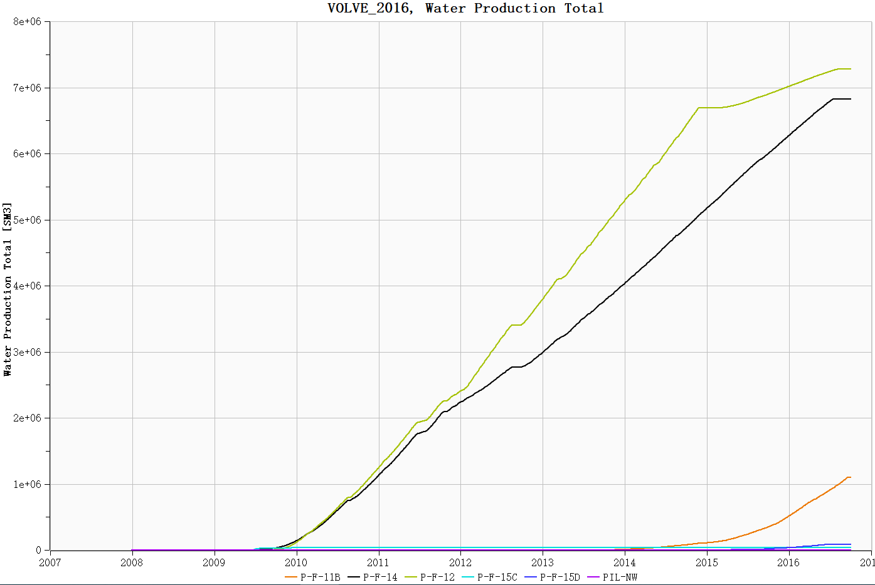
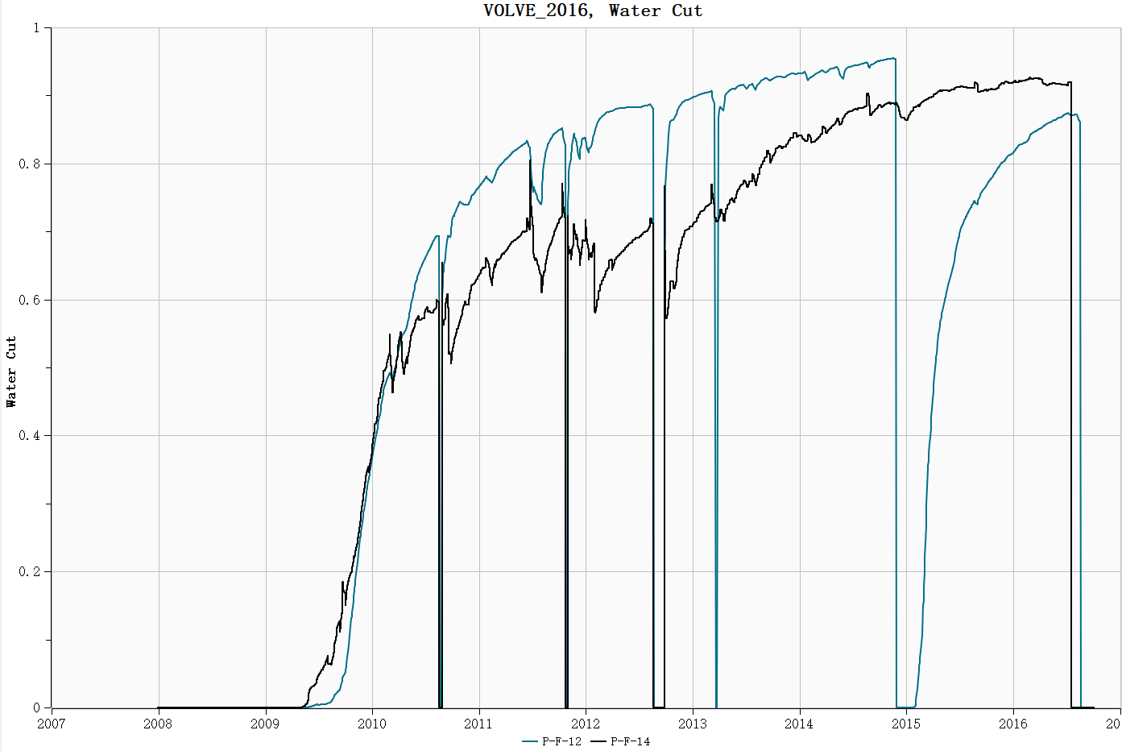
Water flooding performance
Total water production from 2008 to 2016
Water cut for well P-F-14 and P-F-12
Based on https://data.equinor.com/dataset/Volve, Reservoir Model Eclipse

Slide 14
Improved recovery

Slide 15
Suggestions
Planning
More resources on exploration phase
Dedicate more resource to studying faults and their properties
Recovery
Injection of polymer solution
Horizontal wells
Smart Technologies

Slide 16
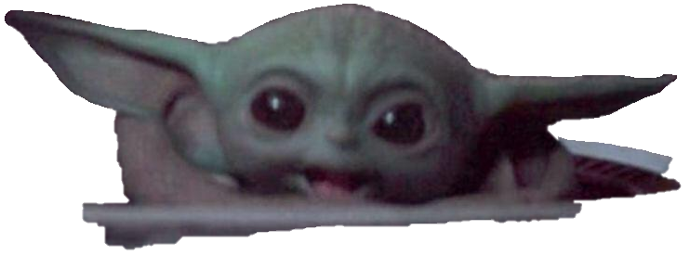
Drill or do not drill. There is no try.
“Star Wars: Episode V – The Empire Strikes Back”, 1980

