Slide 1
SPE 170912
Global Component Lumping for EOS Calculations
S. Ahmad Alavian
Curtis Hays Whitson
Sissel O. Martinsen

Slide 2
Slide 2
Component Lumping – “Pseudoization”
Reduce number of components in an Equation of State (EOS) to a minimum for describing phase and volumetric behavior in a particular range of pressure-temperature-composition space for a particular engineering application.
Reservoir simulation.
Production “tubing” flow performance.
Flowline networks.
Surface processing.
EOSxx → EOSx
Paper 170912 • Global Component Lumping for EOS Calculations • Curtis Whitson

Slide 3
Slide 3
Component Lumping – How?
Start with a detailed EOSxx model – e.g. xx=15-40.
Choose total # of components in lumped EOSx model – e.g. x=6-9.
Choose which components to lump together – e.g. N₂ & C₁.
Choose a method to average EOS parameters – e.g. Coats.
Choose a composition to average EOS parameters – e.g. z_{Ri}.
Choose PVT calculations to validate EOSx – e.g. p_{s}, ρ, μ, y_{i}, x_{i}.
Compare EOSx versus EOSxx for same set of PVT calculations.
  Plots & Tables.
  Single-valued match “quality” metric – SSQ, RMS…
If results are not good enough, go back to step 2.
Paper 170912 • Global Component Lumping for EOS Calculations • Curtis Whitson

Slide 4
Slide 4
Component Lumping – How We Do It
Start with a detailed EOSxx model – e.g. XX=15-40.
Choose total # of components in lumped EOSx model – e.g. X=6-9.
Choose which components to lump together – try them “all”.
Choose a method to average EOS parameters – e.g. Coats.
Choose a composition to average EOS parameters – e.g. z_{Ri}.
Choose PVT calculations to validate EOSx – comprehensive.
Compare EOSx versus EOSxx for same set of PVT calculations.
  Single-valued quality metric – RMS.
Final-pass assessment of best-RMS EOSx models.
  MMP | Plots & Tables.
Paper 170912 • Global Component Lumping for EOS Calculations • Curtis Whitson

Slide 5
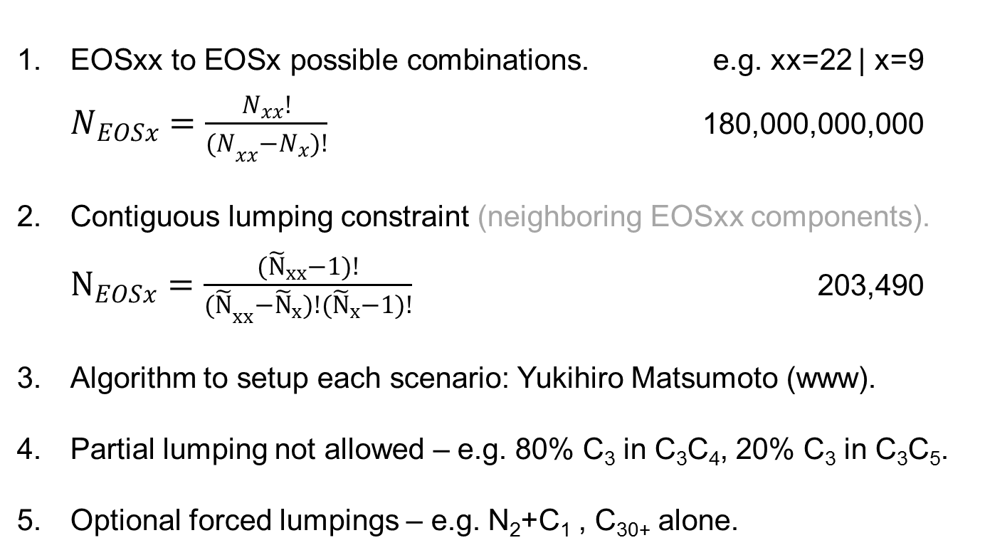
Slide 5
“All” Lumping Combinations
EOSxx to EOSx possible combinations. e.g. xx=22 | x=9
$N_{EOSx}=\frac{N_{xx}!}{{(N}_{xx}−N_{x})!}$ 180,000,000,000
Contiguous lumping constraint (neighboring EOSxx components).
$N_{EOSx}=\frac{({\tilde{N}}_{xx}−1)!}{{(\tilde{N}}_{xx}−{\tilde{N}}_{x})!({\tilde{N}}_{x}−1)!}$ 203,490
Algorithm to setup each scenario: Yukihiro Matsumoto (www).
Partial lumping not allowed – e.g. 80% C₃ in C₃C₄, 20% C₃ in C₃C₅.
Optional forced lumpings – e.g. N₂+C₁ , C₃₀₊ alone.
Paper 170912 • Global Component Lumping for EOS Calculations • Curtis Whitson

Slide 6
Slide 6
Comprehensive p-T-z Data Validation
Range of feed compositions (GORs).
Range of PVT types – p_{s}, ρ, μ, V_{ro}, y_{i}, x_{i}, …
Range of PVT tests – depletion, gas injection, gradient, MMP.
Calculated once with EOSxx.
Calculated for each EOSx lumped scheme.
Final MMP validation – i.e. long-running calculations for only select group of EOSx models.
Paper 170912 • Global Component Lumping for EOS Calculations • Curtis Whitson

Slide 7
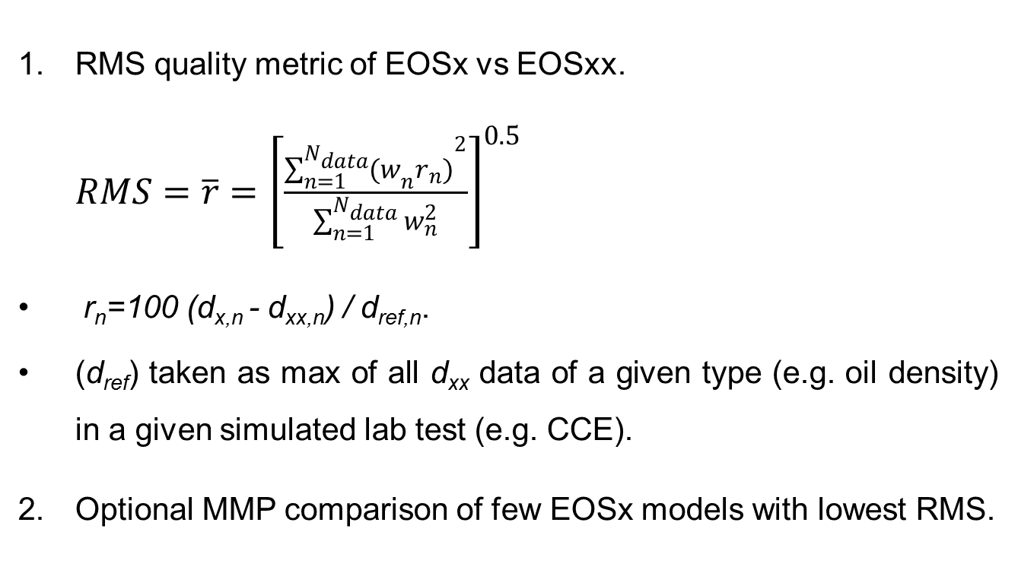
Slide 7
EOSx versus EOSxx
RMS quality metric of EOSx vs EOSxx.
$RMS=\overline{r}={\left[\frac{{\sum_{n=1}^{N_{data}}{{(w}_{n}}r_{n})}^{2}}{\sum_{n=1}^{N_{data}}{w_{n}^{2}}}\right]}^{0.5}$
r_{n}=100 (d_{x,n} - d_{xx,n}) / d_{ref,n}.
(d_{ref}) taken as max of all d_{xx} data of a given type (e.g. oil density) in a given simulated lab test (e.g. CCE).
Optional MMP comparison of few EOSx models with lowest RMS.
Paper 170912 • Global Component Lumping for EOS Calculations • Curtis Whitson

Slide 8
Slide 8
Lumping Examples
Detailed EOSxx (xx=34) | Lumped EOSx (x=15, 9, 6)
Peng-Robinson EOS (LBC) models.
  EOSxx components.
    N₂ & CO₂
    C₁, C₂, C₃, i-C₄, n-C₄, i-C₅, n-C₅
    C₆ C₇ C₈ ... C₂₈ C₂₉ and C₃₀₊
Five fluids from a isothermal gradient used in PVT calculations.
  Lean gas condensate (OGR = 50 STB/MMscf)
  Richer gas condensate (OGR = 100 STB/MMscf)
  Near- critical oil (GOR = 5000 scf/STB)*
  Less-volatile oil (GOR = 2200 scf/STB)
  More-volatile oil (GOR = 1000 scf/STB)
* Averaging sample.
Paper 170912 • Global Component Lumping for EOS Calculations • Curtis Whitson

Slide 9
Slide 9
PVT Calculations & Weighting
Paper 170912 • Global Component Lumping for EOS Calculations • Curtis Whitson

Slide 10
Slide 10
Lumping Example – EOS9
EOS9 lumping constraints.
  3 single components: N₂, CO₂ and C₁
  Lumping starts from C₂.
  6 Lumped components.
142,506 total lumping scenarios.
All scenarios performed (without including MMP calculation).
500 best-RMS scenarios selected, including MMP calculation.
Paper 170912 • Global Component Lumping for EOS Calculations • Curtis Whitson

Slide 11
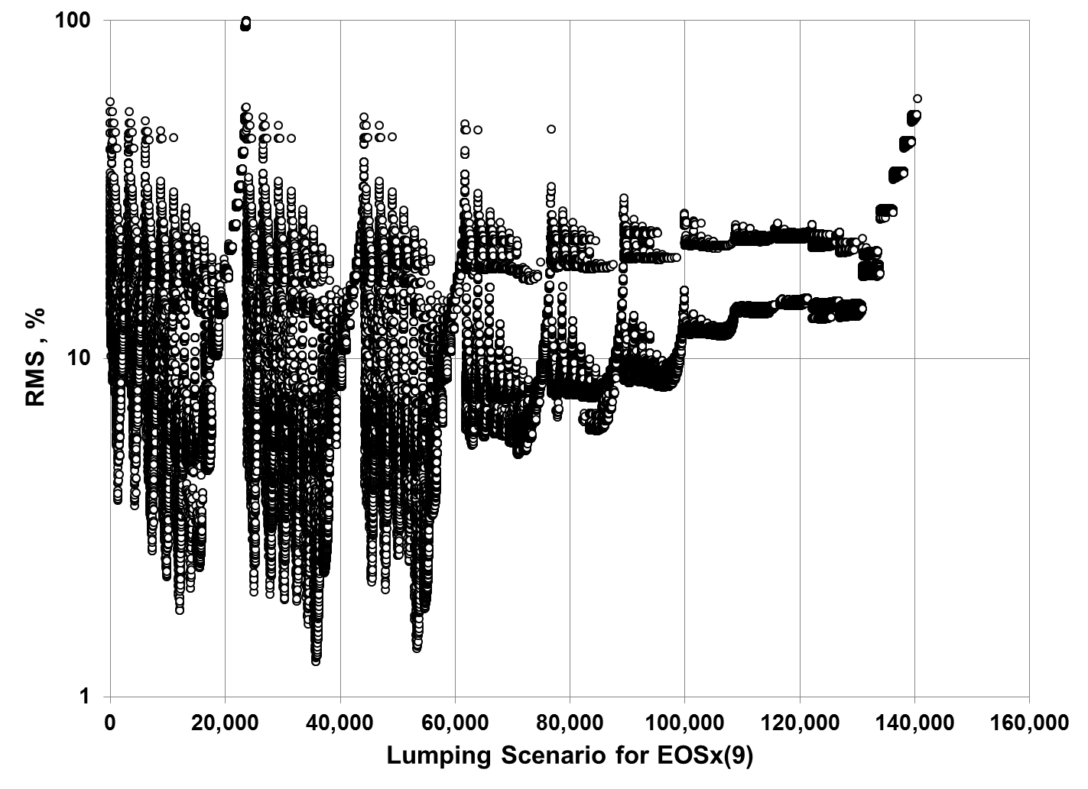
Slide 11
Paper 170912 • Global Component Lumping for EOS Calculations • Curtis Whitson

Slide 12
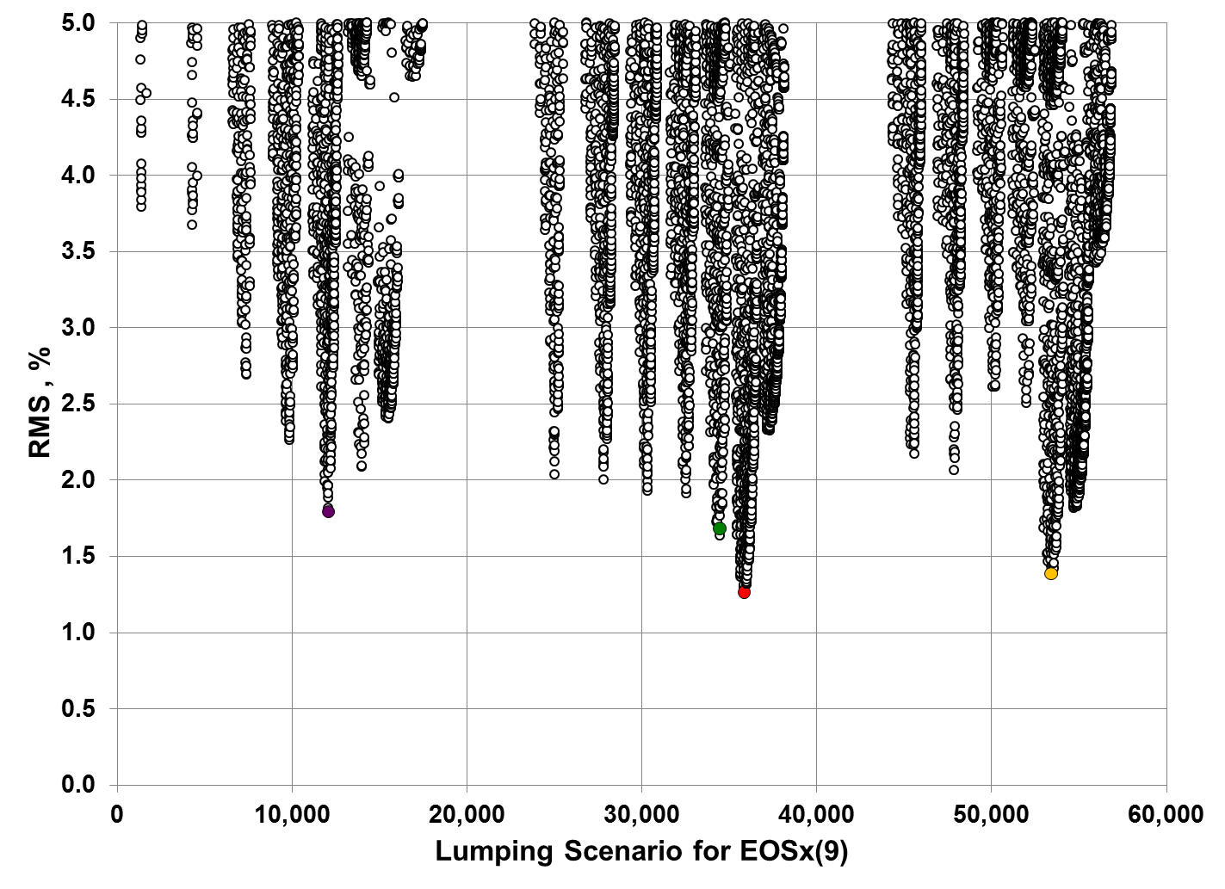
Slide 12
Local Minima
Best scenario with MMP
Best scenario without MMP
Local Minima
Paper 170912 • Global Component Lumping for EOS Calculations • Curtis Whitson

Slide 13
Slide 13
Paper 170912 • Global Component Lumping for EOS Calculations • Curtis Whitson

Slide 14
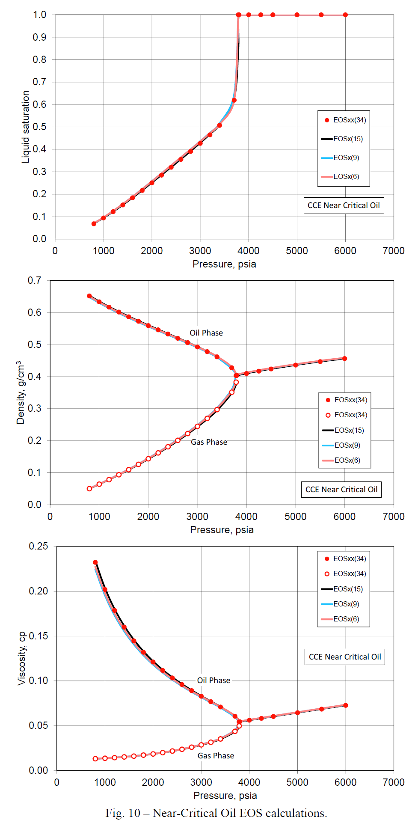
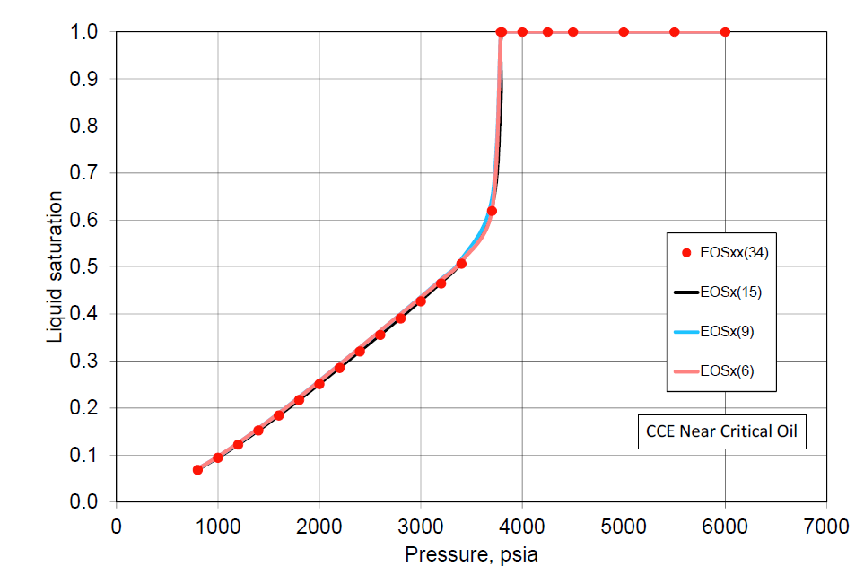
Slide 14
Near-Critical Oil
Paper 170912 • Global Component Lumping for EOS Calculations • Curtis Whitson

Slide 15
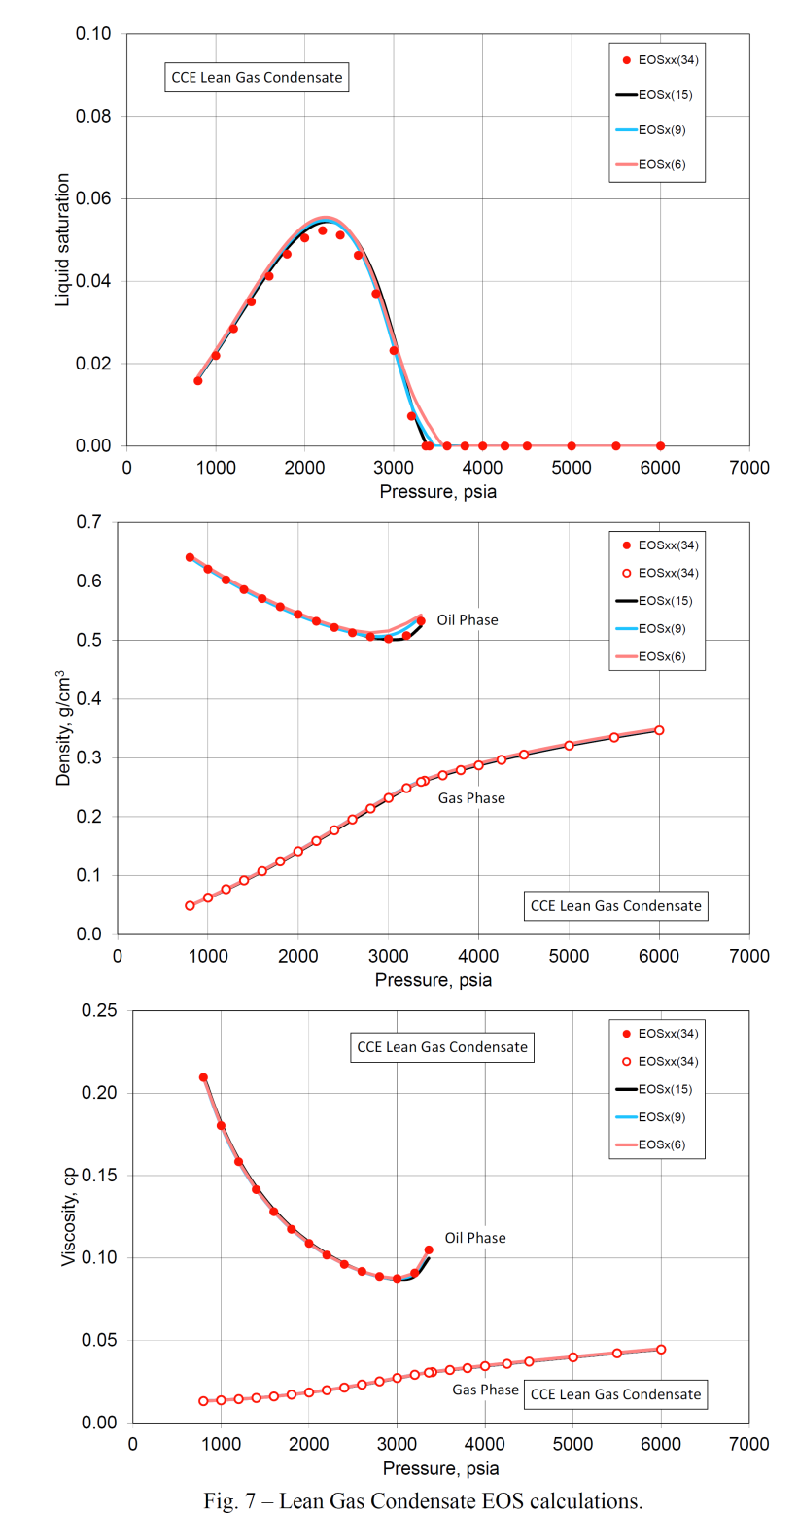
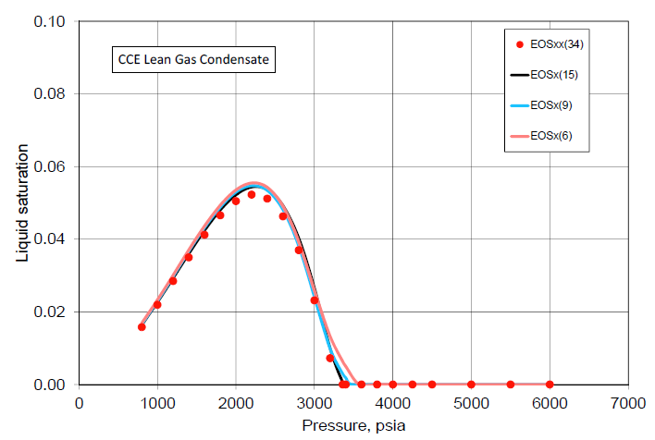
Slide 15
Lean Gas Condensate
Paper 170912 • Global Component Lumping for EOS Calculations • Curtis Whitson

Slide 16
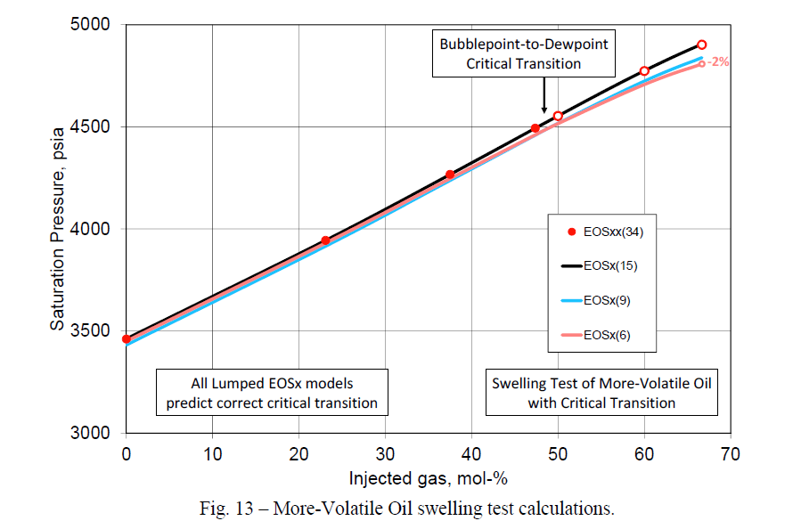
Slide 16
Paper 170912 • Global Component Lumping for EOS Calculations • Curtis Whitson

Slide 17
Slide 17
Conclusions
The lumping method is designed to describe a particular engineering discipline (reservoir, flow assurance, process facilities) for which the lumped EOSx is being applied.
Different EOSx models may be developed for each modling discipline from same EOSxx model – ensures consitency.
The method uses a well-defined quantitative measure of the lumped EOSx model accuracy in terms of how well the PVT compare with the original detailed EOSxx model.
The lumping method makes a comprehensive search of all possible lumping scenarios with few but meaningful constraints.
Paper 170912 • Global Component Lumping for EOS Calculations • Curtis Whitson

Slide 18
Slide 18
Conclusions
The challenge in applying the proposed lumping method is
  Defining an appropriate set of PVT calculations for defining the quality metric for the processes being modeled with EOSx.
  Defining weighting factors for each data to reflect their importance to the processes being modeled with EOSx.
  Automated execution of all EOSx scenarios (Pipe-It) using a fast and robust EOS-based PVT program (PhazeComp).
Paper 170912 • Global Component Lumping for EOS Calculations • Curtis Whitson

Slide 19
Slide 19
Thank You

