Slide 1
Lecture 8.2. Compressors 19/3 2021
Content:
Compressor performance
Stepwise compression
Intergrated process

Slide 2
But first: Correction factor for non-ideal gas
Ideal, isentrophic (8-1):
Non-ideal correction suggested:
Non-ideal, an-isentropic:

Slide 3
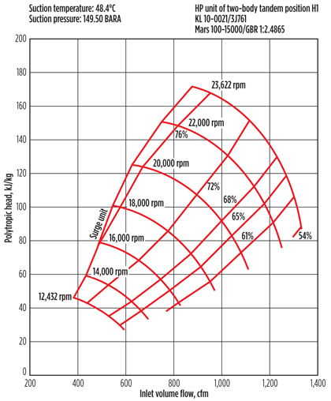
Performance measure: Polytropic head
Power (8-5):
Polytropic head (8-7):
→

Slide 4
Polytropic vs hydraulic head

Slide 5
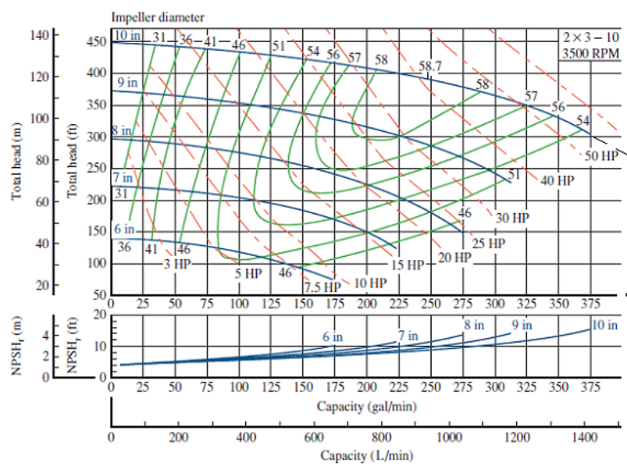
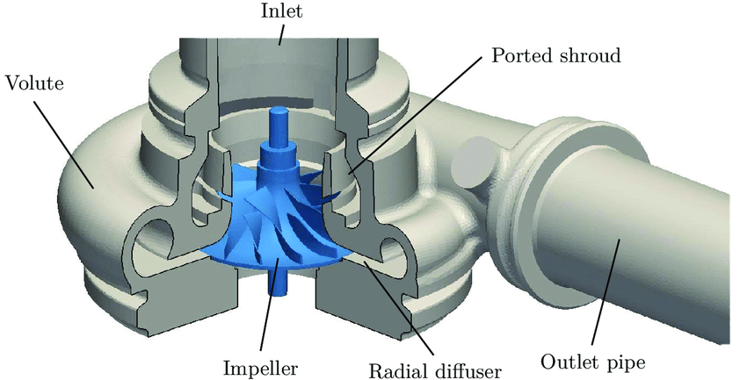
Pump-compressor
Single stage centrifugal compressor

Slide 6
Rotation speed and choking

Slide 7
Stepwise compression
intermedia pressure: p_{i} requiring least work

Slide 8
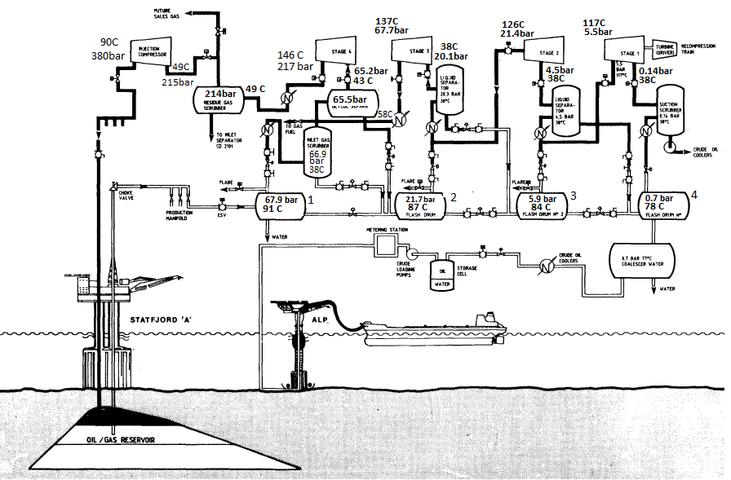
Integrated process
Integrated process: Statfjord A

