Slide 1
Lecture 8.1. Compressors held at 16/3 2021

Slide 2
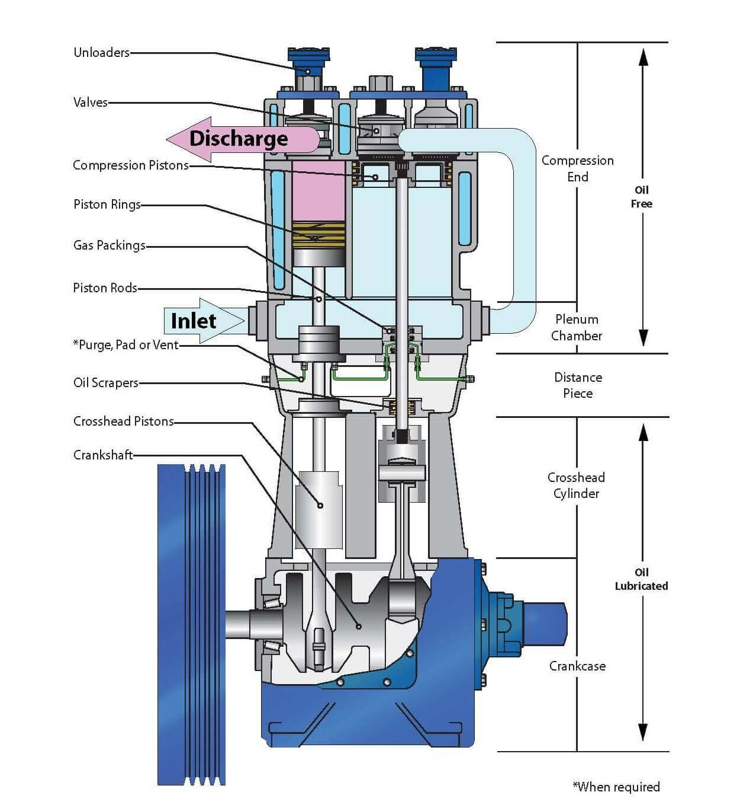
Volumetric, piston, 2 stages
Note different cylinder sizes

Slide 3
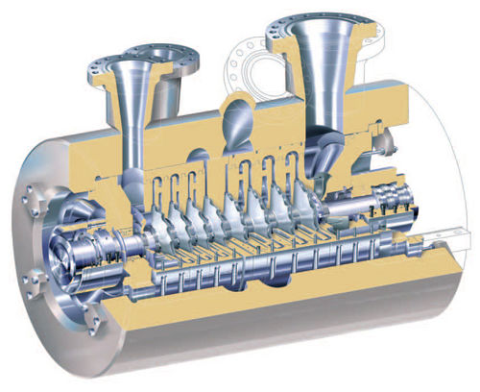
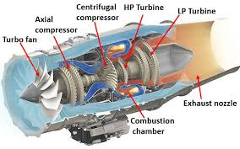
Dynamic compressors
Industrial, 8 stage radial
Jet engine, centrifugal and axial stages

Slide 4
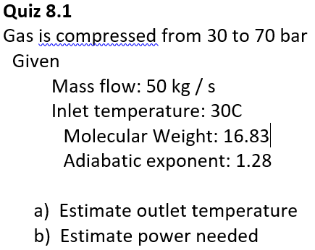
Power: Compressors pump compressible fluid
Pump power relation: dw=Qdp
Isentropic (adiabatic) gas approximation:
By integration

Slide 5
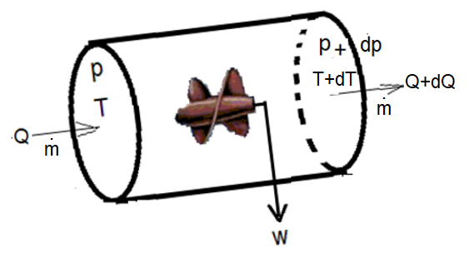
Power: Energy balance
Energy balance:
Enthalpy:
Combined
2 degrees of freedom, e.g.:

Slide 6
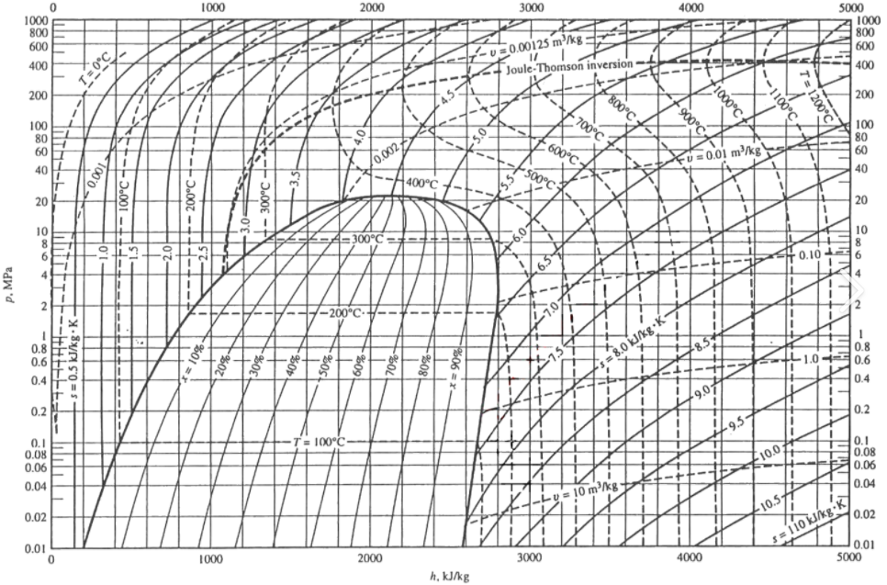
Mollier diagram:

Slide 7
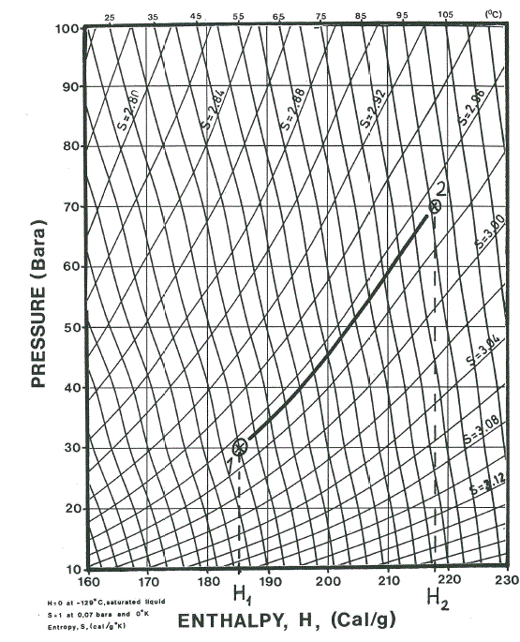
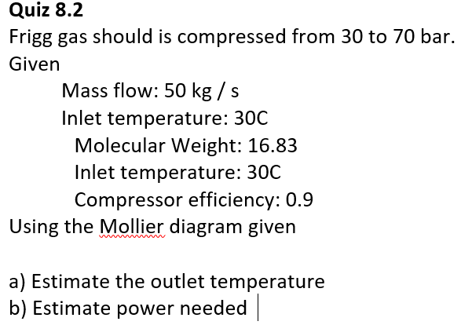

Power by Mollier diagram

