Slide 1
Lecture 7.2. held at 12/3 2021
Content:
Pump control
Jet pump performance

Slide 2
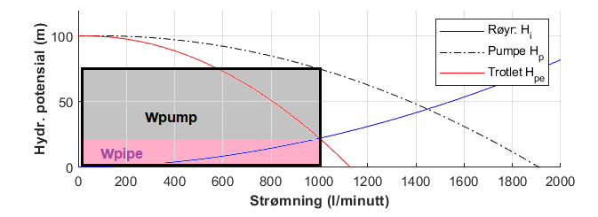
Throttlig control: Choking at pump outlet
Potential drop accross valve:
Potential provided by pump:
Work:

Slide 3
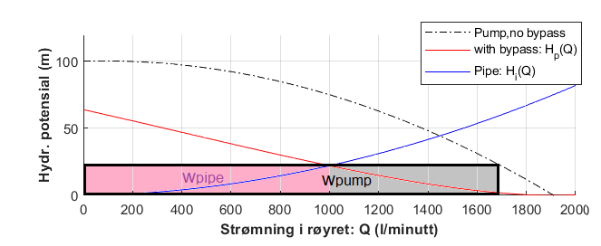
Bypass-control: Network performance
By Kirchoff’s laws:
Closed loop potential balance:
Mass balance at nodes:

Slide 4
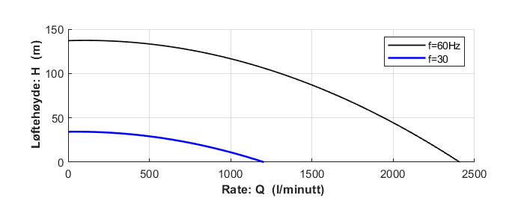
Frequency control (Variable speed drive)
By affinity laws

Slide 5
Jet pump: Velocity and pressure

Slide 6
Performance predicted for drive fluid rate: 180 ltr/min
Ideal efficiency here predicted: η<50%,
Occurring at pumped rate: 700 l/m
Ideal efficiency accounts for momentum loss
through the mixing chamber.

