Slide 1
Lecture 6.2
Gas flow through restrictions
Scheduled 5. march
Course overview & physical lectures
Gas flow through restrictions (6.4.2)
Non-isentropic processes (6.5)

Slide 2
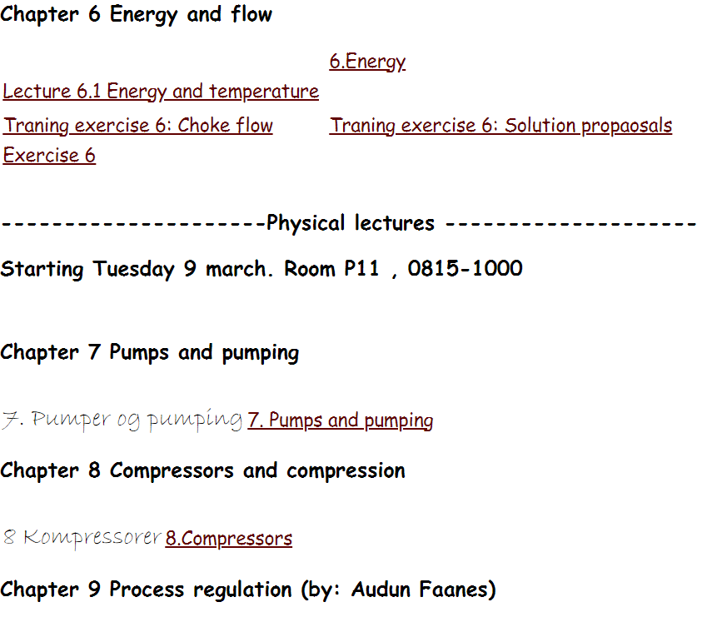
Subjects to be covered before Easter break

Slide 3
From previous lecture: 6.1
Energy conservation, open system
Isentropic assumption:
Ideal gas, no height change
pressure drop will change density and temperature.
We will in this lecture: 6.2, include this in flow calculations

Slide 4
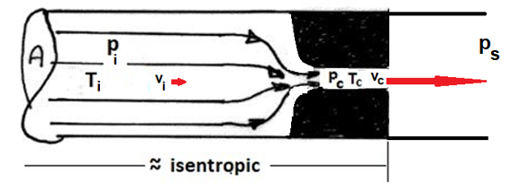
Gas flow through chokes and restrictions
Bernoulli:
Isentropic:
Solved for outflow velocity:
Mass balance→ rate:

Slide 5
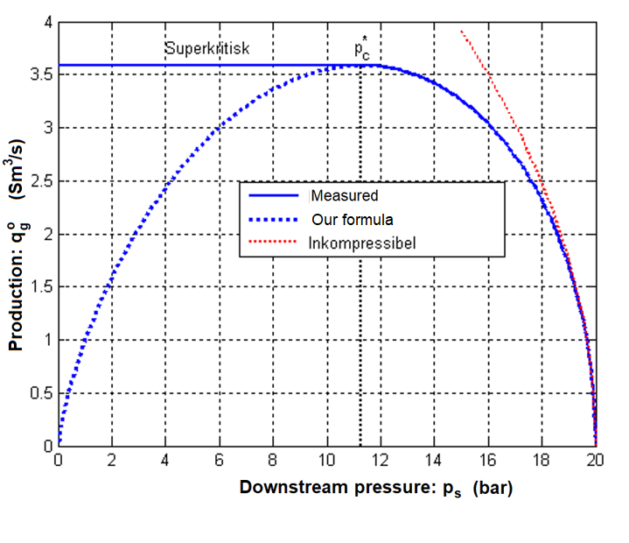
Predicition of flow through choke
Computed criticals:
If downstream pressure drops below critical (about 50% drop), critical flow rate is maintained

Slide 6
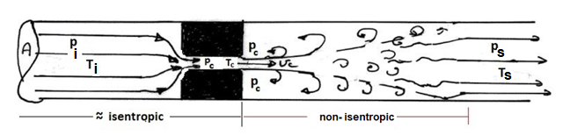

Temperature
Note: This slide has been updated thus differs somewhat from Lecture 6.2.
The lecturer belive that the current, less mathematical derivation is easier to grasp. The results are the same
Temperature drop to choke outlet:
Temperature effect of turbulence (entrophy increase) after choke outlet
Energy, ideal gas flow:
Energy change, upstream-downstream:
For velocites much below critical, kinetic energy contributes little:
With no energy transfer to surrounding (adiabatic):
Ideal gases: Complete temperature recovery:
$$T_{s}=T_{i}$$
Real gases: Joule-Thompson expansion. Temperature may drop, or rise

Slide 7
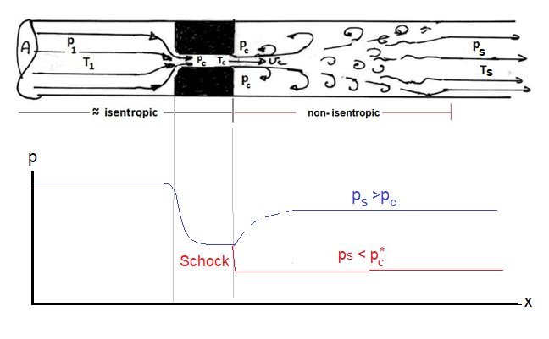
Non-isentropic flow. Choke flow as example
Sonic schock makes flow rate independ of downstream pressure!

Slide 8
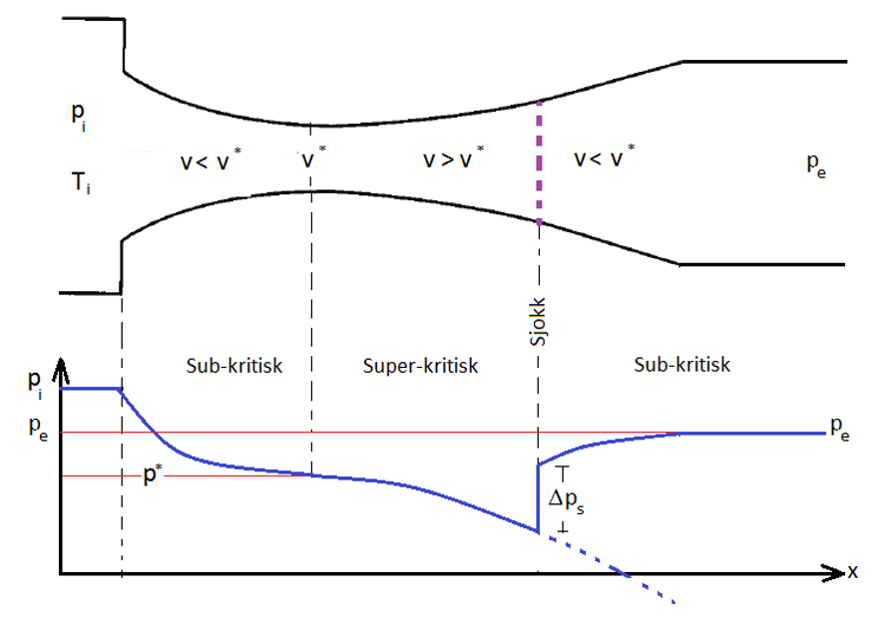
Supersonic flow (Cursory)

