Slide 1
Lecture 6.1 Energy
Scheduled 2 March 2021
Objectives:
The plan, as it is today
Abstracting chapter 6.1, 6.2, 6.3
Exercise 6, chapter 6.4.1

Slide 2
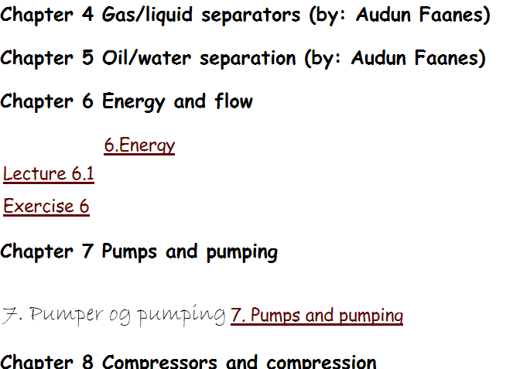
The plan as it is today

Slide 3
The 3 fundamental relations
Mass conservation :
If you put more into a vessel than you take out, the content inside will increase.
Here:
Force balance:
Force is what make things move ( Aristoteles: Upholds movement against friction).
Here:
Energy conservation:
work may transfer to other energy forms. But, no energy is lost.
Here:
( Einstein: mass-energy conversion )

Slide 4
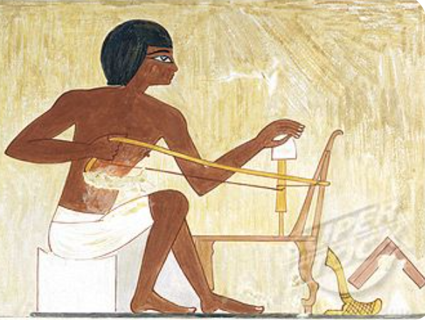
Work to heat conversion : Old Egypt
bow drill

Slide 5
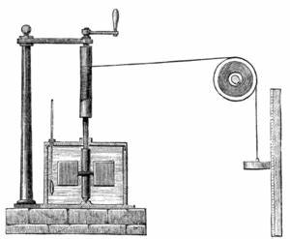
Work to heat conversion: Joule (1884):
Heating of water by agitation
Energy balance:
work of a falling weight
Change of internal energy
Mesurement of transfer

Slide 6
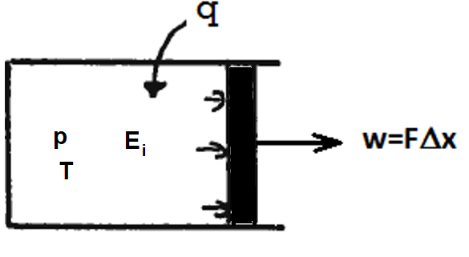
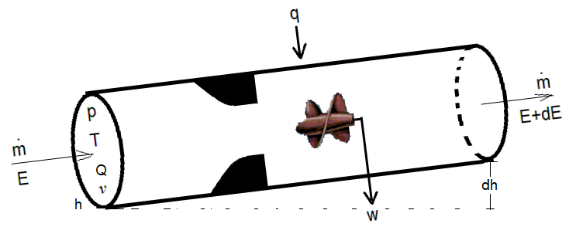
Energy balance for open systems 6.1
Closed system
Open system

Slide 7
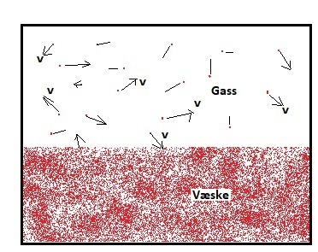
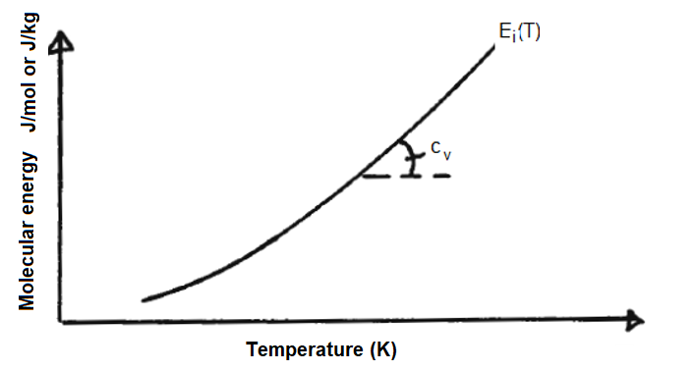
6.2 Conservation relations
Internal energy is associated with molecule vibration and velocity.
Manifested by temperature.
For ideal liquid and gas, un-affected by pressure:

Slide 8
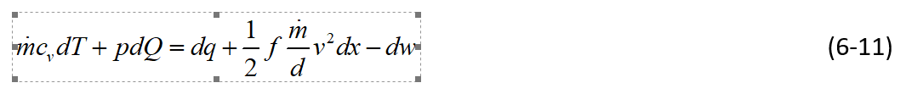
6.4.1 Pipe flow
Pipe flow equation
-- converted to energy units:
Energy conservation
Energy conservation, after subtraction of pipe flow-energy relation

Slide 9
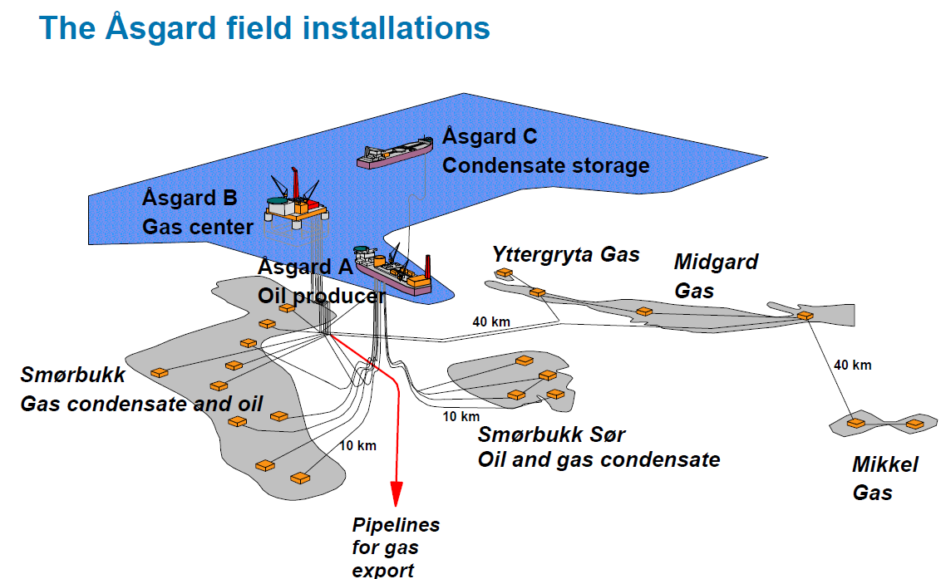

Exercise 6
Concrete example
Exercise 1.2: Cooling by heat flow to surrounding water
Exercise 6: Inclusion of heating by wall friction

Slide 10
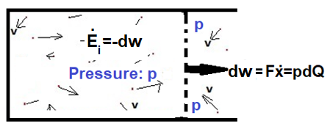
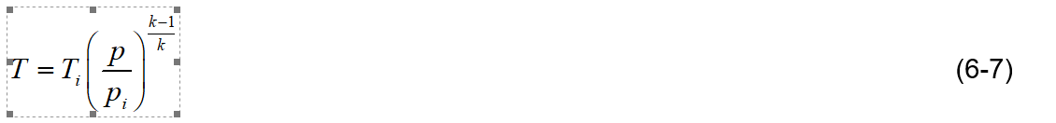
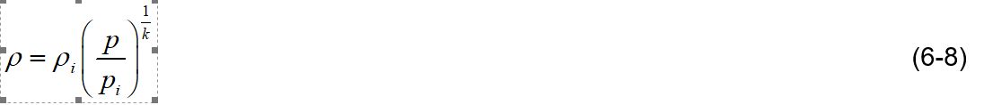
Isentropic model 6.3: No heating, no work transfer, no friction
Energy balance (pressure drop leads to expansion):
Results by combining with the general gas equation: pQ=nRT , ideal gas
Adiabatic exponent:

