Slide 1
Chapter 2 Lecture 4: Slug flow 5 february 2021
Abstraction of chapters
2.2.2 Slip , and
2.2.7 Mixed flow with slippage
Example

Slide 2
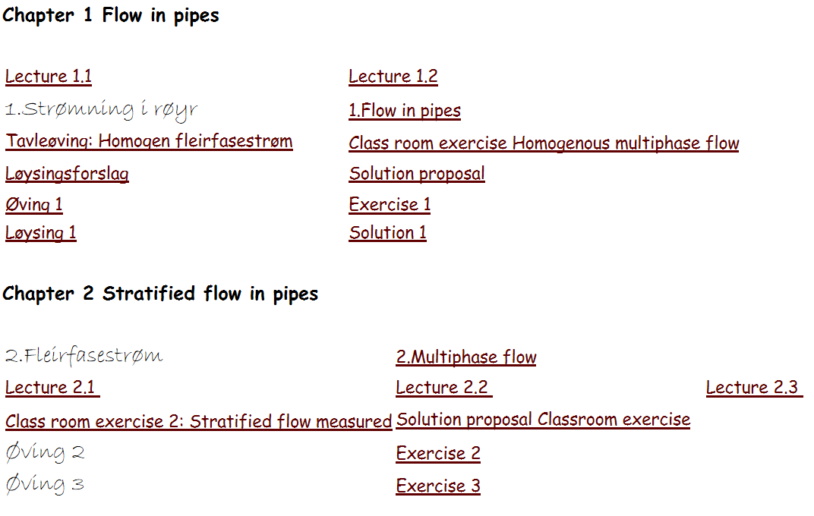
Schedule update
Droplet mechanics in week 6
Process control (Faanes) in week 12

Slide 3
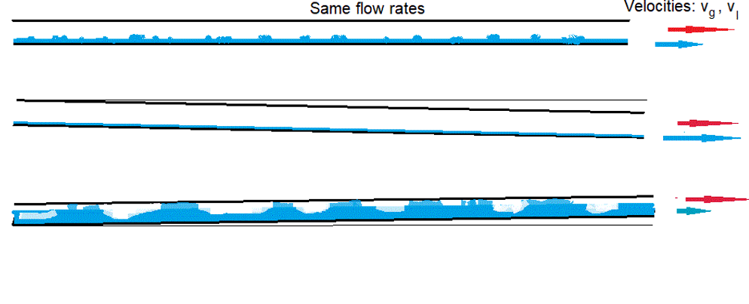
Slug flow
Problem:
In upward-sloping pipe slugging may occurr in predominantly gas flow.
This makes stratified flow predictions nonsense.

Slide 4
Mixed flow with slippage
Solution :
mixed flow, with different gas and liquid velocities
…-iIii
Mixed flow ,chapter 1 eq. (15):
….Flow-averaged density
- With slippage, eq. (2-24):
..Two-phase mixture density

Slide 5
Mixed flow with slippage: and mixture density
holdup prediction by ZF-model (2-4):

Slide 6
Mixed flow with slippage: Slug regime
Holdup prediction, drift flux according to Zukowski

Slide 7
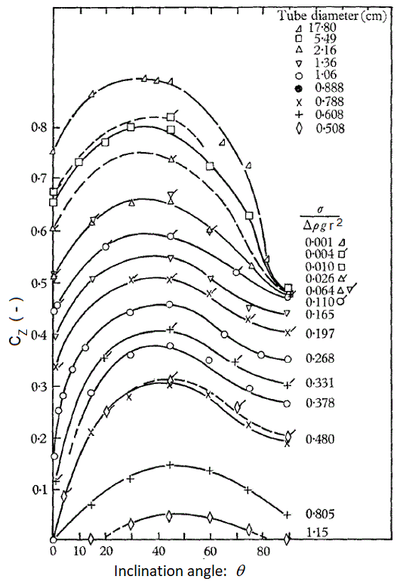
Zukoski

Slide 8
Example
Gas superficial velocity: 1.98 m/s. Liquid superficial velocity : 0.02 m/s
Gas density: 100kg/m³. Liquid density: 900kg/m³
Pipleline slope: 5 degr . Diameter: 0.2 m
→liquid flow fraction:
flow averaged density:
Bubble penetration:
Liquid holdup:
Mixture-averaged density:
Gradient
3 times flow-averaged!

Slide 9
“--- as simple as possible, but no simpler----"
Focusing on overall structure, not details.
NTH-slogan:
Graduating from here, you do not know anything.
But you know where you can find it.

