Slide 1
Chapter 2 Lecture 3: Slug sustainability (aka:«Severe slugging», «Terrain slugging») 2 february 2021
Objective: abstracting chapter 2.2.6
-Principles for sustainability : Criteria
- Consequences of growth

Slide 2
Ockham’s razor: Einstein’s version:
"Everything should be kept as simple as possible, but no simpler."

Slide 3
Wave growth
Slug sustainability if length increases (Lunde /1989/)
Liquid pick-up in front (if vm>vl)
Liquid loss in rear-end

Slide 4
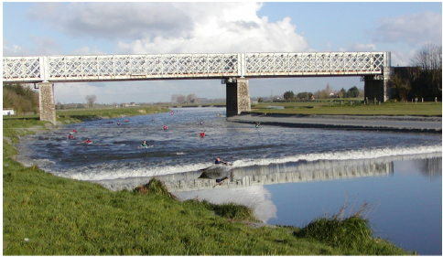
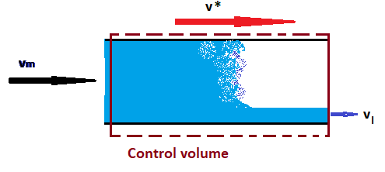
Front:
Hydraulic jump analogy
Mass balance gives
front velocity

Slide 5
Rear-end
Bubble penetration into slug:

Slide 6
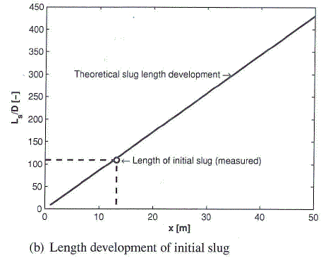
Slug sustainability
Growth velocity:
Dissipation if : vs <0
Increase if: vs >0
«Severe slugging»

Slide 7
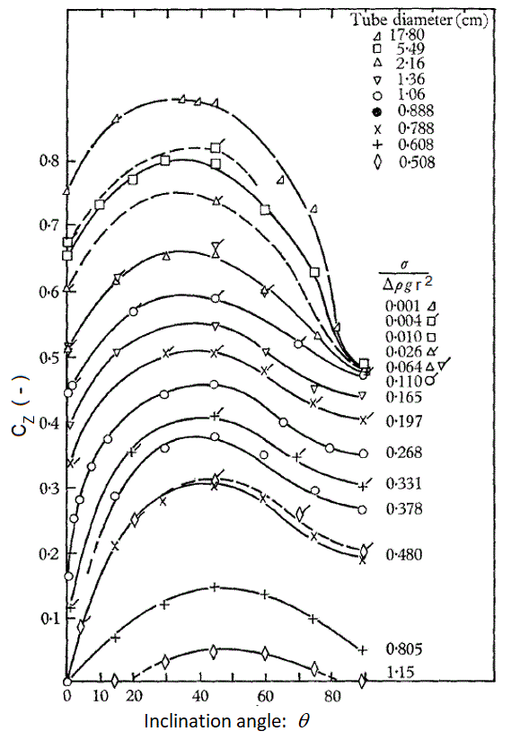
Rear end bubble, by Zukoski

Slide 8
Slug catcher, at outlet of flow line

Slide 9
Slug catcher at Qadirpur Gas Field

Slide 10
Two phase flow facility at Tiller

