Slide 1
Lecture 2.2 Multiphase flow in pipes Scheduled Friday 29/1 2021
Repetition of stratified flow (Newton-Raphson iteration included)
Pressure drop : Chapter 2.2.4
Stability : Chapter 2.2.5

Slide 2
From lecture 2.1 :Force balances
Homogenous mixture:
Where:
Separate channels
Gas:
Liquid:

Slide 3
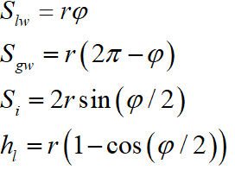
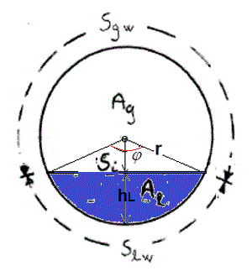
From opening angle estimate, distribution parameters follow

Slide 4
Newton-Raphson iteration
Finding the minimum of F-squared
Taylor series expansion:
Setting:
and solving:
Repeat untill:
and
Also works for multi-variable functions (vectors-matrises)

Slide 5
Pressure gradient: after «θ» has been estimated
Force balance gas channel:
→Pressure gradient:

Slide 6
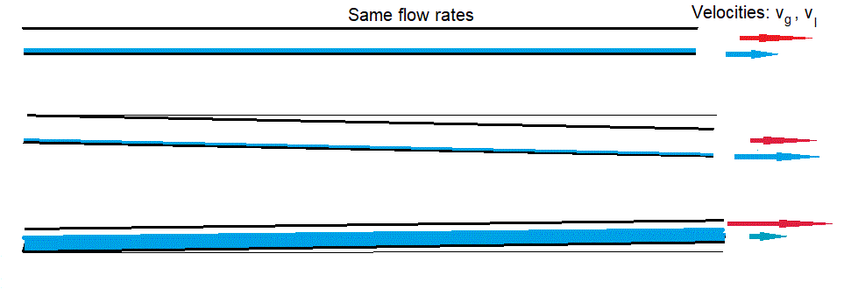
Common results of liquid level prediction
Densities affects liquid level
Gas and liquid velocites
Pipe slope affect liquid level substantially
Will the flow pattern remaing stratified?

Slide 7
Dynamic stability
Vertical change, gas channel:
Vertical change, liquid channel:
Dynamically stable if:

Slide 8
Common prediction & observation

