Slide 1
Lecture 2.1 Multiphase flow in pipes
Scheduled Tuesday 26/1 2021
Considering: Multiphase flow
Flow regimes. Chapter 2.1
Stratified flow. Chapter 2.2.1, 2.2.3, 2.2.4

Slide 2
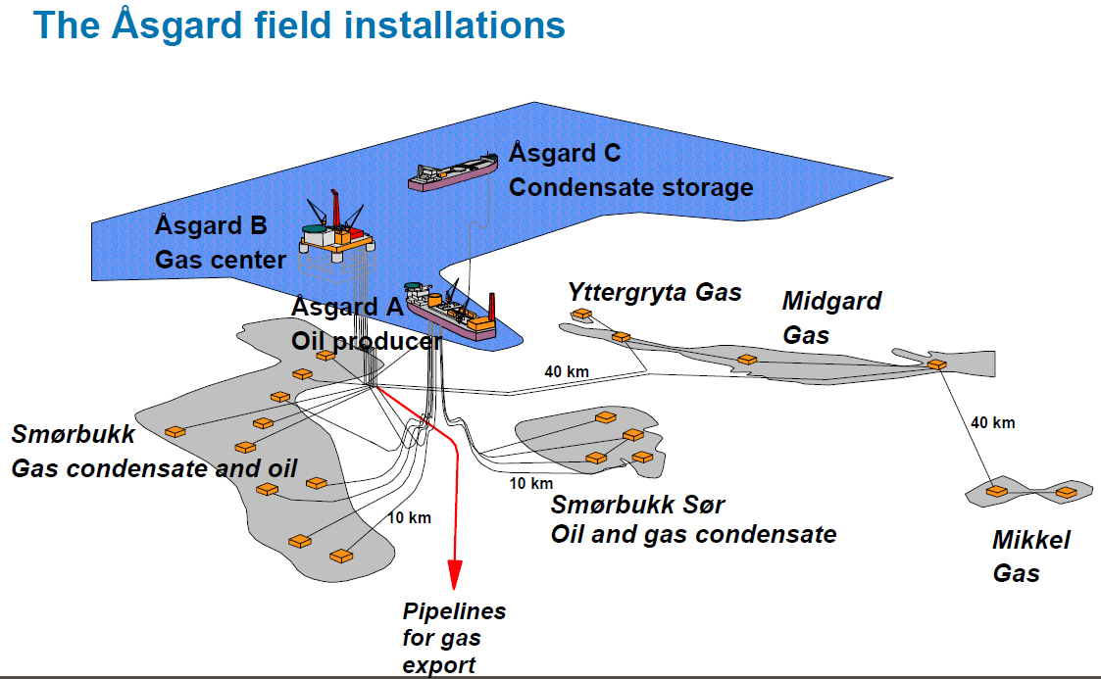
Why bother?
Flow of un-processed fluids (oil, gas, water) from wellhead clusters

Slide 3
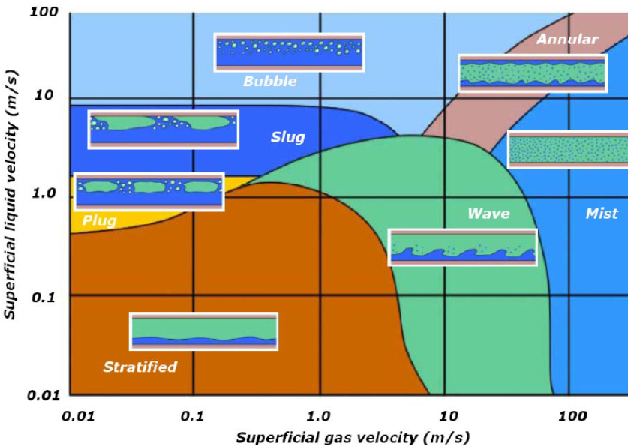
Horizontal flow regimes
Note 1: «Bubble», «Finely dispersed bubble», «Mist» and «Churn» may behave like «Mixtures»
Note 2: Do not use «flow regime maps» for prediction.

Slide 4
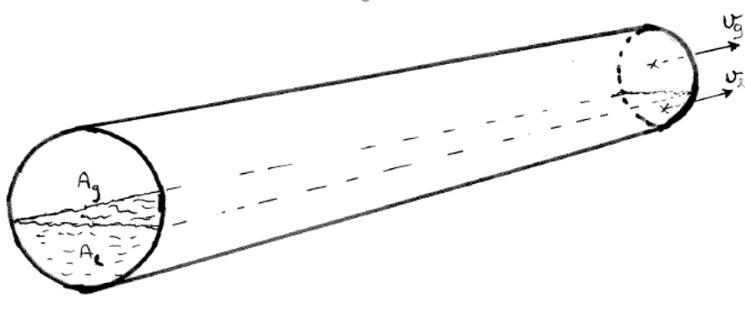
Stratified flow
Velocities:
Holdup:

Slide 5
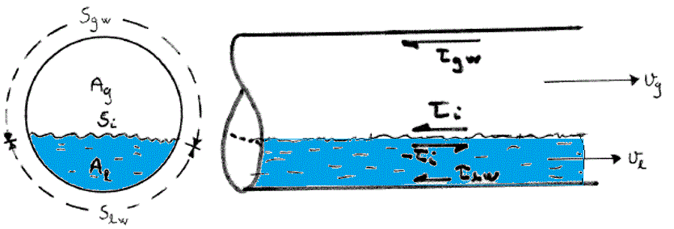
Force balances
Homogenous mixture:
Where:
Separate channels
Gas:
Liquid:

Slide 6
Pressure drop condition
Equal pressure gradient in gas and liquid channels
Eliminating : dp/dx provides necessary condion
Channel geometry providing relations between
Gas- and liquid filled areas:
and wetted perimeters:

Slide 7
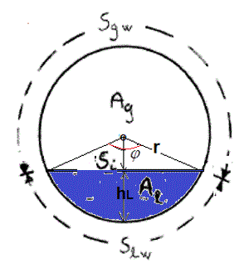
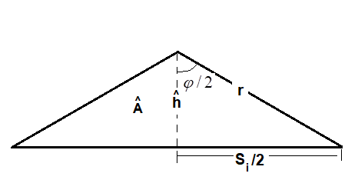
Stratified geometry
Note: For radius r, choice of any of the variables above, e.g.: hL enables us to
calculate the others needed for the pressure drop condition:
What variable would you chose?

Slide 8
Some relations based on «opening angle»

Slide 9
Flow calculation for stratified geometry
Pressure drop condition, depending on opening angle
Wall shear (gas as example)
Thus also shear stresses depend on opening angle :

Slide 10
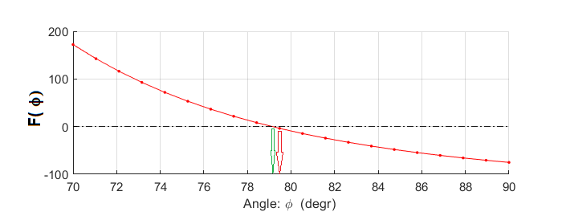
Prediction:
Seek opening angle, such that: F(φ )=0
Rough approach: Calculate for an array of angles and pick closest to zero: red arrow
More elegant: find angle that minimizes: , eg. by NR-iterations

