Slide 1
Lecture 10.4: Sampled data scheduled 23/4 2021
Content
-Delayed response in wells
-Sampled data (10.5.2)
-Frequency spectrum (10.5.3)
-Fast Fourier Transform (10.5.4)
-Training exercise 10.2 , task 2

Slide 2
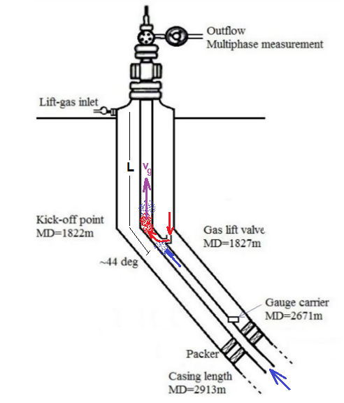
Delayed response in wells
-Temporary pressure drop causes increased gas inflow,
forming high-gas content plug
-High-gas content plug reduces mixture density,
thus changing downhole pressure and inflow
High-gas content plug follows the overall flow,
reaching the outlet after delay:

Slide 3
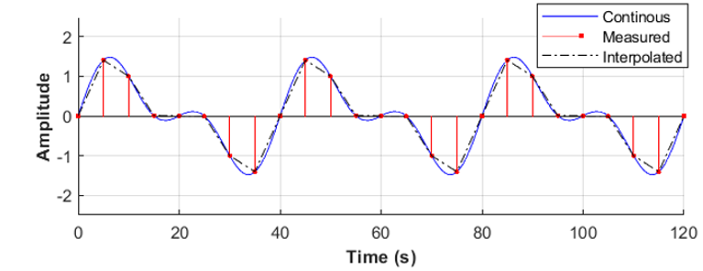
Sampled data interval: Δt=5s

Slide 4
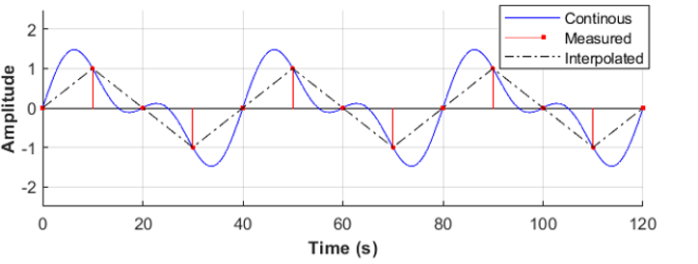
Sampled data interval: Δt=10s
Nyquist’s sampling rule:
Oscillations faster than twice the frequency can not be reconstructed

Slide 5
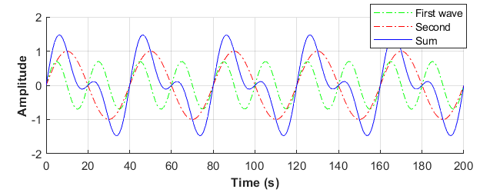
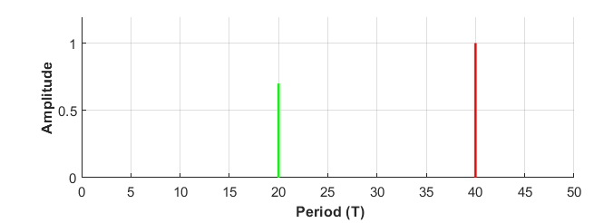
Frequency (period) domain
Time domain
Period (frequency) domain

Slide 6
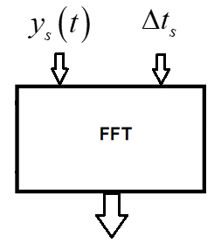
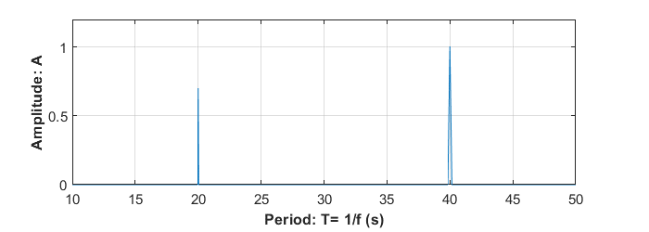
Fast Fourier Transform: An algorithm provided

Slide 7
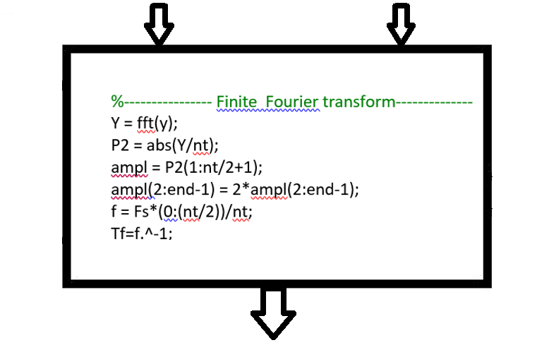
Fast Fourier Transform: Algorithm
Script: 10.5.4

Slide 8
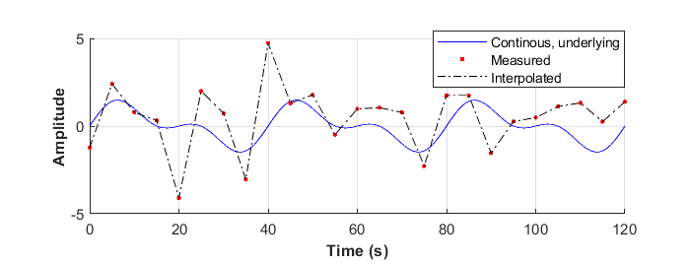
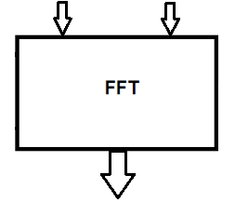
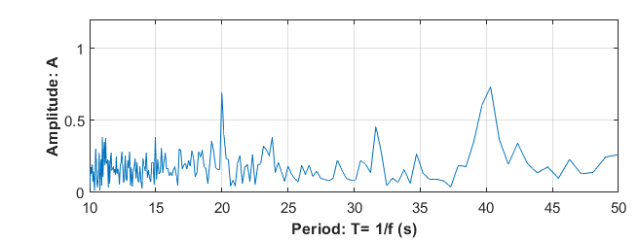
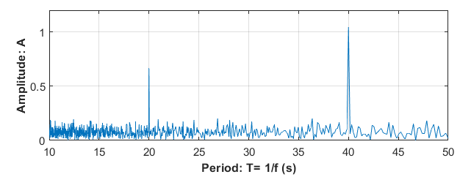
FFT: Application
By 500 measurements
By 2000 measurements

Slide 9
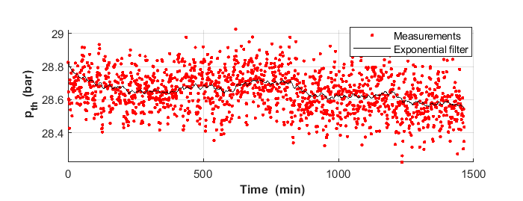
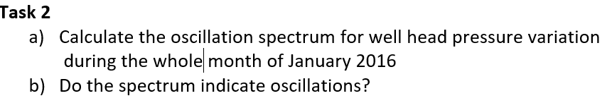
Training exercise 10.2, Task 2
Measured and filtered data
?

