Slide 1
Lecture 10.3
Process dynamics
20/4 2021
Content
What remains
10.4 Process dynamics
10.5.1 Sinusoidal oscillation
10.5.2 Sampled data

Slide 2
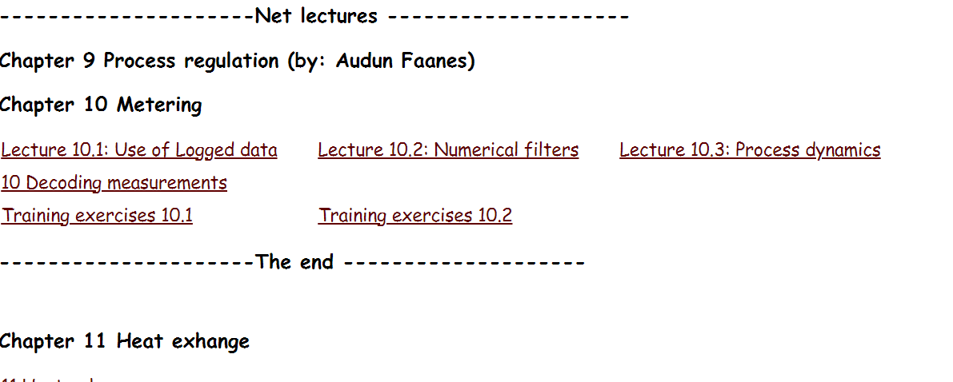
What remains

Slide 3
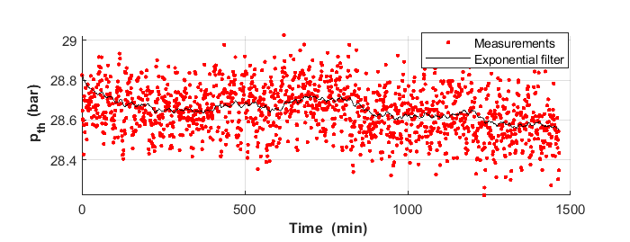
Process dynamics
Do the measurements indicate systematic variations??
?

Slide 4
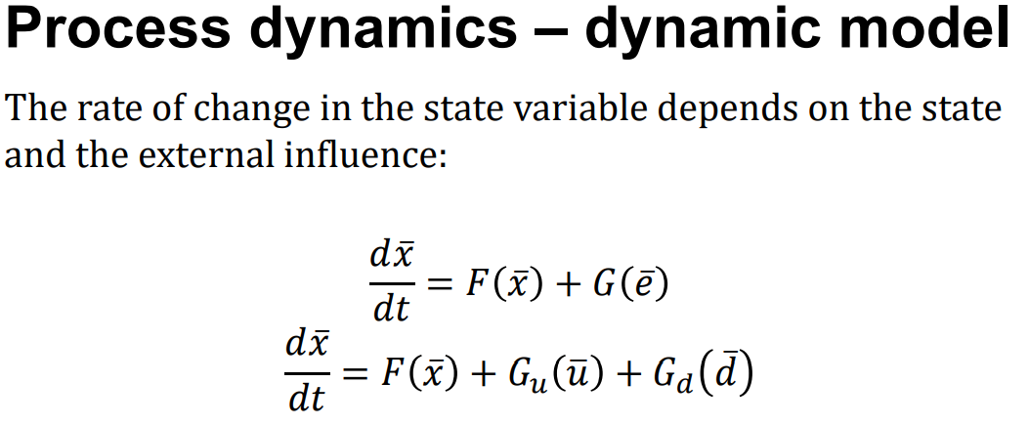
(Audun Faanes)
Immediate response leads to exponential dynamics
Delayed response:

Slide 5
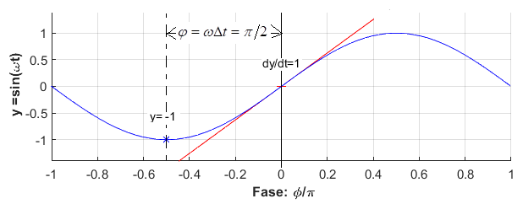
Delayed response
Which relations may fulfill:
(current gradient equals the function value at some previous time)
Sinus?

Slide 6
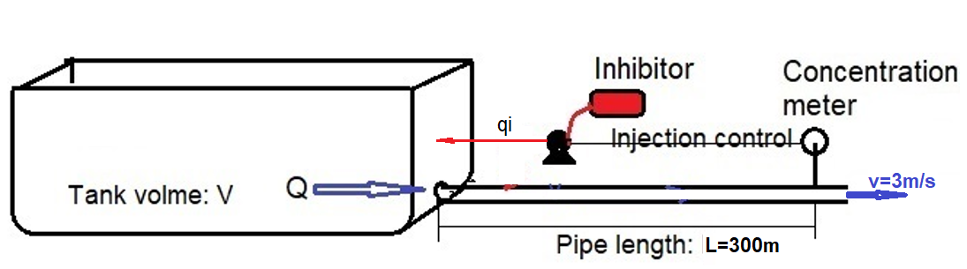
Examples of delayed response
Biological clock: The Nobel Prize in Physiology or Medicine for 2017
Wolf-prey dynamics
Process regulation example

Slide 7
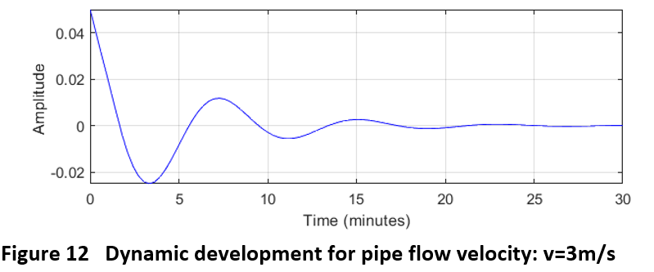
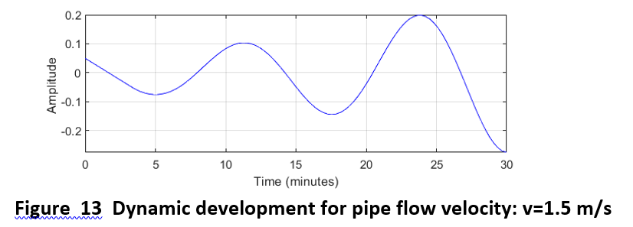
Process regulation example

Slide 8

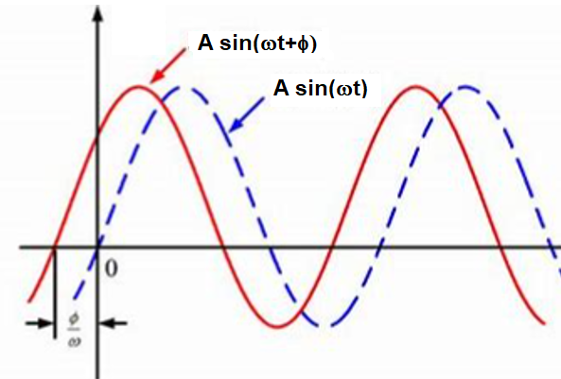
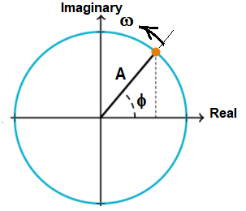
10.5.1 Sinusoidal oscillation
Function

Slide 9
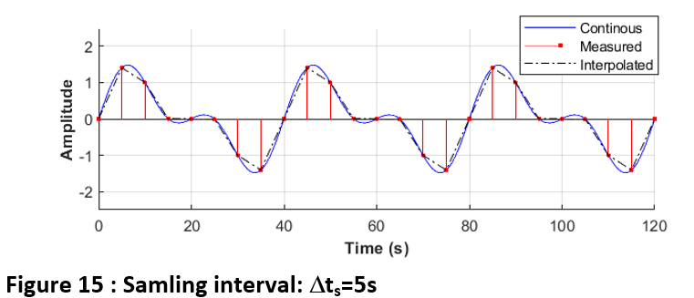
10.5.2 Sampled data
example
Reasonable re-construction by interpolation?

Slide 10
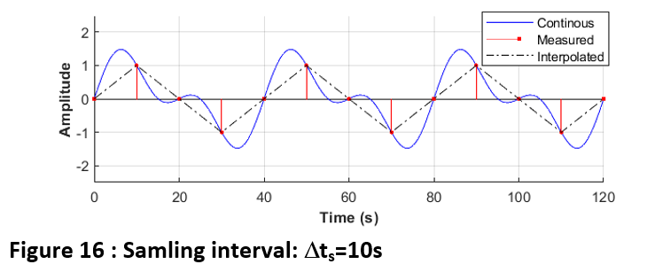
10.5.2 Sampled data
example
Reasonable re-construction by interpolation?

