Slide 1
Lecture 10.2 Decoding measurements 16/4 2021
Content
Exercise 10.1, discussion
Numerical filters, chapter 10.3
Measurement interdependence

Slide 2
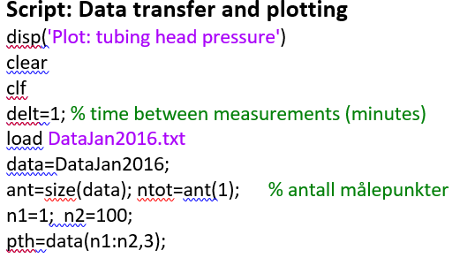
Transfer: Correction of script

Slide 3
Case study: Data measured on a gas-lifted well

Slide 4
Non-modelled variation (exercise 10.1 a)
Neglects correlation between neighbouring measurements

Slide 5
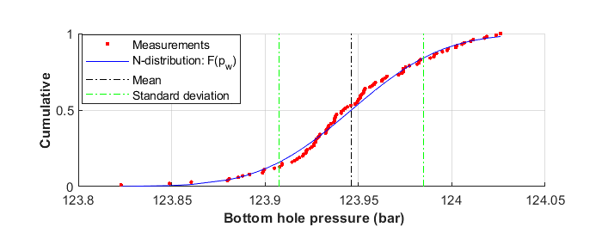
Measurement distribution (exercise 10.1 b)

Slide 6
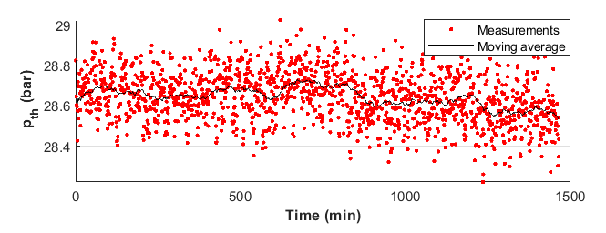
Numerical filter
Moving average:
For interval length: 60 minutes (k=60, Δt=1min)

Slide 7
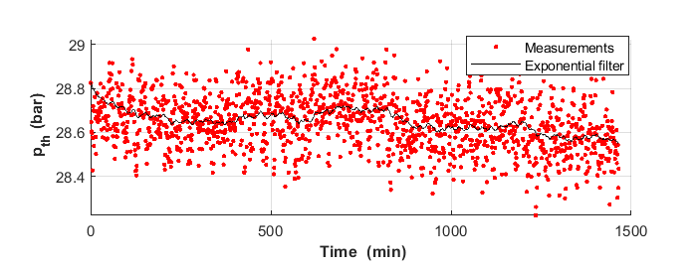
Numercal filters
Exponential
For weighing factor: α=0.02

Slide 8
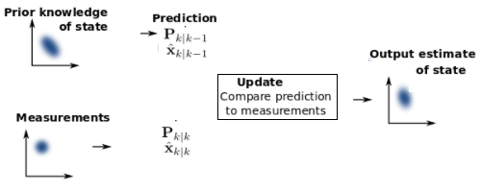
Dependence between neighbouring measurements
Approach 1: Combined prediction and measurement
(eg. Kalman filter)
Approach 2: Identifying characteristic response modes
(→ 10.4 Process dynamics 10.5 Fourier analyzes)

