Slide 1
Lecture 10.1
Decoding measurements
13/4 2021
Content
-Lectures & Exercises
Teaching approach
- Case
- Non-modelled variation

Slide 2
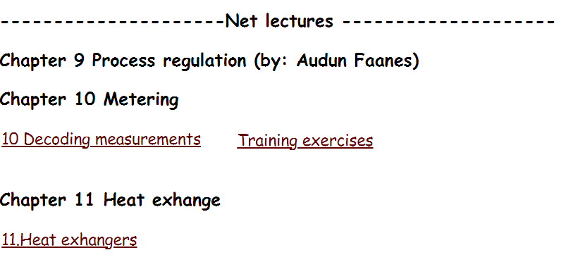
Lectures & Exercises remaining

Slide 3
Teaching approach: «Practical»
Case study, based on measured field data
Application of available scripts (MatLab)
Simple programs provided
Supporting theory
Training exercises: «longer, more comprehensive tasks»
Training exercise 10.1 & 10.2 now solvable

Slide 4
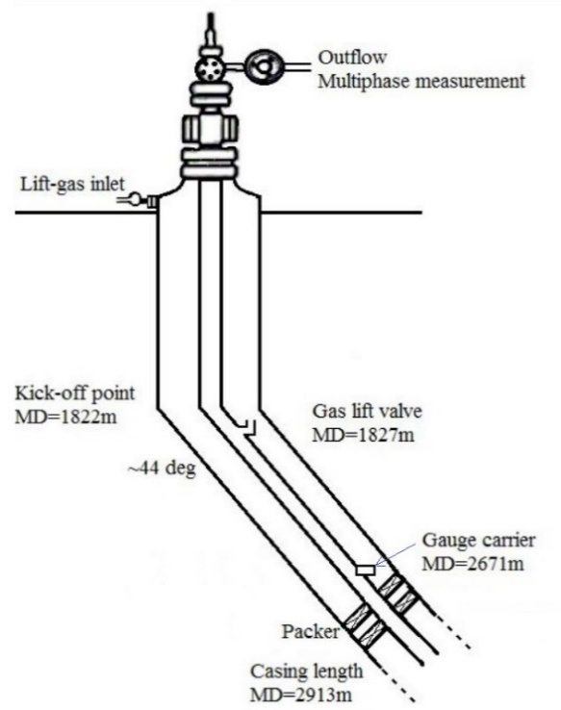
Case study: Data measured on a gas-lifted well

Slide 5
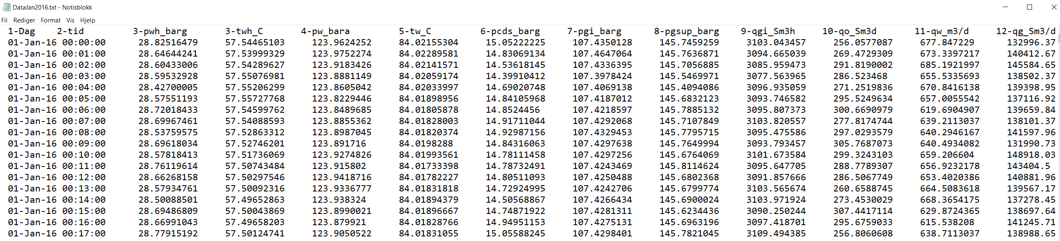
Logged data first 17 minutes of January 2016 shown below
Courtesy Equinor
first day: www.ipt.ntnu.no/~asheim/TPG4135/DataJan2016.txt

Slide 6
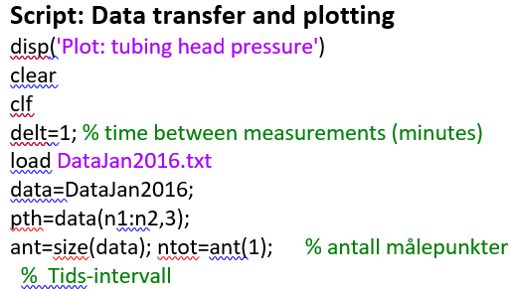
Transfer

Slide 7
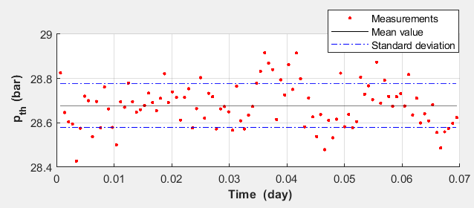
Non-modelled variation with time

Slide 8
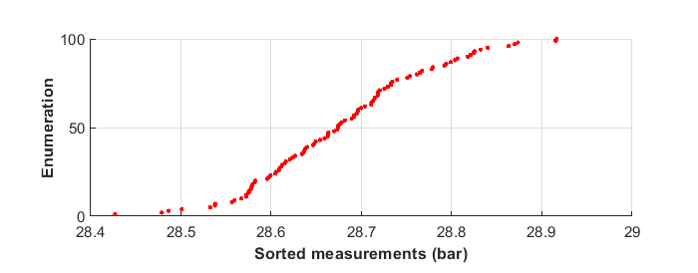
Cumulative variation with size

Slide 9
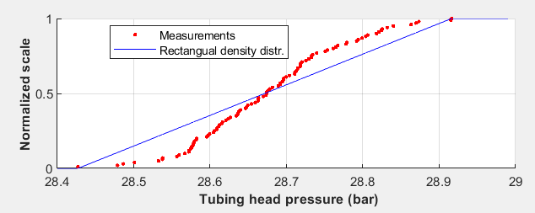
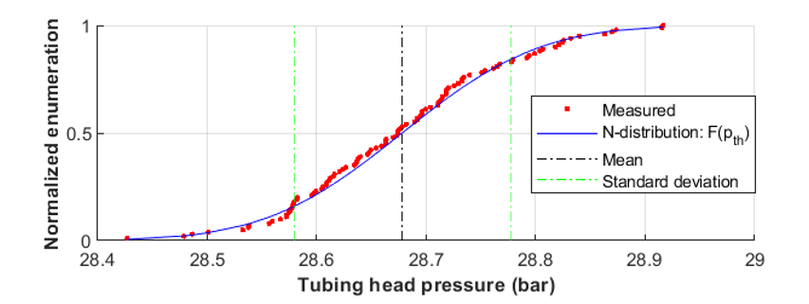
Non-modelled variation distributions

Slide 10
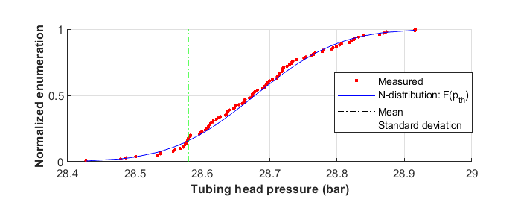

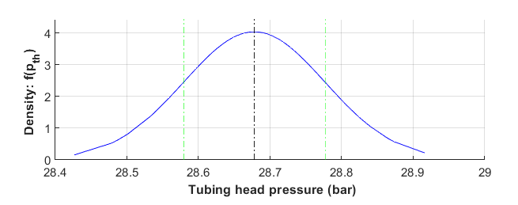

Normal distribution

Slide 11
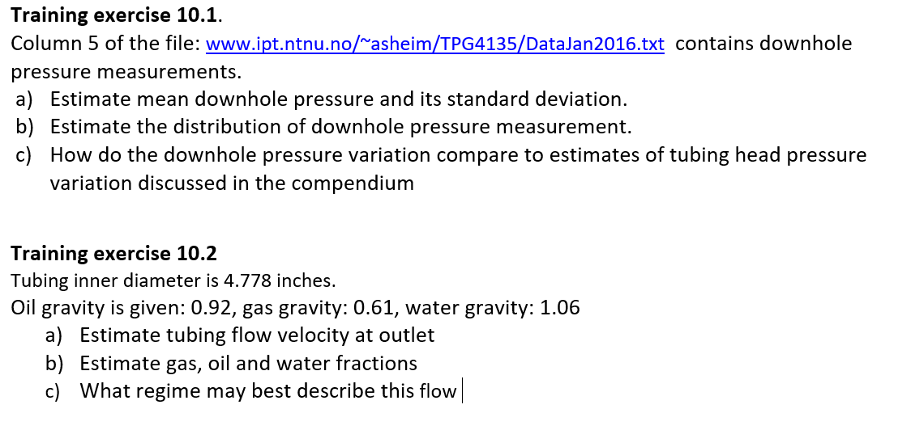
Assignment

