Slide 1
Chapter 1. Lecture 1 19 january 2021
Objectives:
- Single phase flow in pipes
Flow through restrictions
Heat transfer from pipe
- Theory for exercise 1

Slide 2
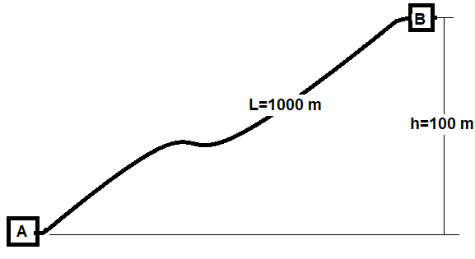
Single phase flow
Case considered
Bernoullis equation:
Flow friction included:
Extension to transient:

Slide 3
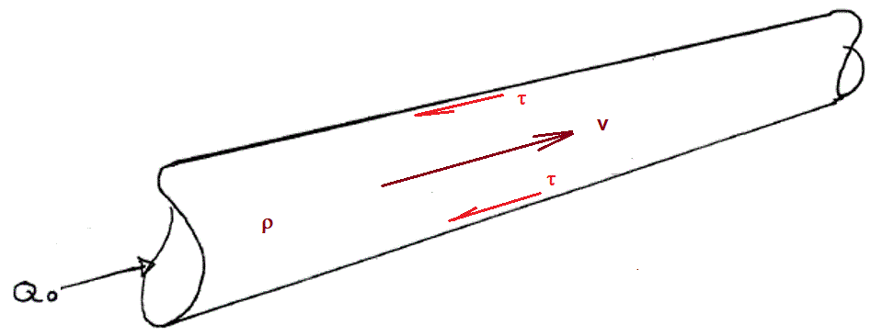
Friction pressure loss
Wall shear tension (force/wetted area):
Wetted area, circular pipe segment:
→Pressure gradient, circular pipe :

Slide 4
Darcy-Weisbach friction factor Colebrook-White/ Moody diagram

Slide 5
Kinetic losses («minor losses», «Stoss-verlust»)
Examle: Flow through orifice
Force balance on control volume:
Resulting pressure loss:
If choke opening much less than pipe cross section:

Slide 6
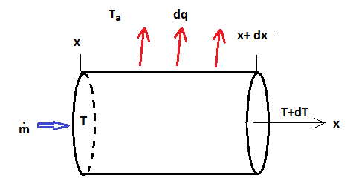
Heat transfer from pipe
Heat content of fluid: cp http://www.engineeringtoolbox.com/specific-heat-fluids-d_151.html
Heat transfer coefficient: U
Heat flow:
Heat content
Mass flow rate:

Slide 7
Heat transfer from pipe line at sea bottom
Mass flow
Analytic solution for constant outer temperature
Numerical solution

Slide 8
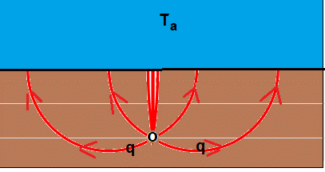
Buried pipe
Surrounding soil reduces heat transfer coeffisient. (Easily solvable)
At start-up, surrounding soil is heated by warmer pipe fluid, resulting in temperature transients

