Slide 1
Introduction TPG4135 Field processing Lecturer : Harald Asheim
Current plan
About this lecturer
3) Exam
4) Lectures and course work
5 a,b,c) Learning material
6) Key dates

Slide 2
2) About this lecturer: Harald Asheim, prof. Emeritus , PhD CV on home page: http://www.ipt.ntnu.no/~asheim/CV.html

Slide 3
3) Exam -Written -Probably home-exam turned in using «Inspera» -Open sources, MatLab will be provided

Slide 4
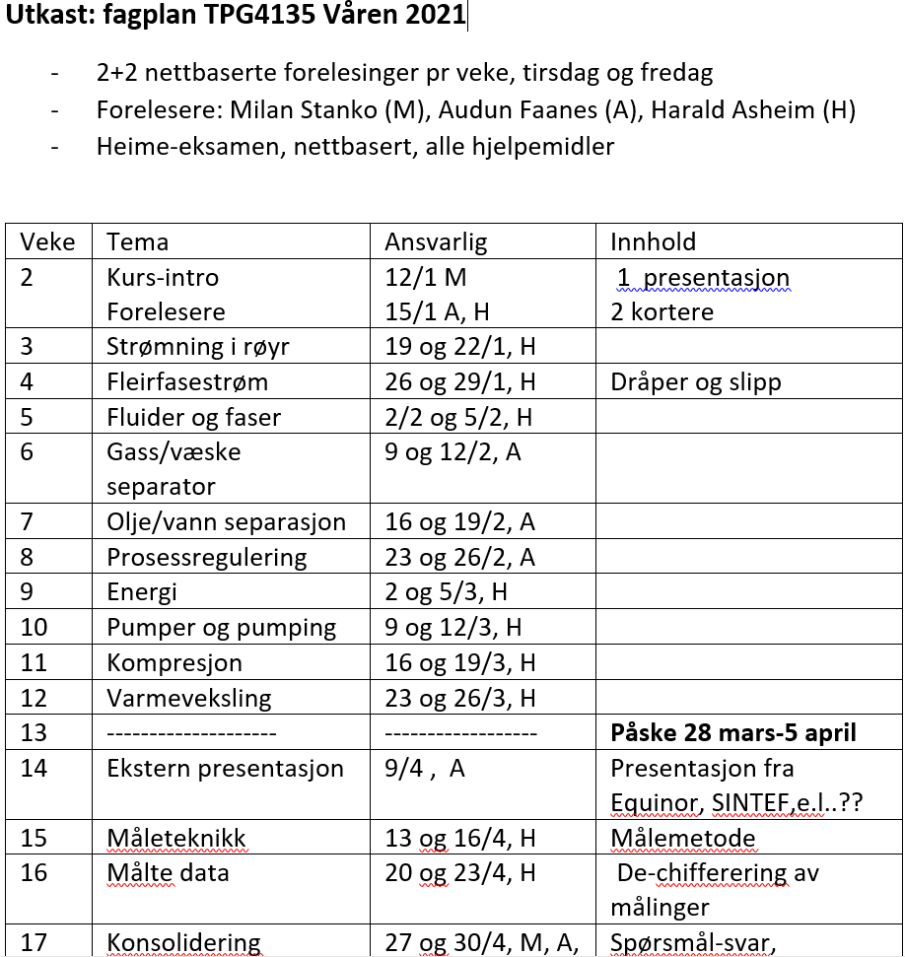
4 Lectures and course work -Net lectures abstracted the learning materials - weekly exercises, turn-in, 50% of turn-ins must be acceptepted

Slide 5
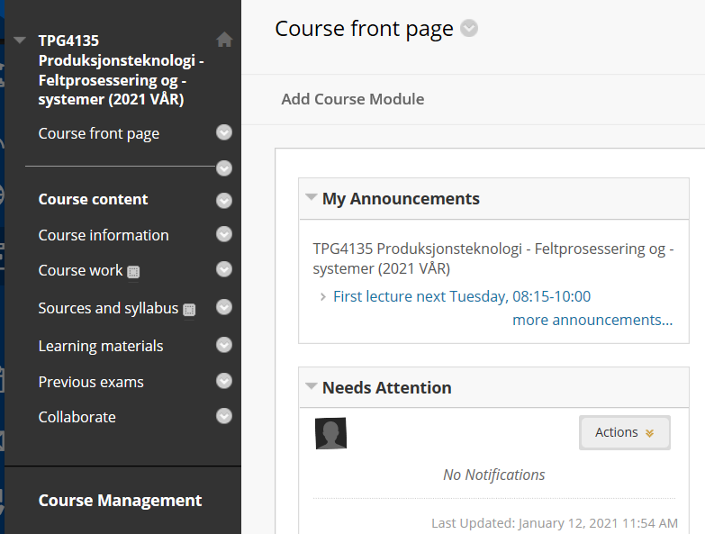
5a) Learning material Blackboard front page

Slide 6
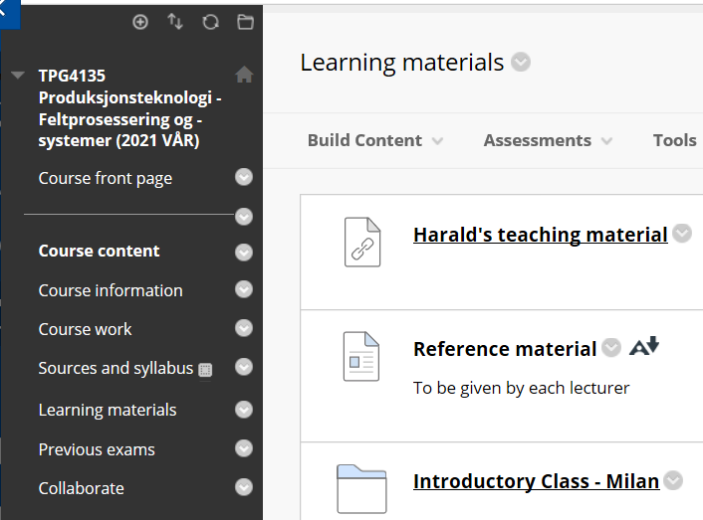
5b) Learning material

Slide 7
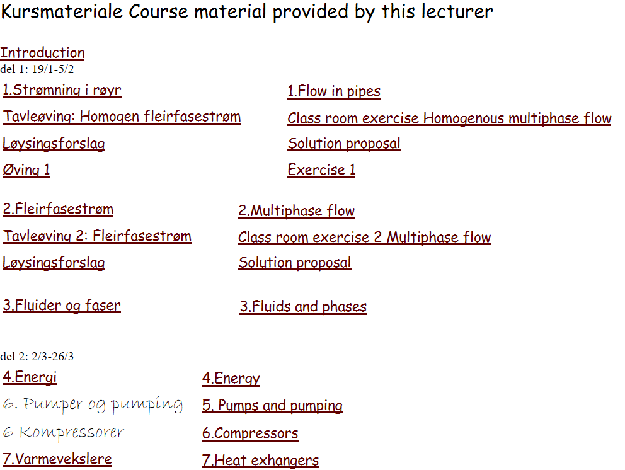
5c) Learning material Opened in Blackboard, Direct access: http://www.ipt.ntnu.no/~asheim/TPG4135.html

Slide 8
6)Key dates 19/1: First net lecture layed out, Ha (Chapter 1) 22/1: Second lecture layed out, Ha (Chapter 1) 26/1: Exercise support, A.E. Abrahamsen (Exercise 1)

