Slide 1
Study on the stress dependency of elastic and non-elastic processes in a dry sandstone
April 23, 2012
Anna M. Stroisz, NTNU
Erling Fjær, NTNU & SINTEF

Slide 2
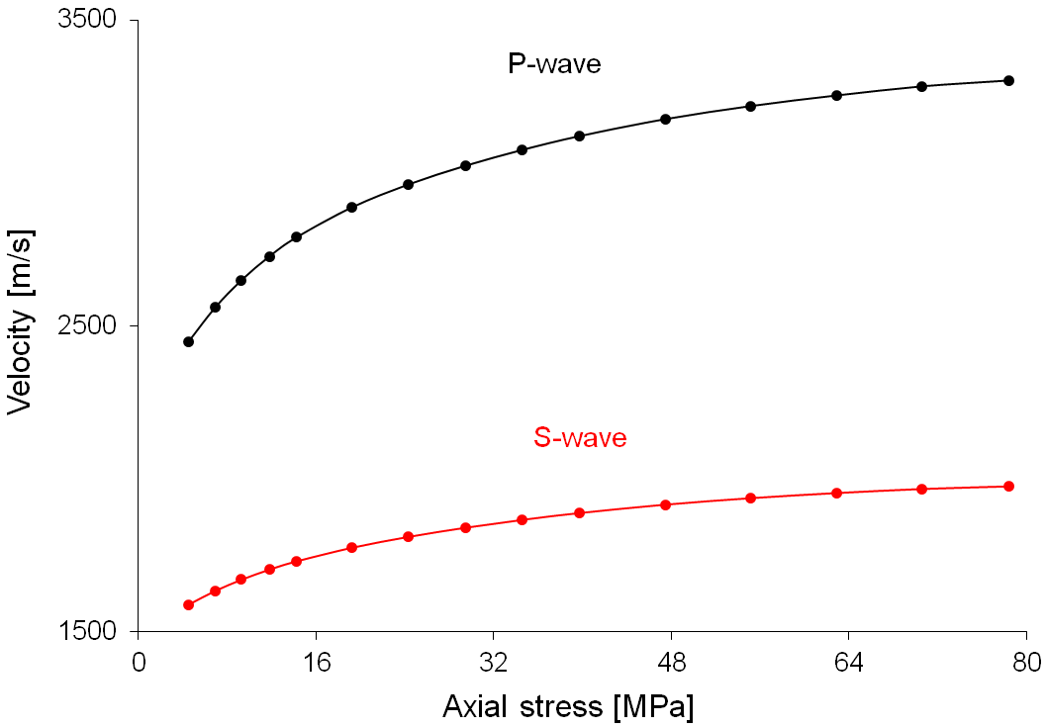
Causes for the stress-sensitivity of wave velocity in sandstone
Separate elastic and non-elastic processes activated in the rock structure under stress

Slide 3
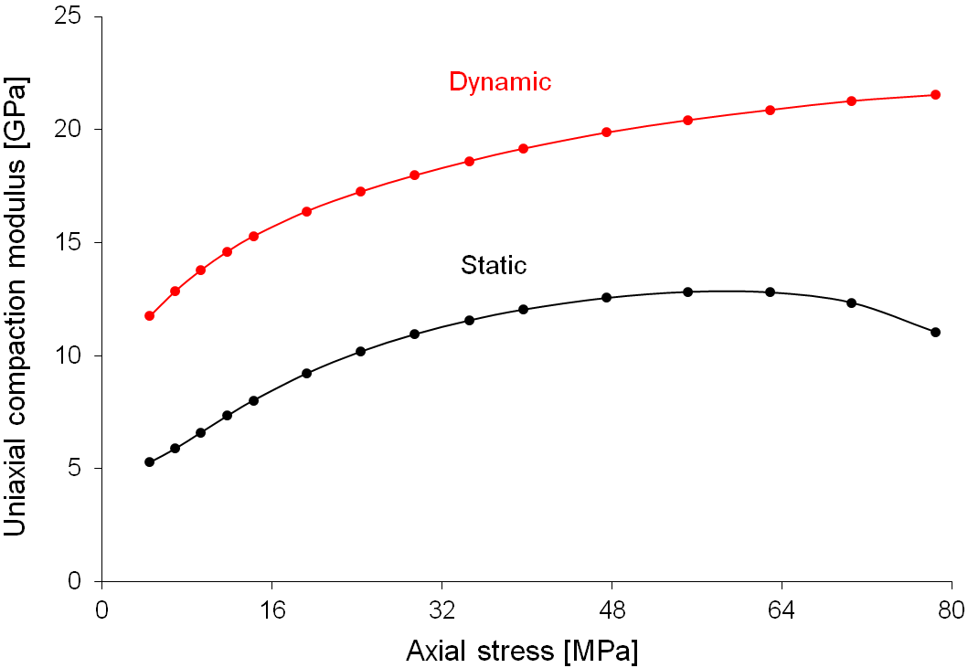
Difference between static and dynamic modulus
Difference can be explained to the processes activated in the rock structure under stress

Slide 4
Processes activated in the rock framework under stress (idealized examples):
Elastic processes
- Closing/opening of cracks (Fig. a)
Non-elastic processes
- Friction controlled shear sliding of internal surfaces in contact resulting in e.g. opening/closing of wing-cracks (Fig. b, c)
- Crushing of asperities at grain contacts or crack faces (Fig. d) - only during loading

Slide 5
Mechanic system:
Triaxial cell (MessTek)
Axial and radial stress
Axial and radial strain
Acoustic system:
Ultrasonic transducer
Single-sine pulse
Frequency 500 kHz
P- and S-wave
Waves propagate along the major external stress i.e. axial stress
Scheme of experimental system

Slide 6
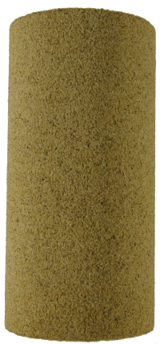
Samples:
Four rock samples have been tested
Two samples of Castlegate sandstone and two of Berea sandstone
Castlegate sandstone
Composition: 70% quartz, 30% feldspar and other rock fragments
No clay
Porosity ~ 26%
Berea sandstone
Composition: 80% quartz, 12% feldspar and other rock fragments
Clay ~ 8%
Porosity ~ 19%
All samples were dry
Samples prepared as cylindrical plugs, size about 1.5’’/3’’ (diameter/length)

Slide 7
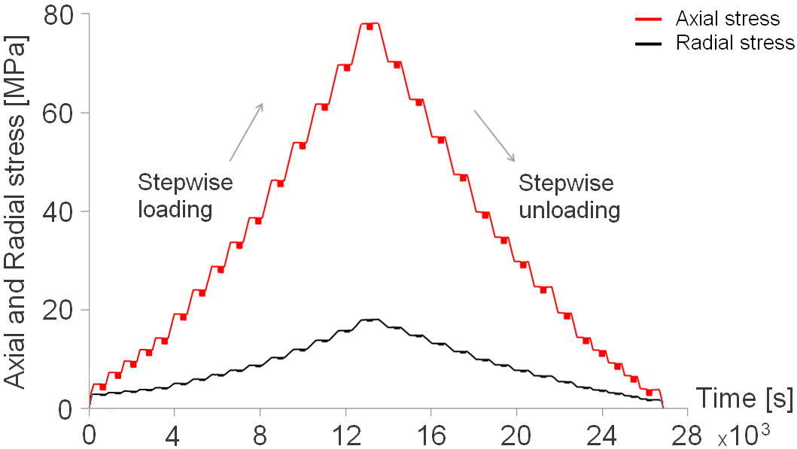
Stress path
Uniaxial compaction (K₀ mode) test
Stepwise stress change
Loading and unloading paths repeated twice

Slide 8
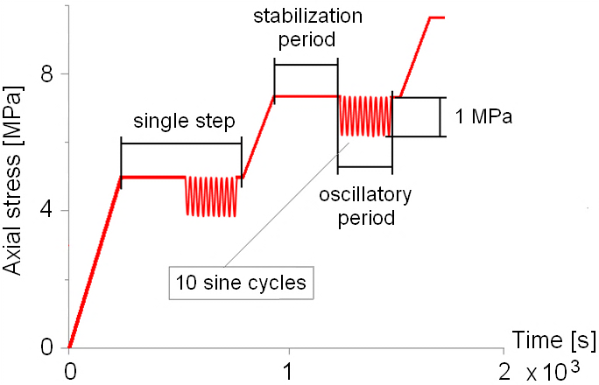
Stress path details
Stepwise path due to large-scale stress changes includes information about the elastic and non-elastic effects
Oscillatory periods that represent small-scale stress changes reveals information about the elastic effects only

Slide 9
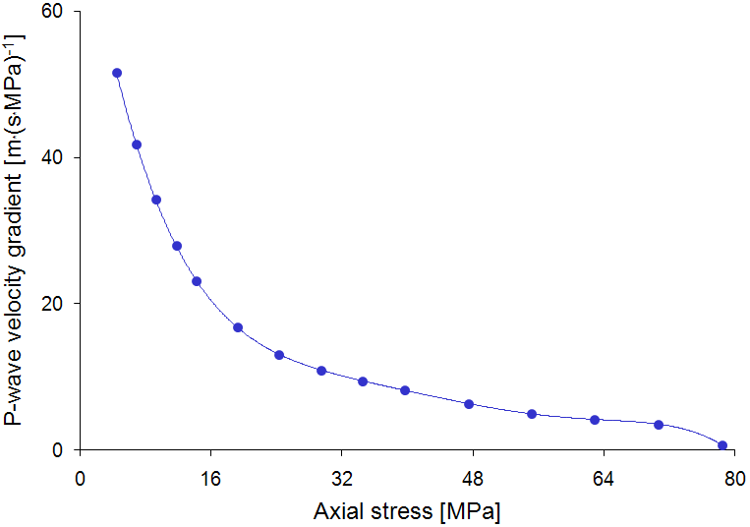
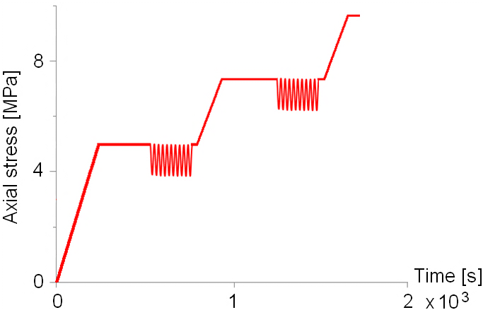
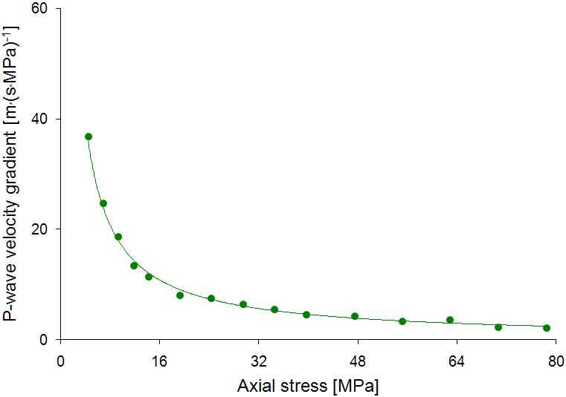
Velocity response on stress path
stepwise path (|^{slope})
elastic (e) and non-elastic (ne)
oscillations (|^{osc})
elastic (e)
Notes:
The stress-sensitivity of wave velocity decreases with increasing stress, but remains finite at high stresses.
The stress-sensitivity of wave velocity for the standard stepwise path is different (larger) than for the oscillatory periods, which. confirms that different processes are involved under this two stress conditions

Slide 10
stepwise path (|^{slope})
elastic (e) and non-elastic (ne)
oscillations (|^{osc})
elastic (e)
Notes:
The response of rock structural on stress can be represented by the stiffness-sensitivity (this allows to investigate how large influence on stiffness dependency on stress has the stress-sensitive velocity term compare to the stress-dependent density term).
* Same calculation procedure applies to share waves resulting in ΔC₄₄/Δσ_{z}

Slide 11
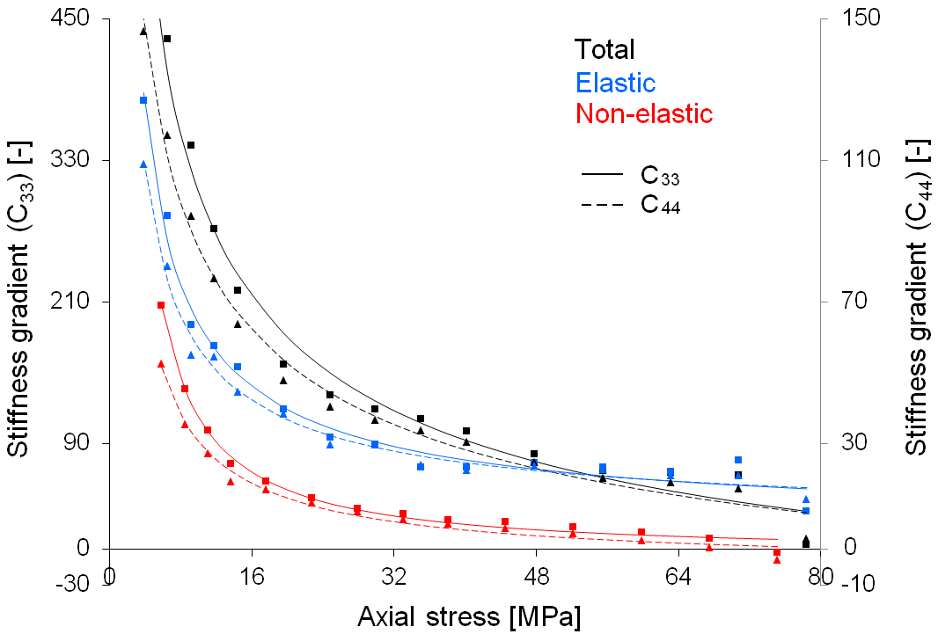
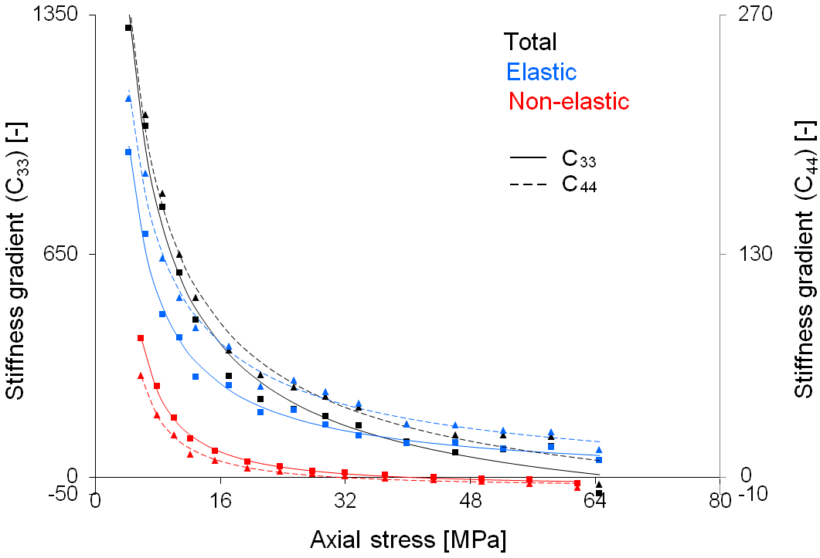
Castlegate sandstone
Berea sandstone
Notes:
Stiffness gradient for Berea is significantly higher (at least at the lower stress levels) than for Castlegate meaning that the Berea is more stress-sensitive, which reveal also in the velocity response on stress (velocity gradient of Berea is greater).
The general trend and organization of the characteristics is similar for both sandstones (stiffness gradients decrease with increasing stress). This means that the elastic and non-elastic contribution is very much alike for both rocks.
The stress dependence of wave velocities is mostly due an elastic process

Slide 12
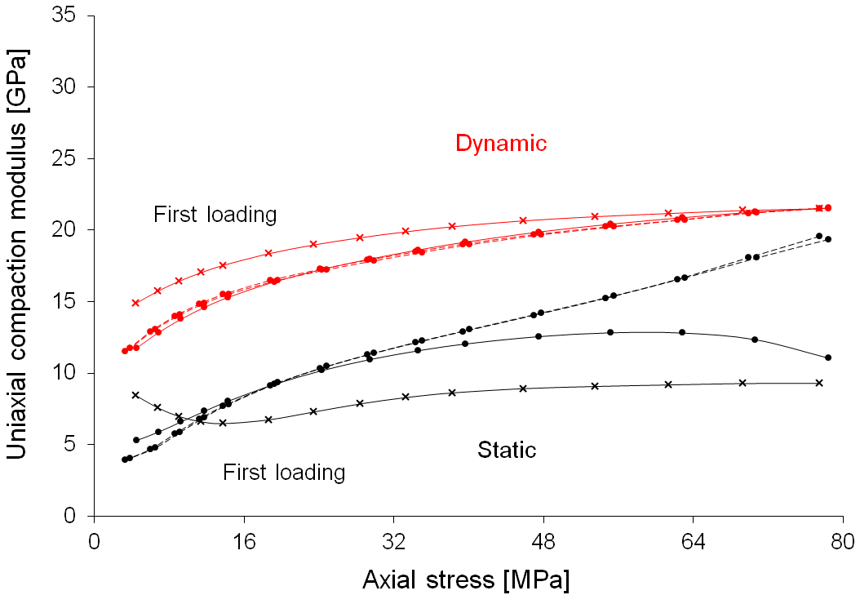
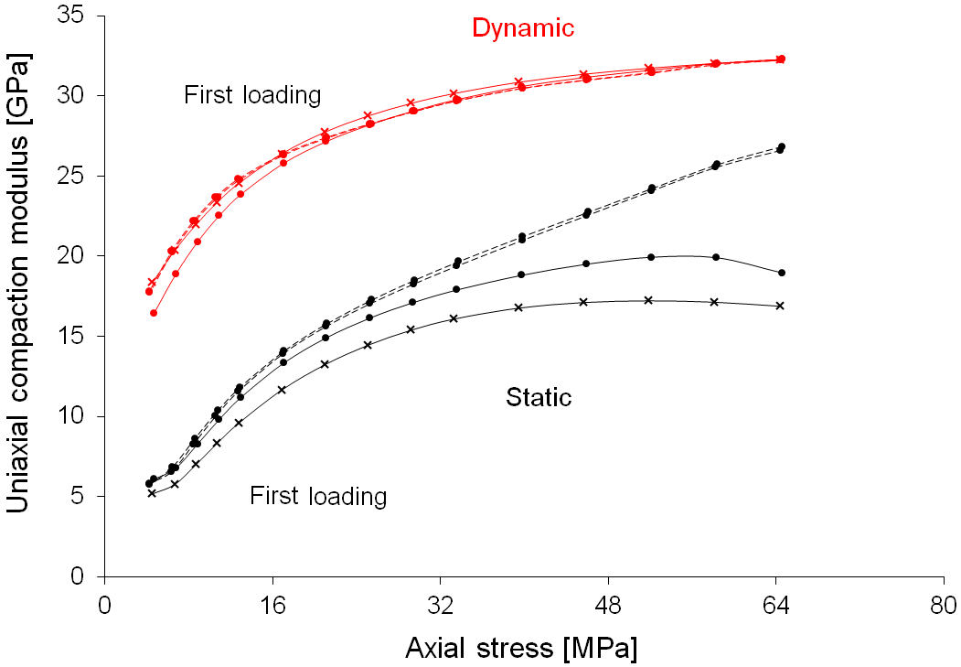
Uniaxial compaction
Castlegate sandstone
Berea sandstone
Static modulus
elastic (e) & non-elastic (ne) processes
Dynamic modulus
elastic (e) processes only
Notes:
The non-elastic compliance component S_{H} ^{ne}
Difference between static and dynamic modulus is ascribed to the non-elastic processes activated in the rock structure under stress
Uniaxial compaction moduli (both static and dynamic) are significantly larger for Berea than Castlegate sandstone which confirms that Berea is much stiffer sandstone (its porosity is about 7% lower)
There is a large difference between loading and unloading path, particularly visible for static modulus at high stress levels (here 2nd run is presented)
The non-elastic compliance decrease with increasing stress

Slide 13
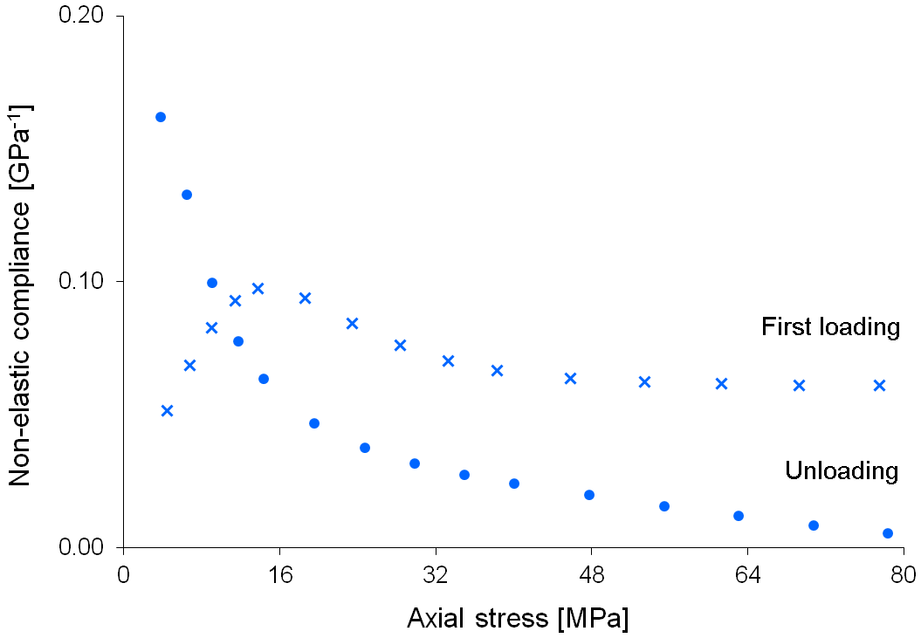
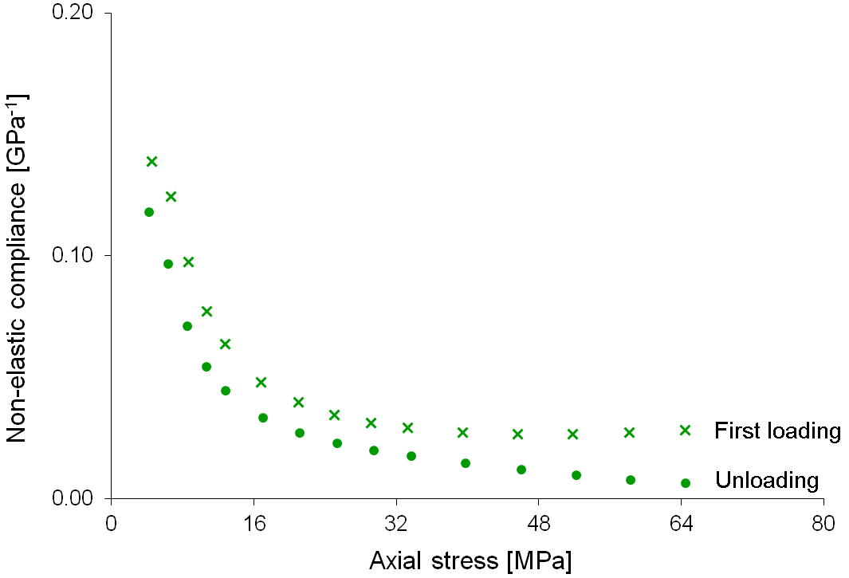
Uniaxial compaction
because
The non-elastic compliance component S_{H} ^{ne}
Castlegate sandstone
Berea sandstone

Slide 14
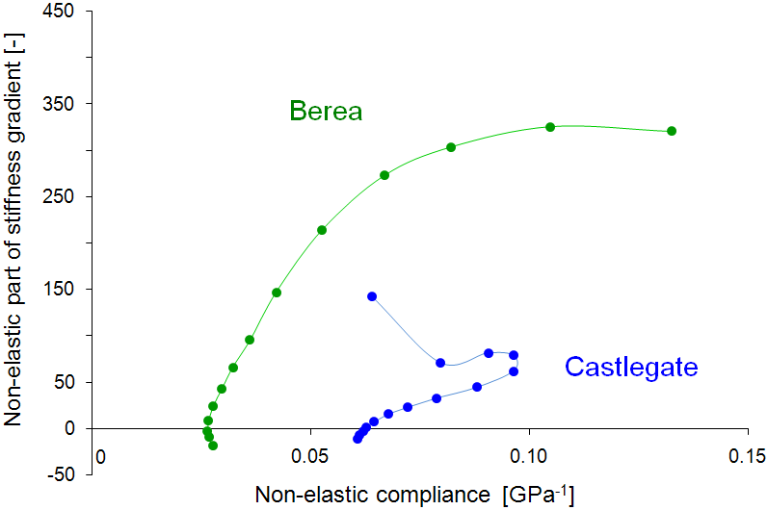
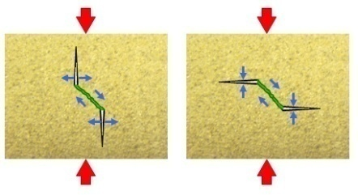
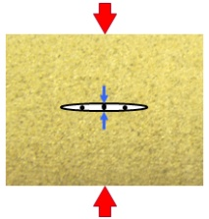
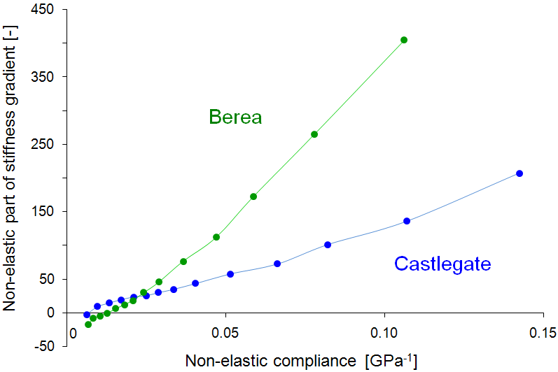
First loading
+
Unloading

Slide 15
Conclusions
The stress-dependence of elastic waves is caused mainly by an elastic process, however the non-elastic processes become increasingly important at higher stress levels
The difference between the static and the dynamic uniaxial compaction modulus can be ascribed to the same type of non-elastic effect during unloading
Castlegate and Berea sandstone show significantly different stress-sensitivity, which may be associated with structural differences

Slide 16
Acknowledgments

