Slide 1
Early detection of gas leakage using seismic data
Underground blowout in 1989 that lasted for a year
2/4-15
2/4-14
100
Time (ms)
800
7 km

Slide 2
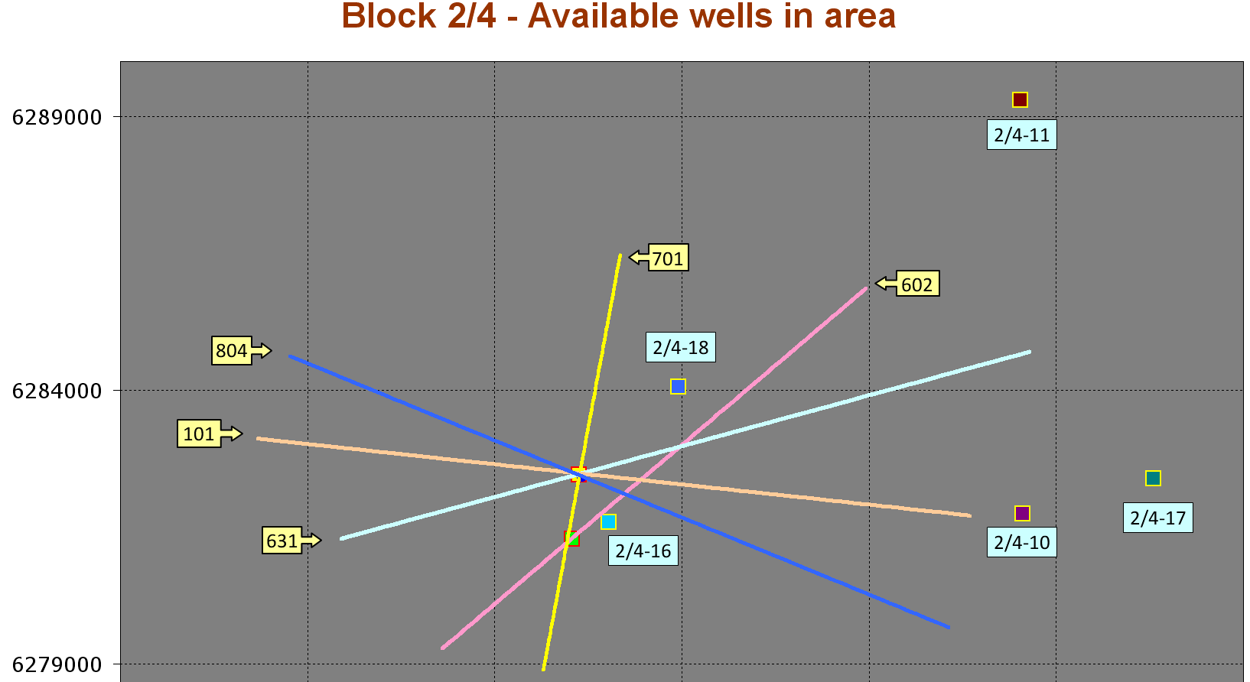
Repeated 2D lines acquired in 2009
2/4-14
2/4-15
In this study we will use brute stacks from 602 and 804

Slide 3
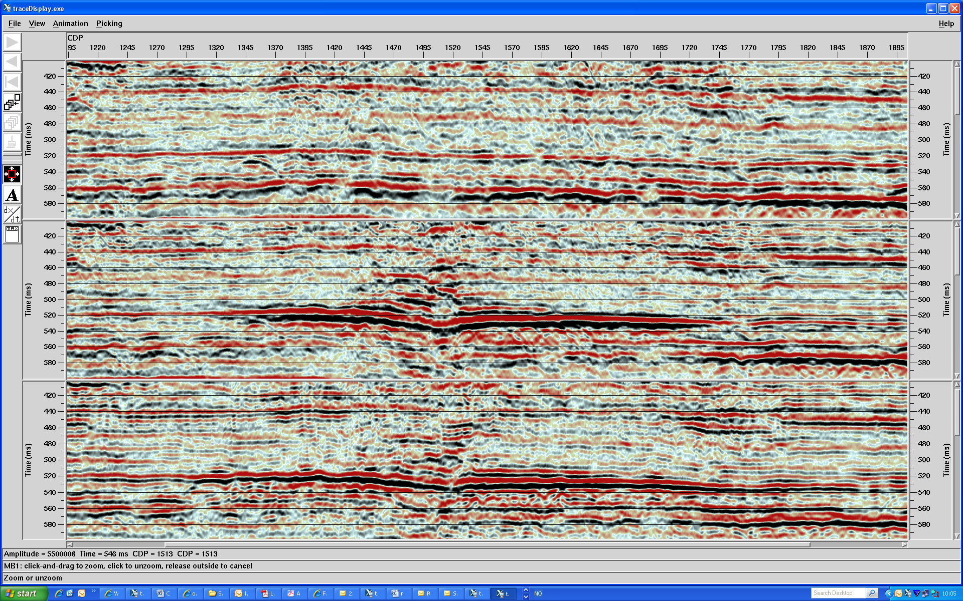
Brute stacks – line 804
SE
NW
2/4-14
1988
1990
520 ms anomaly
2009
Less pulldown in 2009 – slight increase in horizontal extention

Slide 4
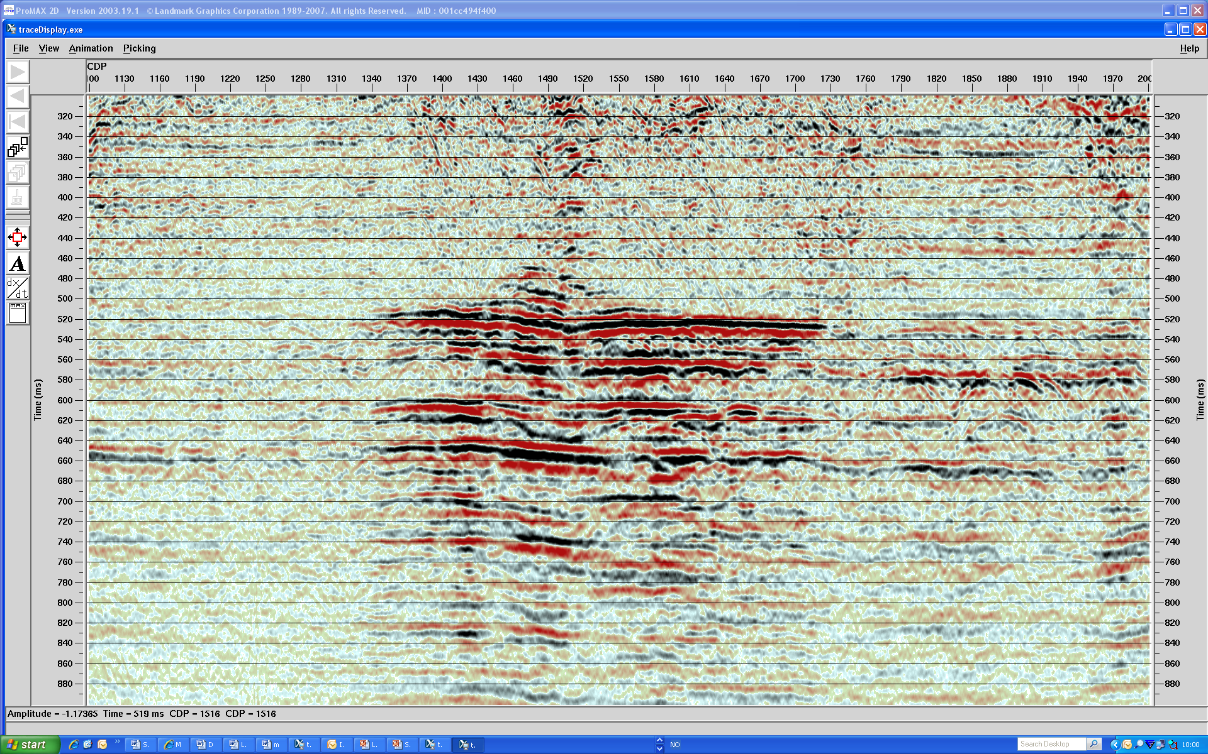
4D difference – line 804 1988-1990 after global scaling
Indications of vertical migration of gas close to the well?
2.4 km

Slide 5
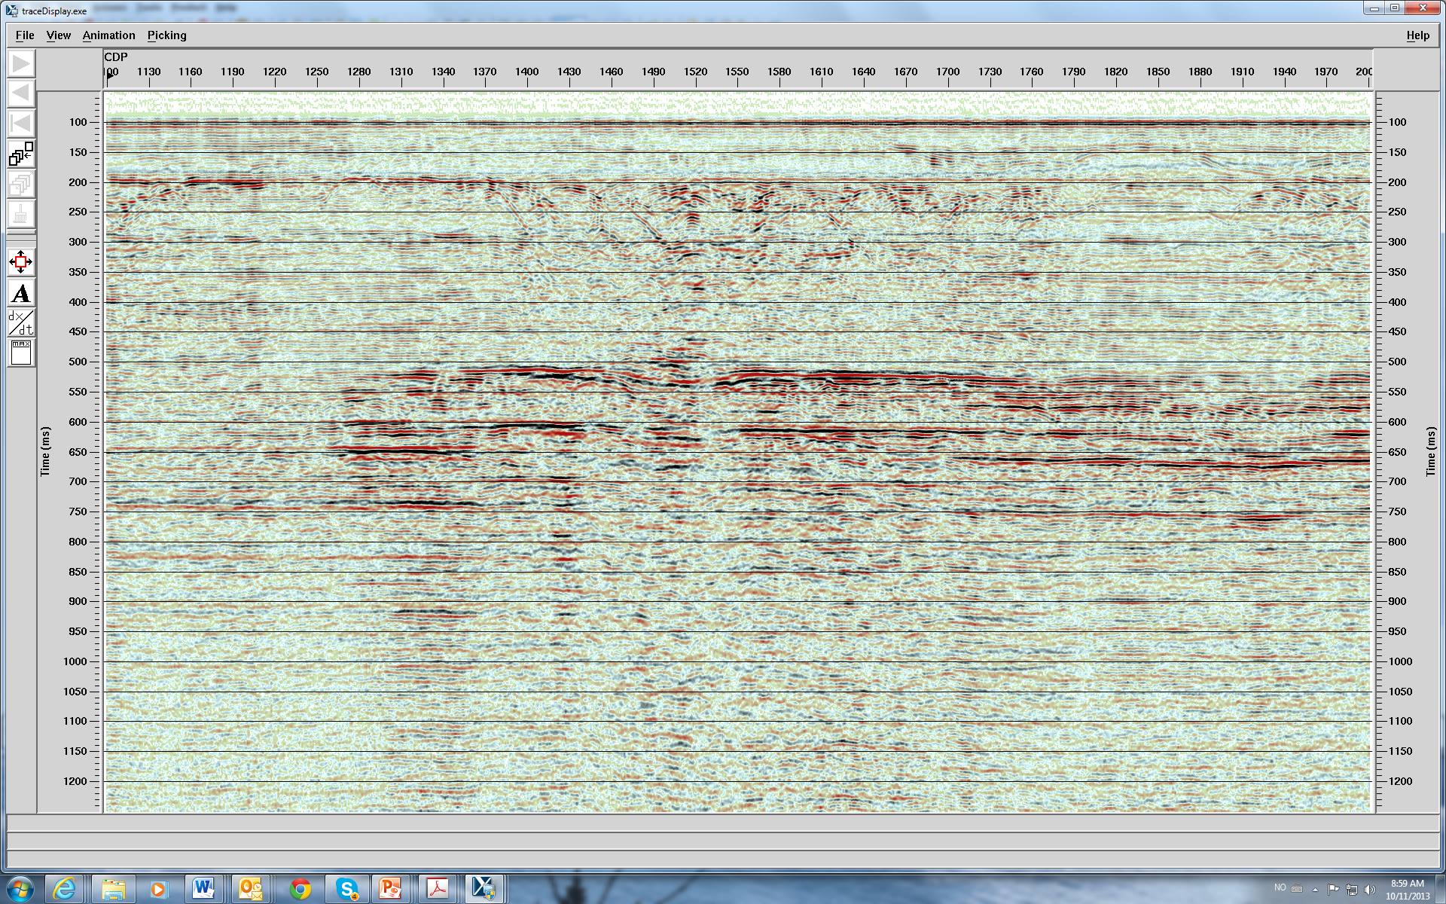
Line 804 difference between 2009 and 1990, difference is scaled by t^1.3
14

Slide 6
RMS amplitude map (504-560 ms window)
14
1.2 km
Viscous fingering?
15

Slide 7
4D differences at 492 August to October 1989
Blowout 20 Januar 1989
Sand layer charged between August and October 1989
3D seismic map of top sand in 1991:
1991
602
14
1.2 km
15
Notes:
This slide shows amplitude difference and modelled gas saturation in the upper sand in August 1989, and in October 1990.
We can see that the amplitude difference has increased with a factor of approximately 10, while the saturation in the layer only is doubled.
The gas saturation in the upper layer in August 1989 is not confirmed by seismic. It is therefore likely that the assumptions of constant leak of gas from the lower to the upper sand in the reservoir model is uncorrect.
This is an indication that the flow path upwards from the lower sand changed suddenly. This might be because of a build up of pressure which lead to fracturing and new migration paths.
To sum up, we have seen that in August 1989 there was no significant timeshifts together with no change in amplitude along the upper reflector and low gas saturation in the upper sand.
We also saw a large increase in amplitude difference along the lower reflector together with a high gas saturation in the lower sand.
In August and October 1990 the timeshifts are dominantly positive together with significant increase in amplitude along the upper reflector and increase in gas saturation in the upper sand. There is a match between the intervals where these three effects are observed.
The amplitude difference at the lower sand is damped compared to August 1989 together with slightly lower gas saturation in the lower sand and considerable gas saturation in the upper sand.

Slide 8
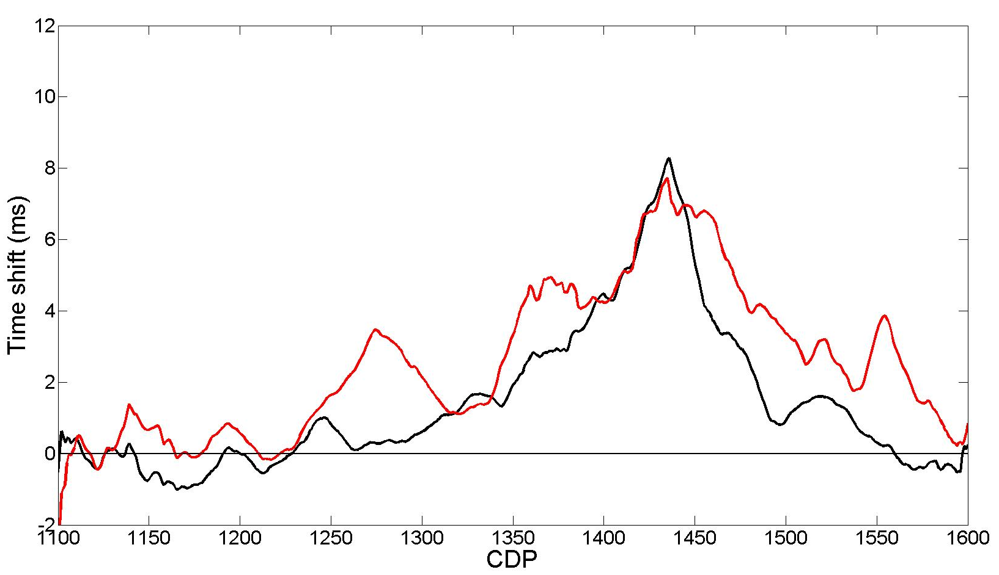
Smoothed timeshifts – line 602 (upper sand)
15
14
1991
14
15
2009
1990
Note: Significant time shift increase close to relief well between 1990 and 2009

Slide 9
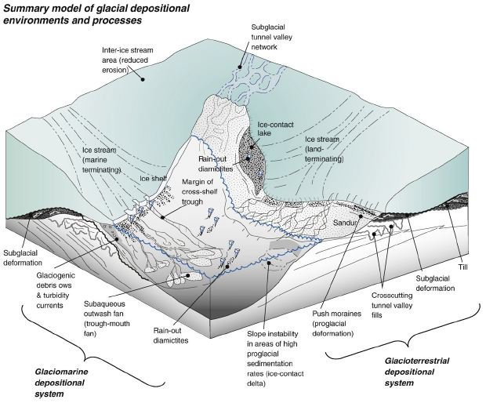
Tunnel valleys
Le Heron et al., 2009
Might store large volumes of gas (and CO₂) – and also serve as transport routes
Seismic interpretation of tunnel valleys close to the blow out well:

Slide 10
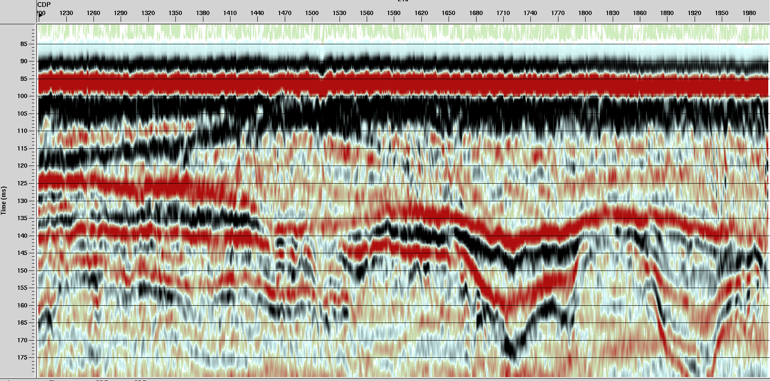
Line 804; 1990: 2/4-14 well is drilled in the middle of a shallow tunnel valley; 30 m below seabed
SE
NW
3 interpreted tunnel valleys shown by arrows marking the three depressions and subsequent erosion patterns below

Slide 11
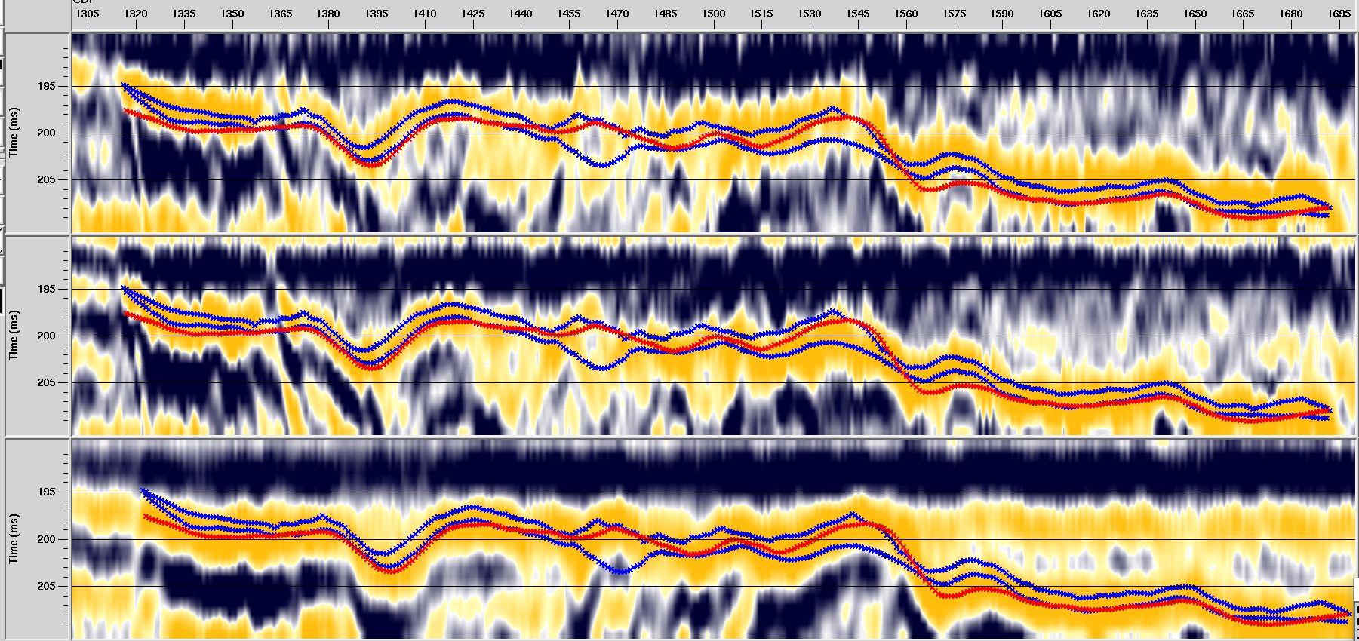
Line 804 – shallow timeshifts – indications of leakage patterns
Alignment of seabed reflection to 100 ms
Near to the well: significant increase in timeshift between 88 and 90 – followed by a reduction back to pre-blowout values again – 800 m width
Outside this region the situation is unchanged between 1990 and 2009
SE
NW
1988
2009
1988
1990
1990
800 m – tunnel valley
2009
2500 m

Slide 12
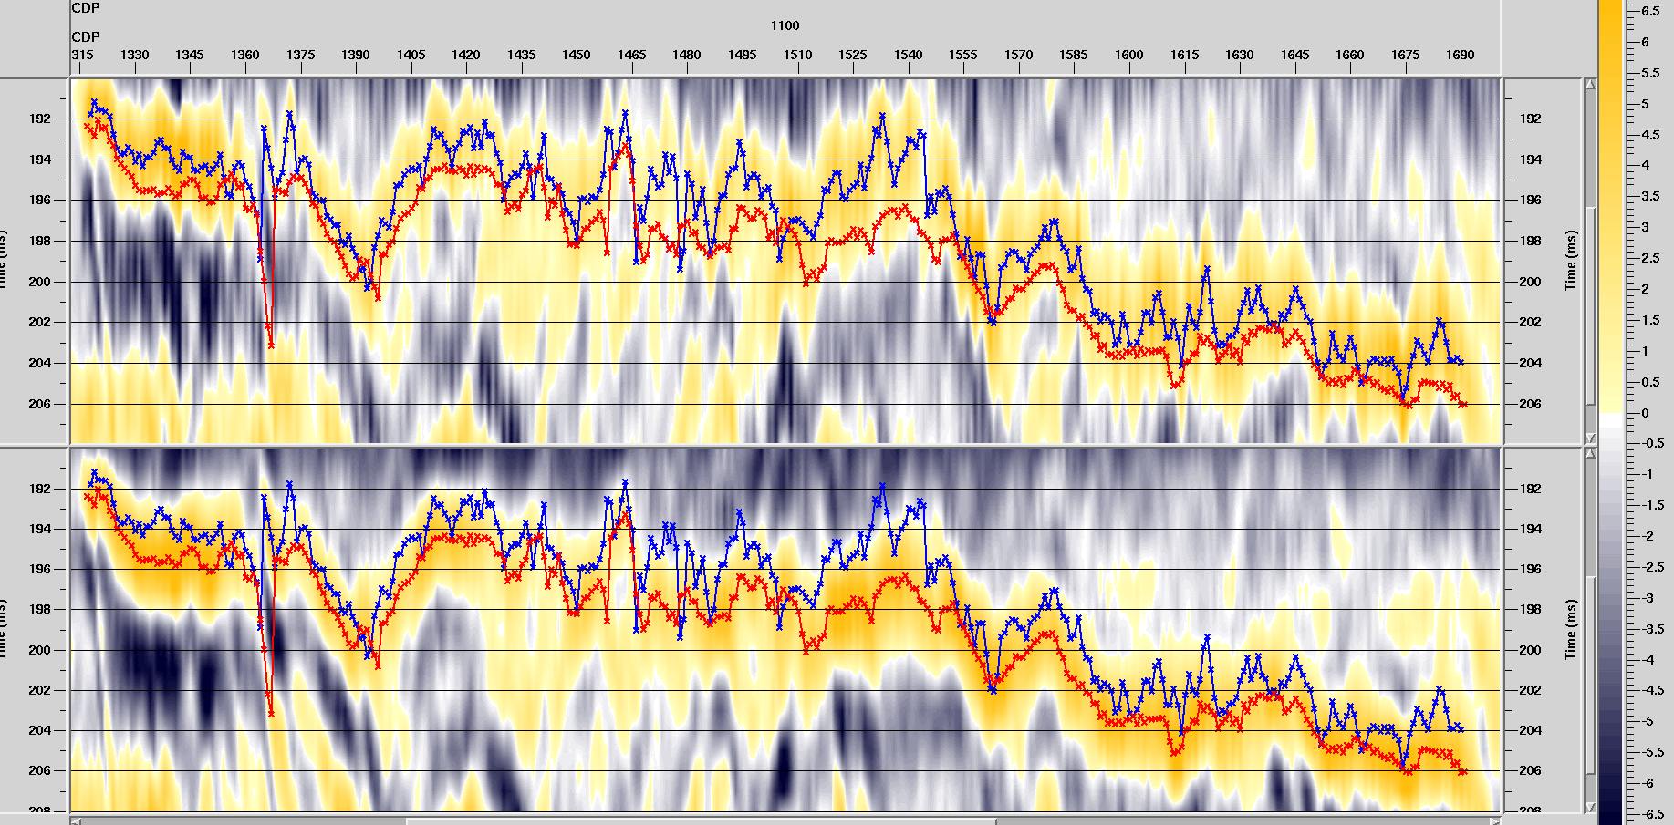
Line 804 1990-1988: estimated time shifts close to well
SE
NW

Slide 13
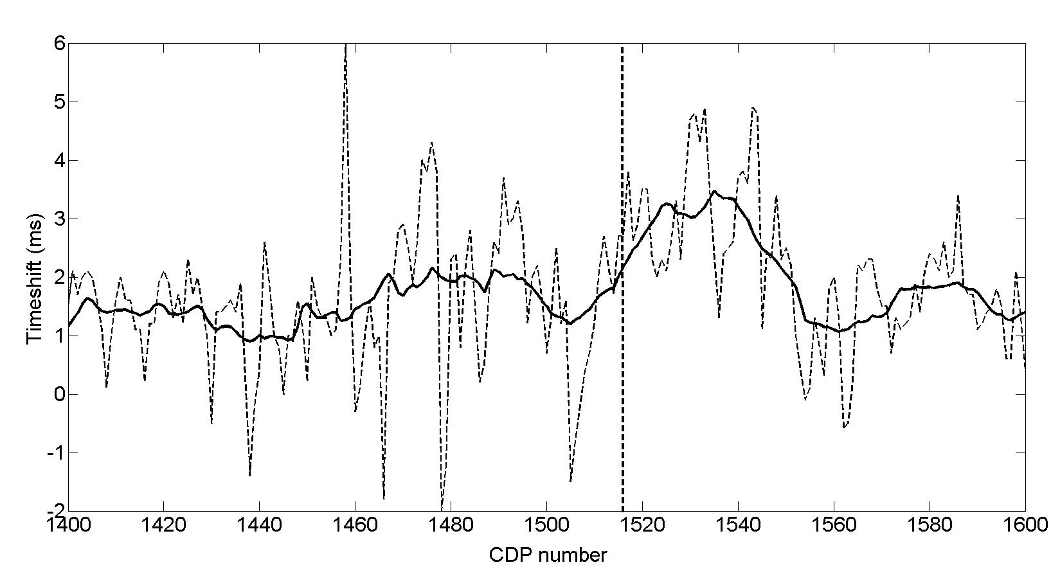
Line 804: 1988-1990 Time shift of 3-4 ms gradually decreasing away from well position
SE
NW

Slide 14
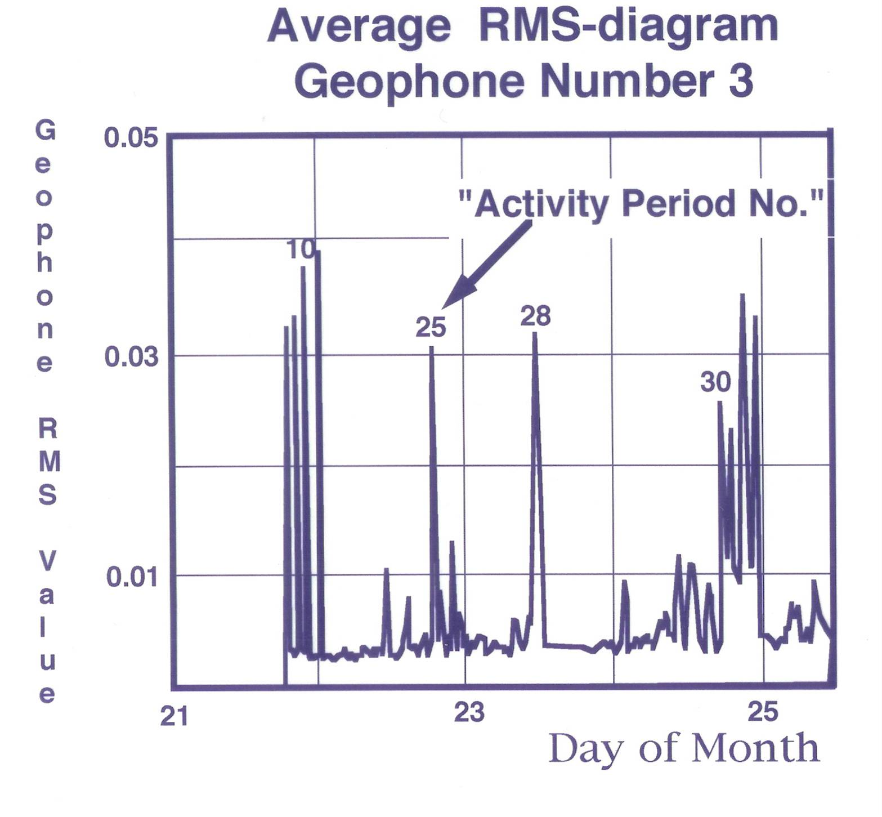
Monitoring of an uncontrolled gas flow by sea bottom seismic instruments – a North Sea case study;
K. A. Berteussen, K. Kolbjørnsen, D. A. Larsen and P. Kristiansen, Presented at the EAGE Dubai meeting 2006
Passive seismic recorded from 21 September to 3 October, 1989

Slide 15
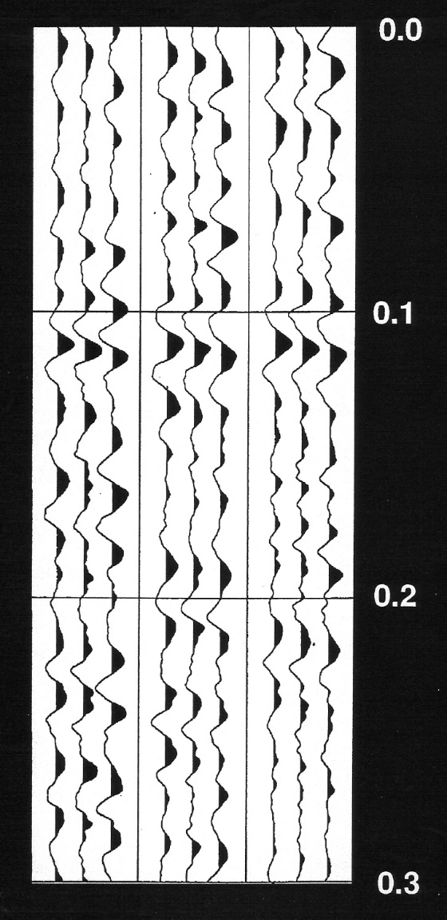
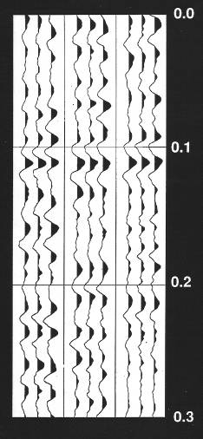
Passive Seismic Listening:
Acquisition geometry and example of seismic data from period 33
Raw Data Aligned Data
Well 2/4-14
1 2 3 1 2 3 1 2 3
1 2 3 1 2 3 1 2 3
+
North
Nedrill
Trigon
3
Safe
Britania
Time (seconds)
Geophones
1
2
Direction to the source for this seismic energy.

Slide 16
Event Location: The U/V Problem
Apparent Velocity
(m/sec)
(Angle of incidence in vertical plane)
Vertical Plane
1478
2500
5000
A
D
90 (deg) 0
90 (deg) 0
B
C
Tape 23, part of
Alternative 1
Horizontal
Event Migrations
B
C
A
D
Main
Energy
Release
Start &
Stop

Slide 17
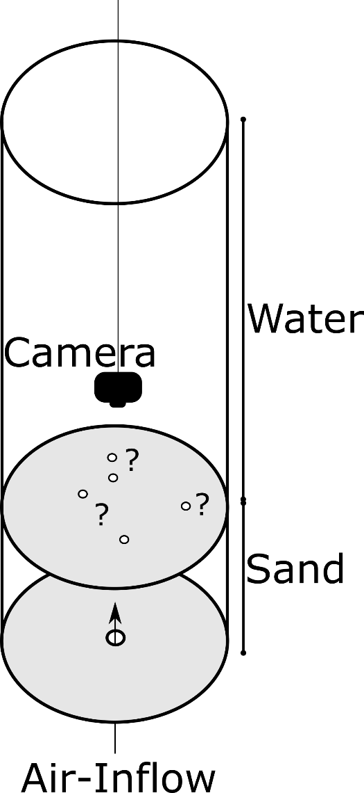
Sand tank experiment at NTNU
Average grain size:
130 μm
Diameter of cylinder:
0.3 m
Sand layer thickness:
0.25 m
Outlet air opening at bottom:
0.4 mm
Sedimentation time:
7 days

Slide 19
Duration: Typically 5-30 seconds

Slide 20
Simple passive seismic model for U-event: Dipping, overpressured gas fracture
1
Main
Energy
Release
3
Start &
Stop
Opening the fracture: Decreasing effective pressure (increased gas pressure)
Building a local bulb at the structural high end of the fracture => changing effective pressure until the bubble is released by vertical leakage
Closing the fracture: Increasing effective pressure along the fracture path

Slide 21
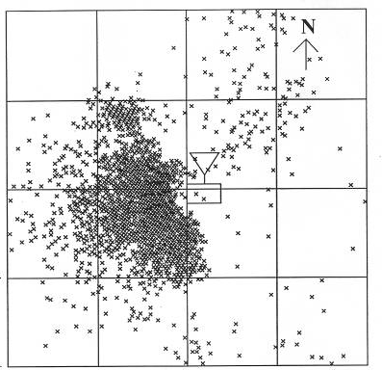
Event location (September 1989) assuming source at 492 m and 250 m
Estimated timeshifts at approximately 200 m depth
150 m
SE
NW
1990-1988
0
150 m
-500
0
500
-250
Distance (m)
250
If we assume shallower source depth (half for instance) the horizontal scale will change from +/- 500 m to +-250 m

Slide 22
Sand tank experiment and leakage at 2/4-14 well
Similar structures in laboratory and field
How could we measure leakages?

Slide 23
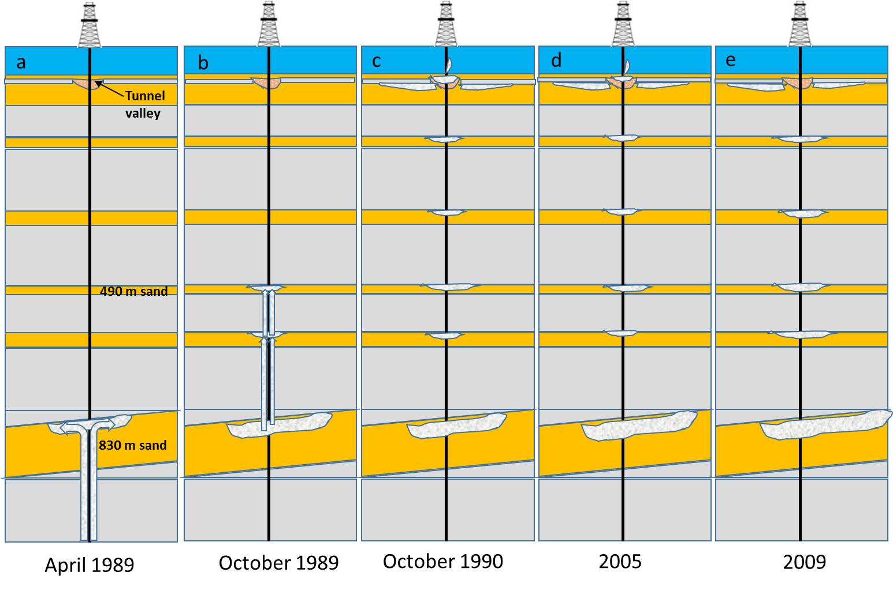

Slide 24
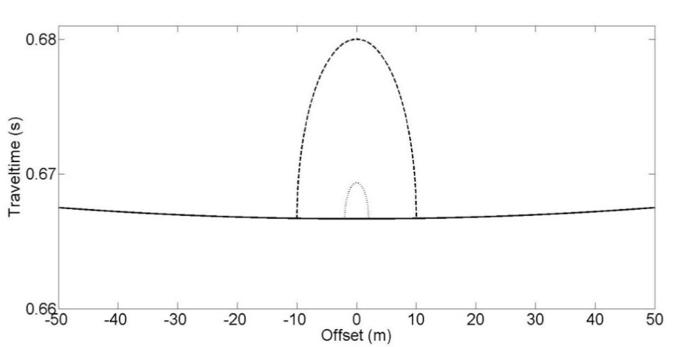
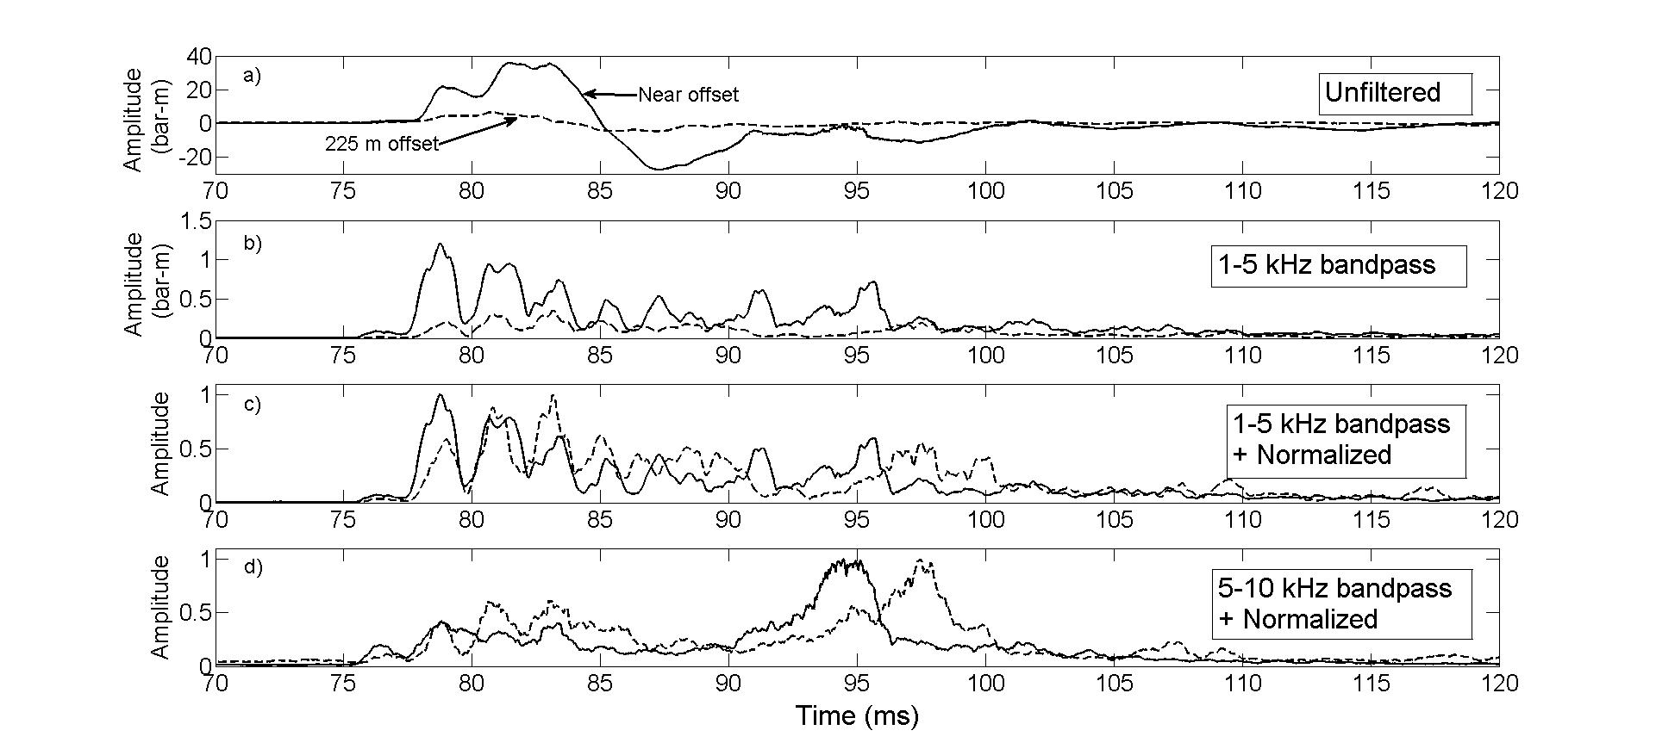
Detecting gas leakage at the seabed
Landrø, Hansteen and Amundsen, Geophysics, 2017
Intersects of pairs with 0.25% increase in traveltime
5 m
No chimney
1 m
Measured signals for various frequency ranges and offsets

Slide 25
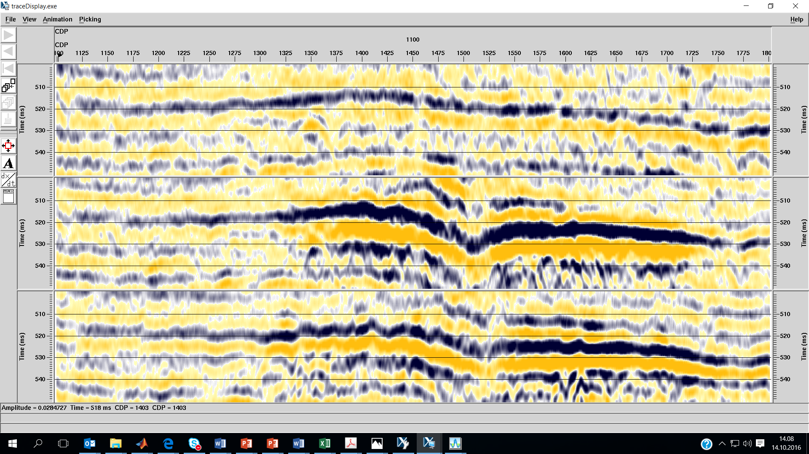
Line 804 – development from 1988 (pre-blowout) to 2009 : 12 ms pulldown in 1990 and 7 ms in 2009
1988
1990
2009

