Slide 1
Spatial reservoir characterization using the dilation factor α
Kenneth Duffaut
(Interpretation of Geophysical Data (IGD))
Faculty of Engineering Science and Technology
Department of Petroleum Engineering
and Applied Geophysics
RoSe meeting, Trondheim, 28th April, 2015

Slide 2
Outline
Introduction
Spatial traveltime analysis - a new application?
Geological scenarios and numerical examples
Conclusions

Slide 3
Introduction 4D or time-lapse traveltime analysis
$$t_{0}\left(x_{0}\right)=\frac{2z\left(x_{0}\right)}{v_{p0}\left(x_{0}\right)}$$
t₀ = two-way vertical time thickness of unit
x₀ = coordinate position along a line
z = thickness of formation unit
v_{p0} = vertical P-wave velocity of unit
Δ = changes in physical parameters
α and R = ratio between relative velocity
and thickness changes
$\frac{Δt_{0}\left(x_{0}\right)}{t_{0}\left(x_{0}\right)} ≈\frac{Δz\left(x_{0}\right)}{z\left(x_{0}\right)}$ - $\frac{Δv_{p0}\left(x_{0}\right)}{v_{p0}\left(x_{0}\right)}$
(Landrø and Stammeijer 2004)
$$\frac{Δv_{p0}\left(x_{0}\right)}{v_{p0}\left(x_{0}\right)}=α\frac{Δz\left(x_{0}\right)}{z\left(x_{0}\right)}$$
x₀
(Røste et al., 2005)
Layer unit
v_{p0}(x₀)
z(x₀)
$$\frac{Δv_{p0}\left(x_{0}\right)}{v_{p0}\left(x_{0}\right)}=−R\frac{Δz\left(x_{0}\right)}{z\left(x_{0}\right)}$$
(Hatchell et al., 2005)
Assuming uniaxial deformation

Slide 4
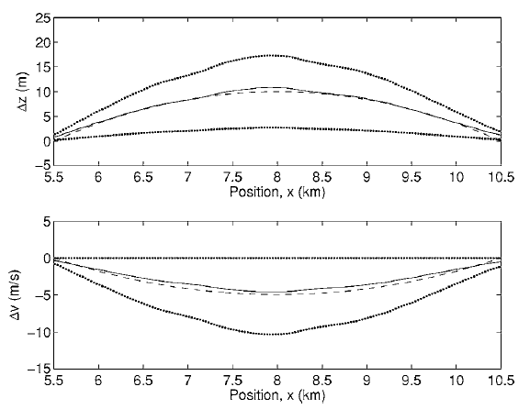
Introduction Relative changes in layer thickness and velocity
Optimal α = -0.6 for all lateral positions
$$\frac{Δz\left(x_{0}\right)}{z\left(x_{0}\right)}=\frac{1}{\left(1−α\right)}\frac{Δt_{0}\left(x_{0}\right)}{t_{0}\left(x_{0}\right)}$$
$$\frac{Δv_{p0}\left(x_{0}\right)}{v_{p0}\left(x_{0}\right)}=\frac{α}{\left(1−α\right)}\frac{Δt_{0}\left(x_{0}\right)}{t_{0}\left(x_{0}\right)}$$
α = -0.6
(Figure courtesy: Røste et al., 2006)

Slide 5
Spatial zero offset traveltime analysis
$$t_{0}\left(x_{0}\right)=\frac{2z\left(x_{0}\right)}{v_{p0}\left(x_{0}\right)}$$
t₀ = two-way vertical time thickness of unit at x₀
x₀ = coordinate reference position along a line
x₁ = a new coordinate position along the line
z = thickness of formation unit
v_{p0} = vertical P-wave velocity of unit
Δ = spatial difference in physical parameters
α = Dilation factor
$\frac{Δt_{0}\left({x_{1},x}_{0}\right)}{t_{0}\left(x_{0}\right)} ≈\frac{Δz\left({x_{1},x}_{0}\right)}{z\left(x_{0}\right)}$ - $\frac{Δv_{p0}\left({x_{1},x}_{0}\right)}{v_{p0}\left(x_{0}\right)}$
$$\frac{Δv_{p0}\left({x_{1},x}_{0}\right)}{v_{p0}\left(x_{0}\right)}=α\left(x_{0}\right)\frac{Δz\left({x_{1},x}_{0}\right)}{z\left(x_{0}\right)}$$
x₀
x₁
Layer unit
v_{p0}(x₀)
z(x₀)
v_{p0}(x₁)=?
z(x₁)=?
Assuming uniaxial deformation

Slide 6
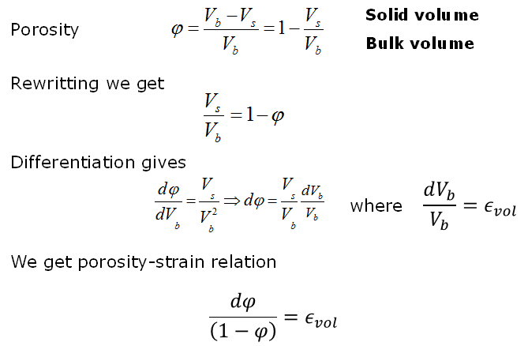
Porosity-strain relation Assume only changes in pore volume

Slide 7
Spatial varying layer thickness and velocity Relative changes in layer thickness and velocity
$$\frac{Δz\left(x_{1,}x_{0}\right)}{z\left(x_{0}\right)}=\frac{1}{\left(1−α\left(x_{0}\right)\right)}\frac{Δt_{0}\left(x_{1,}x_{0}\right)}{t_{0}\left(x_{1,}x_{0}\right)}$$
$$\frac{Δv_{p0}\left(x_{1,}x_{0}\right)}{v_{p0}\left(x_{0}\right)}=\frac{α\left(x_{0}\right)}{\left(1−α\left(x_{0}\right)\right)}\frac{Δt_{0}\left(x_{1,}x_{0}\right)}{t_{0}\left(x_{1,}x_{0}\right)}$$
$$\frac{Δv_{p0}\left({x_{1},x}_{0}\right)}{v_{p0}\left(x_{0}\right)}=α\left(x_{0}\right)\frac{Δφ\left({x_{1},x}_{0}\right)}{\left(1−φ\left(x_{0}\right)\right)}$$

Slide 8
Dilation factor in clean and shaly sandstone Uniaxial deformation
Clean sandstone
Clay-rich sandstone
$$v_{p0}=a−bφ$$
$$v_{p0}=a−bφ−cv_{cl}$$
$$\frac{dφ}{\left(1−φ\right)}=\frac{dz}{z}$$
$α=\frac{\left(φ−1\right)b}{v_{p0}}$
(Carcione et al., 2007)
$$\frac{Δφ}{\left(1−φ\right)}=\frac{1}{α}\frac{Δv_{p0}}{v_{p0}}$$
$α=\frac{\left(a−b\right)}{v_{p0}}−1$
(Røste et al., 2006)
(Coefficients from Han, 1986)
α decreases with decreasing porosity

Slide 9
Dilation factor vs. stress Clean and clay-rich sandstone
(Coefficients from Han, 1986)
α decreases with increasing net stress

Slide 10
Dilation factor vs. volume of clay
(Coefficients from Han, 1986)
α decreases with decreasing clay content

Slide 11
Geological scenarios - numerical examples
Plausible geological reasons causing spatially variation in layer thickness and velocity in a unit
Equal depositional layer thickness followed by ‘’differential compaction’’ or diagenetic effects within a formation unit
Erosion
Lithology changes
clean vs. shaly sandstone
Assume net stress = 40 MPa in all three cases

Slide 12
Spatial porosity and thickness change within unit Differential compaction of clean sandstone
x₀ location with a well
x₁ location without a well
ϕ = 24%
Z = 33m
ϕ = 20%
Z = 31m
$$v_{p0}\left(x_{0}\right)=6.08−8.06∗0.24\sim 4146m/s$$
$$v_{p0}\left(x_{1}\right)=6.08−8.06∗0.20=4468m/s$$
$$t_{0}\left(x_{0}\right)=\frac{2z\left(x_{0}\right)}{V_{p0}\left(x_{0}\right)}$$
$$t_{0}\left(x_{0}\right)=\frac{66m}{4146m/s}≈0.01592s$$
$$t_{o}\left(x_{1}\right)=\frac{62m}{4468m/s}≈0.01388s$$
$α_{0}=\frac{\left(a−b\right)}{v_{p0}}−1=\frac{\left(6.08−8.06\right)}{4.146}−1≈−1.48$

Slide 13
Estimates of layer thickness and velocity at new location Case: Differential compaction
Layer thickness estimate at x₁ location:
$$\frac{Δz\left(x_{1,}x_{0}\right)}{z\left(x_{0}\right)}=\frac{1}{2.48}\frac{\left(0.01388−0.01592\right)}{\left(0.01592\right)}≈−0.0517$$
$$\tilde{z}\left(x_{1}\right)=z\left(x_{0}\right)+Δz\left(x_{1,}x_{0}\right)=33 m−1.71m≈31.3m$$
Correct $z\left(x_{1}\right)=31m$
Velocity estimate at x₁ location:
$$\frac{Δv_{p0}\left(x_{1,}x_{0}\right)}{v_{p0}\left(x_{0}\right)}=\frac{−1.48}{2.48}\frac{\left(0.01388−0.01592\right)}{\left(0.01592\right)}≈0.07647$$
$${\tilde{v}}_{p0}\left(x_{1}\right)=v_{p0}\left(x_{0}\right)+Δv_{p0}\left(x_{1,}x_{0}\right)=4146+317=4463m/s$$
Correct $v_{p0} \left(x_{1}\right)=4468m/s$

Slide 14
Spatially varying layer thickness Erosion of a clean sandstone unit
x₀ location with a well
x₁ location without a well
ϕ = 24%
Z = 33m
ϕ = 24%
Z = 23m
$$v_{p0}\left(x_{0}\right)=6.08−8.06∗0.24\sim 4146m/s$$
$$v_{p0}\left(x_{1}\right)=6.08−8.06∗0.24=4146m/s$$
$$t_{0}\left(x_{0}\right)=\frac{2z\left(x_{0}\right)}{V_{p0}\left(x_{0}\right)}$$
$$t_{0}\left(x_{0}\right)=\frac{66m}{4146m/s}≈0.01592s$$
$$t_{o}\left(x_{1}\right)=\frac{46m}{4146m/s}≈0.01110s$$
$α_{0}=\frac{\left(a−b\right)}{v_{p0}}−1=\frac{\left(6.08−8.06\right)}{4.146}−1≈−1.48$

Slide 15
Estimates of layer thickness and velocity at new location Case: Erosion
Layer thickness and porosity estimate at x₁ location:
$$\frac{Δz\left(x_{1,}x_{0}\right)}{z\left(x_{0}\right)}=\frac{1}{2.48}\frac{\left(0.01110−0.01592\right)}{\left(0.01592\right)}≈−0.12221$$
$$\tilde{z}\left(x_{1}\right)=z\left(x_{0}\right)+Δz\left(x_{1,}x_{0}\right)=33m−4m=29m$$
Correct $z\left(x_{1}\right)=23m$
Velocity estimate at x₁ location:
$$\frac{Δv_{p0}\left(x_{1,}x_{0}\right)}{v_{p0}\left(x_{0}\right)}=\frac{−1.48}{2.48}\frac{\left(0.01110−0.01592\right)}{\left(0.01592\right)}≈0.1809$$
$${\tilde{v}}_{p0}\left(x_{1}\right)=v_{p0}\left(x_{0}\right)+Δv_{p0}\left(x_{1,}x_{0}\right)=4146m/s+750m/s=3396m/s$$
Correct $v_{p0} \left(x_{1}\right)=4146m/s$

Slide 16
Spatial varying lithology clean vs. shaly sandstone unit
x₀ location with a well
x₁ location without a well
ϕ = 24%
Z = 33m
ϕ = 12.5%
Z = 28m
Vcl = 30%
$$v_{p0}\left(x_{0}\right)=6.08−8.06∗0.24\sim 4146m/s$$
$$v_{p0}\left(x_{1}\right)=5.59−6.93∗0.125 −2.18∗0.30=4070m/s$$
$$t_{0}\left(x_{0}\right)=\frac{2z\left(x_{0}\right)}{V_{p0}\left(x_{0}\right)}$$
$$t_{0}\left(x_{0}\right)=\frac{66m}{4146m/s}≈0.01592s$$
$$t_{o}\left(x_{1}\right)=\frac{56m}{4070m/s}≈0.01376s$$
$α_{0}=\frac{\left(a−b\right)}{v_{p0}}−1=\frac{\left(6.08−8.06\right)}{4.146}−1≈−1.48$

Slide 17
Estimates of layer thickness and velocity at new location Case: Lithological change
Layer thickness and porosity estimate at x₁ location:
$$\frac{Δz\left(x_{1,}x_{0}\right)}{z\left(x_{0}\right)}=\frac{1}{2.48}\frac{\left(0.01376−0.01592\right)}{\left(0.01592\right)}≈−0.0547$$
$$\tilde{z}\left(x_{1}\right)=z\left(x_{0}\right)+Δz\left(x_{1,}x_{0}\right)=33m−1.8m≈31.2m$$
Correct $z\left(x_{1}\right)=28m$
Velocity estimate at x₁ location:
$$\frac{Δv_{p0}\left(x_{1,}x_{0}\right)}{v_{p0}\left(x_{0}\right)}=\frac{−1.48}{2.48}\frac{\left(0.01376−0.01592\right)}{\left(0.01592\right)}≈0.081$$
$${\tilde{v}}_{p0} \left(x_{1}\right)=v_{p0}\left(x_{0}\right)+Δv_{p0}\left(x_{1,}x_{0}\right)=4146m/s+336m/s≈4482m/s$$
Correct $v_{p0} \left(x_{1}\right)=4069m/s$

Slide 18
Conclusions
New approach tested by estimating relative changes in layer thickness and velocity using the dilation factor (α) and spatially traveltimes differences of a unit
A few numerical examples are shown.
Only the ‘’differential compaction’’ case gave good estimates of laterally variable layer thickness (porosity) and velocity
Method depends on
reference location
porosity-strain relation of the unit
α is not constant when assuming Han’s model. It decreases as
Porosity decreases (clean and shaly sandstones)
Clay content decreases
Net stress increases (shaly sandstone)

Slide 19
Acknowledge
Thomas Røste for discussions
RoSe for giving me the opportunity to present

Slide 20
Thank you for your attention

