Slide 1
Drift and attenuation on the NCS:
A new look at an old approach
Andrew J. Carter², Veronica Torres Caceres¹,
Kenneth Duffaut¹, Alexey Stovas¹.
¹NTNU, ²Unemployed.
Notes:
I'm going to show you some work we've done using publicly available well data to look at what we think are systematic variations in checkshot drift at wells in the Northern North Sea and the Barents Sea, and trying to understand them under some assumptions that might relate checkshot drift to seismic attenuation.
This is not a new approach, but we've made some observations which we think are interesting.
Some of you may disagree strongly with some of our assumptions or method. If you want to debunk what we've done, please wait until the end, so that everyone else can at least see what we've done.

Slide 2
Outline
Introduction
About our study
Method: Example wells
Assumptions
Results and interpretation
Next steps
Notes:
First, I'll say what I mean by checkshot drift and seismic attenuation and why we want to map variations in seismic attenuation and better understand it.
Then, I'll give an overview of our study.
Then, I'll show you the standardised method we used on all our wells using two example wells.
Then go through some of the assumptions implied by the use of this approach;
Finally we'll take a look at our results, say a bit about our initial interpretation, and about what we want to do next.

Slide 3
Introduction
About our study
Method: Example wells
Assumptions
Results and interpretation
Next steps
Notes:
Just a placemarker to help people see where we are in the presentation – there is one of these slides at each main point in the introduction.

Slide 4
Why map seismic attenuation?
Bandwidth reduction and phase distortion vs. depth
Due to absorption and other effects
Reduced image interpretability and resolution
Potential:
Better correction of images and AVO
Better understanding => attenuation prediction
Sensitivities – find anomalies (?)
Notes:
I don't have time to go into much detail here, but basically, seismic attenuation affects every single seismic survey acquired, some more obviously than others.
Both elastic factors such as scattering and anelastic attenuation can preferentially remove high frequencies, and this reduces the interpretability, accuracy, and resolution of seismic images.
If we assume for the moment that we can estimate the elastic part of the attenuation via modelling, then better attenuation models give us the potential to improve images and improve AVO analysis
It's important that we link work on understanding the causes of attenuation to what we observe on seismic data. This may allow prediction of attenuation from quantities that are easier to measure, as all attenuation measurements suffer from a trade-off between resolution and accuracy.
Attenuation at seismic frequencies and scales is likely sensitive to overpressure, presence of gas, permeability, fracturing, clay content and other subsurface properties and conditions. It's almost sensitive to too much! We need better understanding to use these sensitivities.

Slide 5
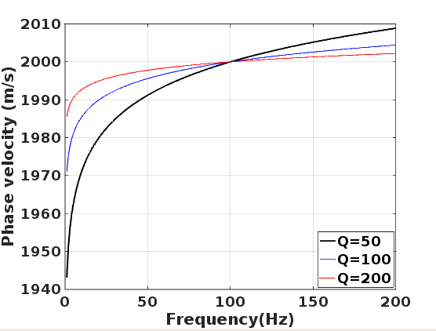
Seismic attenuation and dispersion
For causal linear wave propagation absorption
requires frequency-dependent velocity,
e.g.:
Kolsky-Futterman (NCQ) attenuation model (Kolsky(1953); Futterman(1962))
Notes:
A common way to quantify anelastic attenuation is using 1/Q. 1/Q is proportional to the fractional energy loss per cycle. All of my formulae here, BTW, are approximations for Q>10 or so.
If Q is independent of frequency over the seismic bandwidth, then this kind of model results in an exponential attenuation of high frequencies.
It can be shown that, assuming linear and causal wave propagation, anelastic attenuation results in frequency-dependence of velocity. The lower equation shows approximately how the phase velocity varies as a function of frequency if Q is nearly independent of frequency.
CLICK
The graph shows an example the form of the variation of the velocity with frequency, which I will just call seismic dispersion from here on.

Slide 6
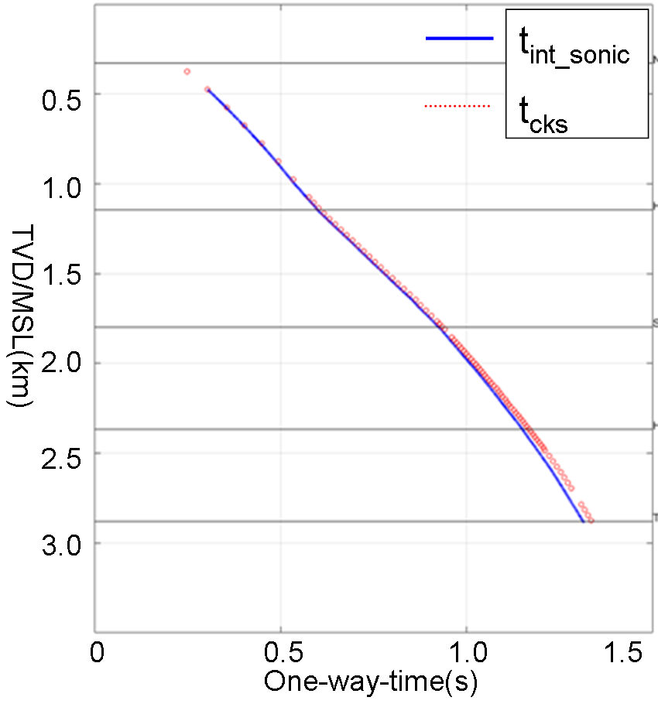
Checkshot drift and seismic attenuation
Stewart et al. (1984)
For example values:
Q = 100;
d = 500 m;
f₂ = 15 kHz,
f₁ = 50 Hz; and
V_{f2} = 2000 m/s
Δdrift ≈ 4.5ms
Notes:
6
Given the assumptions on the previous slide, Stewart et al. (1984) published a recipe for estimating Q from checkshot drift. One which has been used with small variations in quite a few published studies since then.
To be clear, what I mean by checkshot drift here is the difference between the traveltime obtained by integrating the sonic transit times and the VSP or checkshot first arrival picks over the same depth interval. Drift is typically defined as positive when the checkshot traveltime is larger than the integrated sonic traveltime, as is expected for drift due to dispersion.
As you can see from the equation in the top left, the attenuation (1/Q) for any given depth interval is proportional to the gradient of the drift.
The example figures at the bottom give you a rough idea of the magnitude of the effect. Accuracy of traveltime differences in the checkshot and accuracy of the sonic transit times, as well as the required resolution, and the attenuation level itself, control the the resolution obtainable. These are slightly different to amplitude based Q estimation methods which are sensitive to interference effects. This difference in the resolution-accuracy trade-off may sometimes give an opportunity for higher resolution than more conventional methods.

Slide 7
Introduction
About our study
Method: Example wells
Assumptions
Results and interpretation
Next steps
Notes:
Just a few quick words about our study, and what's new or different about it.

Slide 8
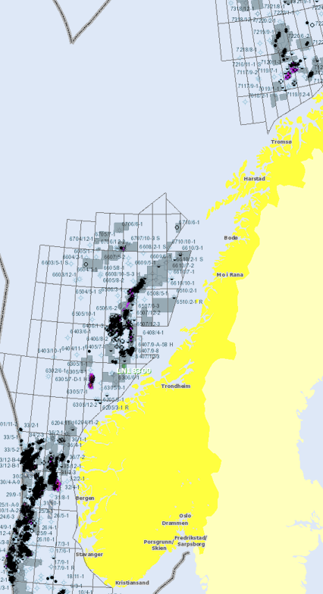
About our study
7220/8-1 (VSP)
Data from 8 wells.
Comparing drift gradients (and Q⁻¹) to geology.
Well data released by NPD.
Notes:
Most previous studies linking checkshot drift to seismic attenuation used only one or two wells. We've used 8 wells from the North Sea and the Barents Sea.
Our aim in using multiple wells is to try to look for systematic variations that we can try to understand in terms of what we know about the geology.
Once we started to see a trend in the results we produced a model to allow the approximate prediction of attenuation from seismic velocity in the region. This has an unusual feature, and we hope it may be useful in improving Q compensation regionally.
We have only used data released to the NPD by data owners. These include well logs, time-depth curves, formation tops, some well reports, and for one well from the Barents Sea, a zero offset VSP dataset, which we're using for quality control.
Using only released data means we likely have more uncertainty in our drift and attenuation observations than the data owners might have had, but we still saw patterns that we believe can be linked to geological properties.

Slide 9
Introduction
About our study
Method: Example wells
Assumptions
Results and interpretation
Next steps
Notes:
OK, so now to show you an example of how this procedure is carried out using 2 wells.

Slide 10
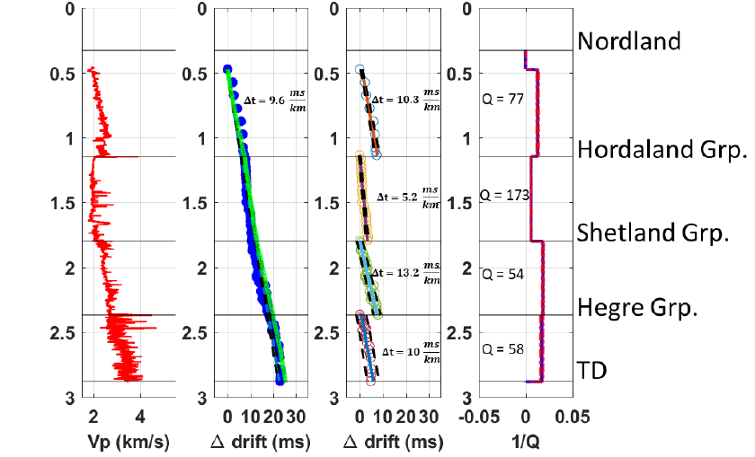
Example drift analysis from well 34/7-1 (Snorre)
Whole Checkshot Q=74
Notes:
The left panel shows the Vp from the sonic log (in red)
The 2nd panel shows drift values for each time-depth pair in the time-depth curve within the depth range of the sonic log. A least-squares line fit to these points gives an average drift gradient for the whole interval covered, which when converted to Q using Stewart et al.'s relation from a few slides ago gives a Q value of 74.
Reflectivity modelling of a synthetic VSP over this same depth interval with no attenuation in the model gave a Q value of 1590 thus we concluded that at this well scattering was not responsible for much of this drift.
The 3rd panel shows the same drift values as in the 2nd panel, but split by interval into fairly thick groups. A linear regression is then used to calculate a drift gradient to give a 1/Q estimate for each interval. These values are plotted in the 4th panel.
Errors in 1/Q come from the spread in the drift values around the regression, but are likely underestimates as there is no way to include the uncertainty in the accuracy of the attenuation-dispersion pair at this stage.
One of the most interesting features of this well is the relatively low attenuation in the Hordaland Group. We think this may be due to the combination of a high porosity and a high proportion of smectite clay leading to a very high water content which is not free to move and thus has a high Q.

Slide 11
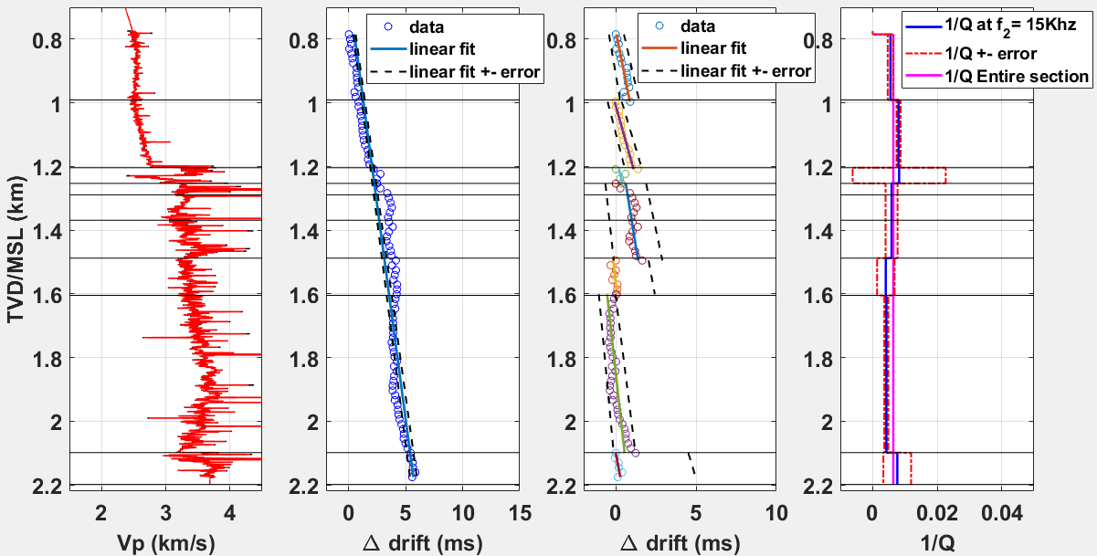
Second example well 7220/8-1 (Johan Castberg)
TORSK
Q=181
KOLMULE
Q=124
KOLJE
Q=122?
GOC
Q=18?
STØ &
NORDMELA
Q=797?
OWC
Q=170
Q=187?
Q=244
TUBÅEN
Whole Checkshot Q=155
Q=235
FRUHOLMEN
SNADD
Q=131
TD
Notes:
11
This 2nd example is from the Johan Castberg discovery well in the Barents Sea. Here the seabed is much harder as the rocks there have been uplifted from depth and retain some properties acquired during burial, compaction, and cementation. The panels are the same as for the previous example.
Here we see much less attenuation at almost all levels. We attribute this to hard rocks with relatively low permeability. We note also that some of the intervals we have grouped together here contain tantalising variations in drift gradient, for example the high positive drift gradient above the GOC and the lower gradient below it.
Modelling followed by Q estimation suggests a negligible contribution from stratigraphic attenuation at this well.
This well also has a ZOVSP, which has been analysed for attenuation. The Q values from drift agree well with spectral ratios over lower frequencies 10-40Hz, but then we see some possible frequency-dependence of Q above 40Hz, leading to significant differences.

Slide 12
Introduction
About our study
Method: Example well(s)
Assumptions
Results and interpretation
Next steps
Notes:
Whilst you digest those example results, I will quickly run through some of the assumptions inherent in our methodology.

Slide 13
Key assumptions
Dispersion from absorption is main cause of drift
Consistent picking of time-depth
Impact of scattering and scale is small
Kolsky-Futterman (NCQ) dispersion/attenuation applies
N. B. Our Q⁻¹ is measured vertically
Notes:
In interpreting drift as velocity dispersion due to anelasticity, we are assuming that other contributions to drift are small. There are quite a few other effects that can contribute to both positive or negative drift and a list of these can be found in Stewart et al.'s original paper. Some well log editing may often be necessary to correct for such effects.
As we used only released data, apart from one well we had no way to assess that traveltime differences in the VSPs are consistently and accurately picked. Also that a consistent (trough-trough or first break) approach has been used. We have had to assume these are ok.
We have tried to assess the contribution to dispersion on some of the wells via reflectivity modelling after minimal upscaling, and spectral ratio analysis over the whole extent of the VSP. So far, we have found negligible contribution from stratigraphic attenuation, but we cannot rule out contributions from other types of scattering.
We are assuming that the Kolsky-Futterman attenuation-dispersion pair applied between seismic and sonic frequencies predicts the attenuation in the seismic frequency band. The approach we have used could be used with other attenuation-dispersion pairs with a suitable adjustment of the equation relating attenuation and drift. As I previously commented, the VSP from Johan Castberg, suggests so far that we can predict the Q from 10-40Hz, but not over the full signal bandwidth at depth. We need to look at more VSPs to assess the extent to which this is well-specific.

Slide 14
Introduction
About our study
Method: Example wells
Assumptions
Results and interpretation
Next steps
Notes:
Next a look at how our attenuation estimates vary with velocity, geological interval, and space, and the rough predictive model we have arrived at.

Slide 15
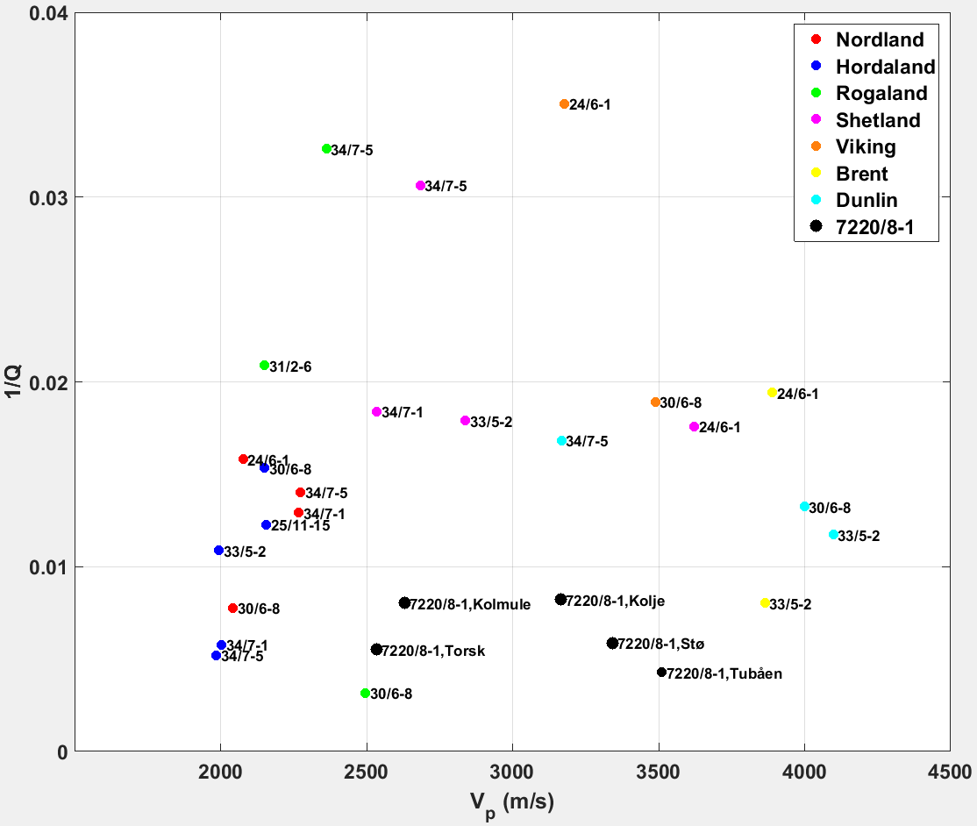
Notes:
What I will highlight here is the general trends, the position of the Hordaland group and the lower attenuation in the shallow, which is an unusual feature, as empirical models usually have Q increasing monotonically with depth and velocity. We may have higher attenuation again in the shallowest unconsolidated sediments, but our data do not sample them, though site survey data may allow a similar experiment there.
The attenuation decreases with depth again as the propagating waves generate less fluid flow. In the middle where our model is least well constrained we see variation that we think may be due to overpressure and presence of gas. We would like to investigate this part of the model further. The Barents Sea wells are shifted to the right compared to North Sea wells due to uplift and higher velocity, leading to a reduced attenuation for a given velocity.

Slide 16
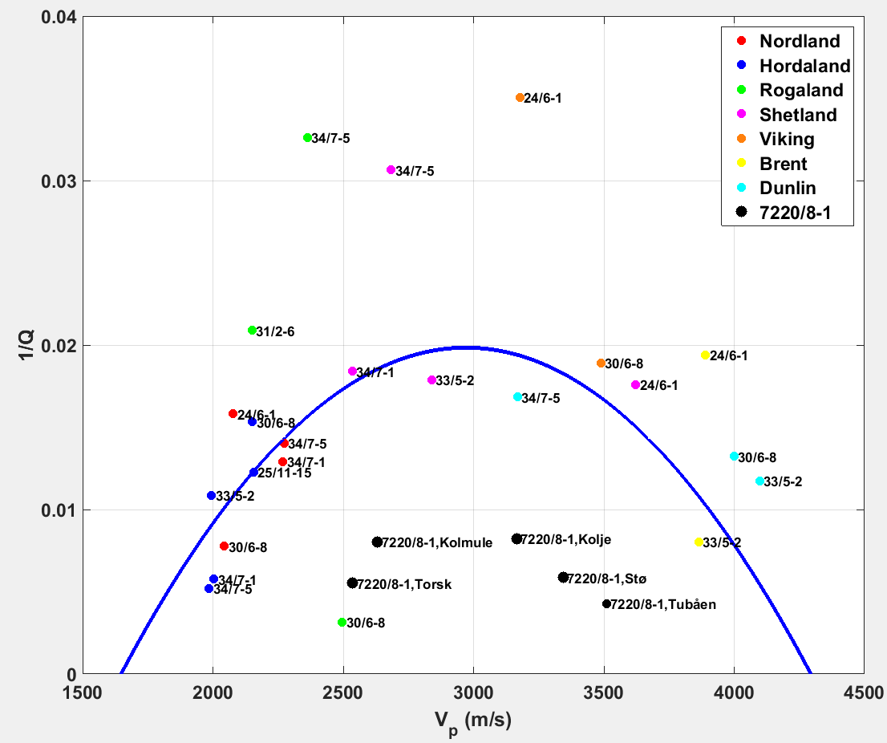
25
a₀=1.133x10⁻⁸ s²/m²
V_{P1}= 1648m/s
V_{P2}= 4294m/s
a₀=1.133x10⁻⁸ s²/m²
V_{P1}= 1648m/s
V_{P2}= 4294m/s
33.3
50
Q
?
100
∞
Notes:
16

Slide 17
Introduction
About our study
Method: Example wells
Assumptions
Results and interpretation
Next steps
Notes:
Finally a few words on what we want to do next to continue evaluating our results and improving our model.

Slide 18
Next steps
Evaluate results i.e. Q/dispersion model assumed:
e.g. via comparison with other Q estimates from VSP.*
Test application of the Q model predictions:
e.g. in processing via well-tie.*
Improve model and understanding:
Analyse more wells;
Use more complete datasets*;
Link to research in rock physics and mechanisms.
Notes:
The largest uncertainty in our attenuation estimates comes from the validity of the link between attenuation and drift. We can assess whether or not this works in practice (not what is happening over the whole bandwidth) by analysing more VSPs over their entire depth range and individual (thick) intervals
We would like to apply our Q model prediction in processing (preferably Q migration) and test it on well-ties.
We would also like to look at more wells, especially high quality wells with good logs and VSPs, and spend some time working on our interpretation and looking at published ideas on attenuation at seismic frequencies and full-band dispersion.
This work would benefit greatly from access to propietary data.

Slide 19
Acknowledgements
The authors gratefully acknowledge:
NRC and NTNU (for funding);
ROSE Consortium;
NPD/NTNU/Schlumberger (for data access);
Michel Dietrich (SKB modelling code);
Colorado School of Mines (Seismic Un*x);
GNU Project (Octave).
Veronica Torres Caceres' presentation at EAGE
is at 1645 on Thursday 14th June in Room B
We are interested in collaboration with groups with access to data and funding.
Notes:
We acknowledge funding from NTNU, data from the Petrel-ready database that is a collaboration between NPD, Schlumberger, and NTNU, and use of a reflectivity modelling code by Michel Dietrich from the University of Grenoble. Seismic Un*x and Octave have also been used a lot by myself during this project.
Veronica will be presenting this work, hopefully with some updated results at EAGE, please go along to see more.
As I said, further work would benefit from collaboration with wealthy data owners, and Veronica and I are both seeking work.

