Slide 1
ROSE meeting 24th-27th April 2017
The relation between static and dynamic stiffness of rocks
PhD student: Serhii Lozovyi
Supervisor: Prof. Andreas Bauer
Acknowledgments: Tore Sirevaag, Erling Fjær
24.04.2017
Trondheim, Norway
Notes:
OK

Slide 2
Elastic media:
Stiffness does not depend on frequency or stress amplitude
Static stiffness = dynamic stiffness
Rocks are not elastic media
Stiffness of rocks depends on frequency and strain amplitude
Static stiffness ≠ dynamic stiffness
Static stiffness depends on stress amplitude (often ignored in geomechanical modeling)
Acoustic velocities (dynamic stiffness) depend on amplitude (non-linear acoustics)
We propose and validate a simple model that relates static and dynamic rock stiffness and describes the dependence of the rock stiffness on stress amplitude

Slide 3
Basics
Dynamic stiffness (seismic, sonic, ultrasonic): µstrain amplitudes
(Quasi-)Static stiffness: mstrain amplitudes
Velocities
P-wave modulus
Young's modulus
H
G
E_{dyn}
ν_{dyn}
Shear modulus
Poisson's ratio
Stress
Young's modulus
σ
ε_{ax} ε_{rad}
E_{static}
ν_{static}
Strains
Poisson's ratio

Slide 4
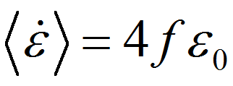
Why does the static undrained stiffness differ from the dynamic stiffness?
Stress amplitude
→ Activation of non-elastic processes (focus of this work);
Strain rate / frequency
→ dispersion effects
average strain rate of a wave:
f – frequency
ε₀ – strain amplitude

Slide 5
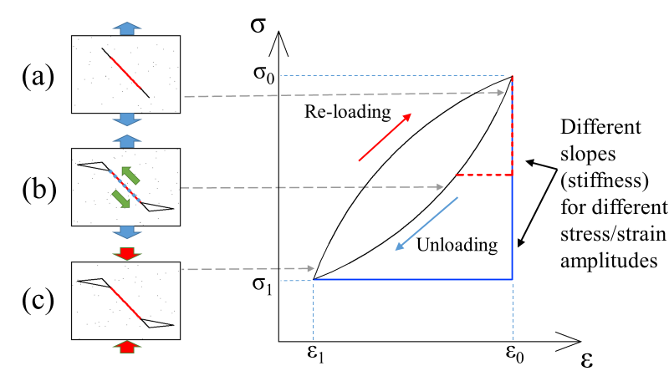
Non-elastic process
– friction is suppressing intergranular movement
– sliding is activated
– friction is reactivated after the change in loading direction

Slide 6
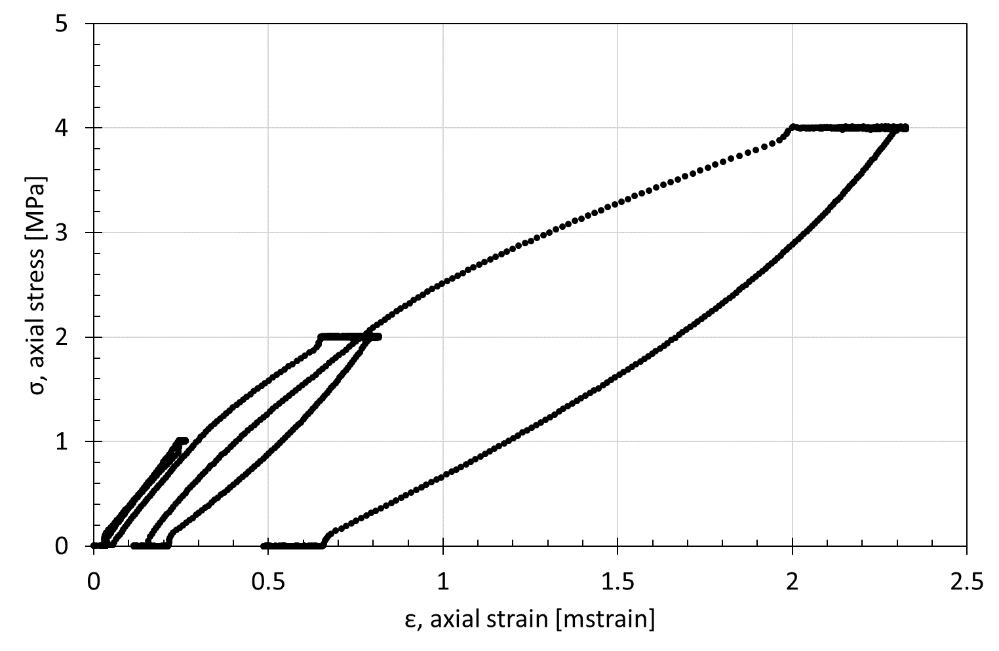
Real experiment Undrained unloading/loading cycles
$$\frac{dσ}{dε}$$
$$Eav=\frac{∆σ}{∆ε}$$

Slide 7
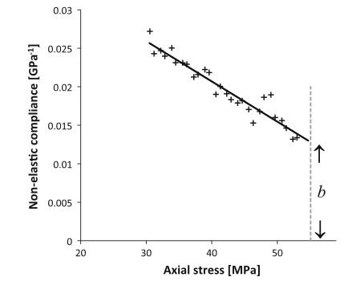
Model by Fjær et al. (2013)
$$S_{E}$$
unloading
Non-elastic compliance
slope
dispersion
$$S_{E}=\frac{1}{E}−\frac{1}{E_{dyn}}=A∙{ ∆σ}_{z} +B$$
A
constants
Δσ_{z}
B
E – local Young's modulus during unloading
E_{dyn} – dynamic (elastic) Young's modulus
${∆σ}_{z}$ – axial stress change
$${∆σ}_{z}$$
Non-elastic compliance tends to increase linearly from the start of the unloading;
Empirical model was confirmed in experiments with sandstones and shales;
No data available in the vicinity of turning point (small Δσ_{z}) due to experimental constrains.

Slide 8
Low frequency apparatus
Very sensitive to small (order of 10⁻⁶) strains,
stress amplitude is a variable in a relatively wide range
Static force from a
loading frame
Axial stress (σ_{ax}) modulations are applied
Ultrasonic P- and
S-wave transducers
Rubber sleeve
Strain gauges
Pore pressure channels
Confining
pressure
Sample
Force sensor
Piezoelectric
actuator
Internal load
sensor for static
Axial ($ε_{ax}$) and radial ($ε_{rad}$) strains are recorded
$$E_{dyn}=\frac{σ_{ax}}{ε_{ax}};$$
$$ν_{dyn} =\frac{ε_{rad}}{ε_{ax}}$$
Measurements on the same core:
Static moduli
Low frequency Young’s modulus and Poisson’s ratio (0.1-150 Hz)
Ultrasonic velocity (500 kHz)

Slide 9
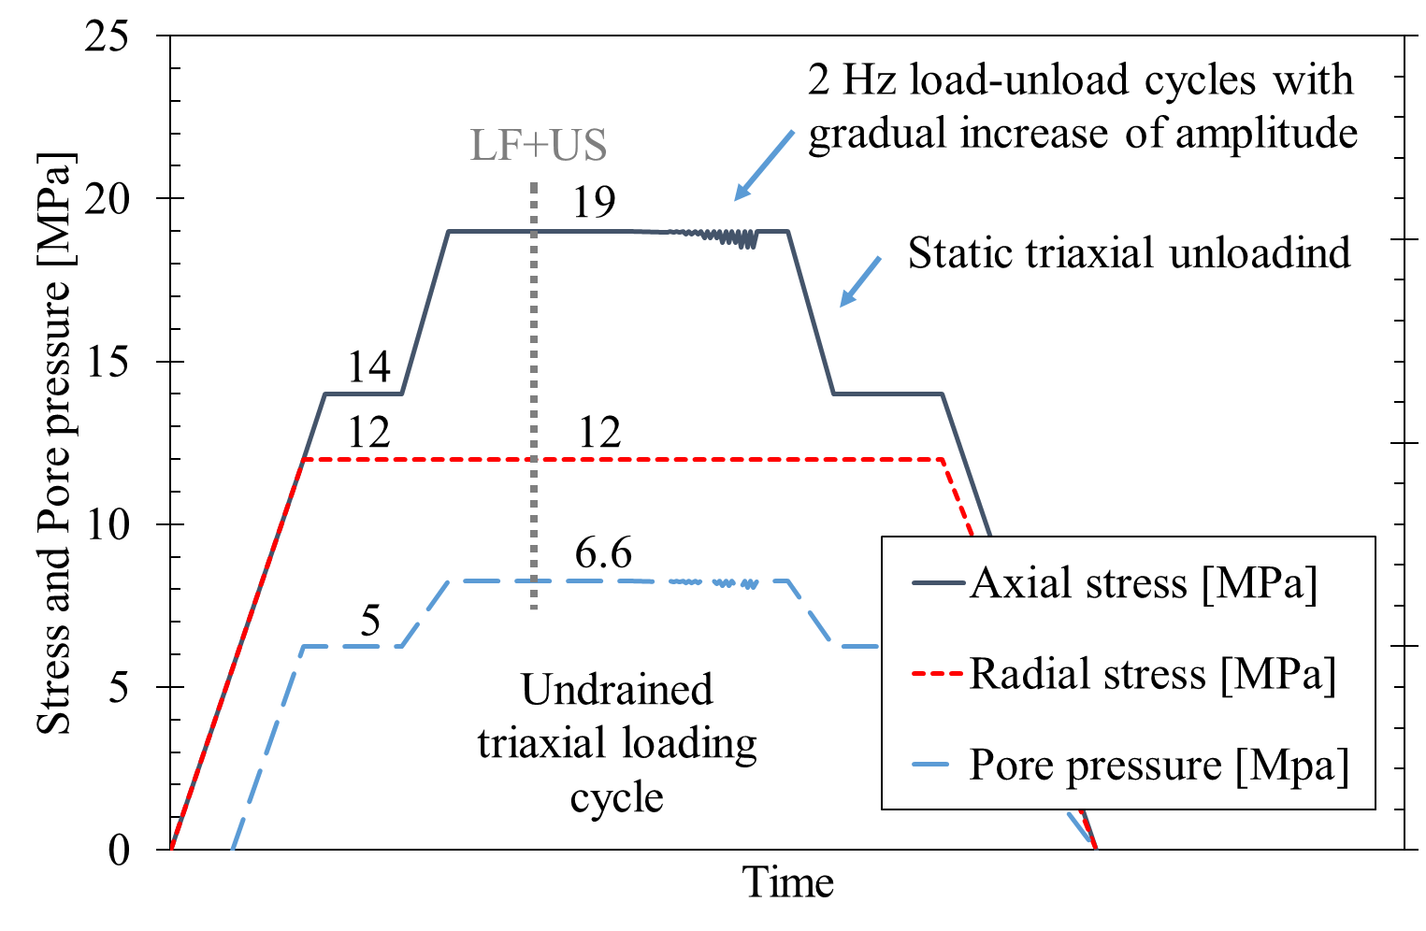
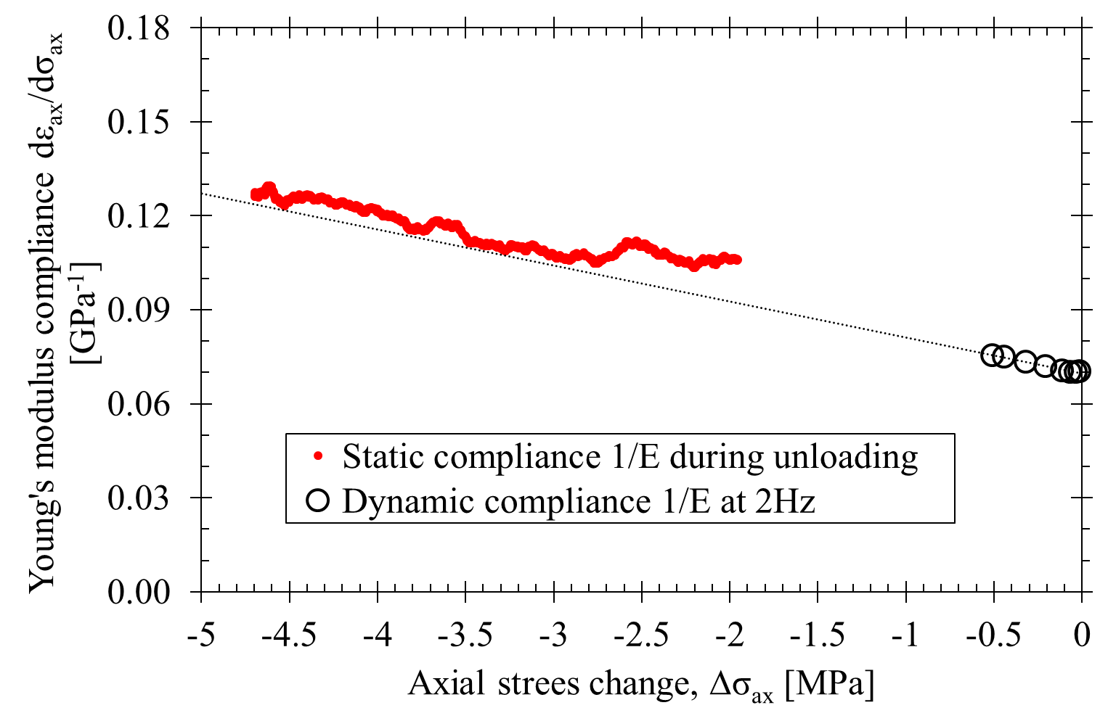
Static unloading and low frequency oscillations at various stress amplitudes (0÷0.5 MPa)
Water-saturated Castlegate sandstone
Compliance
$$C_{E}=\frac{1}{E}=A∙{ ∆σ}_{z}+\frac{1}{E_{el}}$$
Stress path
Strain rate during unloading is similar to average strain rate of dynamic measurement ⇒ dispersion can be neglected

Slide 10
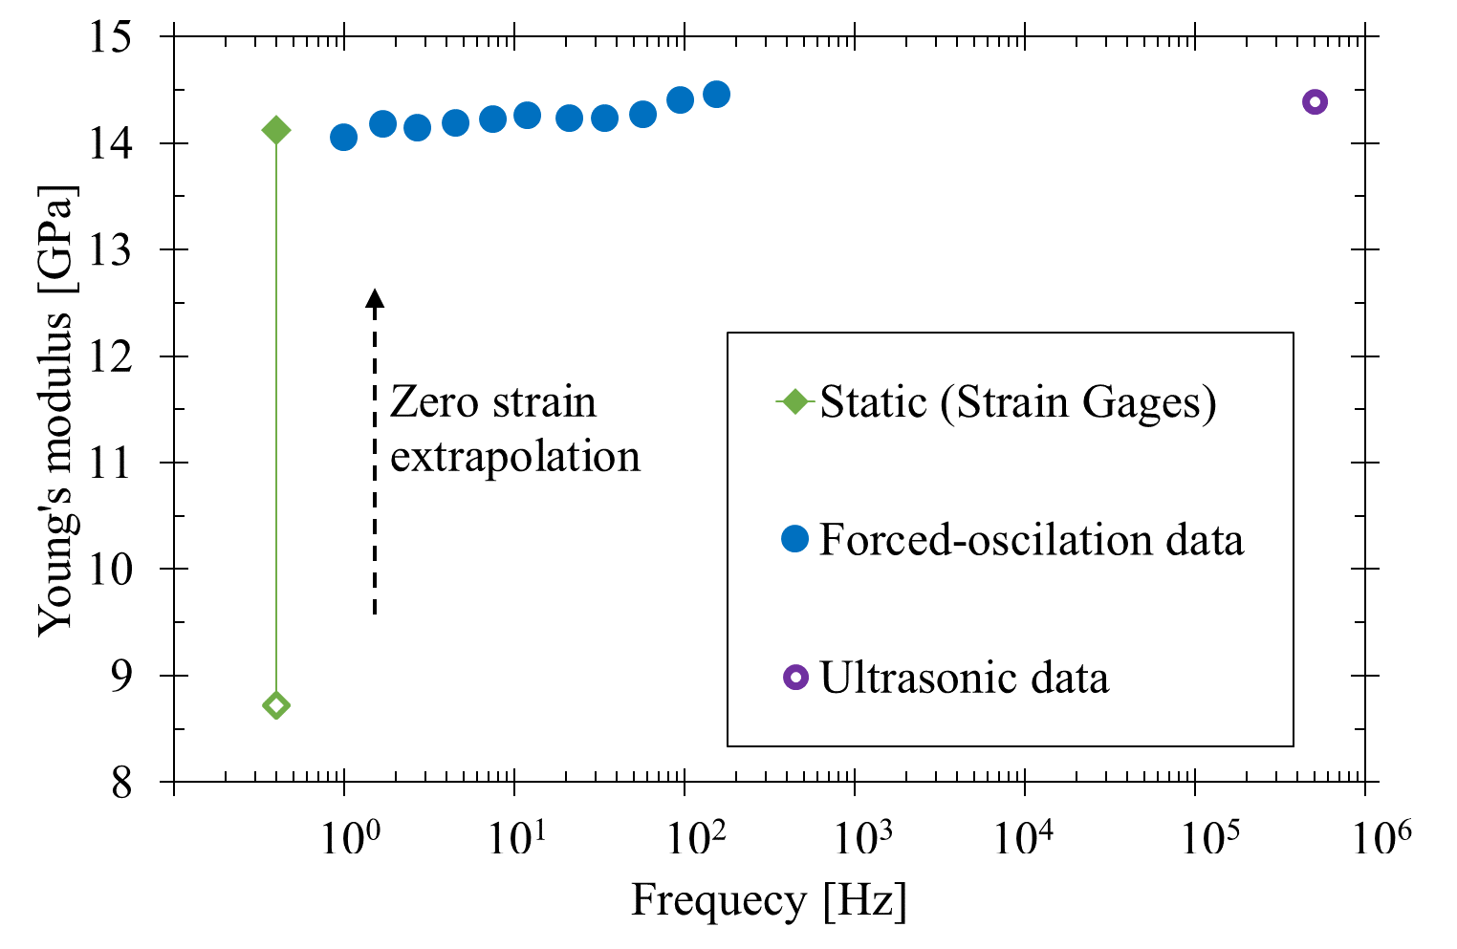
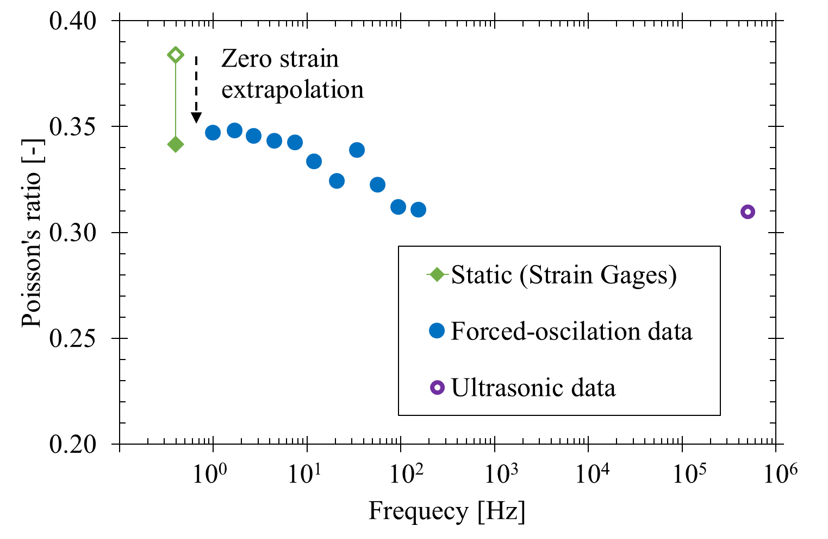
Dispersion effects
Water-saturated Castlegate sandstone
For Castlegate sandstone, the difference between static and dynamic stiffness is due to the larger stress amplitude at static measurements
Dispersion effects are relatively small

Slide 11
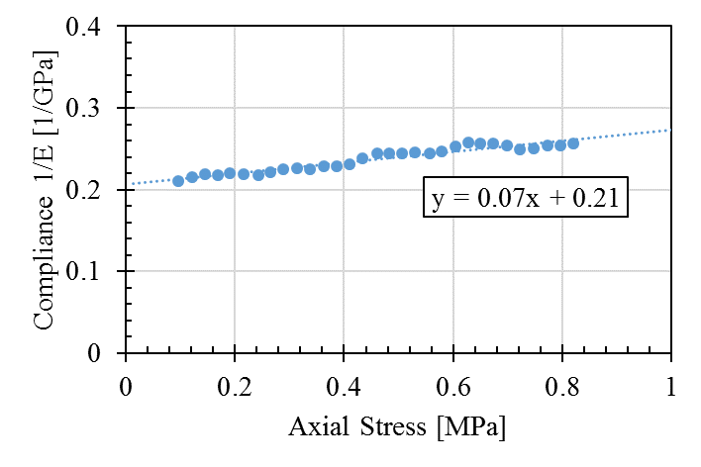
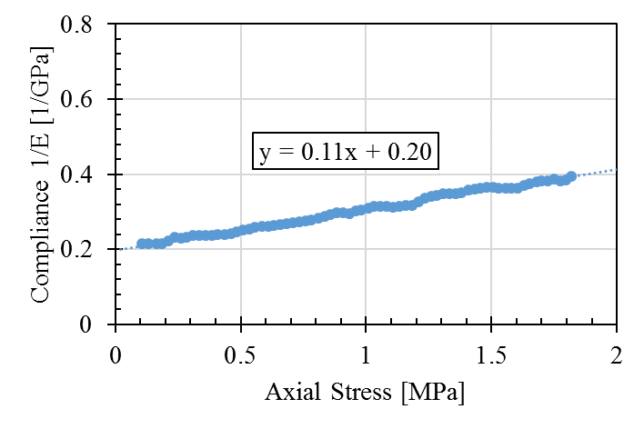
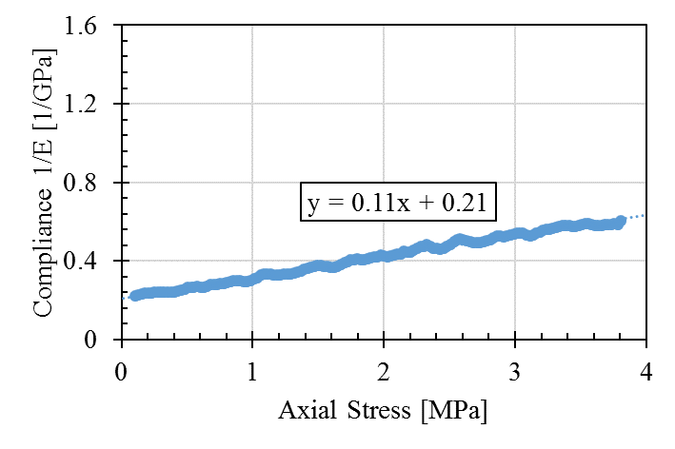
Shales are highly inelastic and dispersive: Example Opalinus clay
E [Gpa]
(1MPa) | (2MPa) | (4MPa)
4.3 | 3.3 | 2.3
4.8 | 5.0 | 4.8
$$\frac{dσ}{dε}$$
Average Stress-strain slope
$$Eav=\frac{∆σ}{∆ε}$$
Zero-strain extrapolation
Stress amplitude: 1 MPa
Stress amplitude: 2 MPa
Stress amplitude: 4 MPa

Slide 12
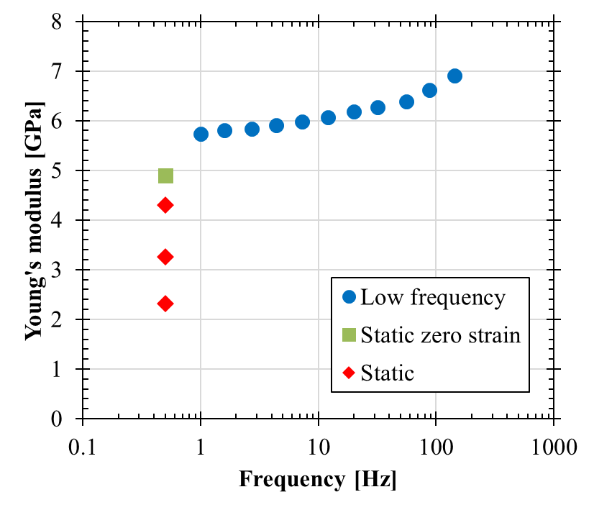
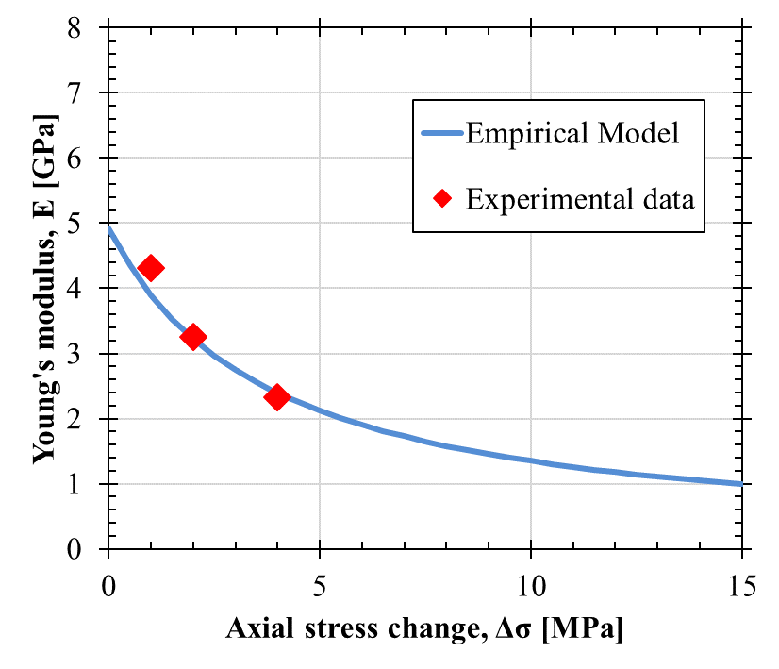
Young's modulus dependance on stress amplitude and frequency
1 Mpa
-53%
2 Mpa
Stress amplitude
4 Mpa
Opalinus clay

Slide 13
Conclusions
Rocks are non-elastic for strains > 1 μstrain, both during loading and unloading
With decreasing stress/strain amplitude, the static undrained stiffness approaches the dynamic stiffness if dispersion effects can be neglected
For some rocks (e.g. Opalinus Clay), non-elastic effects are large, and the typical assumption of quasi-elastic behavior (constant stiffness) up to a yield/failure point may result in significant errors in geomechanical models.
A simple model was proposed that relates dynamic and static stiffness of rocks and describes the dependence of the rock stiffness on stress amplitude, and that could easily be implemented in geomechanical models.

