Slide 1
Rock Physics Analysis and Time-Lapse Imaging of the Induced Chemo-Mechanical Processes upon CO₂ injection into Reservoir Rocks
Tiziana Vanorio
Stanford Rock Physics Laboratory
Notes:
In this presentation I’ll give a snapshot of a very active part of our experimental program which aims at understanding the effect on seismic and transport properties of chemo-mechanical processes which occur in rocks when in presence of fluids that are non in equilibrium with the rock matrix.
The aim is quite broad as it spans from understanding how to enhance rock physics interpretation for 4D monitoring purposes to understanding the necessary building blocks to characterize the rock properties of carbonates and the evolution of their properties upon diagenesis.
In particular I’ll focus the presentation on the first aspect and on CO2 injection.

Slide 2
4D Seismic: Traditional Concept
time-lapse geophysical monitoring is based on the assumption that the time-variant changes in the images of seismic velocity depend on the variation of the properties of the rock frame and the fluid permeating it in response to changes in physical parameters such saturation, pore fluid pressure, temperature, and stress.
Notes:
I mentioned 4D seismic: what’s the weakest link in our current workflow when interpreting time-lapse seismic data

Slide 3
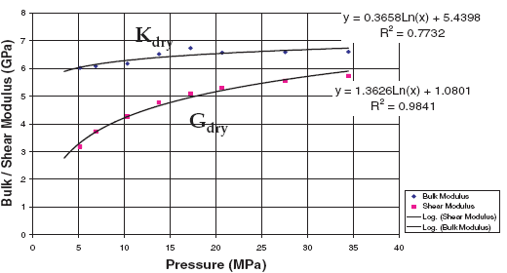
Fluid Substitution: Gassmann Model
Changes in rock seismic velocity and impedance are caused by a purely mechanical interaction between the fluid and the rock frame.
Water Saturated
Rock Seismic Velocity
ANY other fluid
Water Properties
ρ _{fl} ; K_{fl}
Fluid Properties
Solid/Frame Properties
ρ _{fl} ; K_{fl}
K_{o}
K_{dry}
μ_{dry}
ρ₀
ρ_{dry}
Φ
saturation
free and dissolved gas
pore fluid pressure
temperature
mineral composition
properties of the frame
porosity
Notes:
This concept is more implicit when using Gassmann Model, the general tool of choice when interpreting the effect of a fluid on both log and seismic velocity data.

Slide 4
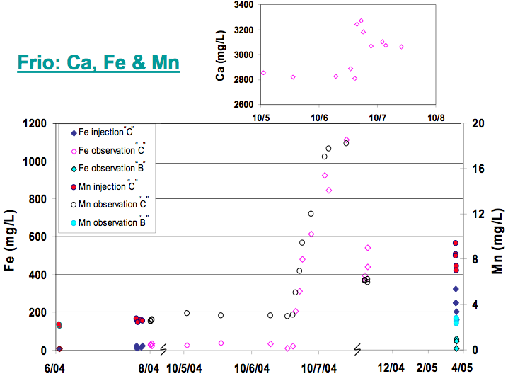
CO₂ Injection
Chemical Disequilibria: Fast and Time-dependent
After two days from the beginning of the injection an increased concentration of cations such as Calcium, Iron, and Manganese are measured at the observation well.
Injection
Two days
Notes:
Time-lapse seismic monitoring is called upon to measure and quantify subsurface changes caused by geochemical processes due to the injection of fluids unlikely to be in chemical equilibrium with the host rocks.
The induced chemical disequilibria are fast, time dependent, and highly site-specific.
Problem: how to include these changes into seismic and rock physics data?

Slide 5
Laboratory Program on CO₂ Injection
Comprehensive Time-Lapse monitoring of:
changes in transport, elastic, and geochemical properties resulting from chemo-mechanical processes induced upon CO₂ injection
precipitation
dissolution
changes in the rock microstructure: Time-Lapse high resolution imaging to quantify pore network modifications
SEM images
Ct-scan images

Slide 6
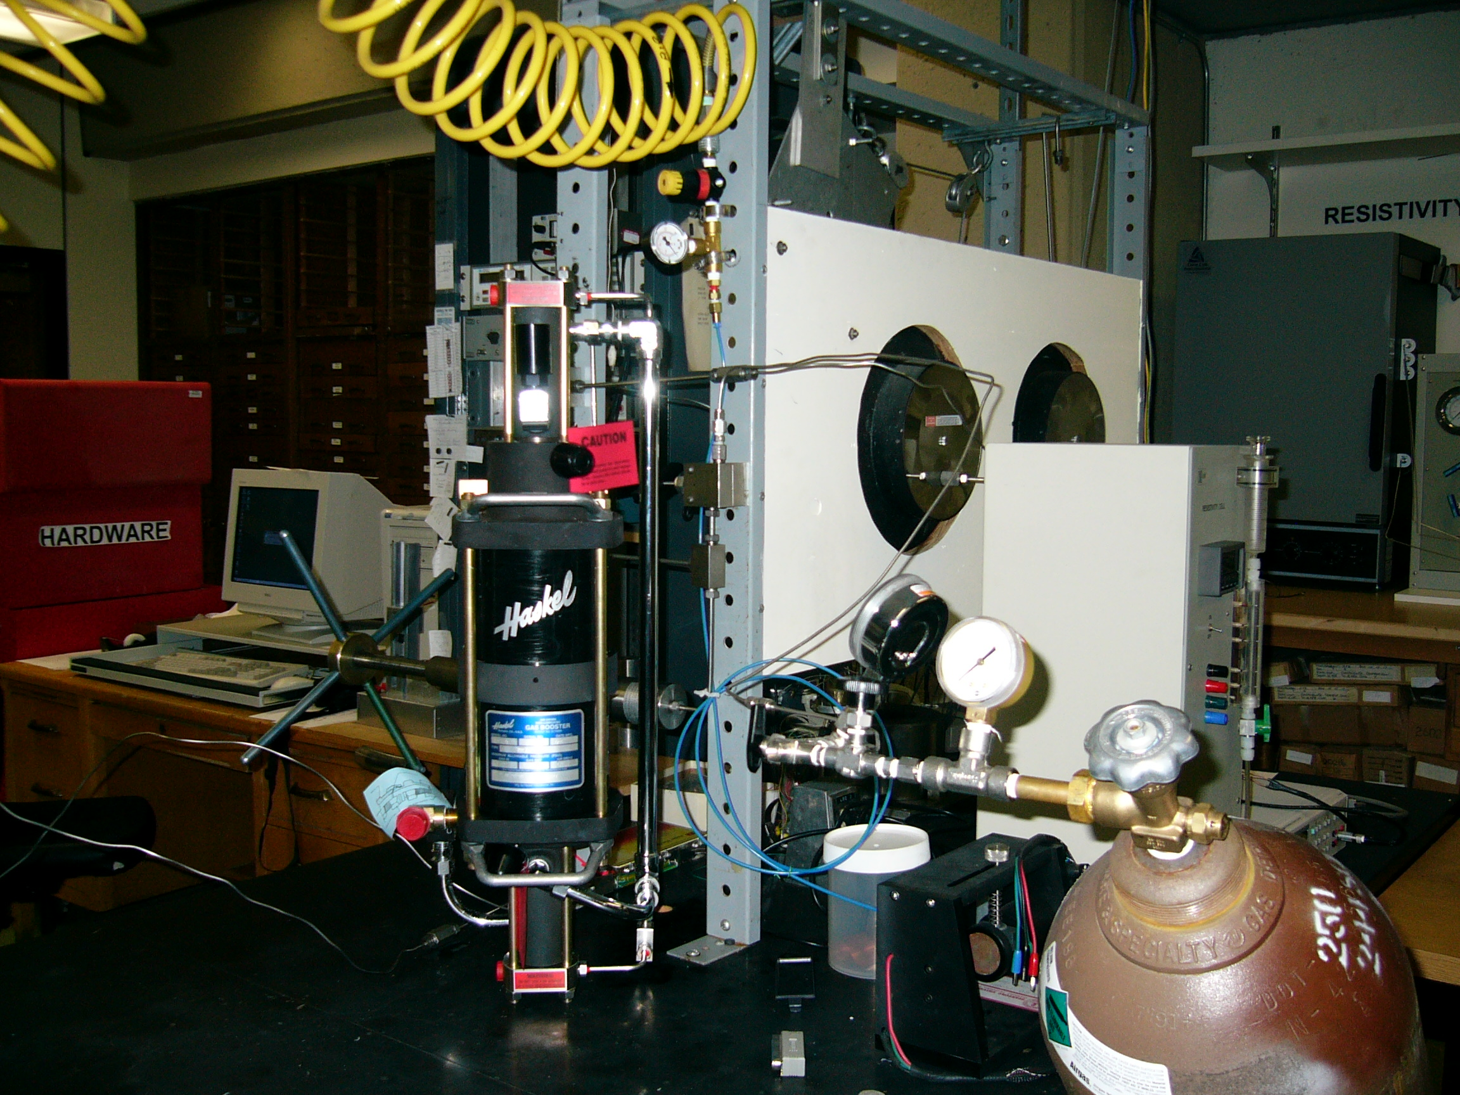
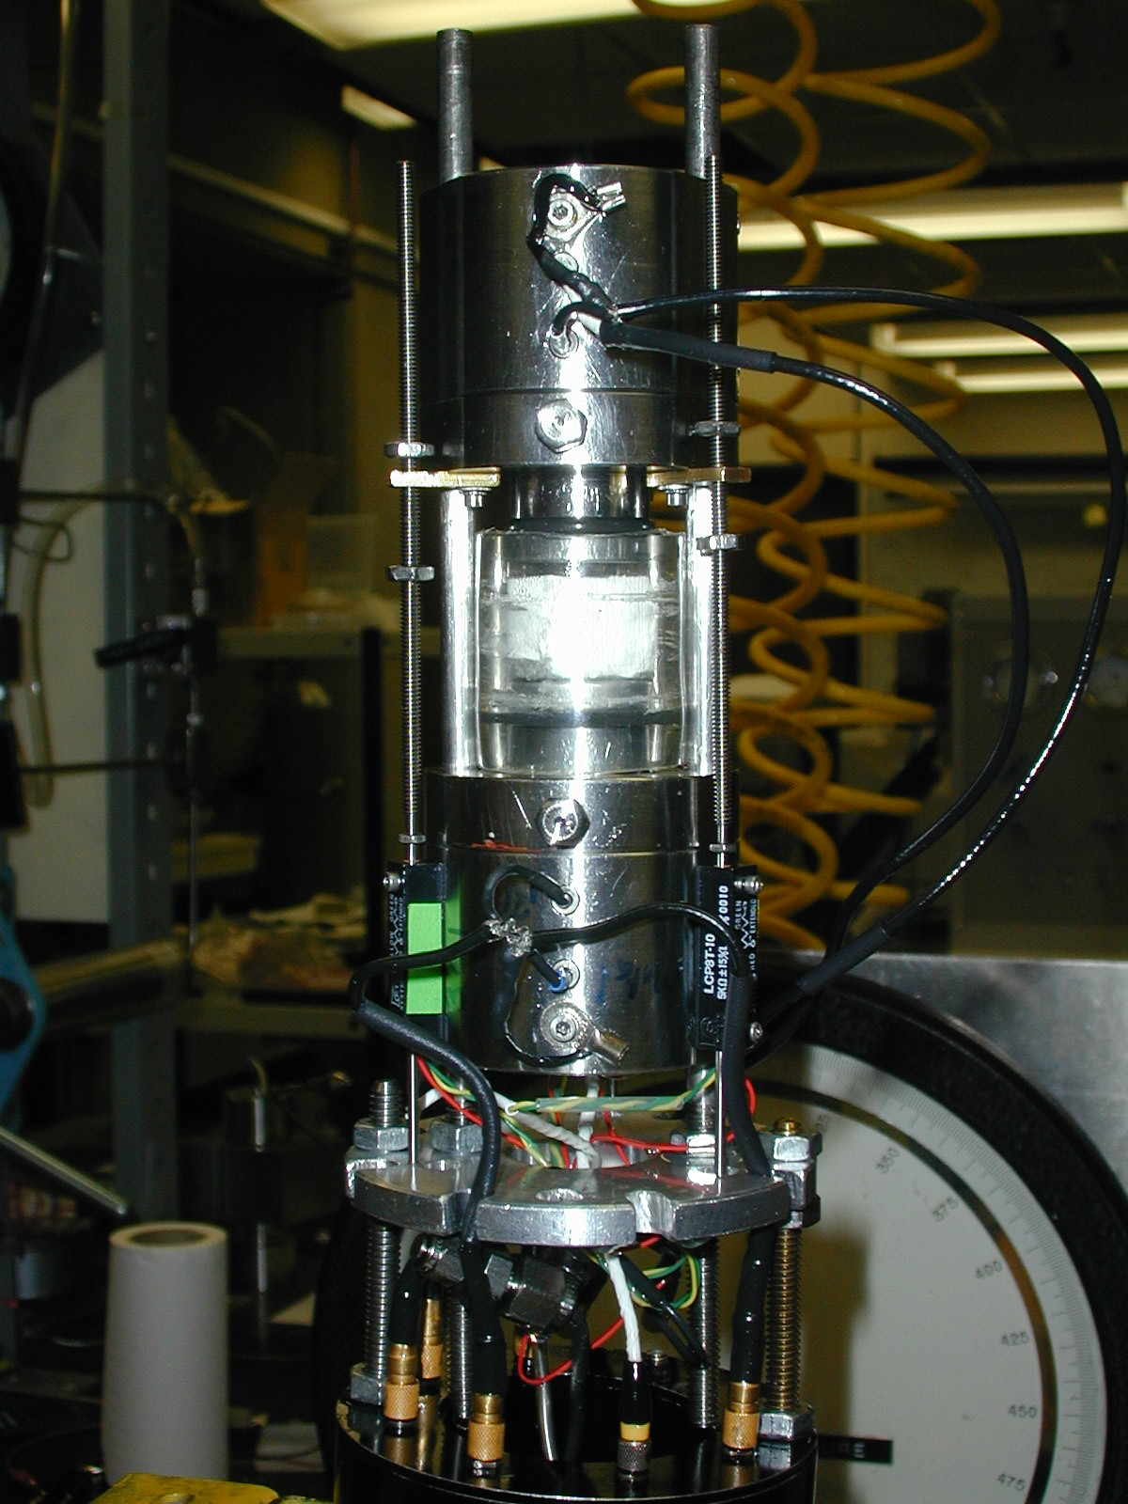
Experimental Design
Injections are performed under reservoir pressure conditions : P_{c} up to 15-55 MPa and P_{f} up to 15-28MPa
Magnitude and location of changes

Slide 7
Rock Samples
Micritic Carbonates
Notes:
micrite is characterized by large surface area; so it’s the most reactive phase in carbonate together with cement

Slide 8
Pre-Injection Characterization
Mictrite Content
Notes:
Similarly to clay in siliciclastics, the amount of micrite changes depending on depositional environment, it needs to be quantified

Slide 9
Pre-Injection Characterization
Pore Space and Its Connectivity
Pore space in blue
Grayscale opacity
Reduced to show
Pore space

Slide 10
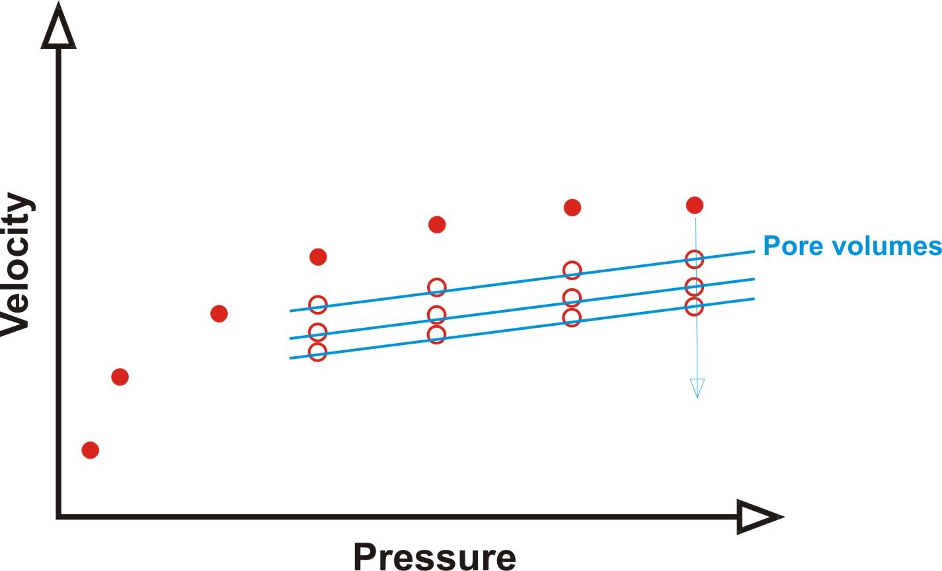
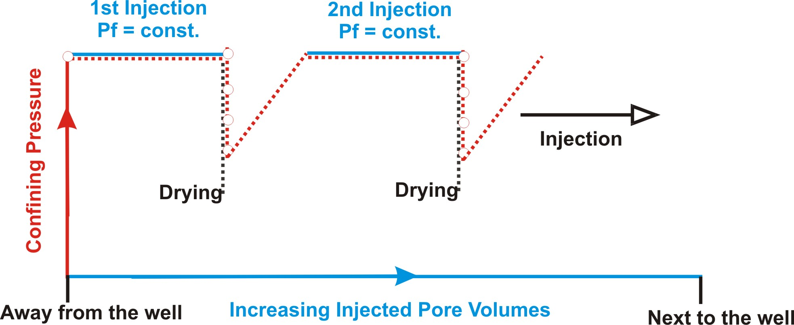
Experimental Protocol
Pre-Injection
dry
Ç√
Ç√

Slide 11
Monitored Properties
Chemical composition (pH, Cation Concentration) of the outlet brine (dissolution)
Porosity and permeability change upon injection (mechanical compaction)
P- and S- wave velocity upon injection and dry frame

Slide 12
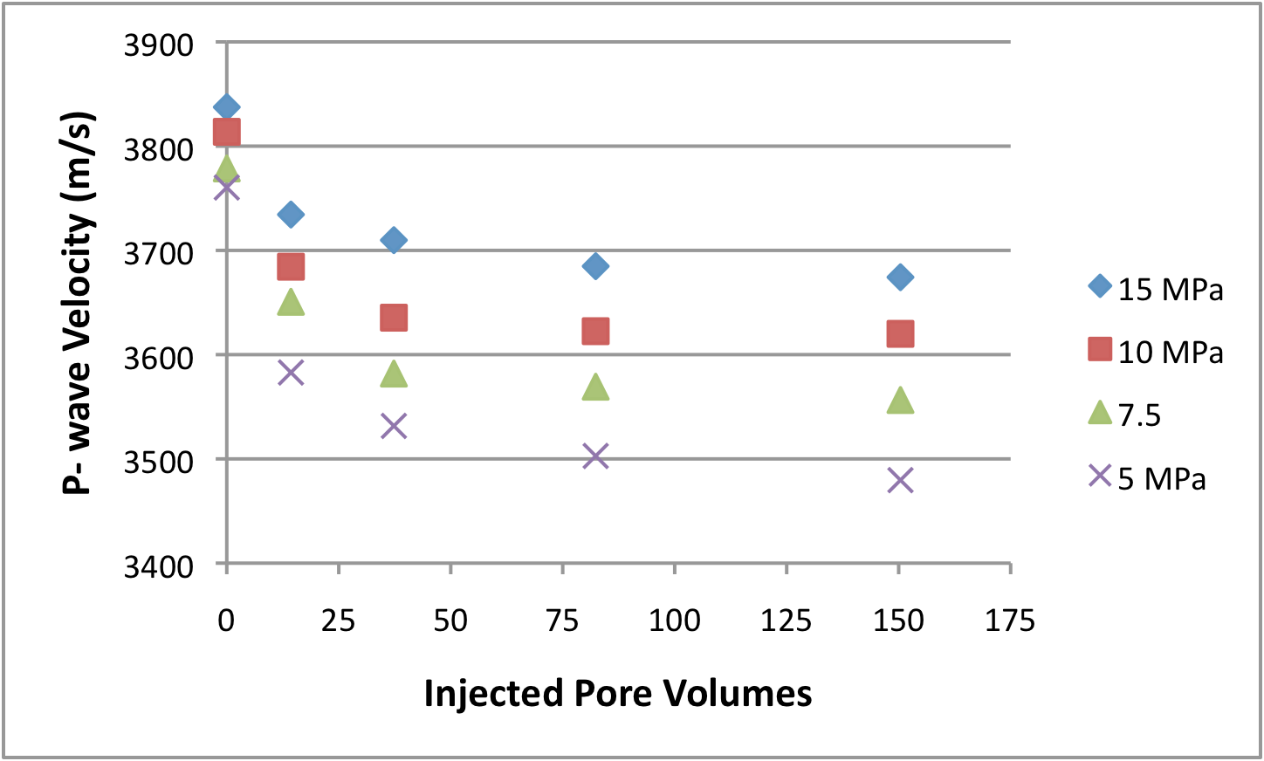
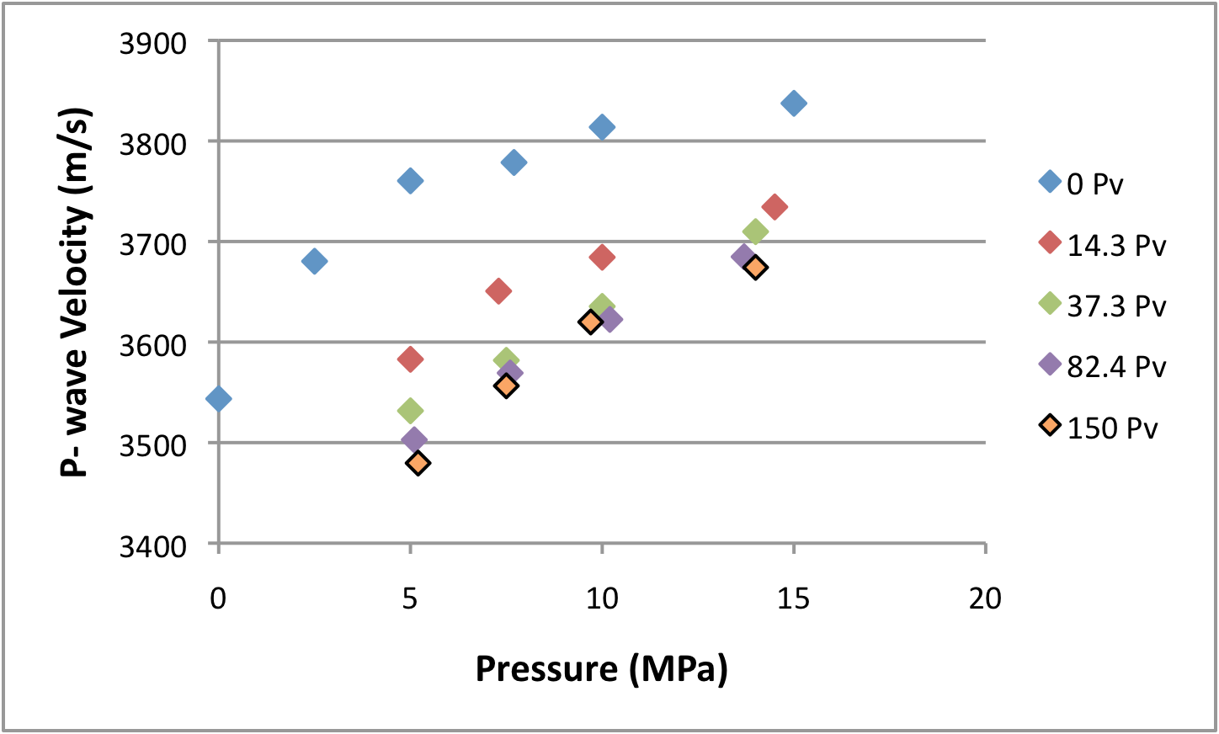
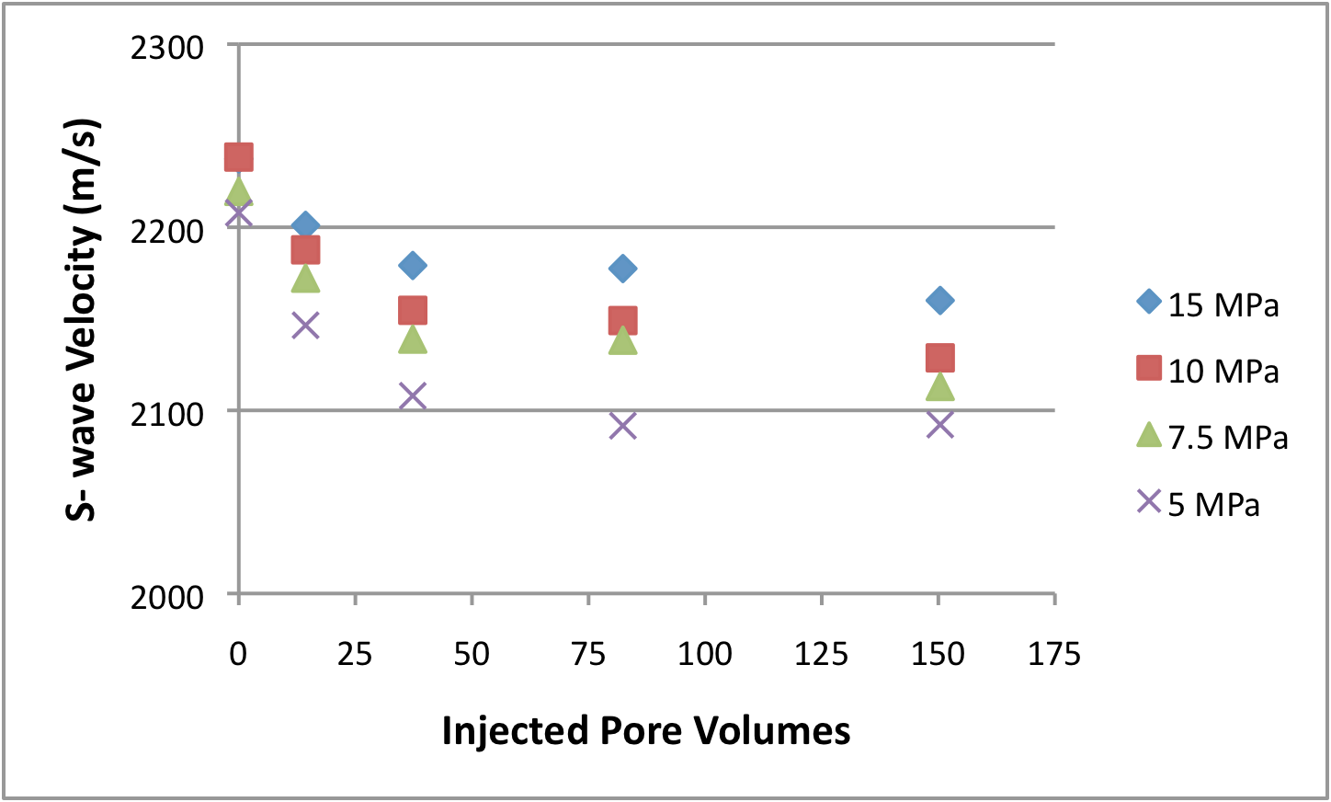
Velocity-Injected Pv-Pressure
Velocities of the dry rock frame after injection
Pre-injection
ΔV
ΔP
ΔV
Pre-injection
ΔP

Slide 13
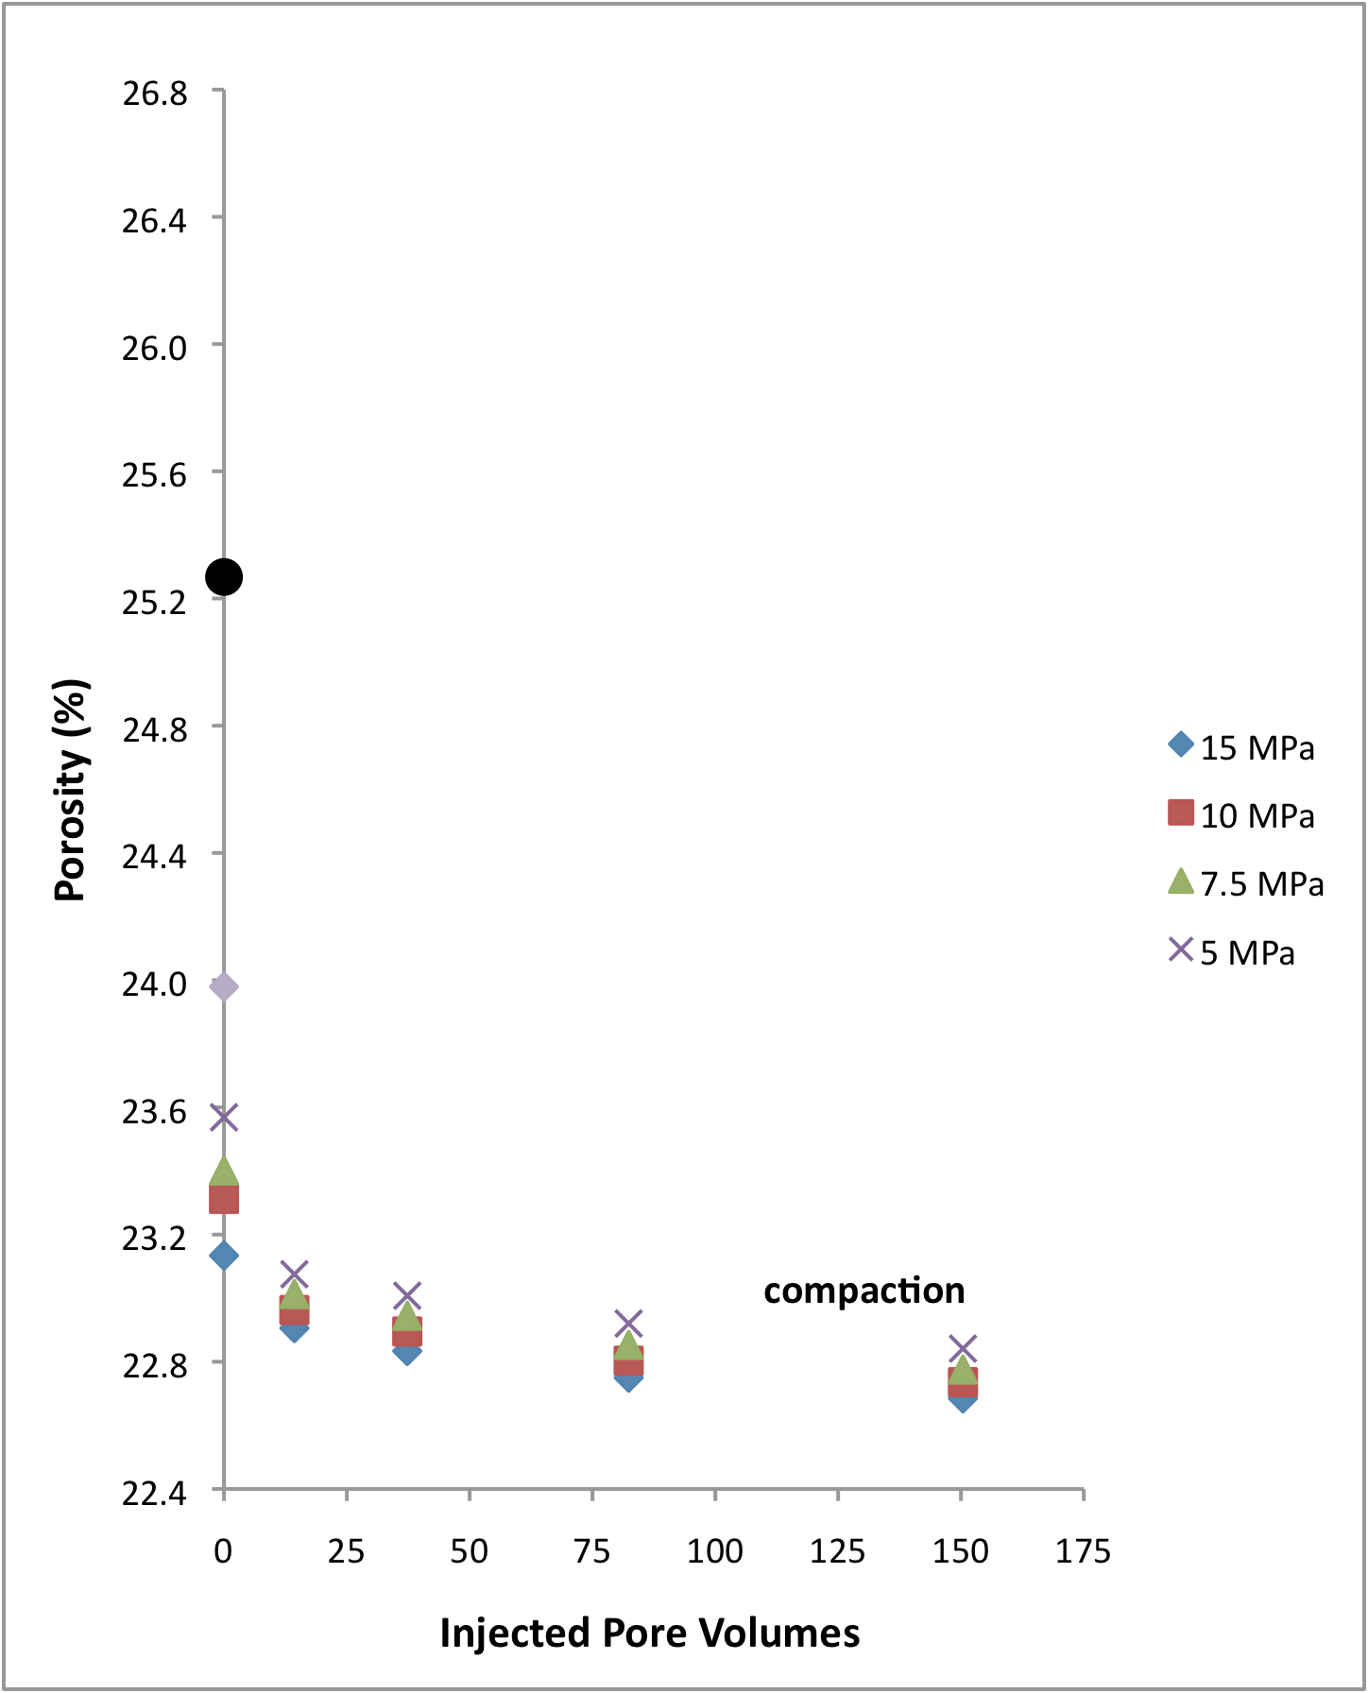
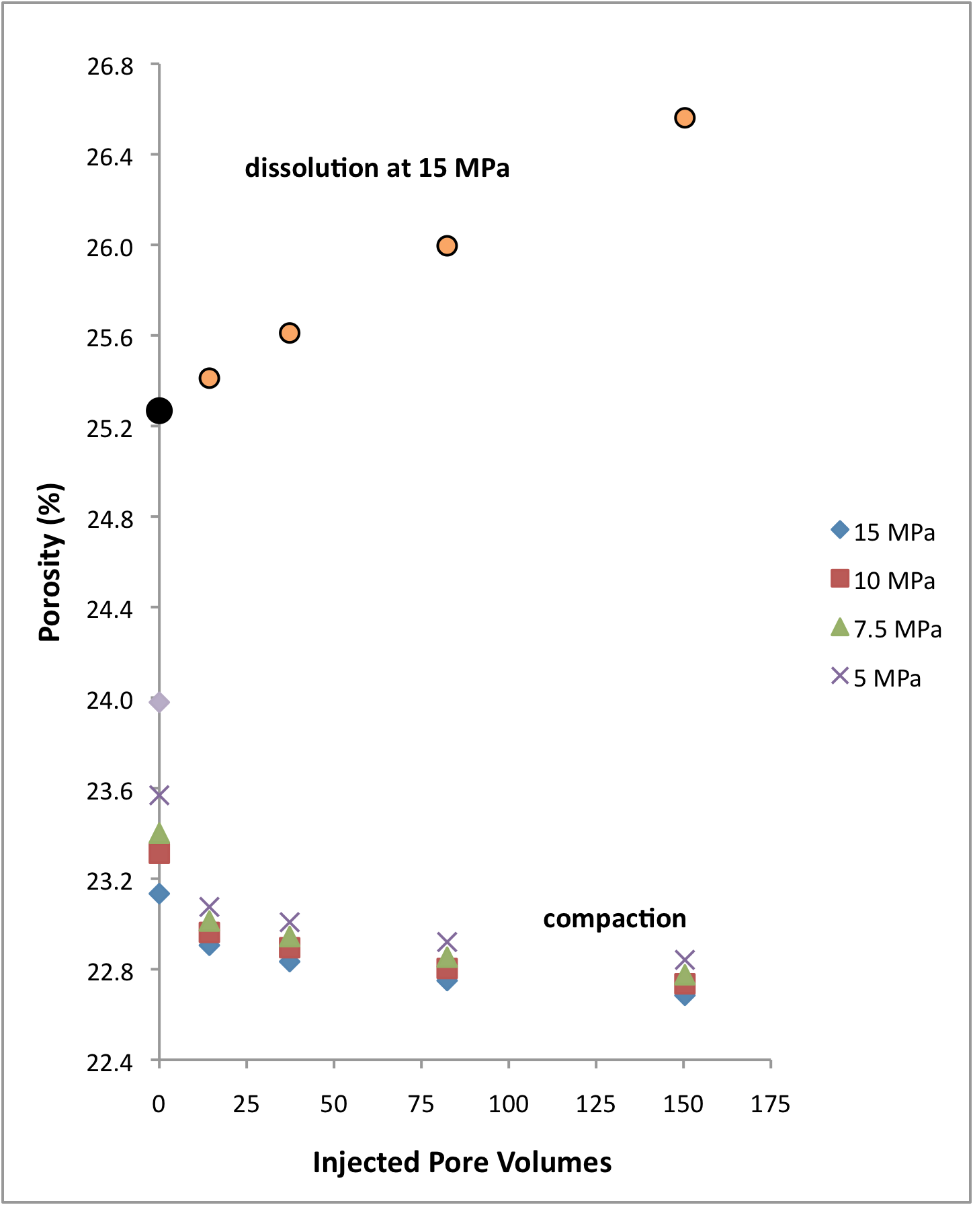
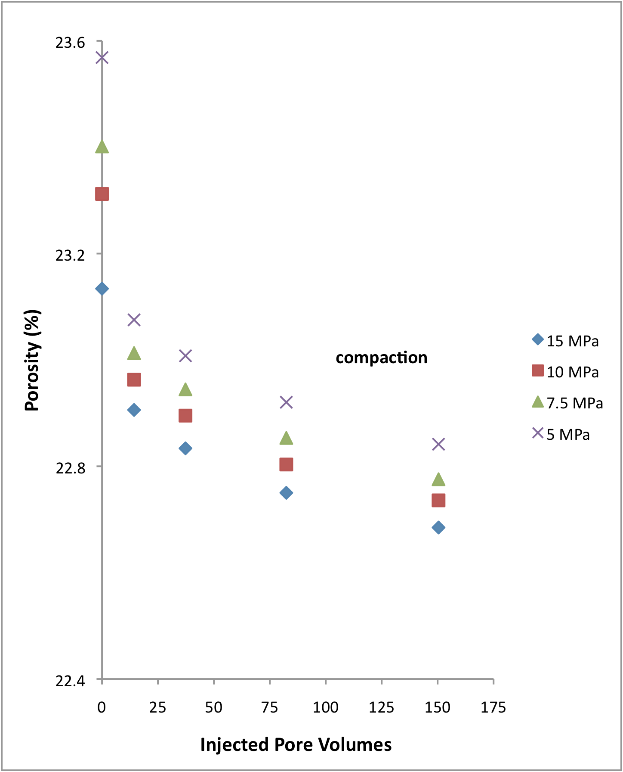
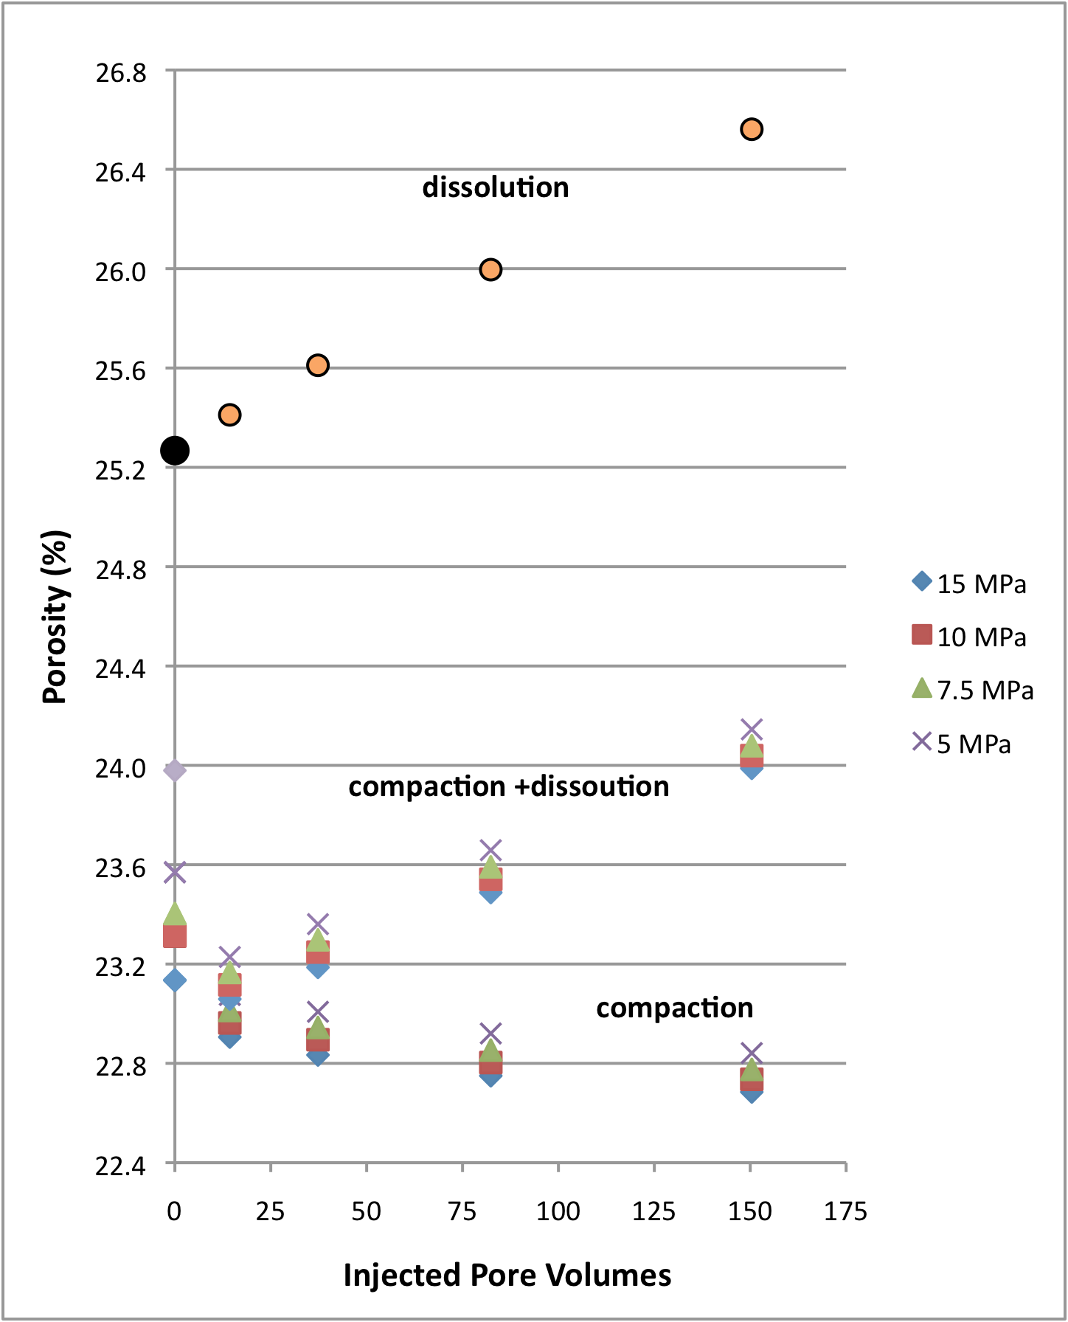
Porosity-Injected Pv-Pressure

Slide 14
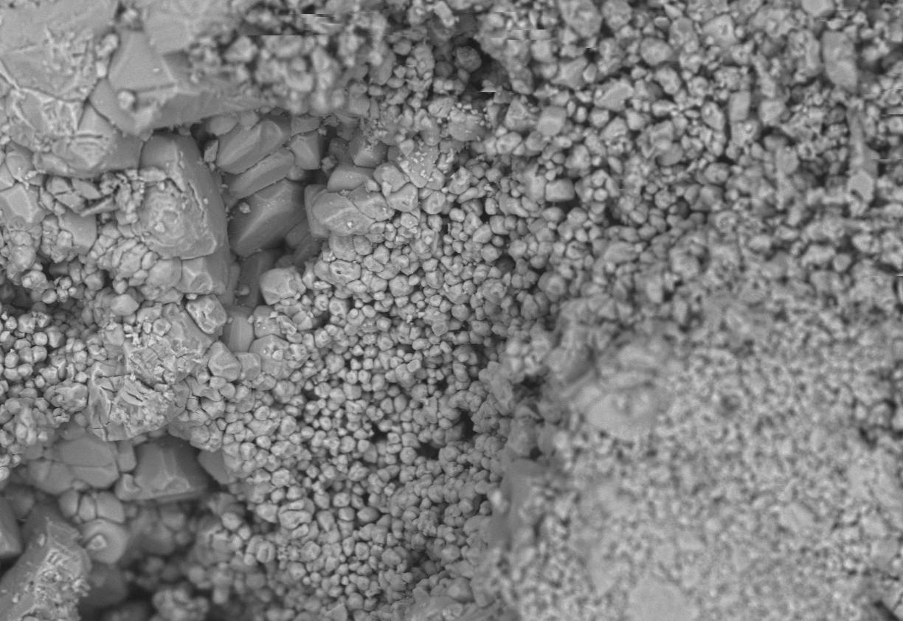
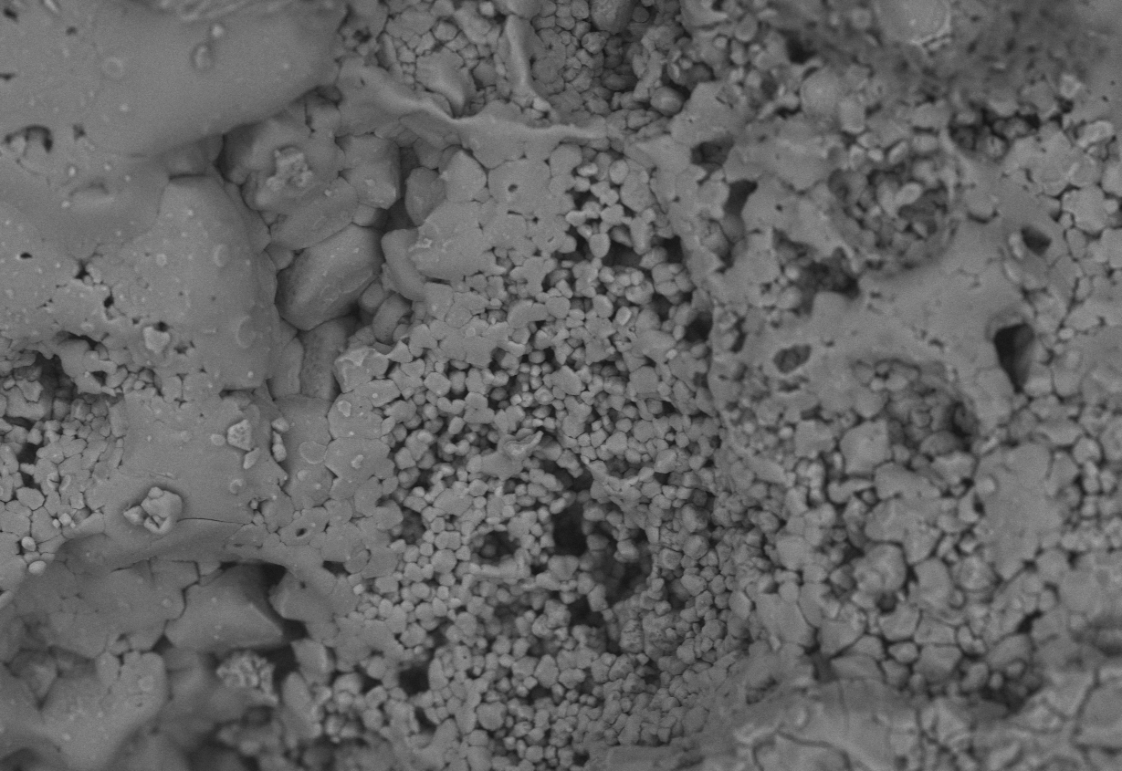
Time-Lapse SEM

Slide 15
Time-Lapse SEM

Slide 16
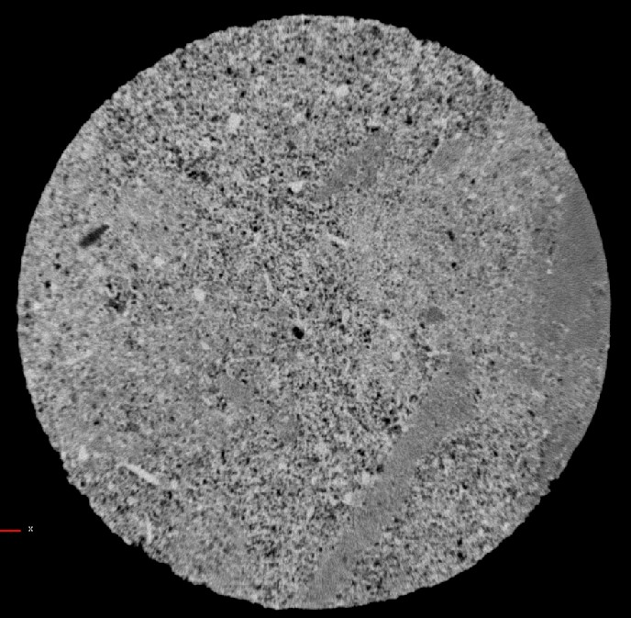
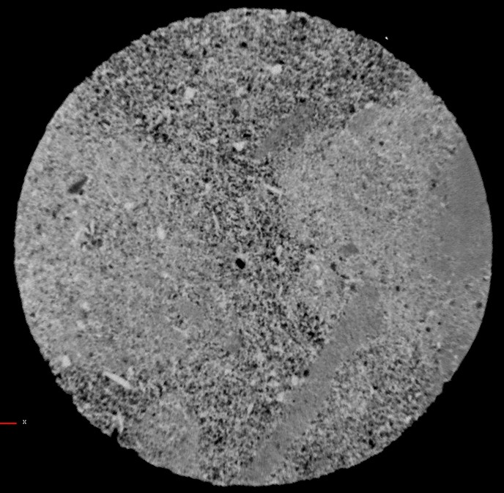
Selective Dissolution
Before CO₂ injection
After CO₂ injection
25 mm
25 mm

Slide 17
Post-Injection Characterization

Slide 18
Conclusions
Experimental data and pore scale images show that the seismic response of CO₂ injection in brine-rock systems is far from being a pure fluid-substitution problem.
Fluid - rock chemical interactions affect the acoustic and transport properties of rock frame. This interaction implies a time-dependence of the properties of the rock frame in addition to those of the fluid permeating the rock (saturation, pressure…).

Slide 19
Conclusions
Experiments shows where changes are likely to occur:
cement dissolution at the grain contact ➔ elastic modui
porosity/density ➔ elastic moduli
the fraction of complaint pores seems to increase with injection as carbonates become more sensitive to pressure upon injection

Slide 20
Where Are We Going?
Water Saturated
Rock Seismic Velocity
ANY other fluid
Amount of Dissolved Minerals
Water Properties
ρ _{fl} ; K_{fl}
Fluid Properties
Solid/Frame Properties
ρ _{fl} ; K_{fl}
K_{o}
K_{dry}
μ_{dry}
ρ₀
ρ_{dry}
Φ
saturation
free and dissolved gas
pore fluid pressure
temperature
mineral composition
properties of the frame
porosity
Notes:
Over the years 4D seismic has experienced tremendous developments: better data quality and resolution by installing permanent recording systems
These efforts will be vain if we do not enhance data interpretation. Neglecting the occurrence of chemo-mechanical processes, their interdependency, and coupling with the rock microstructure and reservoir conditions leads to poor interpretation.

Slide 21
Where Are We Going?
Notes:
How Pore Network evolves upon injection of reactive fluids– Porosity-Permeability-velocity Trends

Slide 22
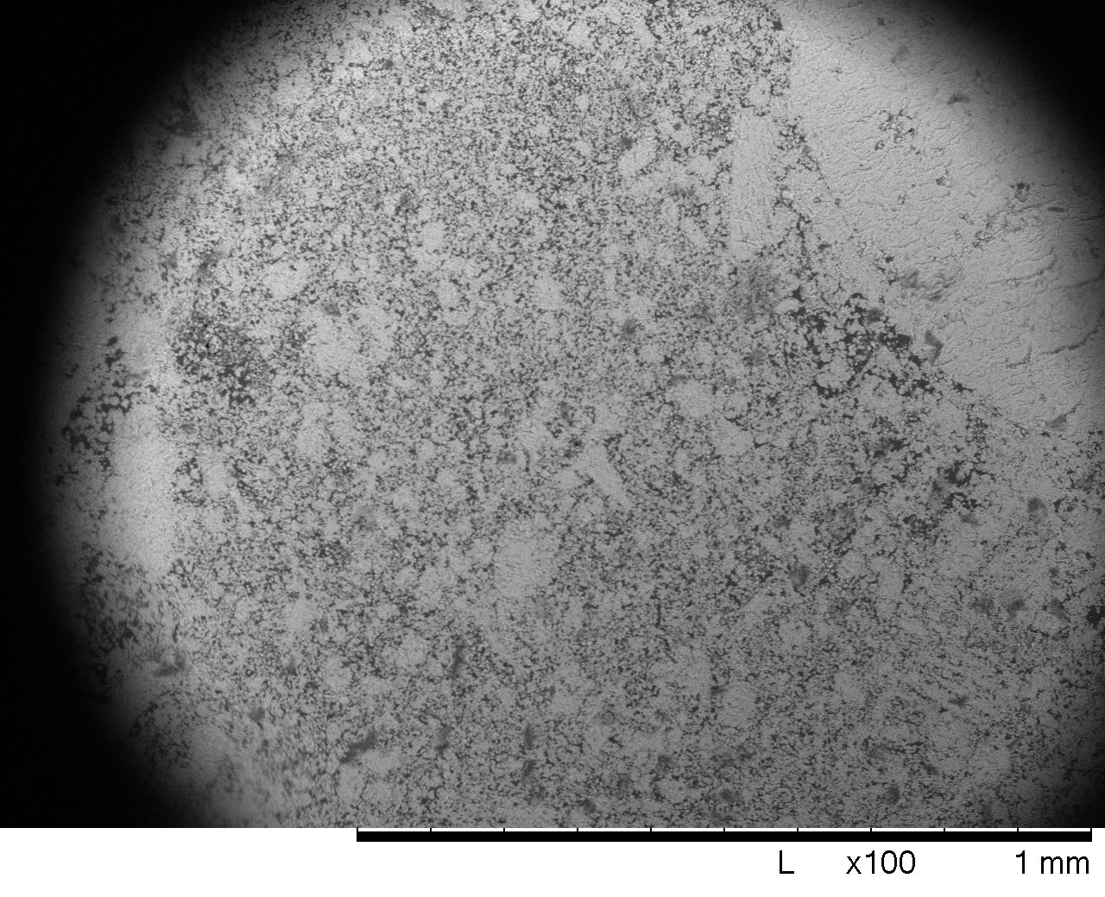
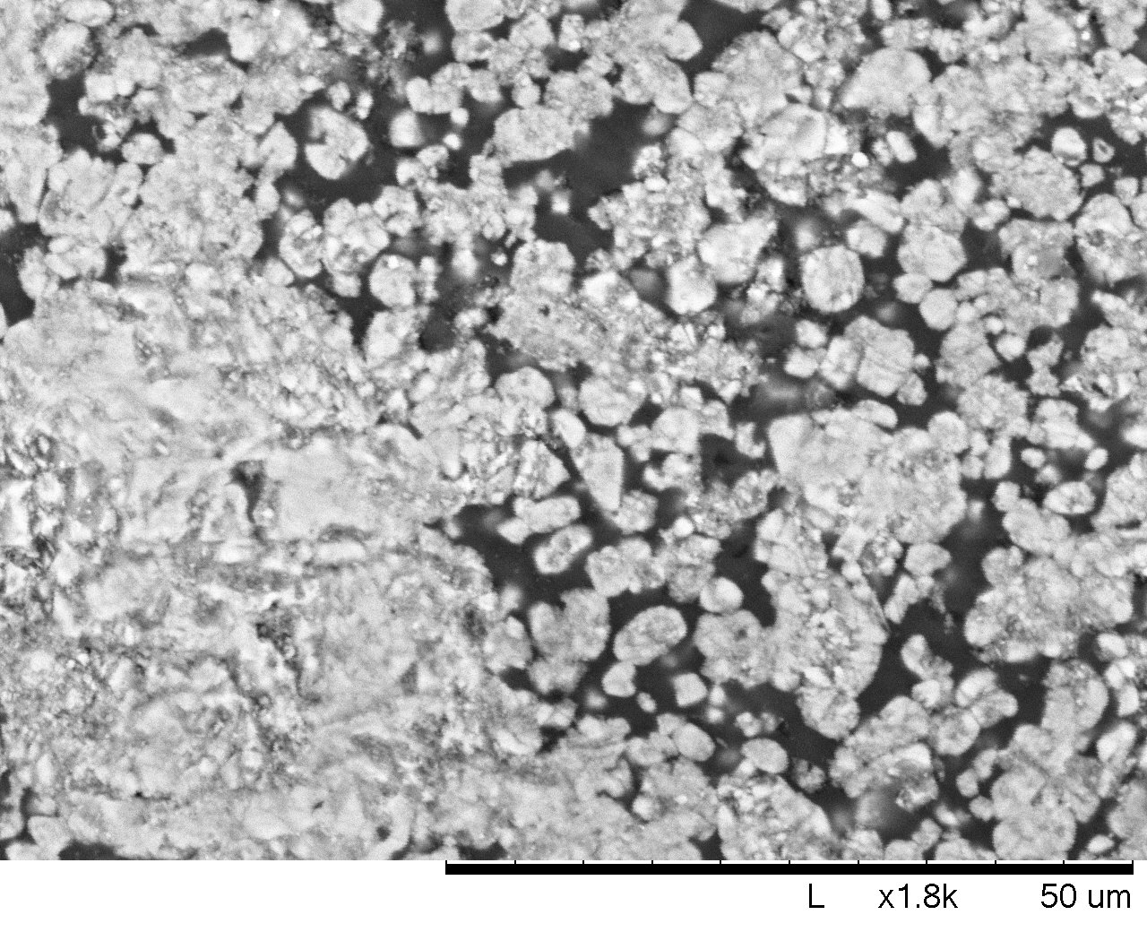
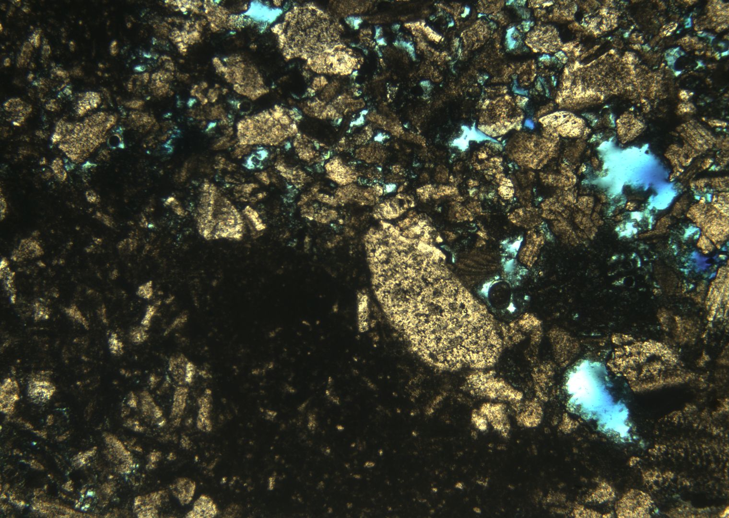
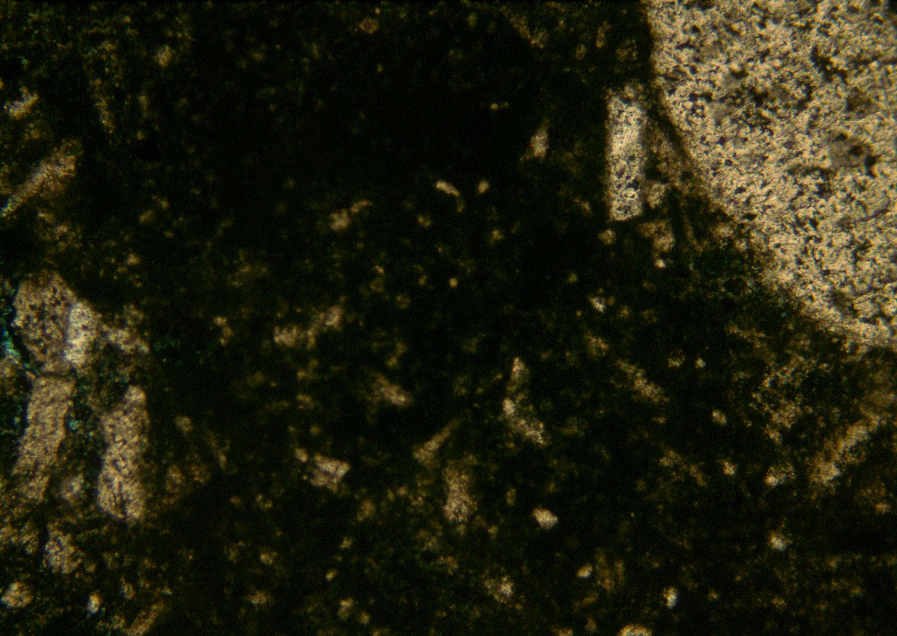
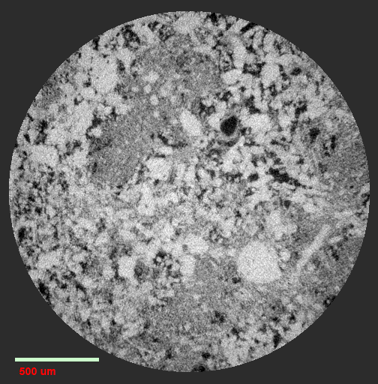
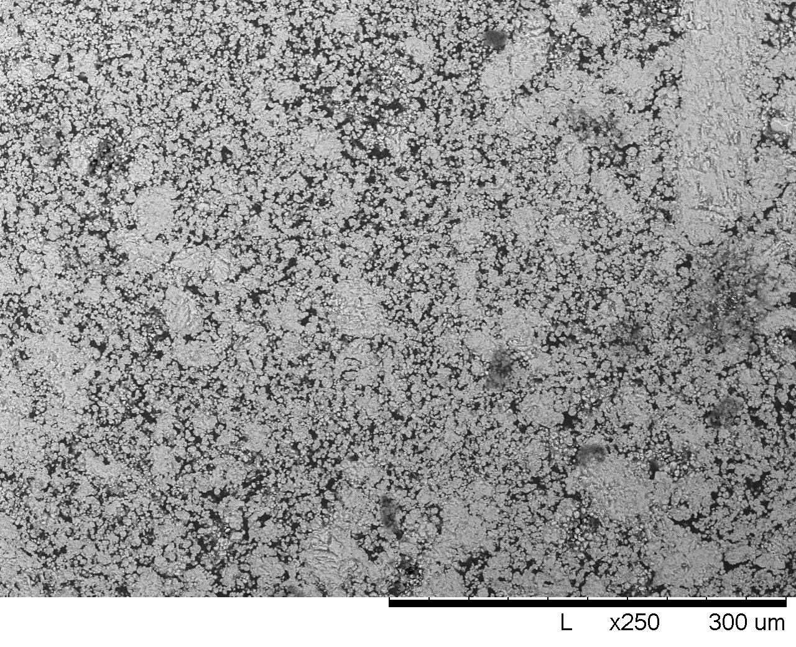
Carbonate Rock Physics
Heterogeneous Microstructure

Slide 23
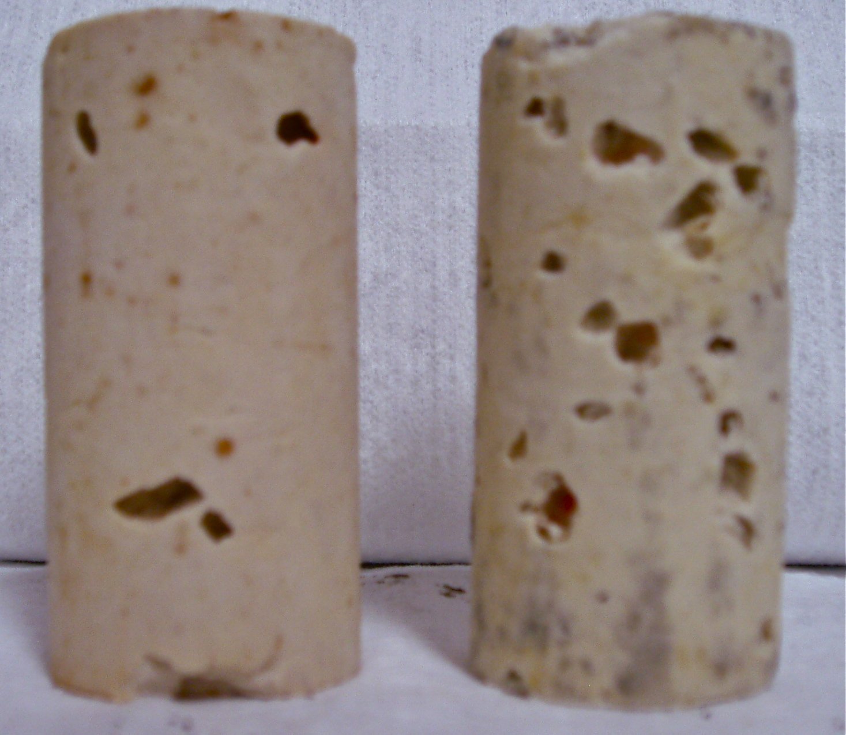
Synthetic Samples

Slide 24
Acknowledgments
Stanford Global Climate and Energy Project Award 55
DOE –NETL Project Award DE-FE0001159
Ingrain Inc., Houston, TX
ExxonMobil Upstream Research Co, TX
Petrobras, Brasil
Stanford Rock Physics & Borehole Consortium

Slide 25
Conclusions
In carbonate rocks, velocity decreases mainly because of the formation of new, more complaint pores. Carbonates become more sensitive to pressure upon injection; i.e., the fraction of complaint pores increases.
Sandstones experience larger decrease in velocity as well as larger compaction than carbonates; velocity decreases because of dissolution of cement at the grain contacts.

Slide 26
CO₂ Injection in Sandstones
Velocities of the dry rock frame after injection

Slide 27
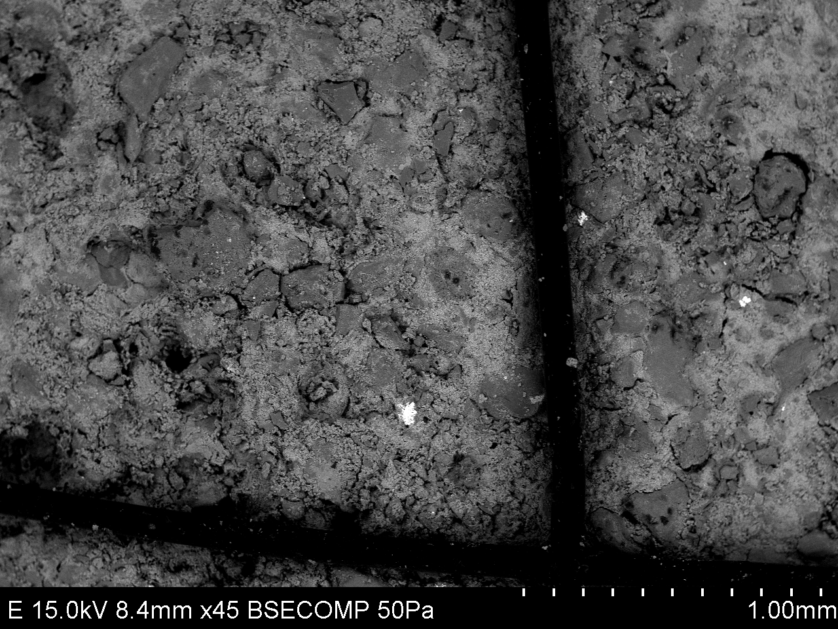
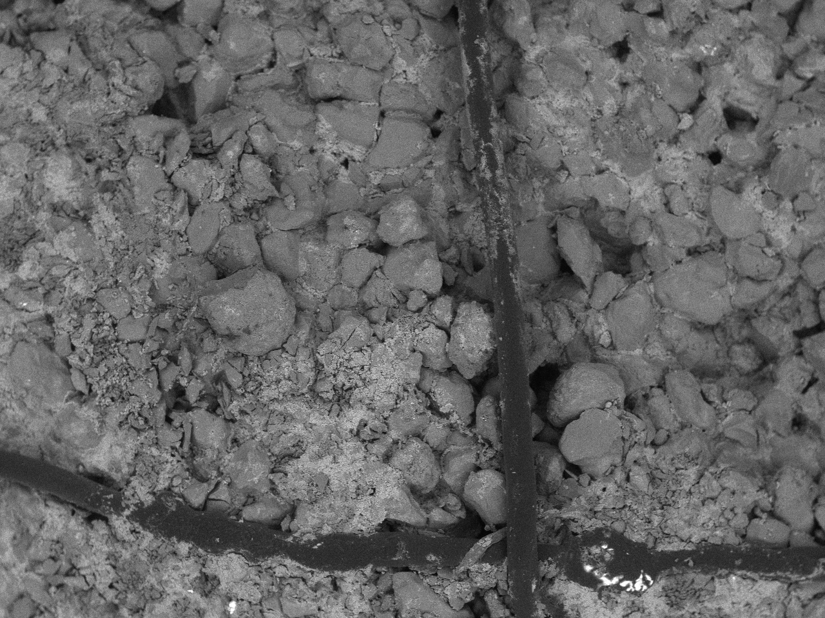
Time-Lapse SEM

Slide 28
Post-Injection Characterization

Slide 29
Time-Lapse NMR
T2 is inversely proportional to Surface/Volume ratio of the pore space
Pore coupling
Tight Limestone
Micritic Carbonate
“New pore space”
Smaller Pores
Larger Pores
Grombacher and Vanorio, 2011- Geophysics

Slide 30
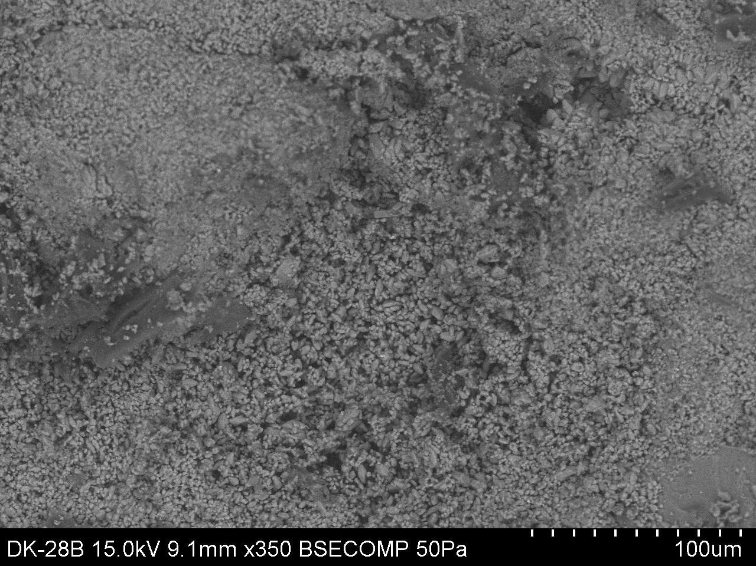
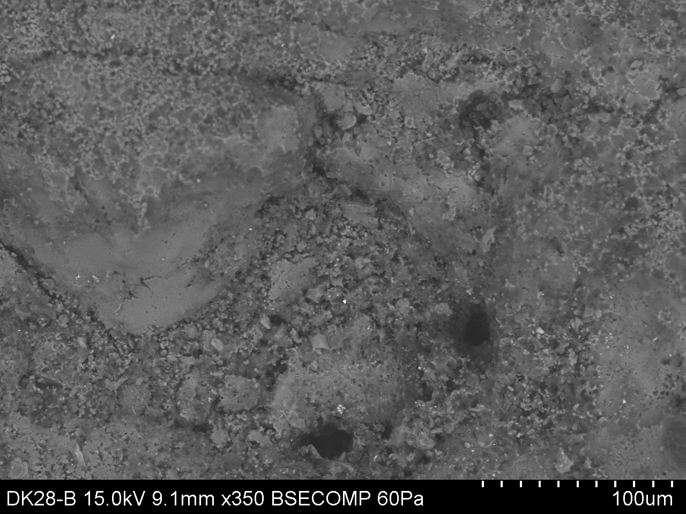
Time-Lapse SEM

