Slide 1
Ultrasonic Studies of Stressed Sand and Clay
Mohammad Hossain Bhuiyan
& Rune M Holt
NTNU & SINTEF, Trondheim, Norway

Slide 2
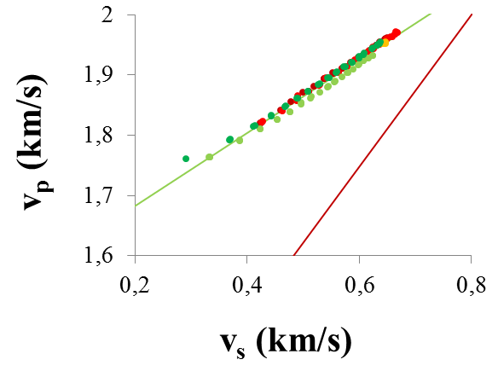
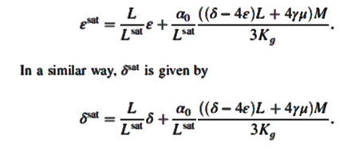
Motivation
Explore the effect of fluid substitution on anisotropic parameters
Explore the behavior of v_{p}/v_{s} for sand and clay
Impact of fluid substitution on Anisotropy? (Collett & Gurevich, 2013; Thomsen, 2012)
How well known v_{p}/v_{s} trends does not works for uncosolidated sediments?

Slide 3
Effect of fluid on anisotropic parameters

Slide 4
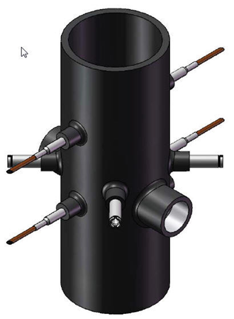
Lab tests in triaxial set-up (only unsorted Ottawa sand)
Dry
Saturated
Saturated with 3,5wt% NaCl
Multi-directional P- & S-wave velocity measurements permit determination of all 5 TI elastic stiffness parameters => Thomsen's ε, γ, δ (+ η)

Slide 5
Effect of fluid on Epsilon (Uniaxial strain condition)
dry

Slide 6
Effect of fluid on Epsilon (Uniaxial strain condition)
Sat
dry

Slide 7
Effect of fluid on Epsilon (Uniaxial strain Condition)
Dry + Isotropic Gassmann
Sat
dry

Slide 8
Effect of fluid on Epsilon (Uniaxial strain Condition)
Dry + Anisotropic Gassmann
Dry + Isotropic Gassmann

Slide 9
Effect of fluid on Epsilon (Hydrostatic stress)
dry

Slide 10
Effect of fluid on Epsilon (Hydrostatic stress)
dry
Saturated

Slide 11
Effect of fluid on Epsilon (Hydrostatic stress)
dry
Dry + Isotropic Gassmann
Saturated

Slide 12
Effect of fluid on Epsilon (Hydrostatic stress)
dry
Dry + Isotropic Gassmann
Dry + Anisotropic Gassmann
Saturated

Slide 13
Effect of fluid on Gamma (Uniaxial strain condition)

Slide 14
Effect of fluid on Gamma (Uniaxial strain condition)

Slide 15
Effect of fluid on Gamma (Hydrostatic stress)

Slide 16
Effect of fluid on Gamma (Hydrostatic stress)

Slide 17
Effect of fluid on Delta (Uniaxial strain condition)
Dry

Slide 18
Effect of fluid on Delta (Uniaxial strain condition)

Slide 19
Effect of fluid on Delta (Uniaxial strain condition)

Slide 20
Effect of fluid on Eta (Uniaxial strain condition)

Slide 21
Effect of fluid on Eta (Uniaxial strain condition)

Slide 22
Effect of fluid on Eta (Uniaxial strain condition)
C₃₃
C₃₃

Slide 23
Vp-Vs
(sand-clay)

Slide 24
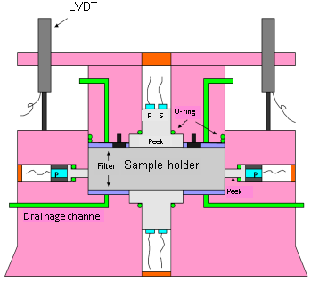
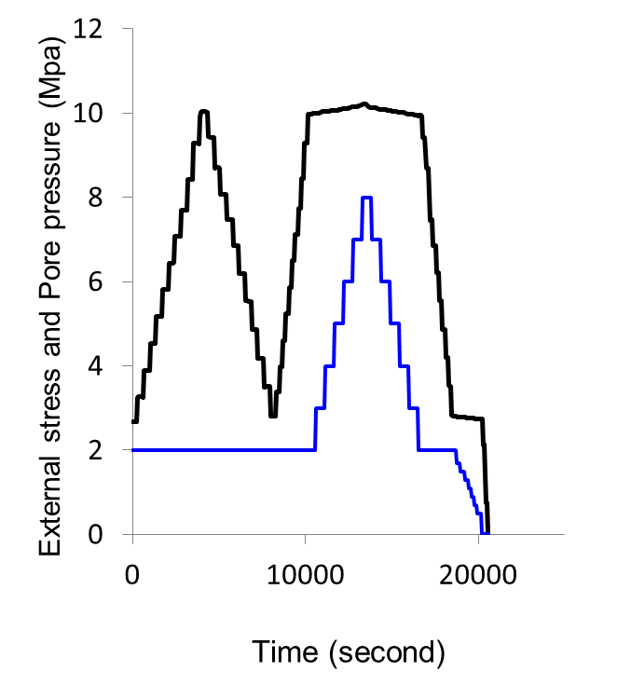
Lab tests in Oedometer
Only saturated (sand-clay)
dry
saturated
Fluid effects
(only sand)

Slide 25
Vp/Vs: Role of fluid (only sand data)
Data from Oedoemeter
Dry

Slide 26
Vp/Vs: Role of fluid (only sand data)
Data from Oedoemeter
Saturated
Dry

Slide 27
Vp/Vs: The role of clay content and stress
Data from tests with brine-saturated sand, clay (kaolinite) and sand:clay mixtures
v_{P}/v_{S} decreases with stress, more in clay than in sand
Clay shows higher v_{p}/v_{s} than sand

Slide 28
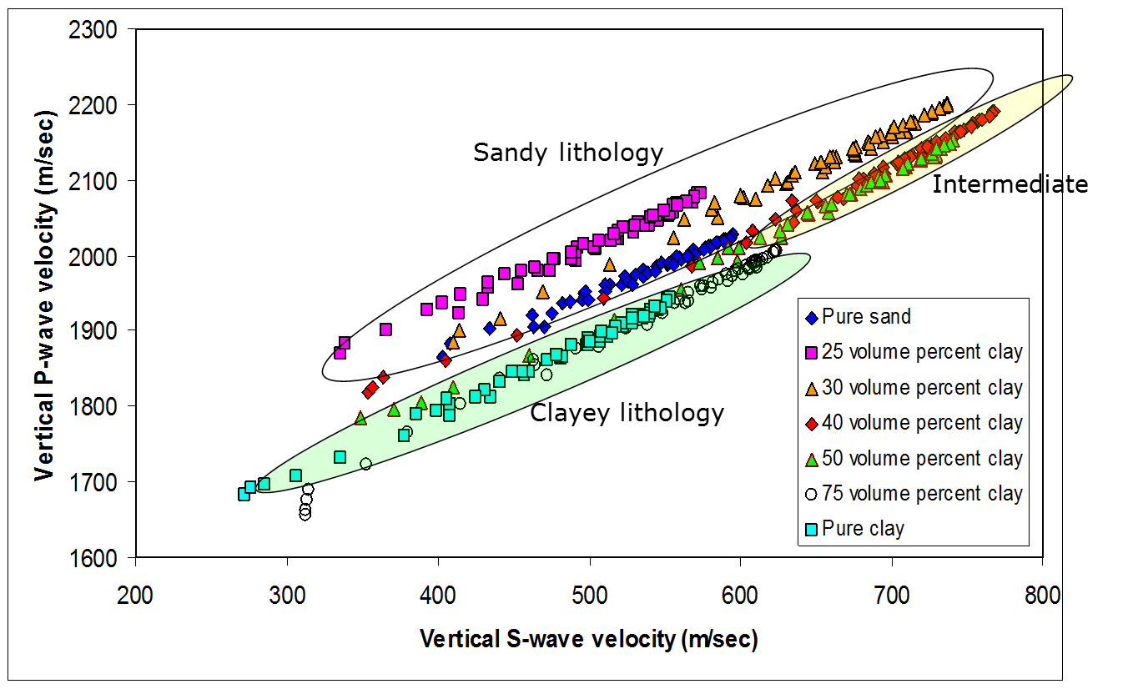
Vp/Vs trends
Oedometer tests performed with brine-saturated sand, clay (kaolinite) and sand:clay mixtures have been used to address v_{P} vs. v_{S} trends (here: only axial velocities)

Slide 29
v_{P}/v_{S}: trends for sand
Higher velocities for Ottawa than for angular Columbia sand, but similar v_{P}-v_{S} trends
Plotting v_{P} vs v_{S} gives a better picture than showing v_{P}/v_{S} alone
No obvious effect of grain size

Slide 30
v_{P}/v_{S}: global trends for sand
The trends are different from data at low stress (< 10 MPa) and above
Data from Zimmer, 2003 (Diamond); Domenico, 1977 (circular), Prasad, 1988 (square); Mondol et al., 2010 (triangle) and Yin, 1992 (star)

Slide 31
v_{P}/v_{S}: trends for clays
The trends are different from sand + again for data at low stress (< 10 MPa) vs. above
Diamonds: This study
Squares: Mondol et al. (2009)
Circles: Yin (1992) (hydrostatic data)

Slide 32
Vp/Vs: Role of state of consolidation and clay content

Slide 33
v_{P}/v_{S}: The role of Stress Path (only for sand)
Ottawa sand data from triaxial set-up, showing apparent data collapse when v_{P}/v_{S} is plotted against net mean stress

Slide 34
v_{P}/v_{S}: The role of Stress Path (only for sand)
Ottawa sand data from triaxial set-up, showing apparent data collapse when v_{P}/v_{S} is plotted against net mean stress

Slide 35
v_{P}/v_{S}: The role of Stress Path (only for sand)
Ottawa sand data from triaxial set-up, showing apparent data collapse when v_{P}/v_{S} is plotted against net mean stress

Slide 36
v_{P}/v_{S}: The role of Stress Path (only for sand)
Ottawa sand data from triaxial set-up, showing apparent data collapse when v_{P}/v_{S} is plotted against net mean stress

Slide 37
Conclusions
Comparison between measured dry and saturated anisotropy parameters are conformable with theory within experimental uncertainty
v_{P}/v_{S} relation is sensitive to fluid saturation, stress, lithologies and state of consolidation.
Well known v_{p}/v_{s} trends fail to explain v_{p}/v_{s} relation for uncosolidated sandy lithologies but fairly capture for clayey lithologies.

Slide 38
Acknowledgements
ROSE Program at NTNU for financial support
Jørn Stenebråten & others in the Formation Physics Laboratory at SINTEF & NTNU

