Slide 1
The impact of partial CO₂ saturation on seismic velocities of sandstones
ROSE Meeting 24th – 27th April 2017
By
Nicolaine Agofack, Andreas Bauer, Serhii Lozovyi
Acknowledgments: Rune M. Holt, Dawid Szewczyk, Pierre Cerasi, Øyvind Haave

Slide 2
Outline
1. Problem statement
2. Tested material and experimental setups
3. Results and discussion
4. Modelling
5. Some conclusions

Slide 3
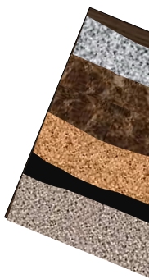
Context : CO₂ storage and monitoring
Global climate change
CO₂ Capture and Storage (CCS)
Transport
Capture
a well
CO₂ remains the most important of these gases (IPCC, 2007)
One of the major challenges is monitoring of CO₂:
Mapping its movement in the subsurface
Demonstrating that it is stored safely in the reservoir
Reservoir
(Xue & Ohsumi, 2004)

Slide 4
Context : Field frequency versus Lab frequency
Time-lapse (4D) seismic is one of the powerful tools for monitoring and detection of leakage.
(Murphy III, 1982)
Velocities of partially saturated rocks exhibit dispersion (change with frequency)
It is possible to measure the dynamic stiffness of a rock at seismic frequencies (in the lab), and seismic velocities are calculated under the assumption of a homogeneous rock mass and the absence of macroscopic dispersion effects (Spencer, 1981)
Seismic wave velocity also depend on:
Pore fluid and pore pressure
Degree of saturation of pore fluid
Differential pressure
Porosity and permeability of the rock, …

Slide 5
Saturation procedure
Mixing of CO₂ and water under high pressure at room temperature → CO₂ dissolved into water.
n
Flowing of water saturated with CO₂ into a sample under pressure slightly ( ̴ 5%) higher than the mixed pressure → Prevent CO₂ to come out of water during this process.
n
n
Decreasing of pore pressure at constant differential stress and temperature → decrease of CO₂ solubility and some CO₂, called «free CO₂» come out of the solution and is distributed at different regions of the sample (assumed homogeneous at mesoscopic scale).
n
n
n
Estimation of the degree of saturation of free CO₂ for different decrease of pore pressure, (based on thermodynamic properties of CO₂ and water)

Slide 6
Experimental setups
Water + CO₂ mixing setup
Triaxial cell
(refer to D. Szewczyk’s presentation)
Confining fluid line
Evacuation (out of the Lab)
Piston
Vacuum pump
Confining chamber
V_{v1}
V_{v2}
V₁
V₂
V₃
V_{e}
LVDT
Strain Gauge
P1
Pg1
Sample
V₅
Accum Mixer and Bottom Pp
V₄
Aluminium with strain gauge
Accumulator
Mixer
Temperature Controller
Piezoelectric force sensor
CO₂ bottle
TC3
V_{out}
V_{in}
TC2
V₆
TC1
After mixing, V₆ and V_{in} are opened and
water + dissolved CO₂ is injected
Pore fluid lines:
Water
Water + dissolved CO₂

Slide 7
Experimental procedure
Loading path and CO₂ Saturation.
Axial stress
16.5
Pressures and stress
14.5
14.5
14 MPa
Flowing Water-CO₂
12.5
7.5
Axial stress
12 MPa
Test
Water-sat
5.5
sam
Test
W+CO₂-sat
5 MPa
Test
Presence of free CO₂ (gas)
Confining pressure
Test
Water-sat
Pore pressure
Alu
Time
Seismic frequency measurement
Sinusoidal stress applied: sample & aluminium
V_{out}
V_{in}
Strains ε_{alu} and ε_{sam} are measured by strain gauges
Water
Axial stress : is constant
Water + dissolved CO₂
Young modulus
Poisson ratio

Slide 8
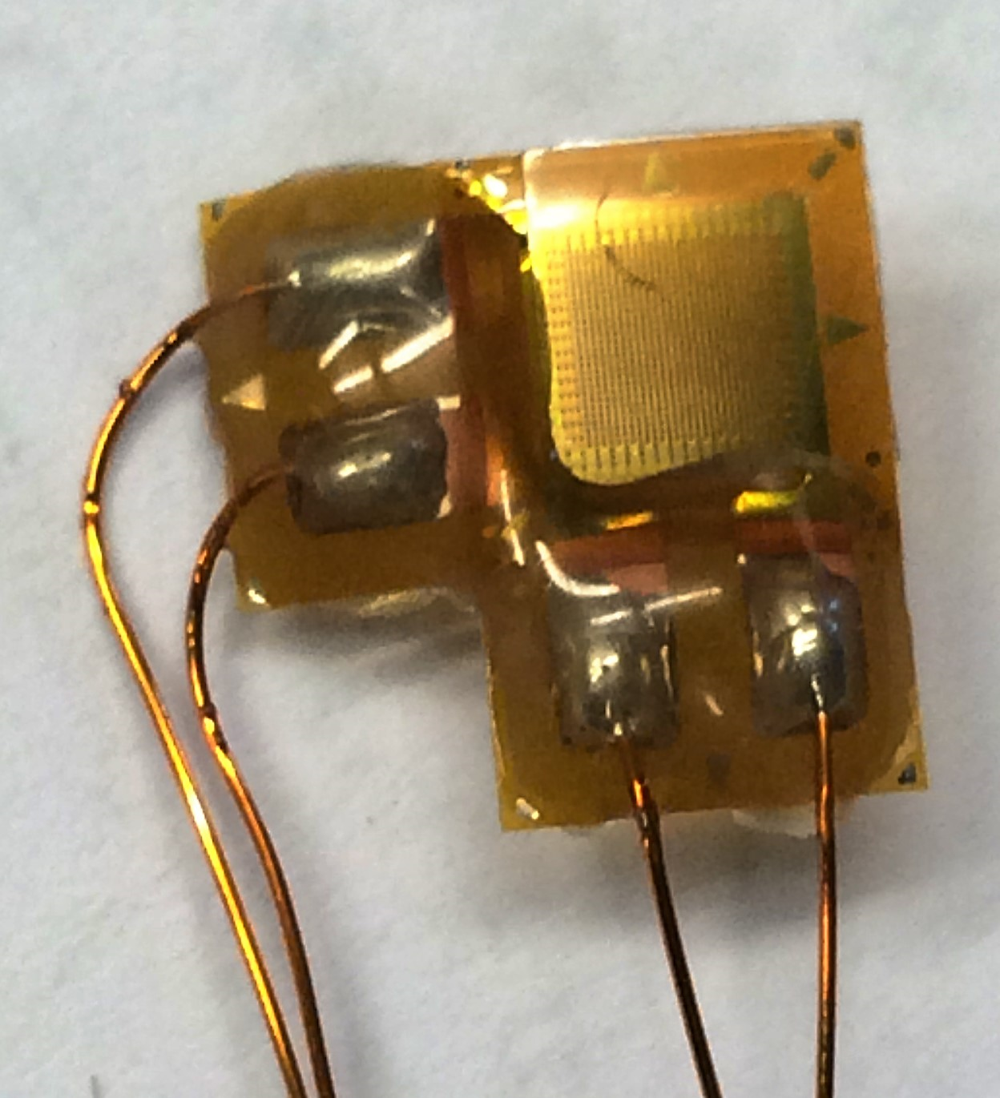
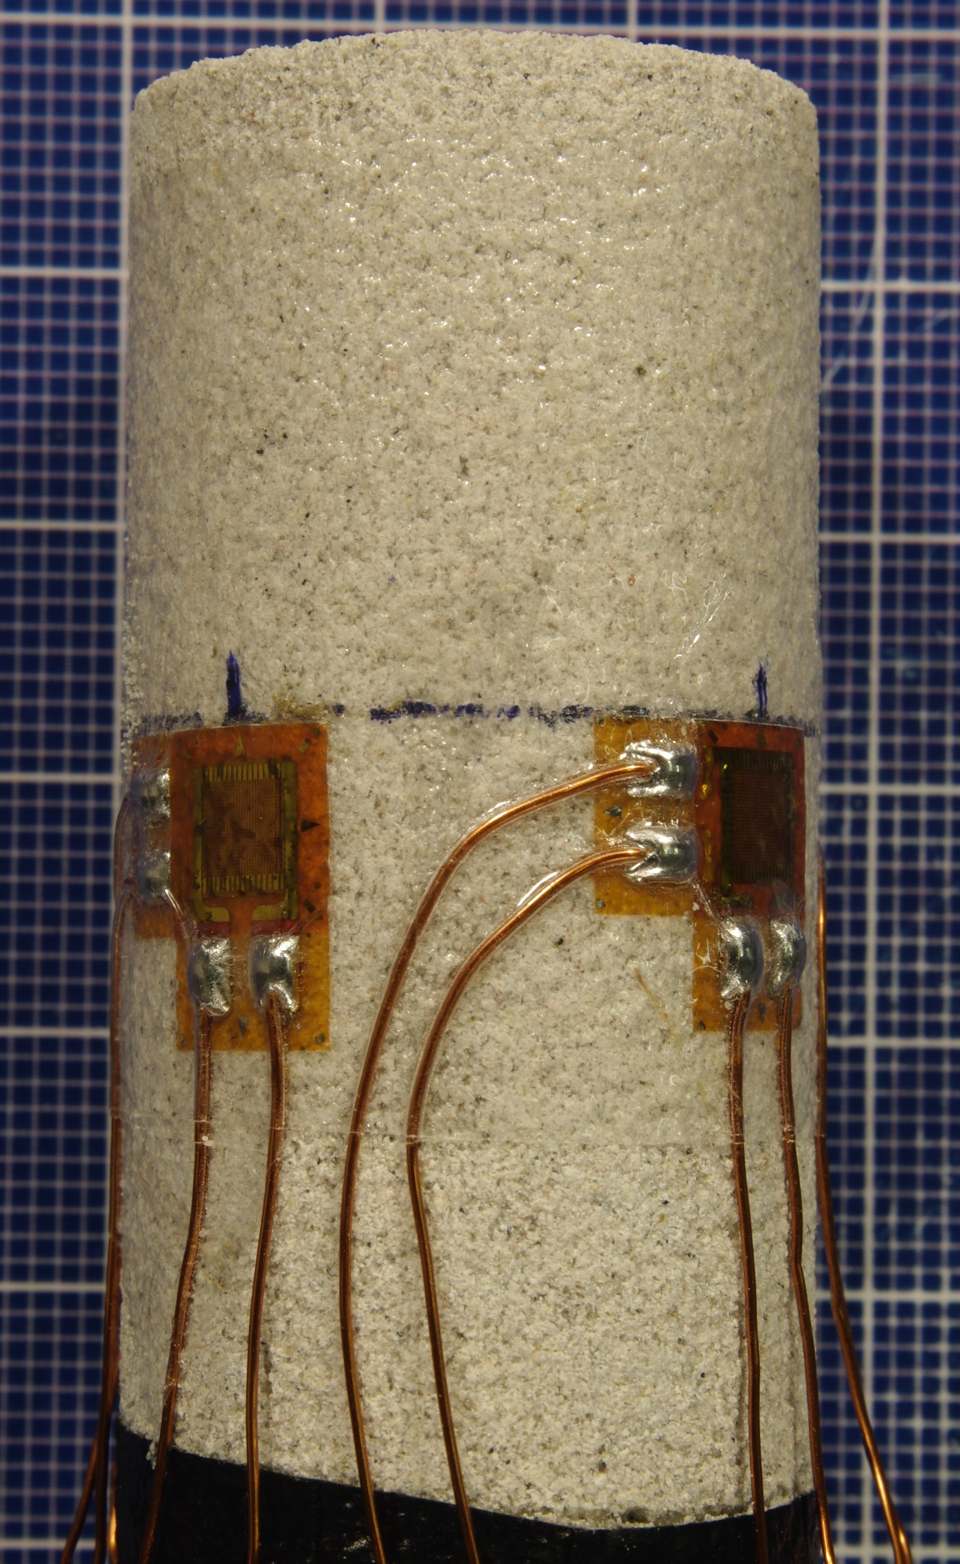
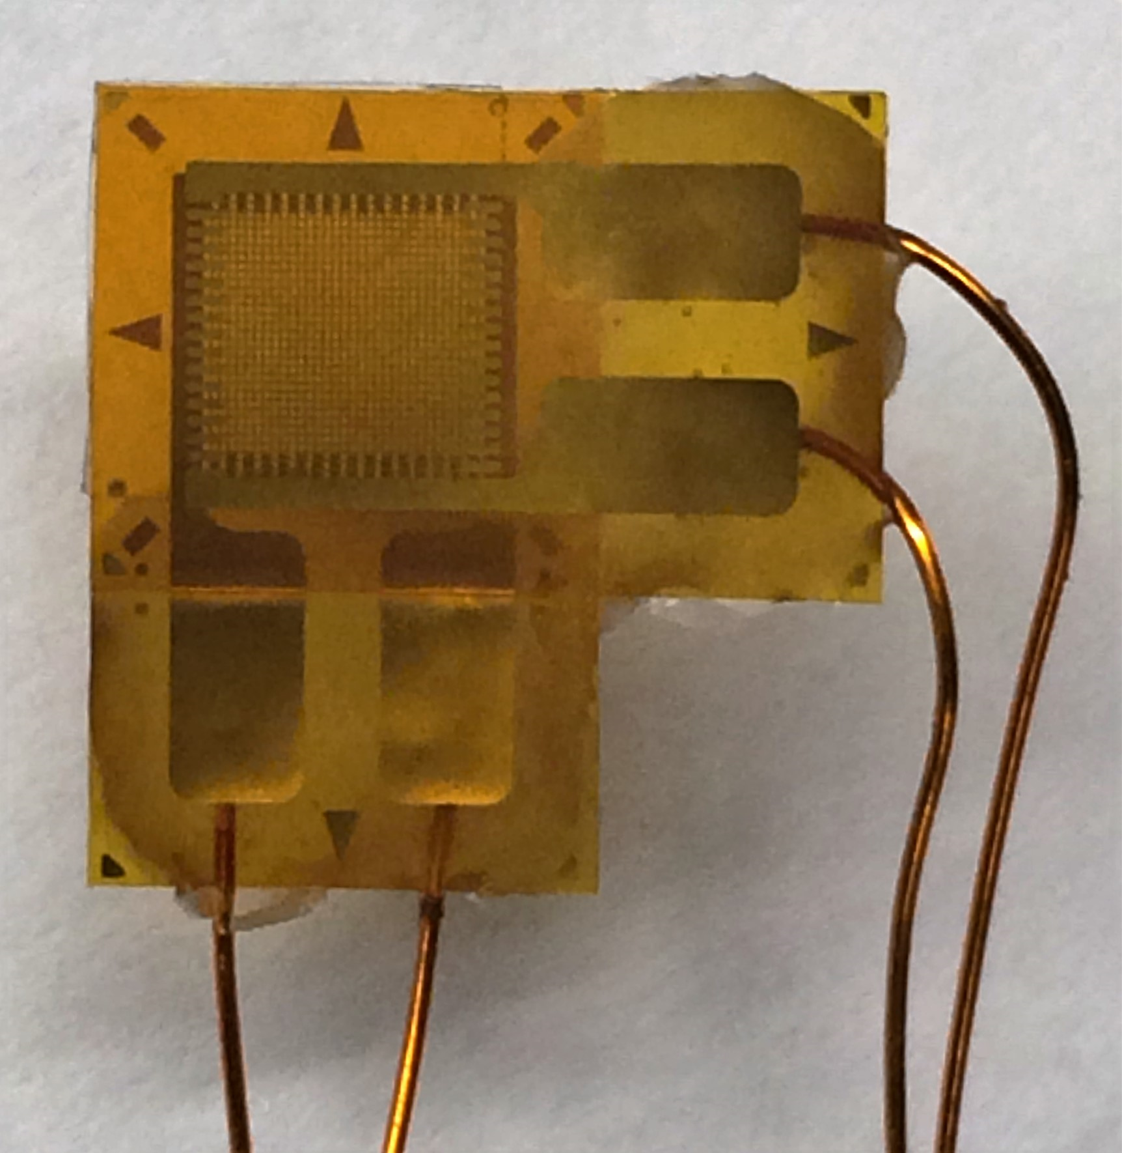
Tested material and experimental setups
Castlegate Sandstone was used in this experiment.
It has about 29% of porosity, composed of 70% quartz and contain no clay. Its permeability is around ̴ 10⁻¹⁴ m² (10 mD)
Properties of the sample
4 strain gauges used
Sample with strain gauges
Property | Value
Diameter (cm) | 2.512
Length (cm) | 5.116
Cross-section (cm²) | 4.958
Weight (g) | 46.34
Density (g/cm³) | 1.847

Slide 9
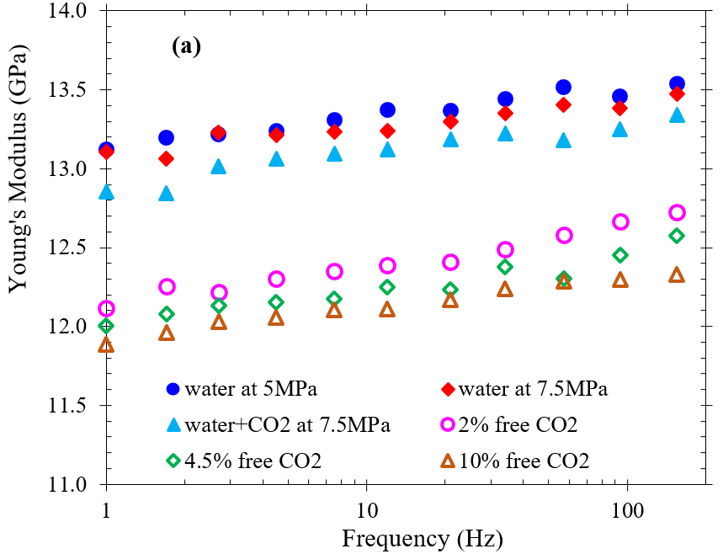
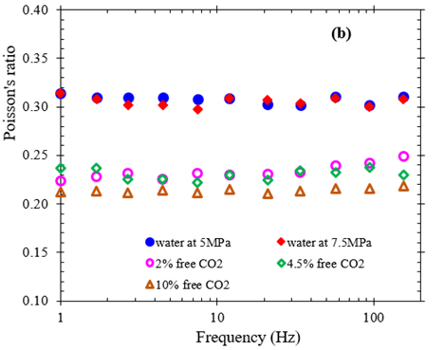
Results and interpretation
Young modulus and Poisson ratio
Young modulus
Poisson ratio
Liquid-saturated sample
Partially Gas-saturated sample
The presence of “free” gas CO₂ drops significantly the Young modulus and the Poisson ratio

Slide 10
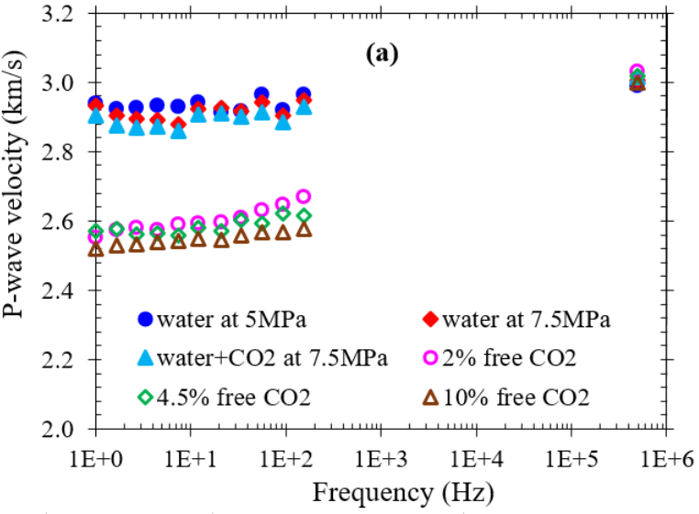
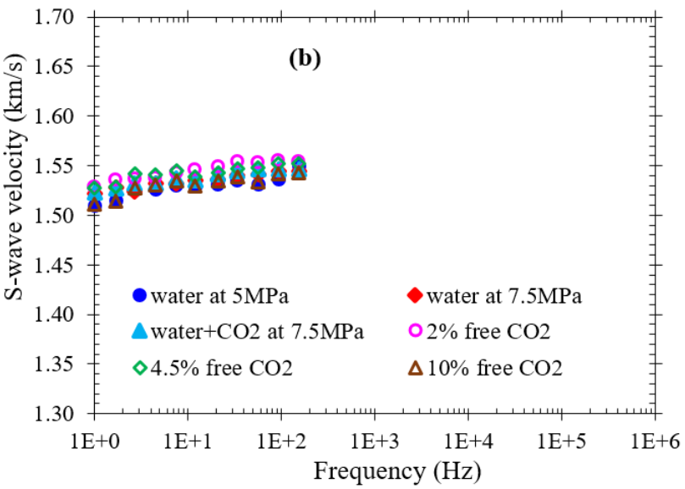
Results and interpretation
Evaluation of P- and S-wave velocities
Assuming that the sample is isotropic, homogeneous and linear elastic, P-wave and S-wave velocities are calculated from Young modulus, Poisson ratio and rock’s density.
P-wave velocity
S-wave velocity
No data
At ultrasonic frequency, P-wave velocity was evaluated from the travel time.

Slide 11
Modelling / Isothermal or adiabatic conditions ?
K_{f} of the pore fluid needs to be evaluated in Gassmann model, specially in a closed system composed of water with dissolved CO₂ + free CO₂
p
p
dm
- dm
Free CO₂
Free CO₂
Water saturated with CO₂
Water saturated with CO₂
Isothermal (zero frequency) with dissolution of CO₂
Adiabatic without dissolution of CO₂
free CO₂
Water with dissolved CO₂
Due to dissolution of free CO₂
Reuss average

Slide 12
Modelling / Isothermal or adiabatic conditions ?
K_{f} of the pore fluid needs to be evaluated in Gassmann model, specially in a closed system composed of water with dissolved CO₂ + free CO₂
Test | ρ_{saturated rock} (g/cm³) | K_{f}^{isot} (GPa) | K_{f}^{adia} (GPa)
water at 5MPa | 2.137 | 2.2394
water at 7.5MPa | 2.138 | 2.2544
water+CO₂ at 7.5MPa | 2.142 | 2.1992
2% free CO₂ | 2.137 | 0.0268 | 0.3091
4.5% free CO₂ | 2.130 | 0.0175 | 0.1326
10% free CO₂ | 2.115 | 0.0106 | 0.0540
Bulk modulus K_{f} of the pore fluid is significantly affected by the presence of free CO₂
The adiabatic modulus is more than 5 times higher than the isothermal one

Slide 13
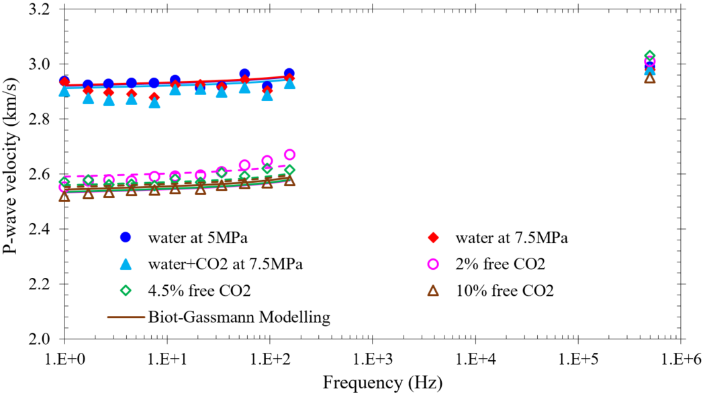
Biot-Gassmann Modelling
P-wave velocity
isothermal
adiabatic
Data consistent with B-G model at seismic frequency
Dispersion at ultrasonic frequency needs to be considered

Slide 14
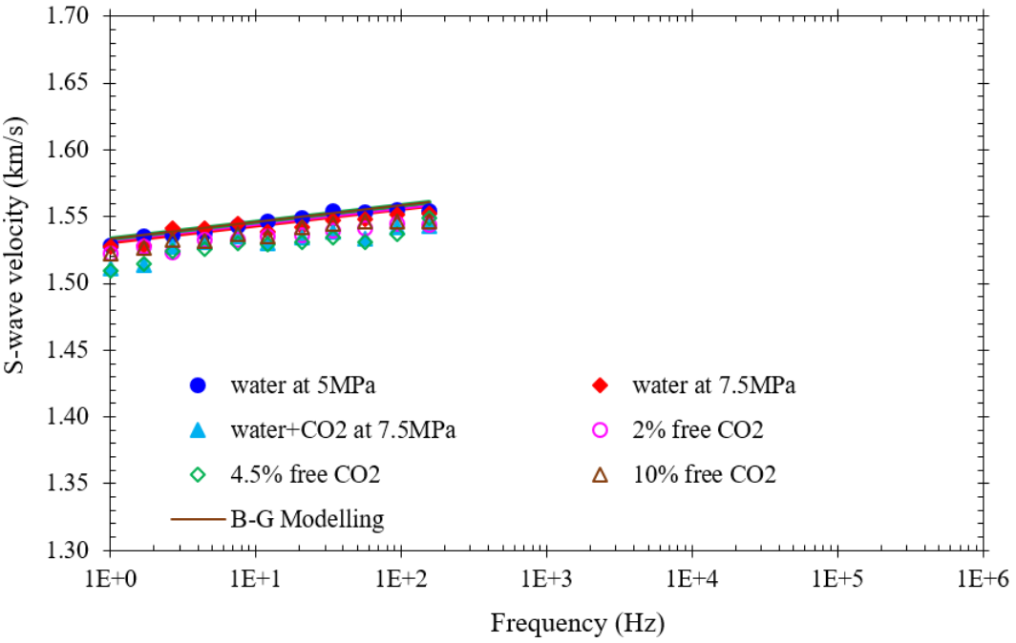
Biot-Gassmann Modelling
S-wave velocity
As assumed by B-G model, S-wave velocity is hardly affected by pore fluid.

Slide 15
Conclusions
The measurements presented in this investigation were done on Castlegate Sandstone with 29% of porosity.
A seismic frequency, the presence of free gas CO₂ in the pore space affects significantly the P-wave velocity and attenuation,
A ultrasonic frequency (Lab freq), the presence of free gas CO₂ in the pore space affects hardly P-wave velocity.
S-wave velocity was hardly affected by pore fluid.
The results were consistent with Biot-Gassmann model.
For the sample with free CO₂, significant dispersion was observed.
Dispersion fit and attenuation of P-wave simulated by Cole–Cole model gave a transition frequency at around 200 kHz.

