Slide 1
Low Frequencies for Inversion of Reflections
Lasse Amundsen, Ørjan Pedersen and Rune Mittet

Slide 2
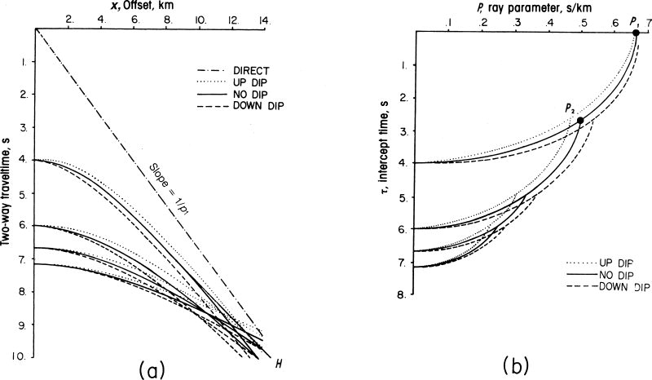
Outline
Motivation for tau-p inversion
Indirect tau-p inversion: FWI with Gauss-Newton scheme
Direct tau-p inversion: Scaling («AVA») and stretching («residial migration») the gradient of constant velocity inversion («c-v migration»)
Discussion/Conclusion
Hyperbolic reflections transform into ellipses, straight events into points.
Phase velocity
$$v(p,z)=\frac{c(z)}{\sqrt{1−{\left(pc(z)\right)}^{2}}}$$

Slide 3
Motivation for tau-p reflection inversion
Fast, elastic Newton-type inversions for VP, VS, density, attenuation …
Used where geology is «flattish»
Unconventionals: «sweet spot» mapping
Gas hydrates
Temperature changes of water column
Starting model for general FWI
Understand the potential, pitfalls, and limitations of FWI
What can the gradient (of the misfit function) offer you “today”?
Effect of missing low frequencies
Assumtions in this presentation
Acoustic wave equation; constant density
Known wavelet
Amundsen and Ursin 1991 F-K inversion of acoustic data: Geophysics 56 1027-1039
Zhao, Ursin and Amundsen 1994 F-K elastic inversion: Geophysics 59 1868-1881
Amundsen, Reitan and Arntsen 2005 Geometric analysis of data-driven inversion/depth imaging: JSE 14 51-62
Amundsen, Reitan, Helgesen and Arntsen 2005 Data-driven inversion/depth imaging: Inverse Problems 21 1823-50
Amundsen, Reitan, Arntsen and Ursin 2006 Acoustic AVA inversion/depth imaging: Inverse Problems 22 1921-45
Amundsen, Reitan, Arntsen and Ursin 2008 Elastic AVA inversion/depth imaging: Inverse Problems 22 1921-45

Slide 4
I. FWI with Gauss-Newton method
$$F\left(m\right)=\frac{1}{2}\sum_{ω}{∆P^{∗}(ω)∆P(ω)}$$
Misfit function is sum over frequencies
$$g=∇F\left(m\right)$$
Gradient of misfit function
$$H=∇^{2}F\left(m\right)$$
Hessian
$$∆m=−H^{−1}g$$
Model update
In tau-p, the gradient can be found analytically when - the sum over frequencies ranges from – to + infinity - the wavelet is unity
Essentially, the gradient becomes a sum of step functions – which is great since it contains information about the velocity profile.
The high frequencies are not important.
Take out low frequencies, and the gradient will change.

Slide 5
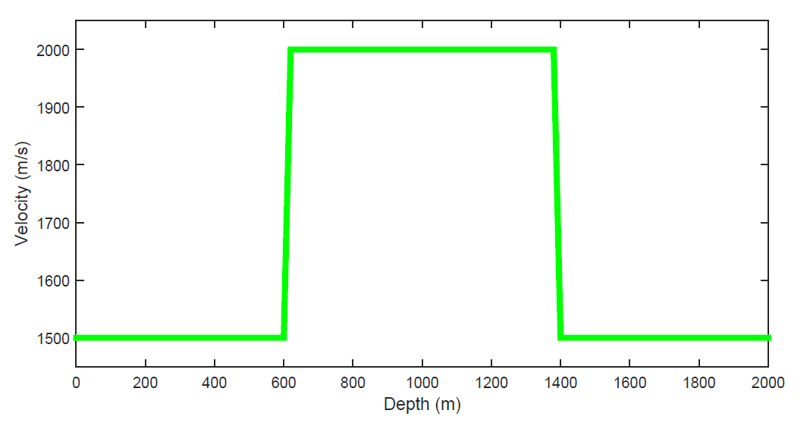
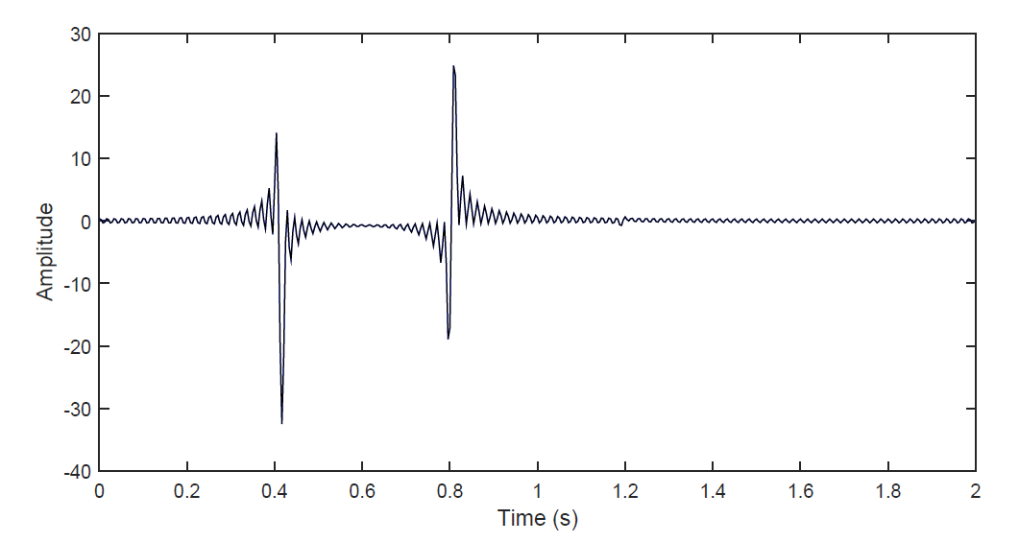
Slab velocity model and tau-data for p=0
$$c_{1}$$
Model parameters M=100
# frequencies N=120 (up to 30 Hz)

Slide 6
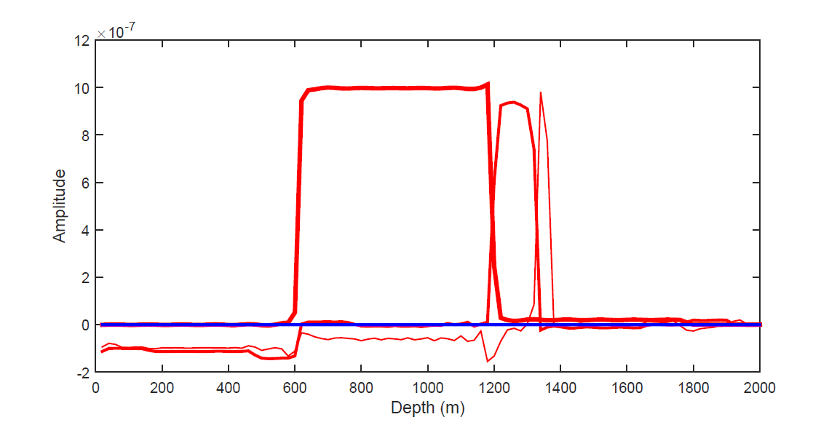
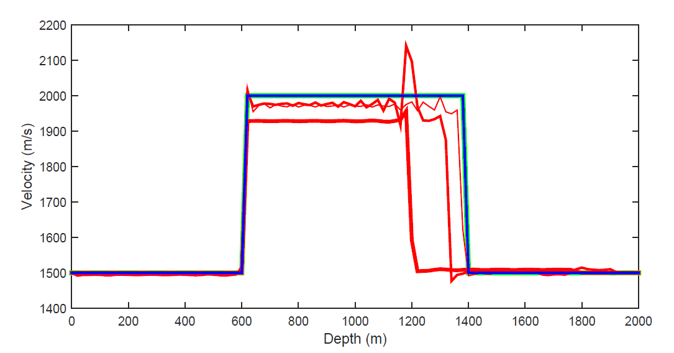
Gradient and velocity updates (GN inversion)
Start model: Constant velocity
Iterations 1,2,3 and 10
$$c_{1}$$
1
2
3
1
2
3
The gradients have layer or box- structure.

Slide 7
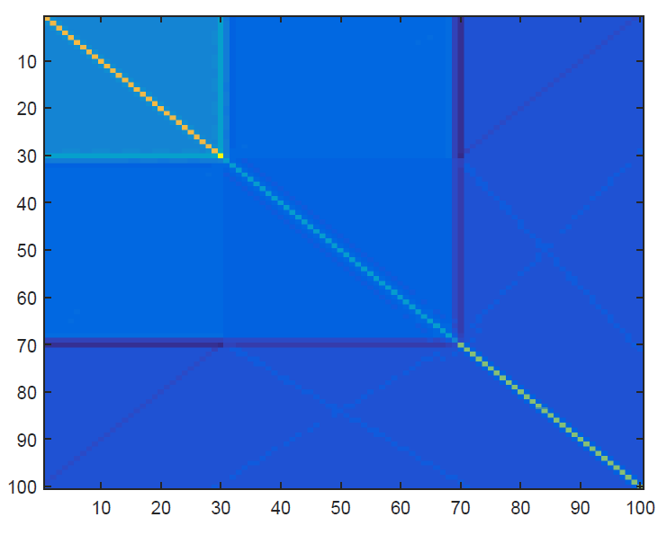
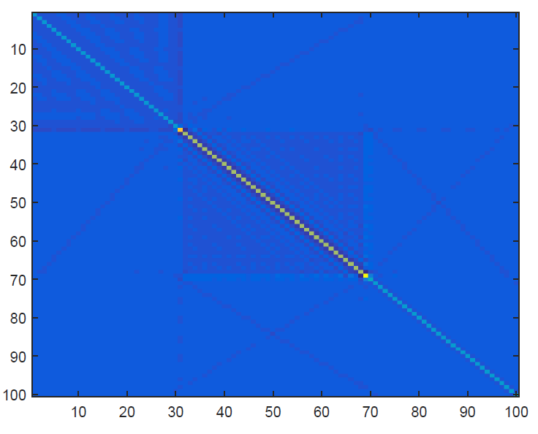
Hessian and its inverse (iteration 10)
Since the gradients have layer-structure, the inverse Hessians do not need to do a big job. No stabilization is needed.

Slide 8
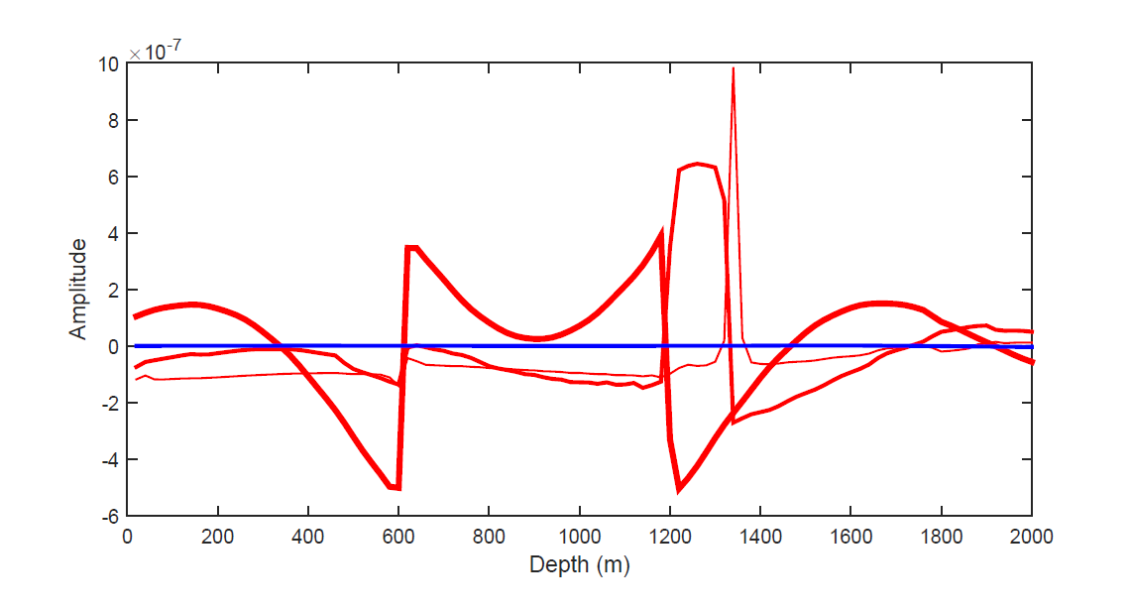
Gradients without and with low frequencies
1
2
3
fmin<1.25 Hz
2
3
fmin=1.25 Hz
1
“What can the gradient (of the misfit function) offer you “today”?”

Slide 9
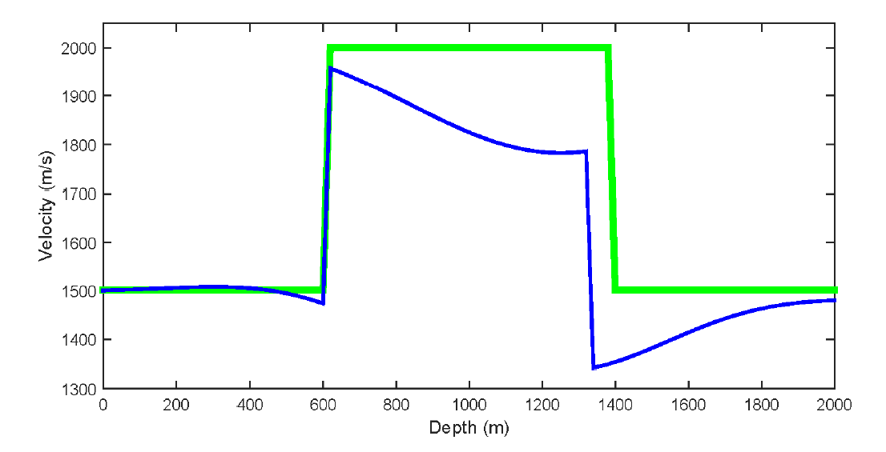
Velocity inversion without and with low frequencies
fmin<1.25 Hz
fmin=1.25 Hz
Both models produce «exactly» the same data and reduce misfit by ${10}^{−6}$

Slide 10
II. Scaling and streching the gradient from constant-velocity inversion
1
$\hat{v}\left(p,z\right)=f[c_{1},∆z,g\left(p,z\right)]$ ; $\hat{v}\left(p,z\right)=\frac{c(z)}{\sqrt{1−{\left(pc(z)\right)}^{2}}}$
Scaling g to get phase velocity v but in “squeezed” geometry;
Scaling = AVA
$$\hat{v}\left(p,z\right)=v\left(p,\int_{0}^{z}{dz^{′}\frac{\hat{v}\left(p,z′\right)}{v_{1}(p)}}\right)$$
Stretching v to phase velocity in «correct» geomery;
Stretching = Residual migration
2
c1, v1 is water-speed velocity … note that scale and stretch depend only on gradient’s amplitude!

Slide 11
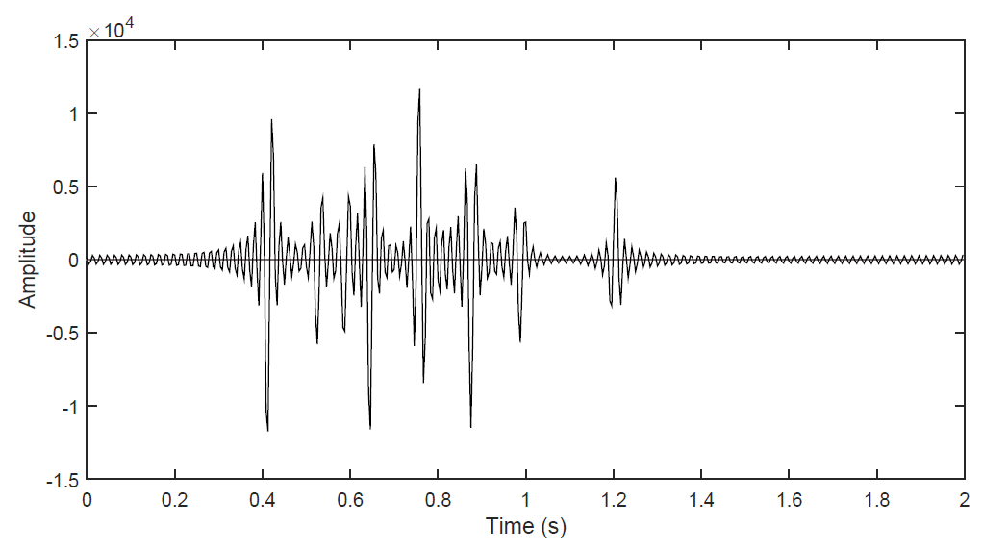
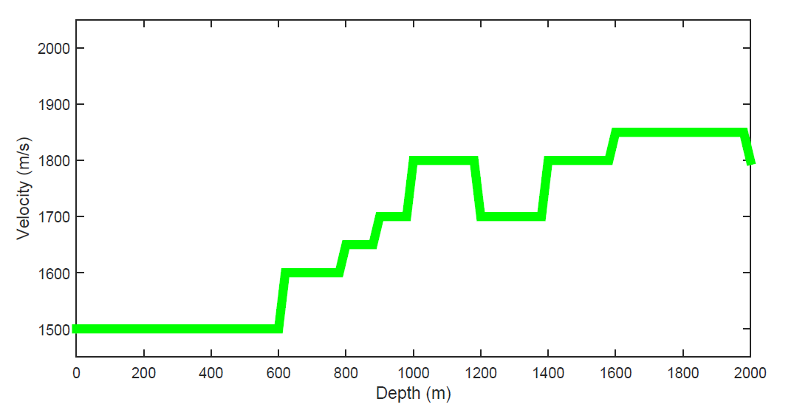
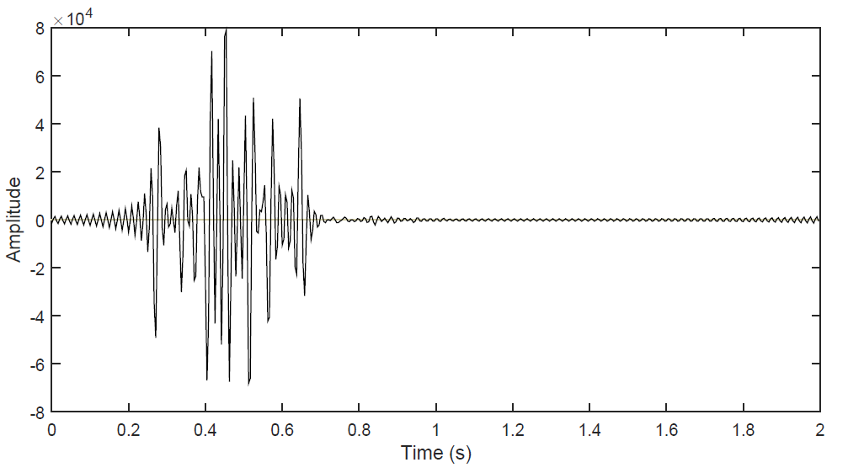
Velocity model and data (p=0 and p=0.75/c1)
p=0
p=0.75/c1

Slide 12
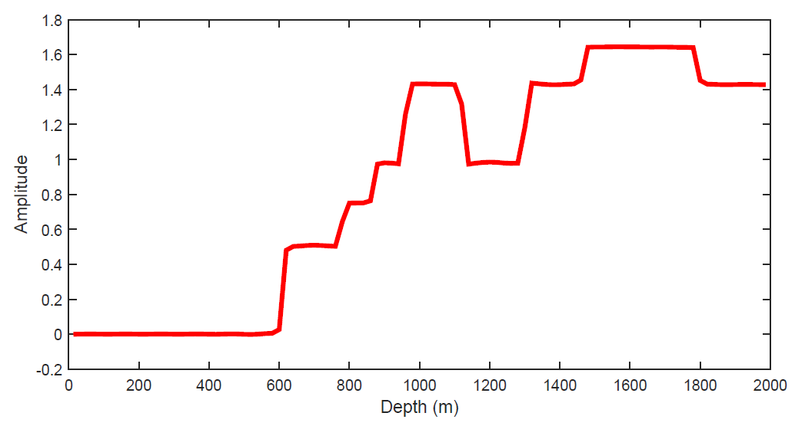
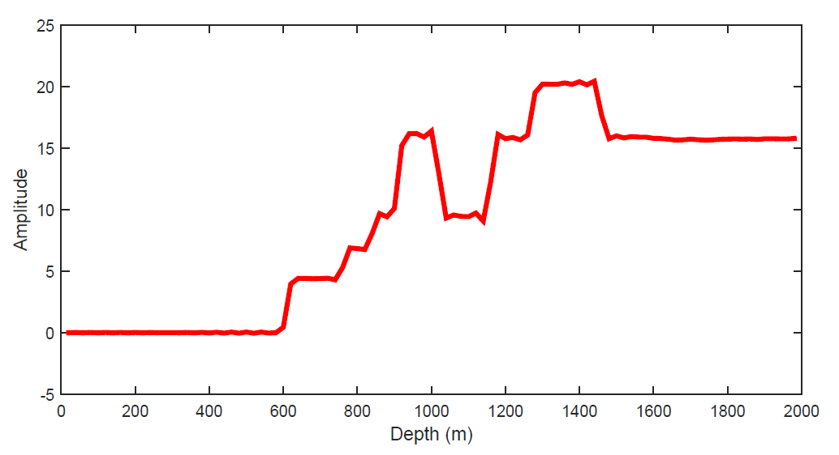

«Constant-velocity» gradients in pseudo-depth
$$g\left(p=0,z\right)$$
$$h_{n}(0)$$
$$c_{n}$$
$$c_{1}$$
$$g\left(p=\frac{0.75}{c_{1}},z\right)$$
$$h_{n}(p)$$
$${Note: c}_{n}=\frac{1}{p}\sqrt{1−(1−{\left(pc_{1}\right)}^{2}){\left(\frac{h_{n}(0)}{h_{n}(p)}\right)}^{2} }$$
Apply AVA to gradient $g$ : $\hat{v}\left(p,z\right)=f[c_{1},∆z,g\left(p,z\right)]$

Slide 13
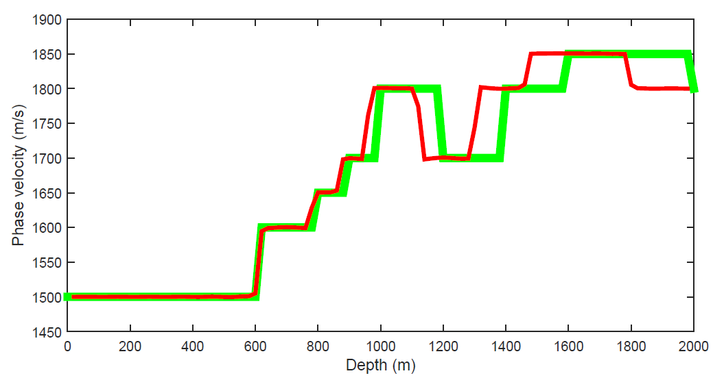
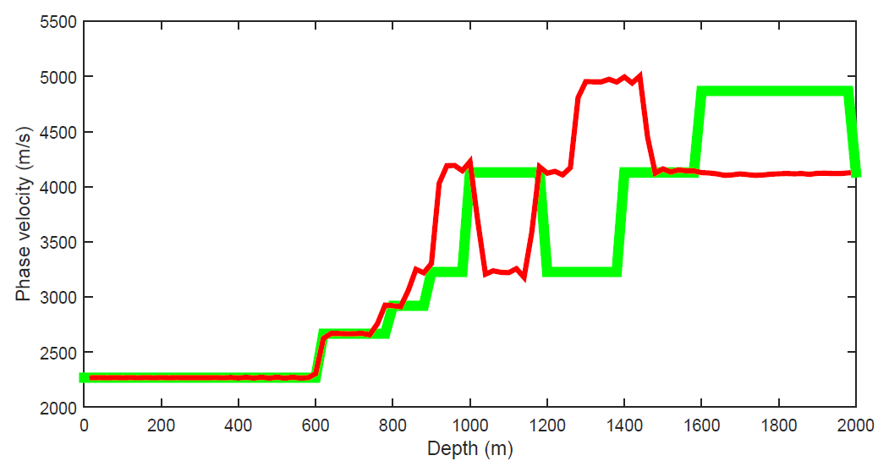

Scale gradients to phase velocity
$$\hat{v}\left(p=0,z\right)$$
$$v_{1}(p=0)$$
$$\hat{v}\left(p=\frac{0.75}{c_{1}},z\right)$$
$Apply residual migration to$ $\hat{v}$: $$\hat{v}\left(p,z\right)=v\left(p,\int_{0}^{z}{dz^{′}\frac{\hat{v}\left(p,z′\right)}{v_{1}(p)}}\right)$$
$$v_{1}(p)$$

Slide 14
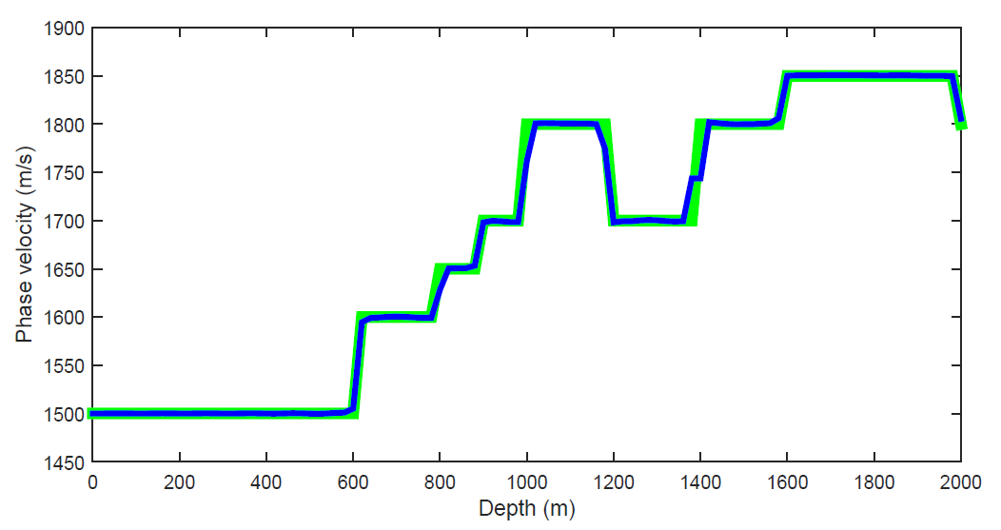
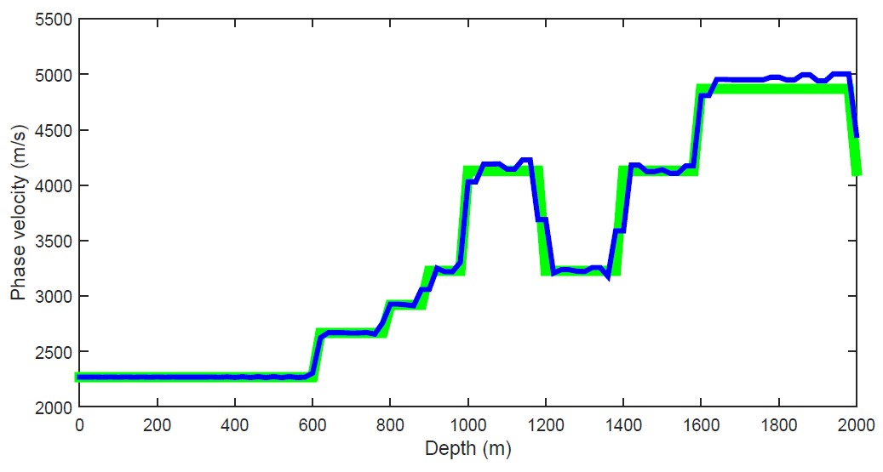
Residual migration («stretching»)
p=0
p=0.75/c1
$Residual migration to$ $\hat{v}$: $$\hat{v}\left(p,z\right)=v\left(p,\int_{0}^{z}{dz^{′}\frac{\hat{v}\left(p,z′\right)}{v_{1}(p)}}\right)$$

Slide 15
Discussion/Conclusion
Need low frequencies to calculate a gradient that carries information of layer velocities
The Hessian can partly correct the gradient for missing low frequencies
Scaling and stretching the gradient shown for plane-layer tau-p inversion – need generalization to laterally varying medium … tougher problem to handle

