Slide 1
A new parameterization in acoustic orthorhombic media
Shibo Xu* and Alexey Stovas
Norwegian University of Science and Technology
23th April. 2018

Slide 2
The parameterization matters !
Seismic modeling
Full waveform inversion
Traveltime approximation
Sensitivity & trade-off
Velocity analysis
Tomography
Objective
A perturbation-based approximation for traveltime using different parameterization

Slide 3
Outline
1 A new parameterization for an acoustic orthorhombic model
2 Perturbation based method for traveltime approximation
3 Sensitivity analysis of anellipticity parameters
4 Numerical examples
5 Conclusions

Slide 4
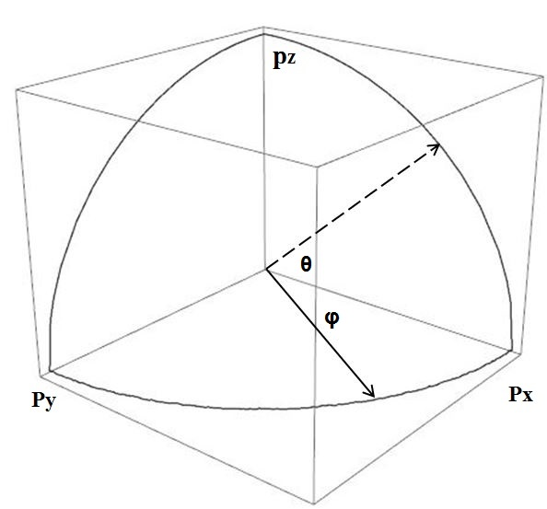
Seismic Anisotropy
The dependence of the seismic velocity on the propagation angle
Transverse isotropic model with a vertical axis
Isotropic model
Orthorhombic
2 independent coefficients
5 independent coefficients
9 independent coefficients

Slide 5
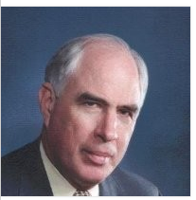
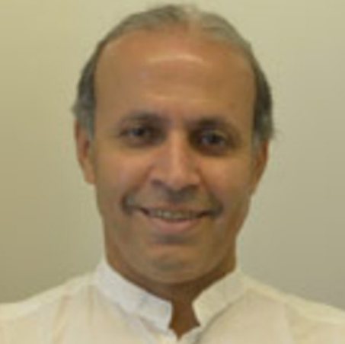
Elastic anisotropy model
Leon Thomsen (1986)
VP0, VS0, ε, δ, γ
Acoustic assumption for anisotropy model
Tariq Alkhalifah (1998)
Vp, ε, δ
Alkhalifah and Tsvankin (1995)

Slide 6
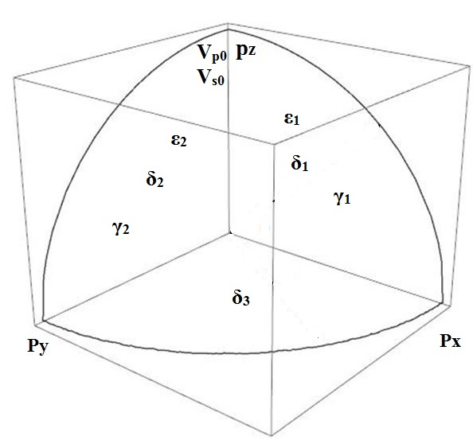
Parameterization ORT model

Slide 7
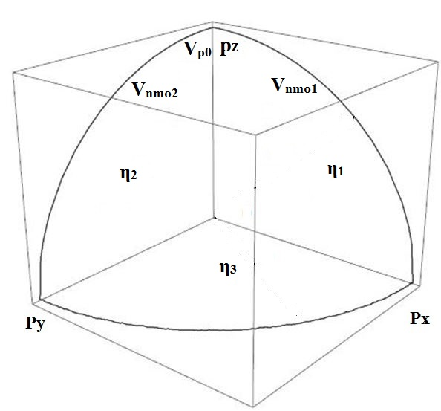
Acoustic ORT model

Slide 8
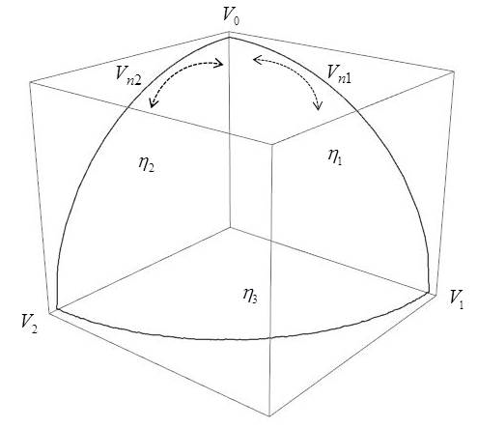
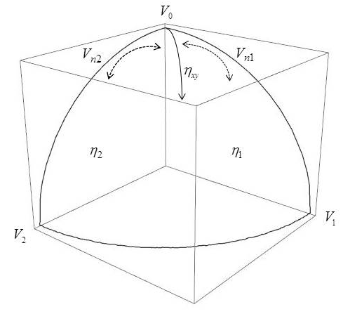
The parameterization for acoustic ORT model

Slide 9
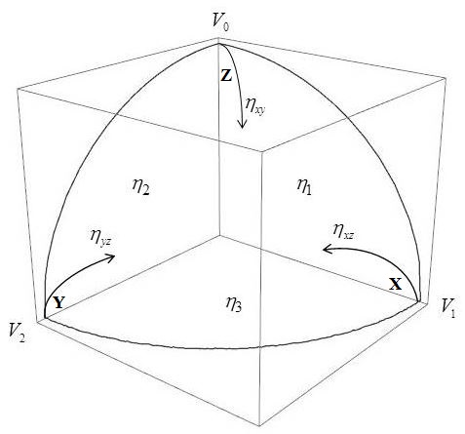
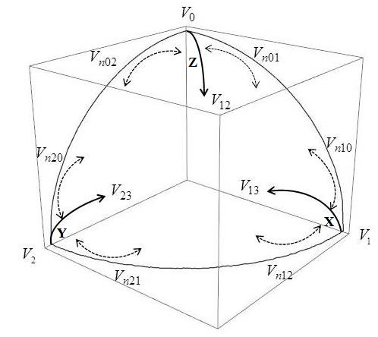

Slide 10
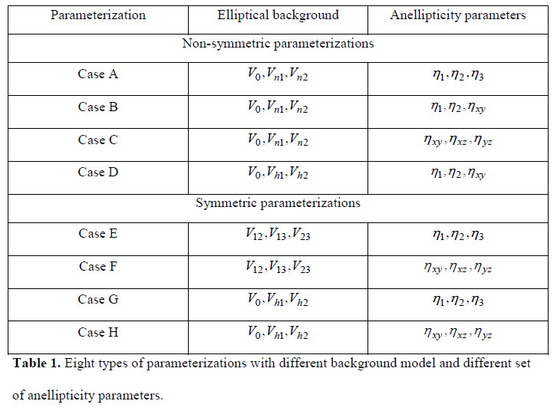
The parameterizations

Slide 11
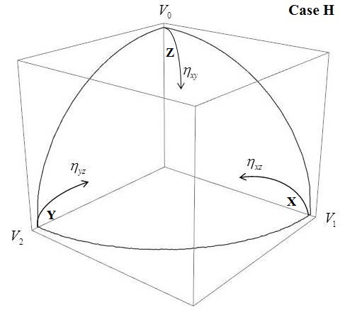
Perturbation-based approximation
Acoustic Eikonal equation in ORT model

Slide 12
Sensitivity analysis
Group velocity related coefficients

Slide 13
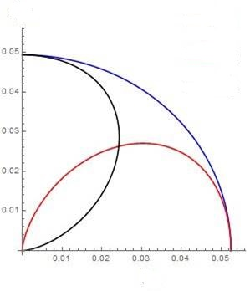
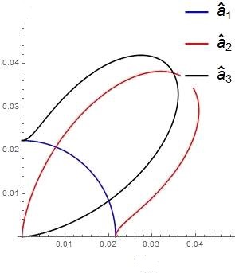
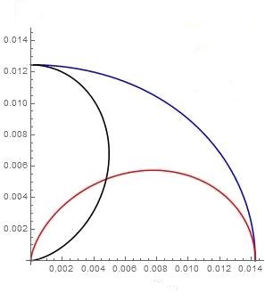
Sensitivity analysis

Slide 14
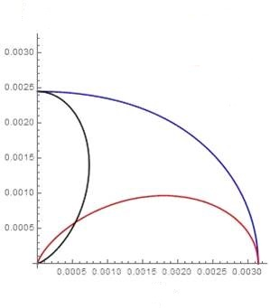
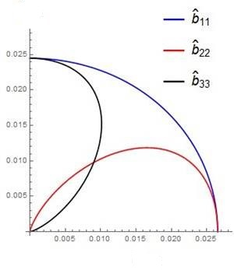
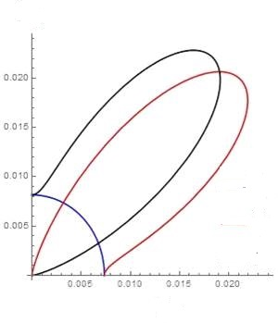
Sensitivity analysis

Slide 15
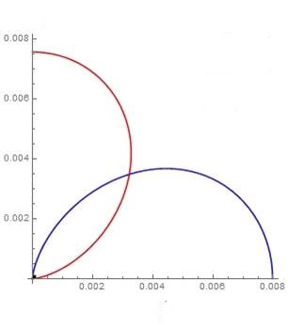
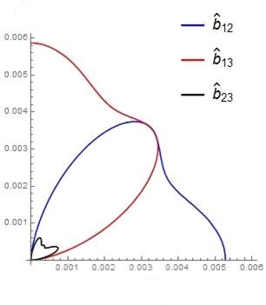
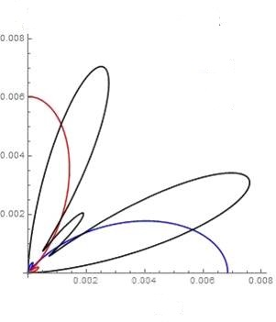
Sensitivity analysis

Slide 16
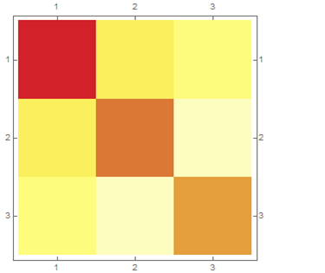
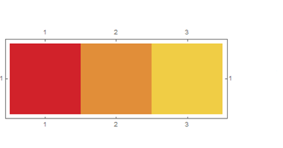
Overall sensitivity (case H)

Slide 17
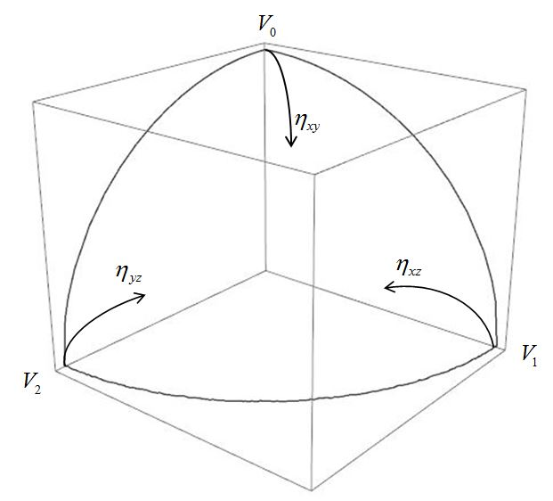
Numerical examples (model parameters)

Slide 18
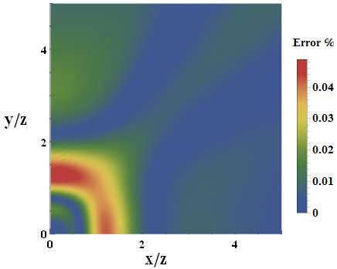
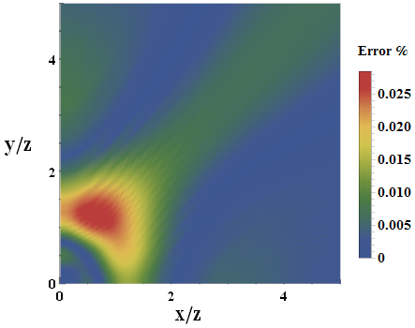
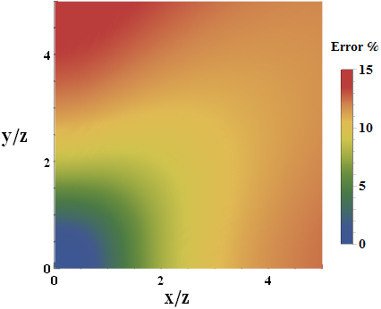
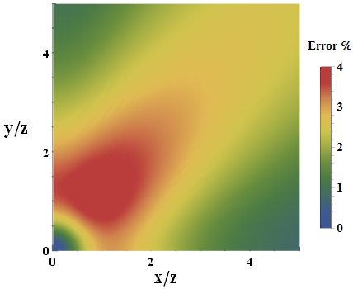
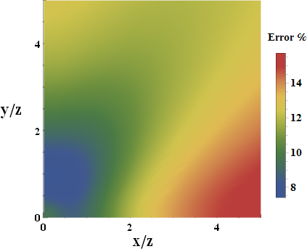
Numerical examples-Case H

Slide 19
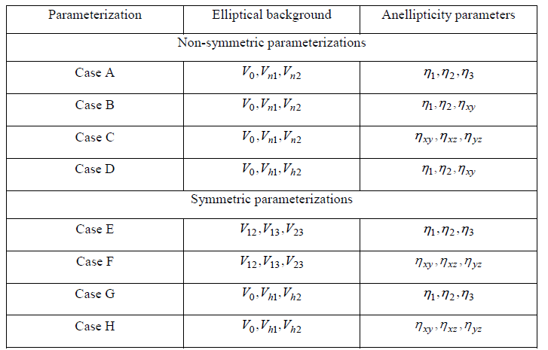
Numerical examples

Slide 20
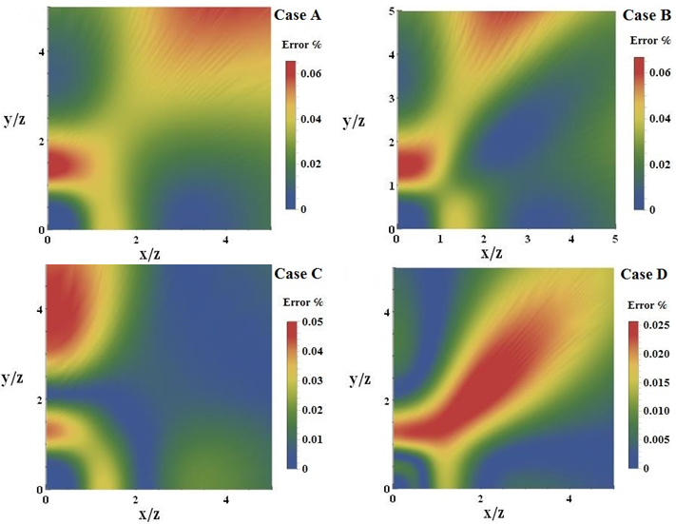
Numerical examples

Slide 21
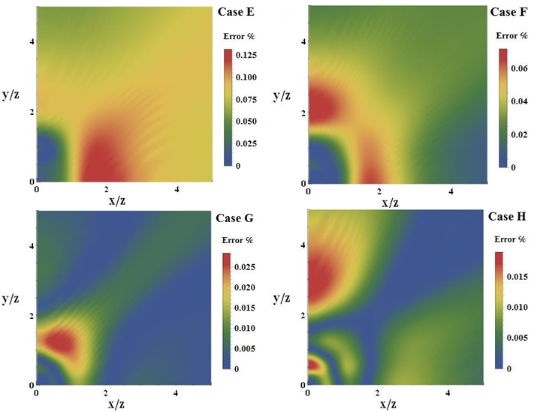
Numerical examples
Most accurate

Slide 22
Conclusions
Ａ group of new parameterizations for a homogeneous ORT model.
The parameterization with vertical and two horizontal velocities and three cross-term anellipticity parameters results in best accuracy (model dependent).
More accurate traveltime results in better accuracy in the anisotropy estimation of the velocity analysis.

Slide 23
End
Thanks for attention !
Xu S. and Stovas A. 2017, A new parameterization for acoustic orthorhombic media, Geophysics, 82, C229-C240

