Slide 1
Analysis of the influence of water salinity on time lapse seismic response
Filipe Borges

Slide 2
Why should I care about the salinity?
Primary recovery factor of a reservoir is usually low – demands IOR/EOR methods
Most common IOR method: Water Injection
Maintains the pore pressure and displaces the oil from the pore space
Easily available in most fields
Cheap
Good news for geophysicists: significant contrast in acoustic properties between HC and water.
Offshore fields: seawater injection
Salinity of 35,000 ppm (3.5 % weight fraction)
What is the salinity of the reservoir brine?

Slide 3
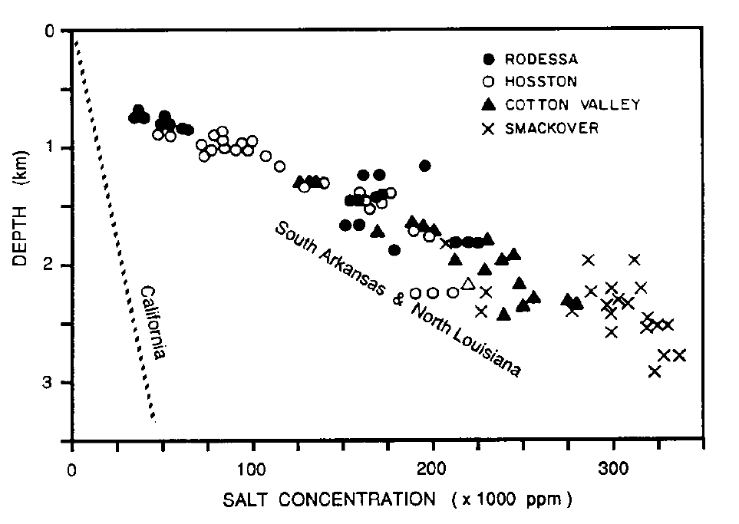
Why should I care about the salinity?
Batzle & Wang, 1992. Seismic Properties of Pore Fluids.

Slide 4
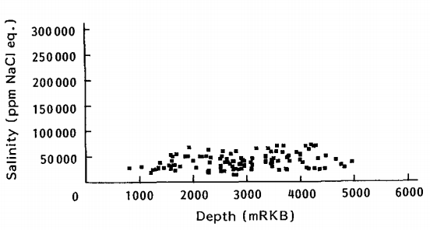
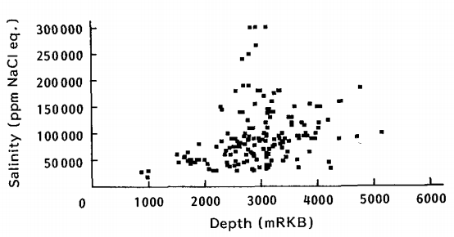
Why should I care about the salinity?
Bjørlykke & Gran, 1992. Salinity variations in North Sea formation Waters: implications for large-scale fluid movements.

Slide 5
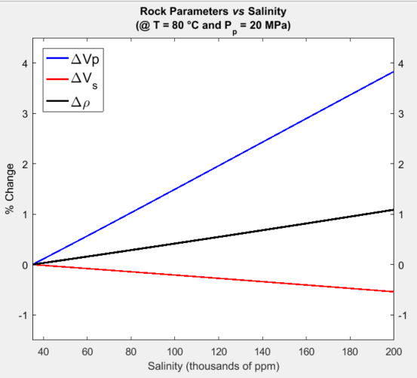
Rock Parameters vs Salinity
Δ$S_{w}$ = 60% (17° API Oil)
Δ$P_{P}=7 MPa$

Slide 6
How to evaluate this effect?
Use of a rock physics framework (+ Gassmann and Batzle & Wang) to model the elastic properties under diferent reservoir conditions
Zoeppritz equations to calculate the reflectivity behaviour under such conditions
Try to invert the reflectivity to the reservoir changes
Add noise, invert and estimate uncertainty

Slide 7
Scenario 1 – Injection below the Free Water Level (FWL)

Slide 8
‘‘Complex’’ Reservoir Model
Overburden
Reservoir

Slide 9
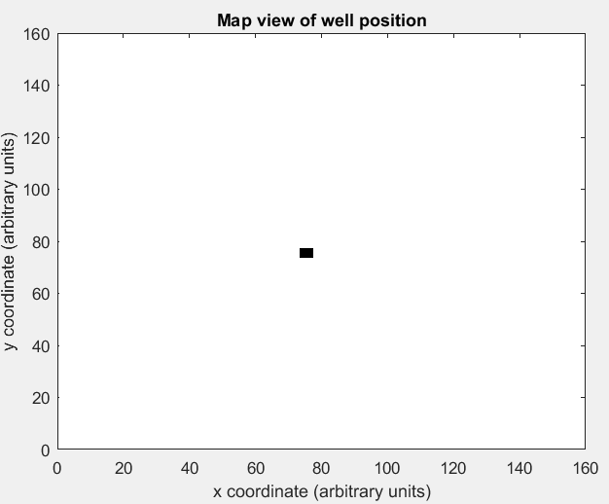
‘‘Complex’’ Reservoir Model

Slide 10
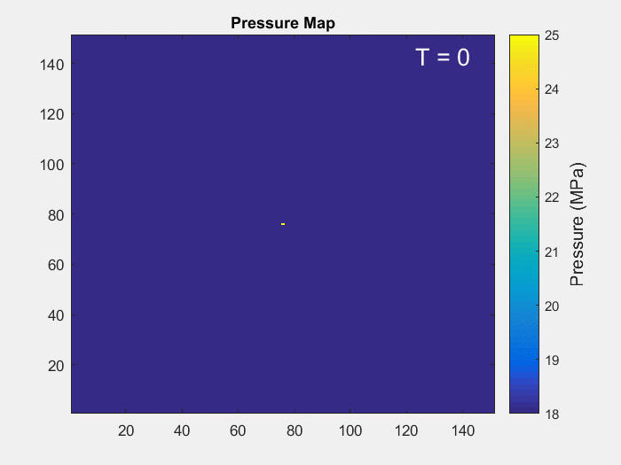
‘‘Complex’’ Reservoir Model

Slide 11
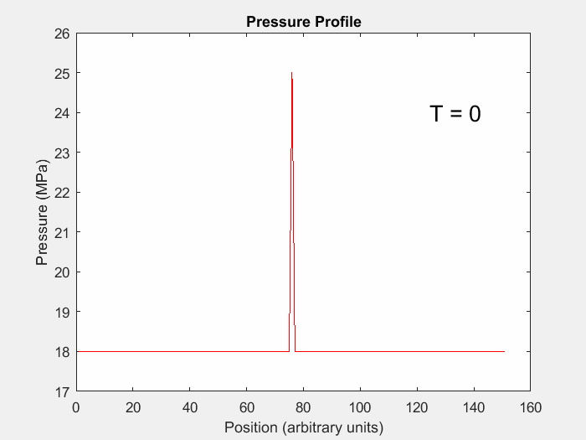
‘‘Complex’’ Reservoir Model

Slide 12
Reservoir Model - Pressure

Slide 13
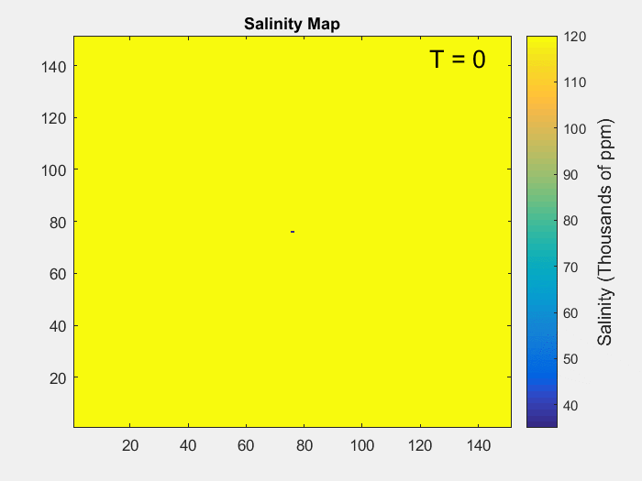
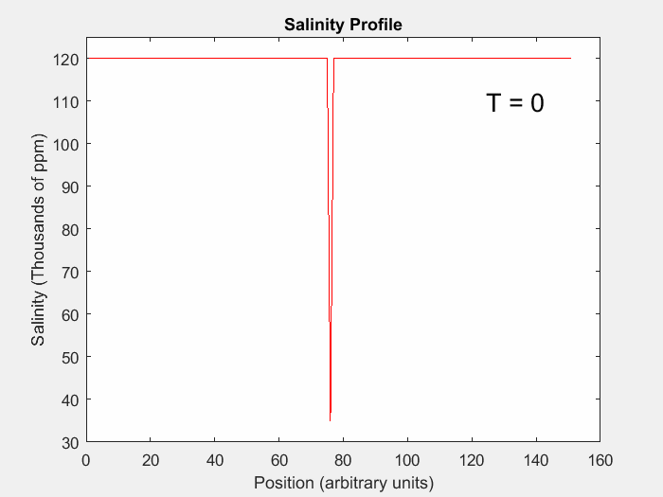
Reservoir Model - Salinity

Slide 14
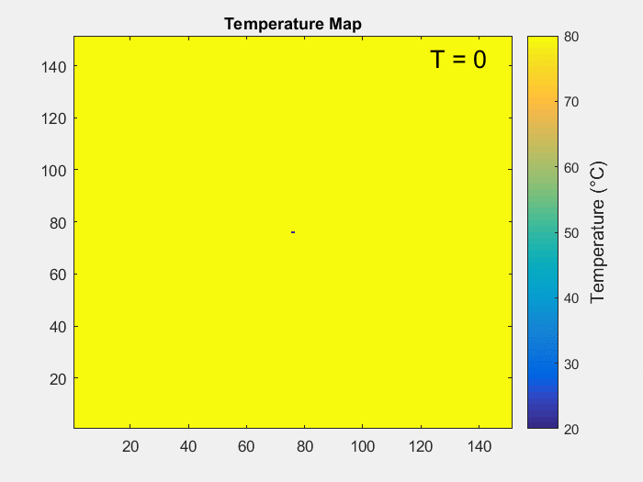
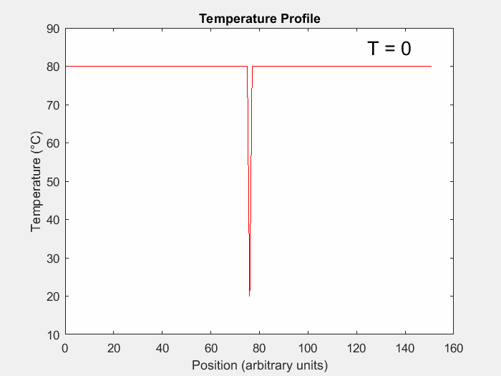
Reservoir Model - Temperature

Slide 15
Approximations for Reflectivity and Rock Physics

Slide 16
Approximations for Reflectivity

Slide 17
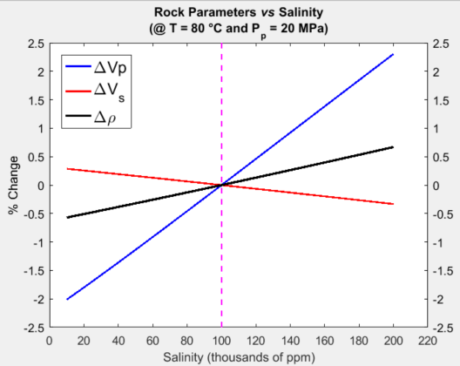
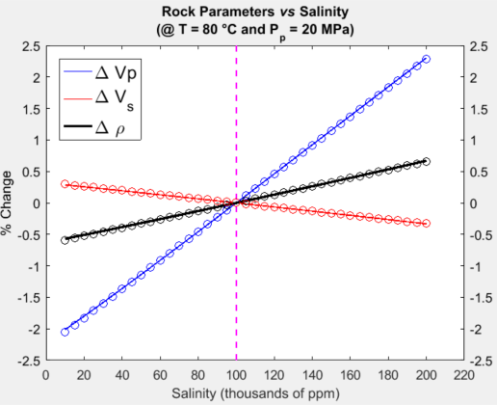
Approximations for Rock Physics

Slide 18
Estimating Pressure, Salinity and Temperature

Slide 19
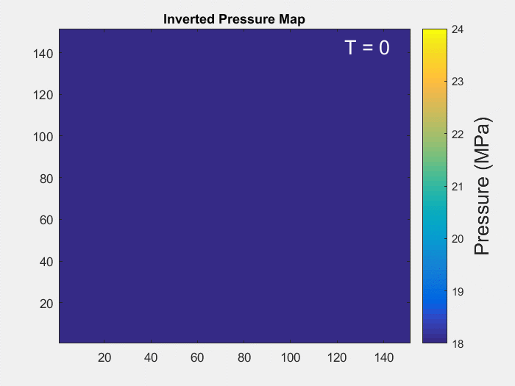
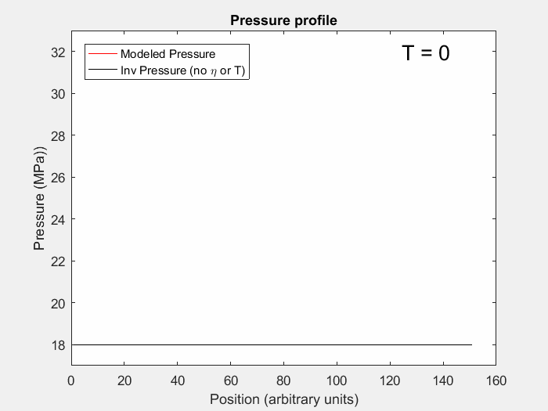
Pressure Estimation

Slide 20
Pressure Estimation– without Salinity or Temperature

Slide 21
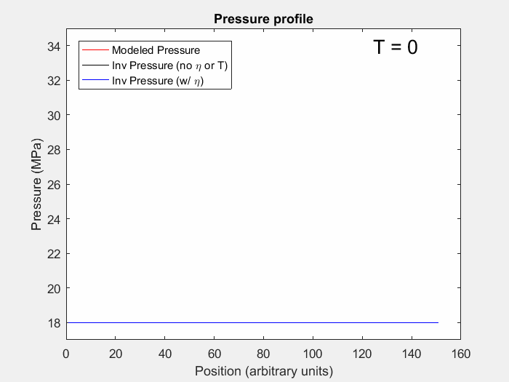
Pressure Estimation (+ Salinity, no T)

Slide 22
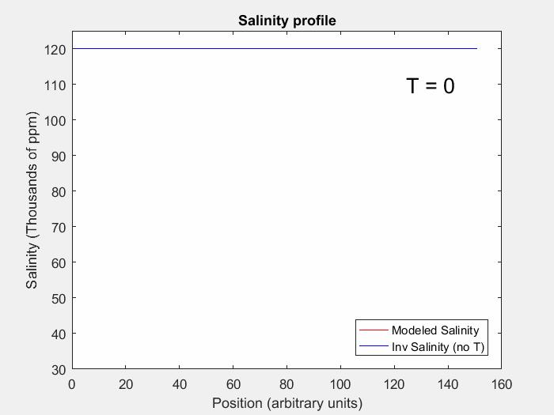
Salinity Estimation (no T)

Slide 23
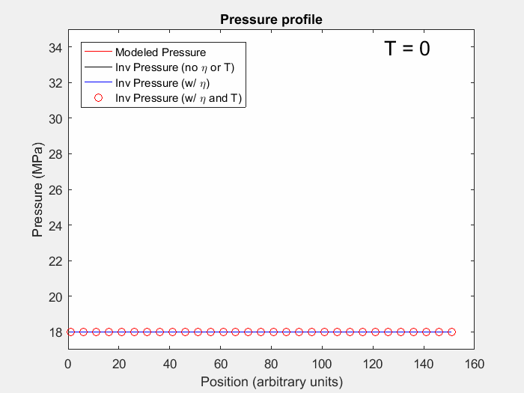
Pressure Estimation (with Salinity and Temperature)

Slide 24
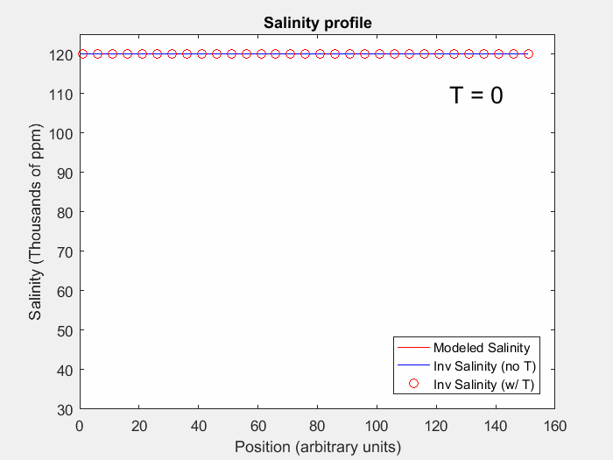
Salinity Estimation (with Temperature)

Slide 25
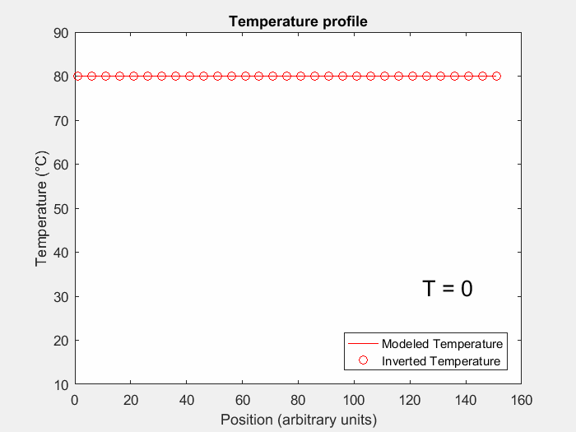
Temperature Estimation

Slide 26
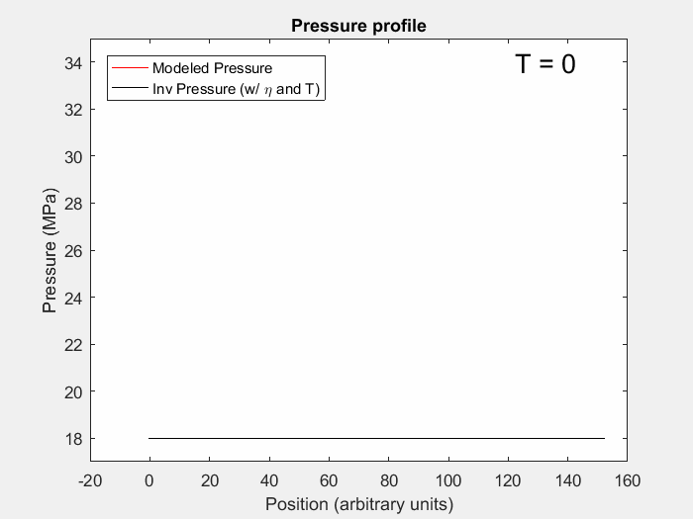
Pressure Estimation (with Salinity and Temperature) + Noise

Slide 27
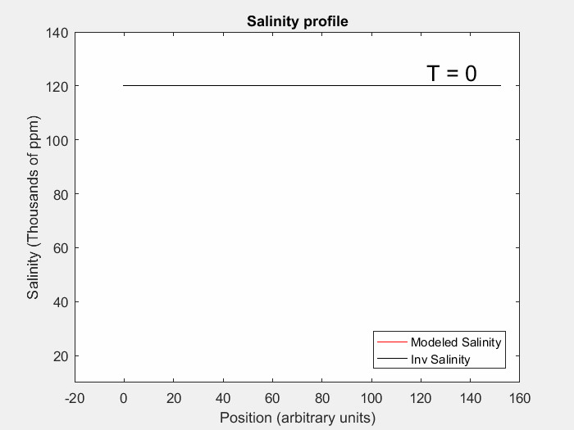
Salinity Estimation (with Temperature) + Noise

Slide 28
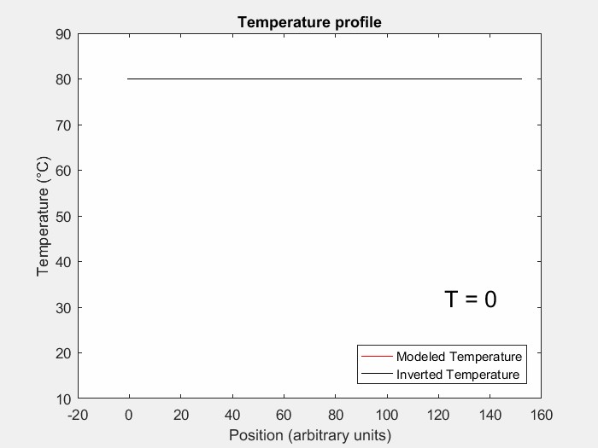
Temperature Estimation + Noise

Slide 29
Scenario 2 – Water Flooding

Slide 30
Scenario 2 – Pressure (no Salinity)

Slide 31
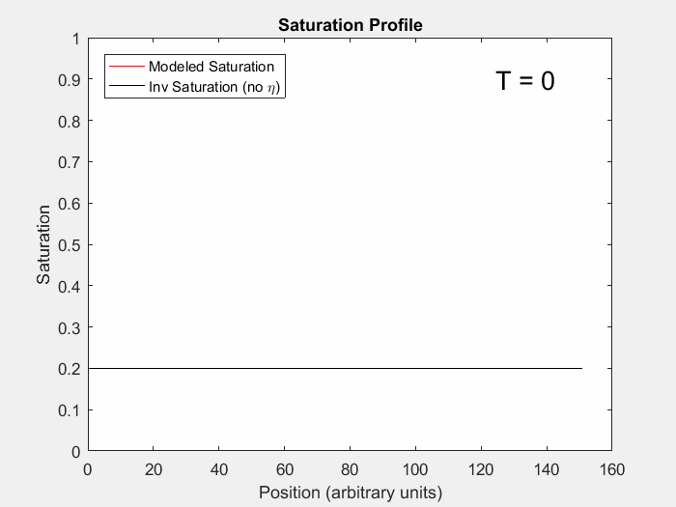
Scenario 2 –Saturation (no Salinity)

Slide 32
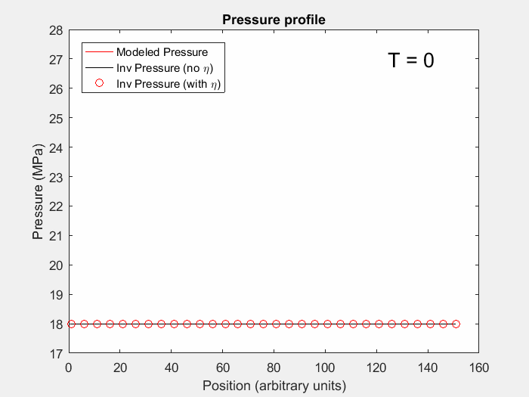
Scenario 2 – Pressure (with Salinity)

Slide 33
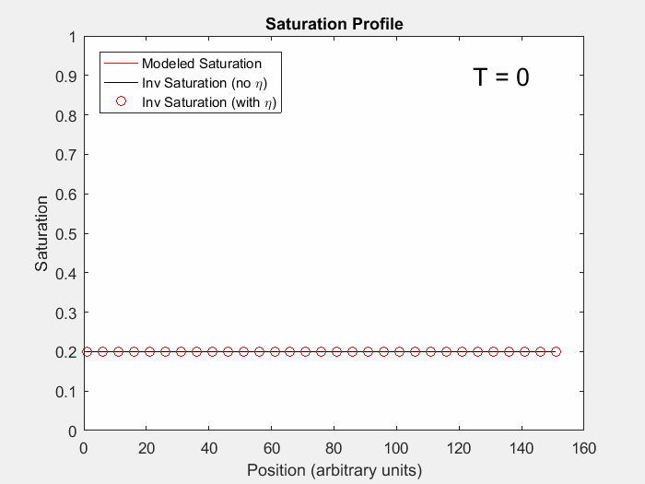
Scenario 2 – Saturation (with Salinity)

Slide 34
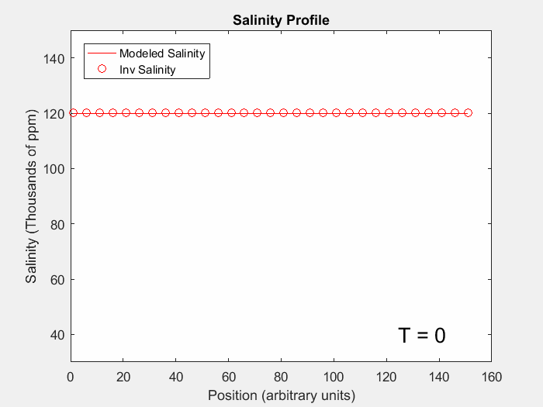
Scenario 2 – Salinity

Slide 35
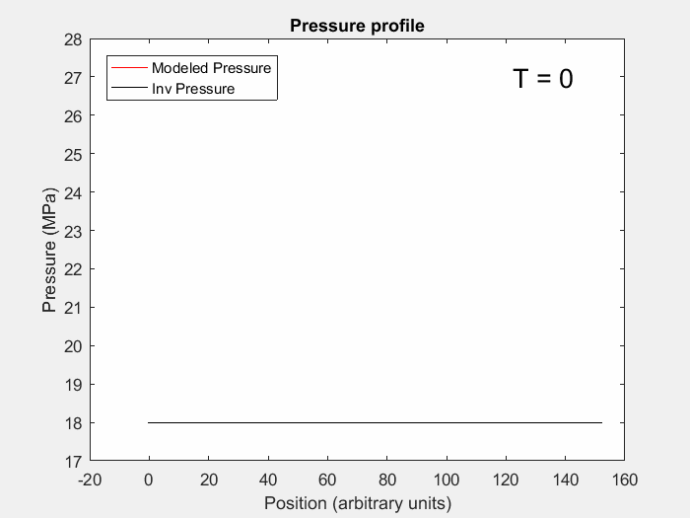
Scenario 2 – Pressure (with Salinity) + Noise

Slide 36
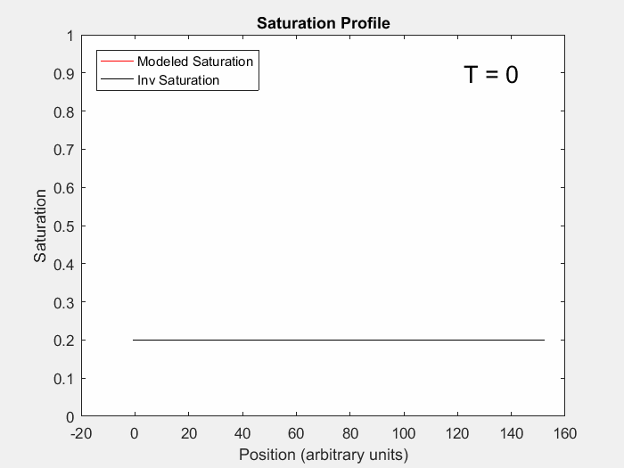
Scenario 2 – Saturation (with Salinity)

Slide 37
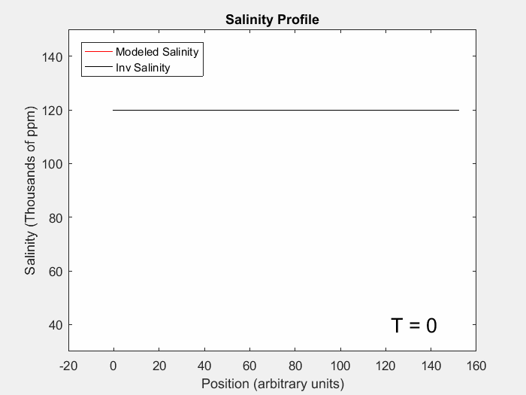
Scenario 2 – Salinity

Slide 38
Conclusions
Brine salinity seems to have a non-negligible contribution to time-lapse changes
High salinity contrast may mislead estimations of other reservoir parameters
Direct estimation of salinity change is very sensitive to noise levels of seismic data.
Even if you can’t estimate salinity, it may be importante to consider it as a variable – specially when injecting below the FWL.
May become more relevant as low-salinity injection projects are comissioned

Slide 39
Challenges & Next Steps
Try to estimate changes in pressure, saturation and salinity from field data
Pending: Authorization from Brazilian Petroleum Agency (ANP) to use seismic and well data.
Evaluate the influence of pore fluid on seismic anisotropy
00/00/2012

Slide 40
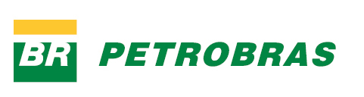
Acknowledgments
00/00/2012

Slide 41
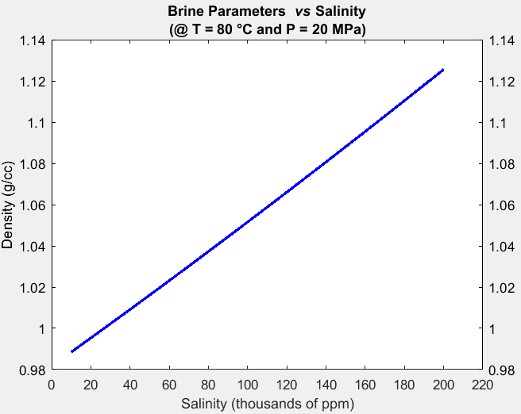
Brine Density vs Salinity

Slide 42
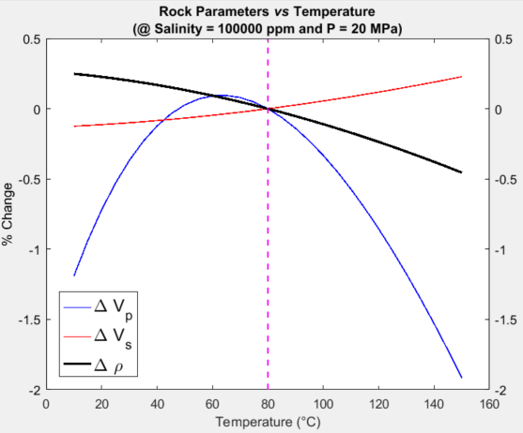
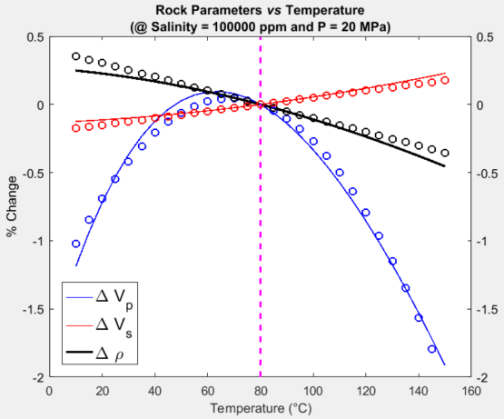
Scenario 1 – Injection below FWL

Slide 43
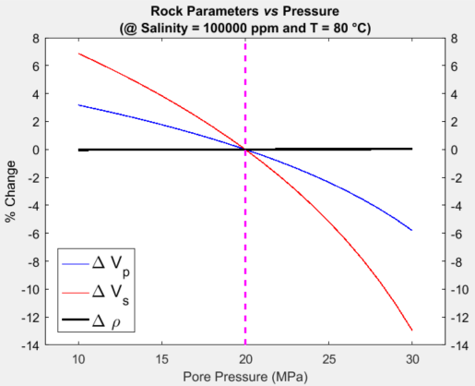
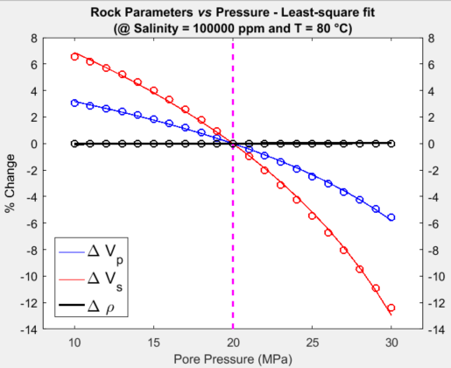
Scenario 1 – Injection below FWL

