Slide 1
Upscaling for orthorhombic media
Yuriy Ivanov, Alexey Stovas
27 Apr 2015, ROSE meeting
Trondheim

Slide 2
Outline
Motivation
Theory
Considered models
ORT-az + ORT
VTI + ORT
Conclusions
Yuriy Ivanov
Trondheim, 2015
Notes:
Add picture

Slide 3
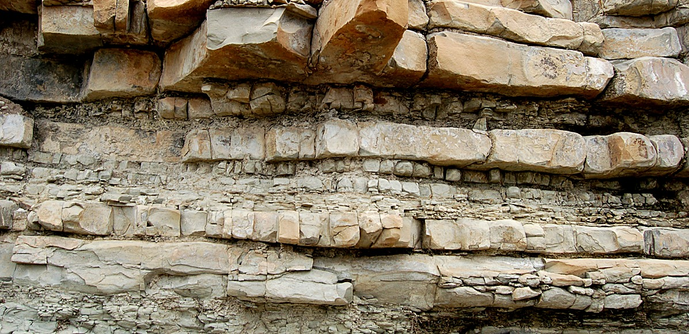
Motivation
http://imgkid.com/sedimentary-rock-layers.shtml
How does the seismic wave behave in the presence of thin (compared to wavelength) layering and/or fractures?
Yuriy Ivanov
Trondheim, 2015
Notes:
Add picture

Slide 4
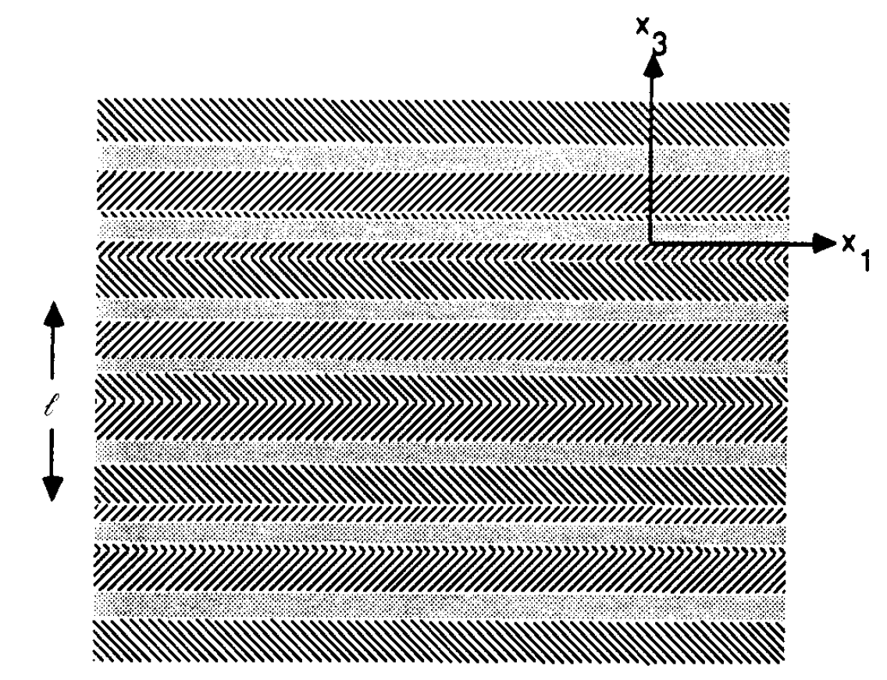
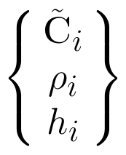
Elastic moduli of layered anisotropic media
Schoenberg and Muir, 1989:
Assumptions:
1. Thickness of individual layer is smaller then a wavelength
2. Stationarity
(Schoenberg and Muir, 1989)
Yuriy Ivanov
Trondheim, 2015

Slide 5
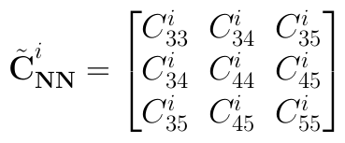
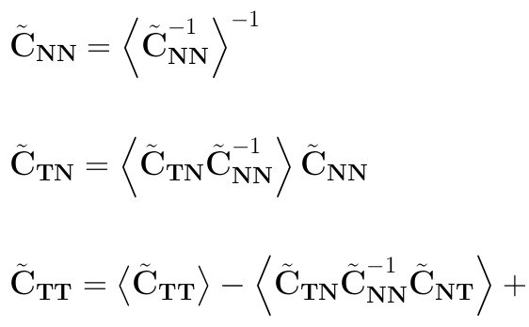
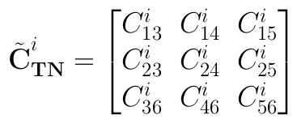
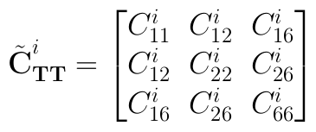
Elastic moduli of layered anisotropic media
Valid for arbitrary anisotropy
Does not assume periodicity of the layers
Effective media symmetry order is equal to the lowest symmetry order of the individual layers
Yuriy Ivanov
Trondheim, 2015

Slide 6
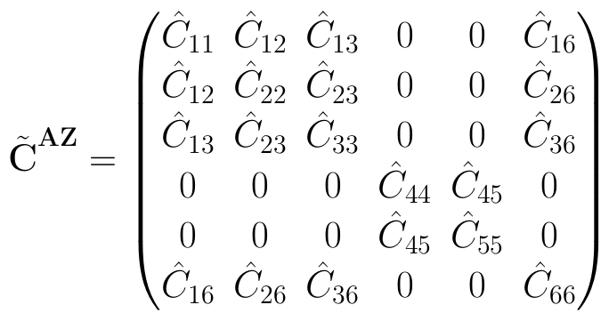
Effective anisotropic media: ORT-az + ORT
- azimuth
Yuriy Ivanov
Trondheim, 2015

Slide 7
Effective anisotropic media: ORT-az + ORT
Can effective (averaged) orthorhombic stiffness matrix be represented by some azimuthally rotated orthorhombic stiffness matrix?
?
Monoclinic
Orthorhombic + azimuth
Yuriy Ivanov
Trondheim, 2015

Slide 8
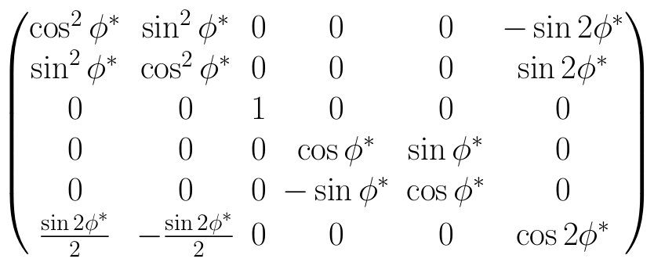
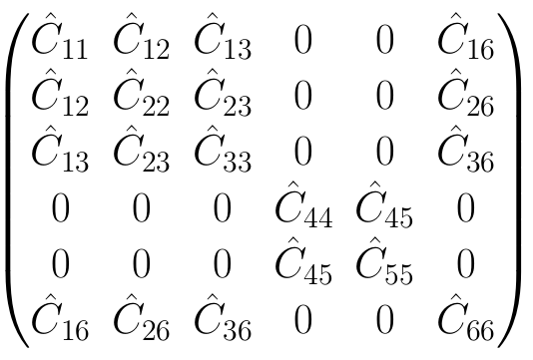
Effective anisotropic media: ORT-az + ORT
Approach I
Can effective (averaged) orthorhombic stiffness matrix be represented by some azimuthally rotated orthorhombic stiffness matrix?
Yuriy Ivanov
Trondheim, 2015
Notes:
Approximate

Slide 9
Effective anisotropic media: ORT-az + ORT
- effective azimuth
Yuriy Ivanov
Trondheim, 2015

Slide 10
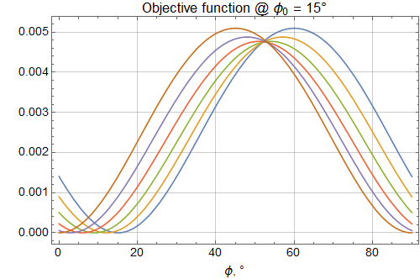
Effective anisotropic media: ORT-az + ORT
φ₀
Yuriy Ivanov
Trondheim, 2015

Slide 11
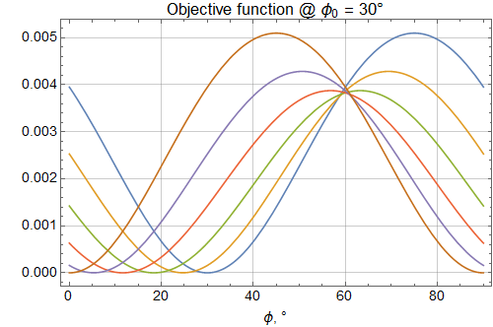
Effective anisotropic media: ORT-az + ORT
φ₀
Yuriy Ivanov
Trondheim, 2015

Slide 12
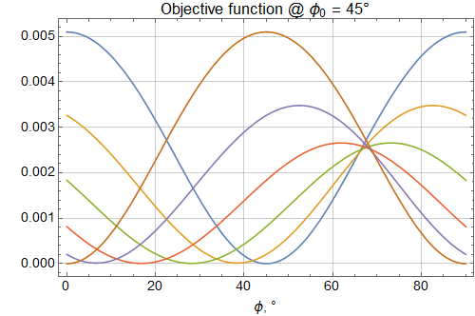
Effective anisotropic media: ORT-az + ORT
φ₀
Yuriy Ivanov
Trondheim, 2015

Slide 13
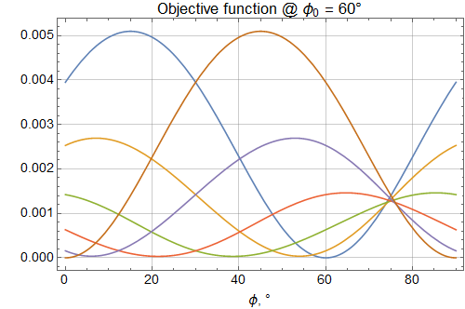
Effective anisotropic media: ORT-az + ORT
φ₀
Yuriy Ivanov
Trondheim, 2015

Slide 14
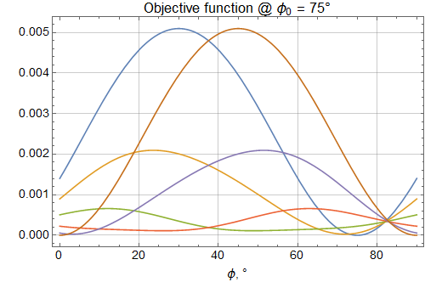
Effective anisotropic media: ORT-az + ORT
φ₀
Yuriy Ivanov
Trondheim, 2015

Slide 15
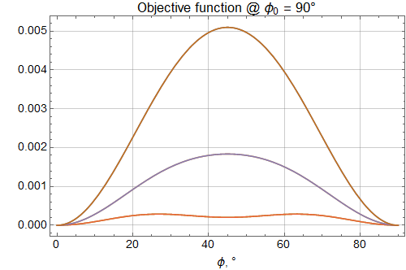
Effective anisotropic media: ORT-az + ORT
φ₀
Yuriy Ivanov
Trondheim, 2015

Slide 16
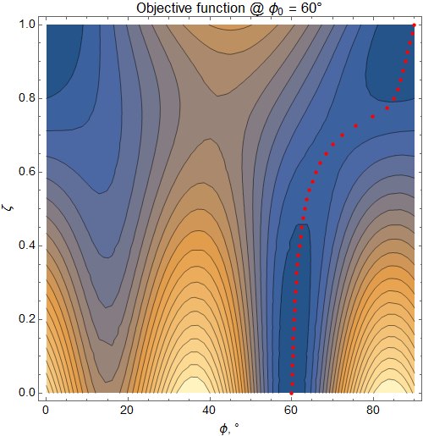
Effective anisotropic media: ORT-az + ORT
φ₀
Inverted azimuth
Yuriy Ivanov
Trondheim, 2015

Slide 17
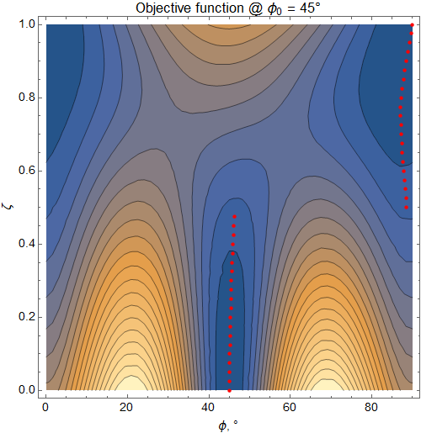
Effective anisotropic media: ORT-az + ORT
φ₀
Inverted azimuth
Yuriy Ivanov
Trondheim, 2015

Slide 18
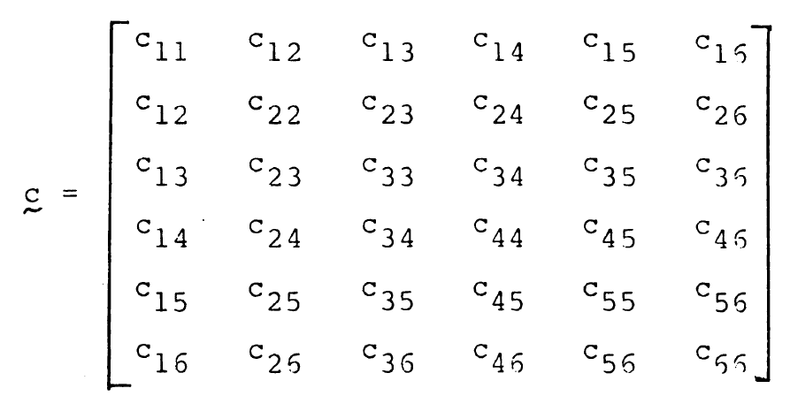
Effective anisotropic media: ORT-az + ORT
Approach II
Cowin S.C., Mehrabadi M.M., 1987:
On the identification of material symmetry for anisotropic elastic materials.
Yuriy Ivanov
Trondheim, 2015

Slide 19
Effective anisotropic media: ORT-az + ORT
Dilatational stiffness tensor:
Voight stiffness tensor:
Yuriy Ivanov
Trondheim, 2015

Slide 20
Effective anisotropic media: ORT-az + ORT
Voight stiffness tensor
Number of distinct eigenvalues can be used to deduce number of symmetry planes
Dilatational stiffness tensor
- transformation matrix
(pure orthorhombic)
(monoclinic)
Yuriy Ivanov
Trondheim, 2015

Slide 21
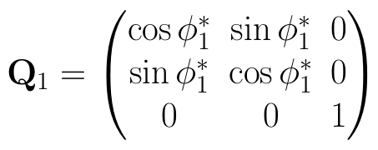
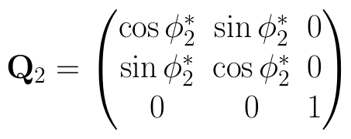
Effective anisotropic media: ORT-az + ORT
(monoclinic)
Voight stiffness tensor
Dilatational stiffness tensor
?
Browayes et al., 2004
Yuriy Ivanov
Trondheim, 2015

Slide 22
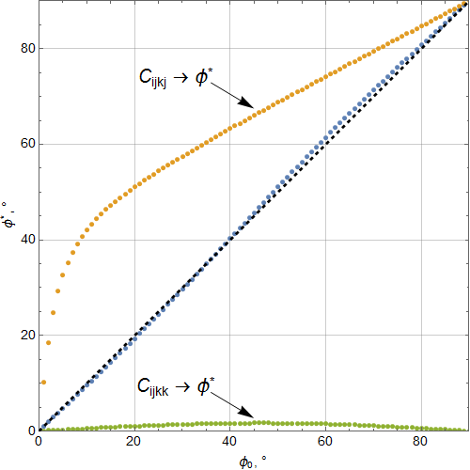
Effective anisotropic media: ORT-az + ORT
Approach II
Approach I
= 0.35
Yuriy Ivanov
Trondheim, 2015

Slide 23
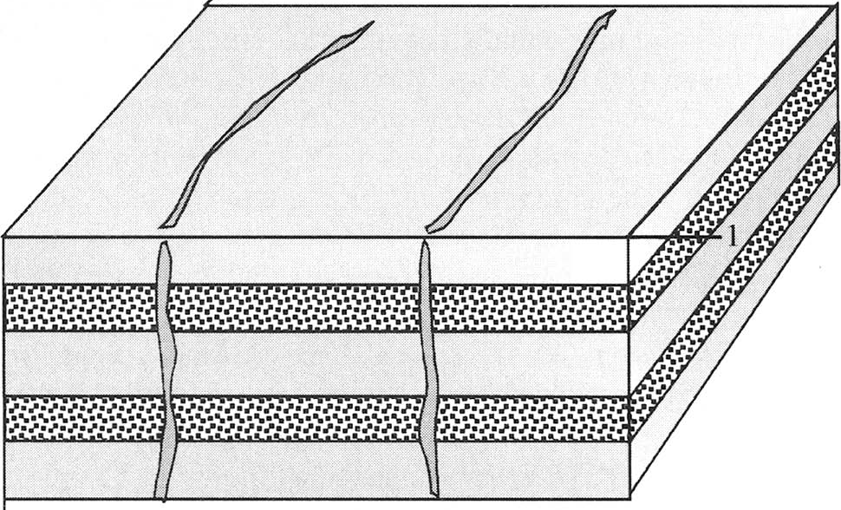
Effective anisotropic media: VTI + ORT
- background VTI medium parameters
- fracture weaknesses (Schoenberg and Helbig, 1997)
Yuriy Ivanov
Trondheim, 2015

Slide 24
Effective anisotropic media: VTI + ORT
- background VTI medium parameters
- fracture weaknesses (Schoenberg and Helbig, 1997)
Yuriy Ivanov
Trondheim, 2015

Slide 25
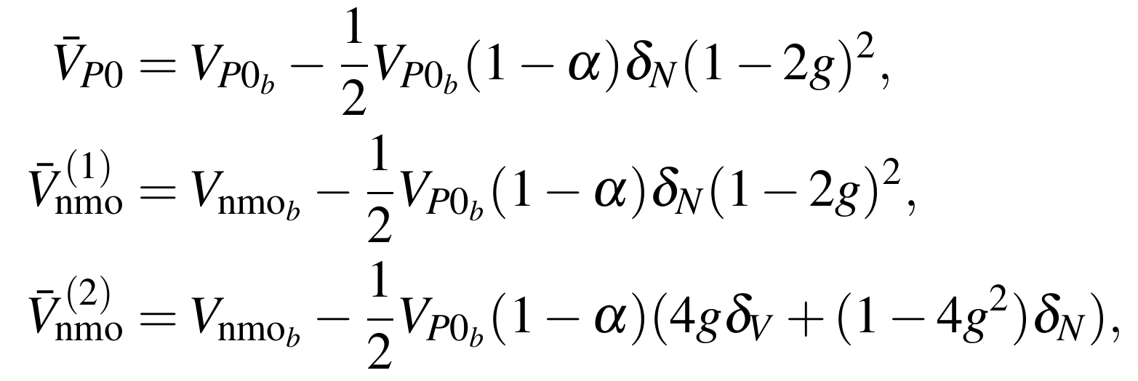
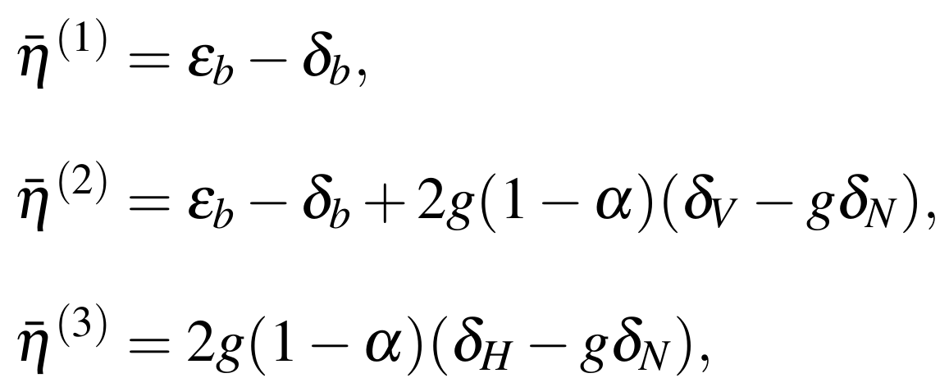
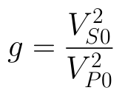
Effective anisotropic media: VTI + ORT
Following Bakulin et al. (2000):
Yuriy Ivanov
Trondheim, 2015

Slide 26
Effective anisotropic media: VTI + ORT
Following the approach of Bakulin et al. (2000), fracture parameters can be estimated (not resolvable if ORT/VTI ratio in the composite is unknown):
Yuriy Ivanov
Trondheim, 2015

Slide 27
Effective anisotropic media: VTI + ORT
Infinite frequency approximation
Ray
Yuriy Ivanov
Trondheim, 2015

Slide 28
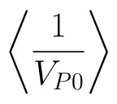
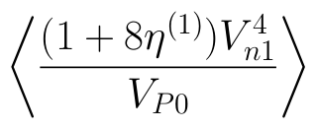
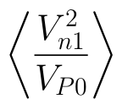
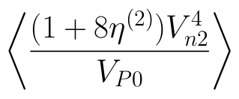
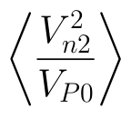
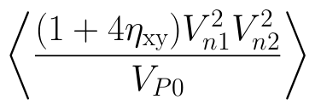
Effective anisotropic media: VTI + ORT
Infinite frequency approximation – slowness surfaces are averaged
,
,
,
Yuriy Ivanov
Trondheim, 2015

Slide 29
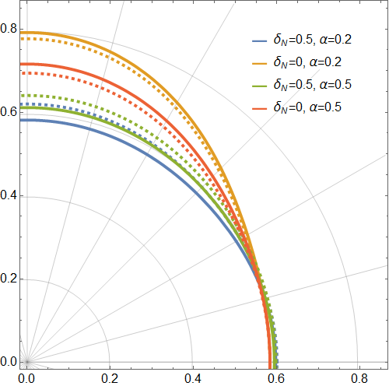
Effective anisotropic media: VTI + ORT
Following Bakulin et al. (2000):
- wet
- dry
Yuriy Ivanov
Trondheim, 2015

Slide 30
Effective anisotropic media: VTI + ORT
What if the logged interval is known to have fractures?
Yuriy Ivanov
Trondheim, 2015

Slide 31
Effective anisotropic media: VTI + ORT
Should we include fractures before or after averaging??
Yuriy Ivanov
Trondheim, 2015

Slide 32
Effective anisotropic media: VTI + ORT
X
X + 150 m
Data courtesy – Statoil ASA
Yuriy Ivanov
Trondheim, 2015

Slide 33
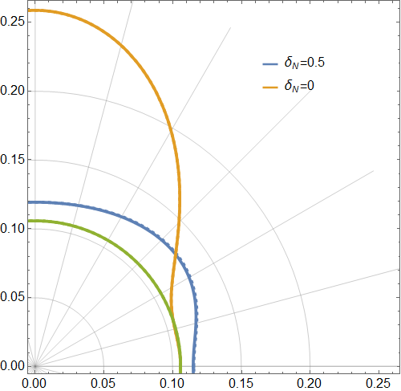
Effective anisotropic media: VTI + ORT
Following Bakulin et al. (2000):
- wet
- dry
Yuriy Ivanov
Trondheim, 2015

Slide 34
Conclusions
Averaged media behavior is studied for different types of constituent media:
ORT-az + ORT
VTI + ORT (vertically fractured VTI)
Two approaches on approximation ORT-az + ORT composite with an effective ORT-az medium is shown
Linearized expressions for anisotropy parameters for VTI + ORT composite are derived
Demonstrated how fractures can be included in well-logging data
Yuriy Ivanov
Trondheim, 2015

