Slide 1
Aspect ratio histograms of 3D Ellipsoids and 2D Ellipses*
* Paper submitted to Geophysics
M. Landrø
ROSE meeting 2015

Slide 2
3D ellipsoids might represent…
Pore
Crack
Grain

Slide 3
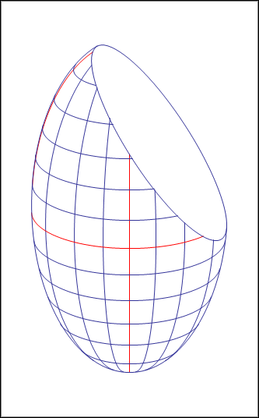
Cutting an ellipsoid with a plane
n
Klein (2012) shows that the cut is an ellipse with half axes
2D aspect ratio
Special case 1: two shortest semiaxes, a =b < c =>
3D aspect ratio
……..
Simple relation between 2D and 3D aspect ratio

Slide 4
The histogram of the 2D aspect ratio
Histogram given by the derivative of n₃ with respect to the 2D aspect ratio:
N = number of realizations
Note: h is independent of n₃-distribution

Slide 5
The 3D to 2D transform:
The 2D to 3D transform:

Slide 6
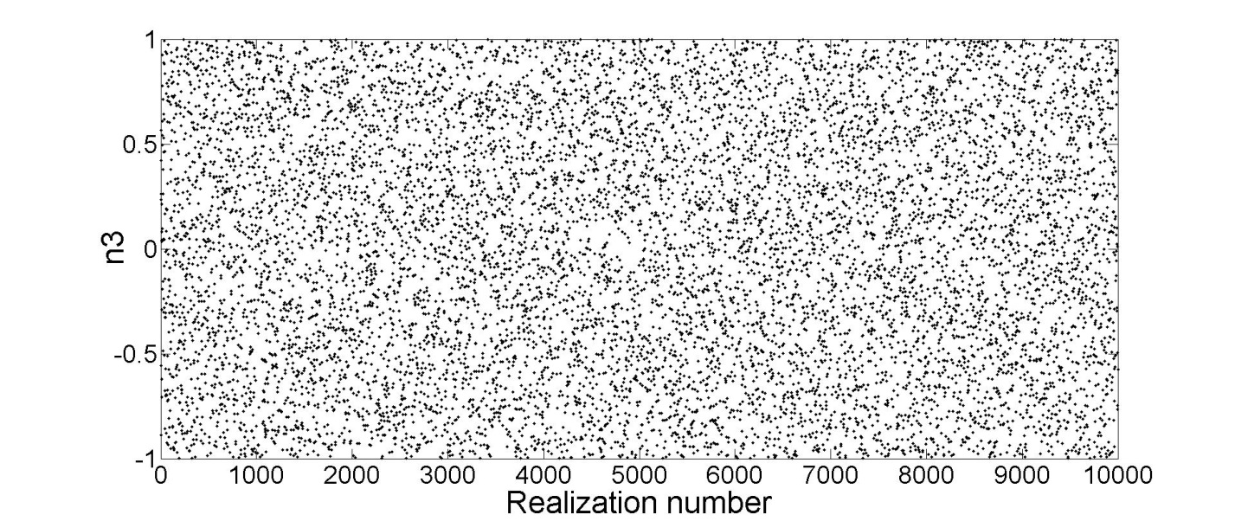
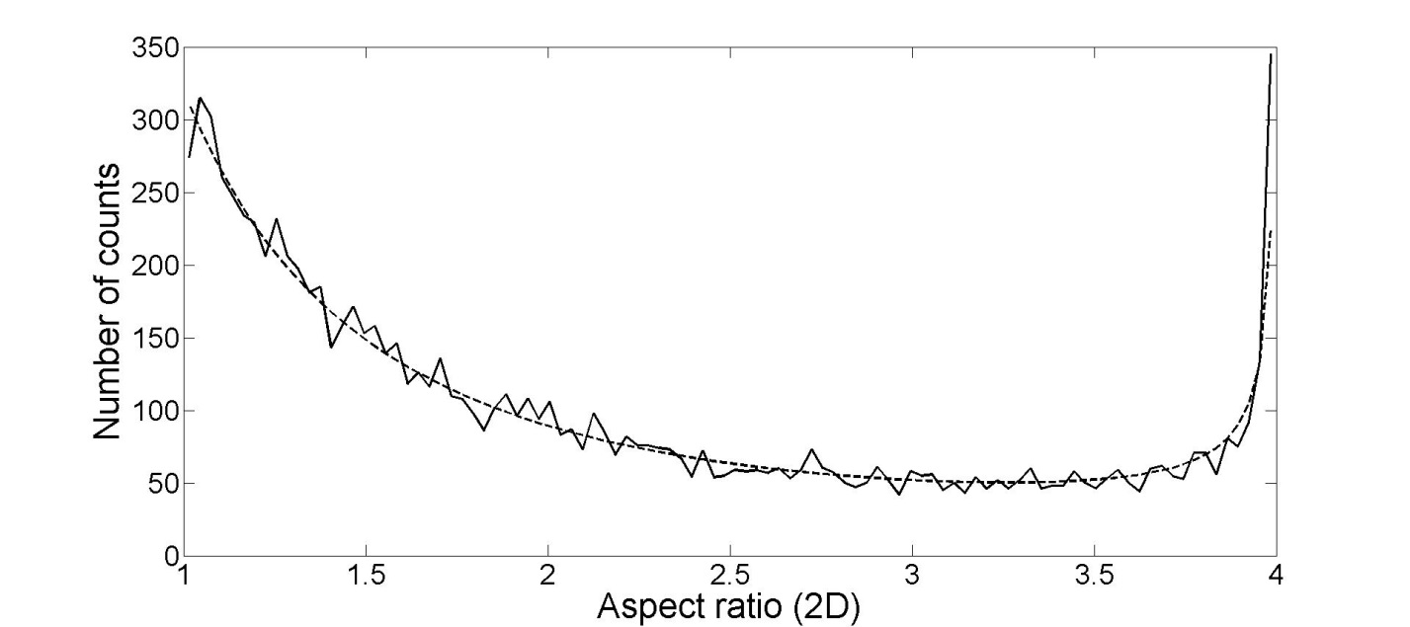
Uniform distribution - 10 000 realizations
Simulated

Slide 7
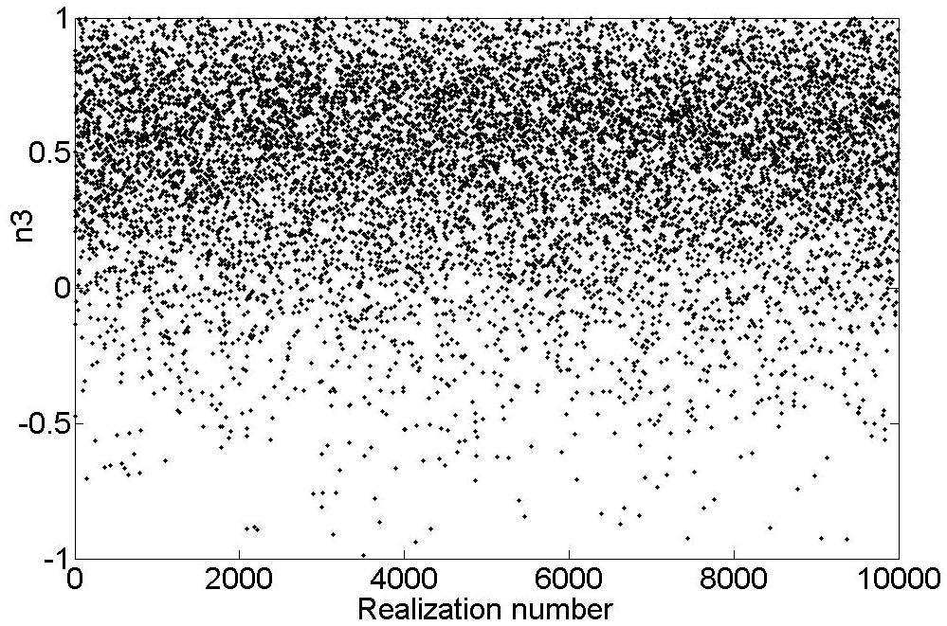
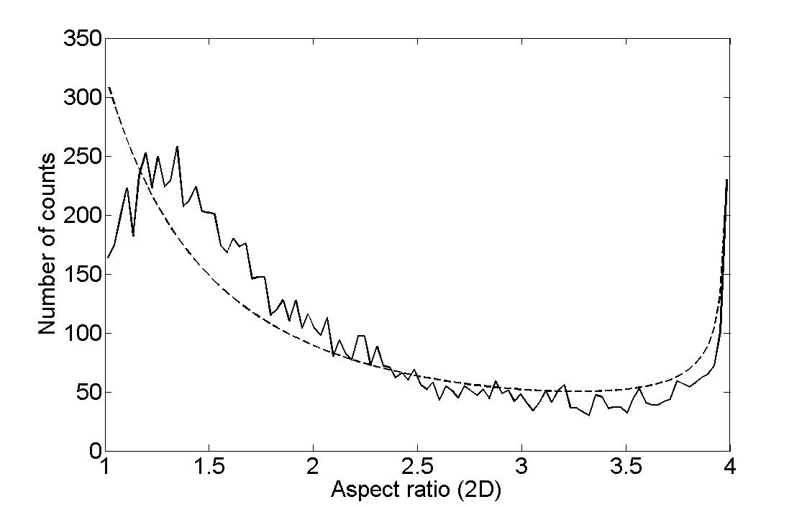
Non-uniform example
Normal distribution:
Decreasing the standard deviation yields a worse fit
Simulated
Note: This formula is general, not dependent on the assumed distribution –independent of n₃

Slide 8
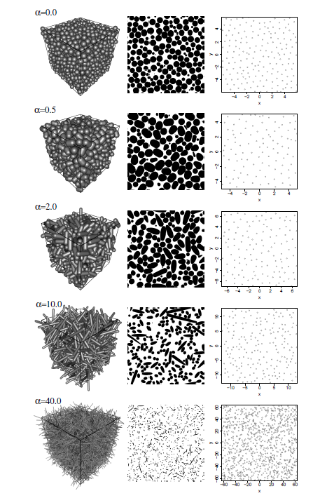
Rudge et al., 2008:
Rudge et al., 2008 use spherocylinders and use a random close packing – followed by one single 2D cut.
I computed the 2D aspect ratio from this figure and compared to my results =>

Slide 9
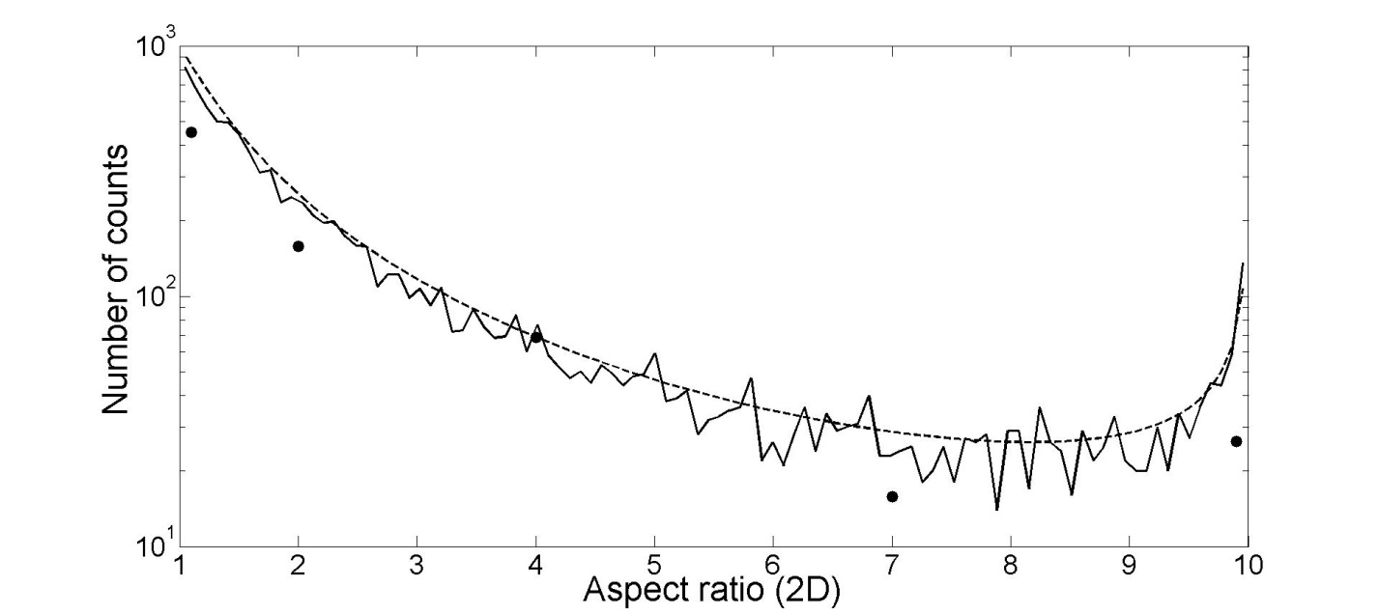
Comparison with Rudge et al., 2008
Rudge (2008)
Simulated
Rudge et al., 2008 use spherocylinders and use a random close packing – followed by one single 2D cut

Slide 10
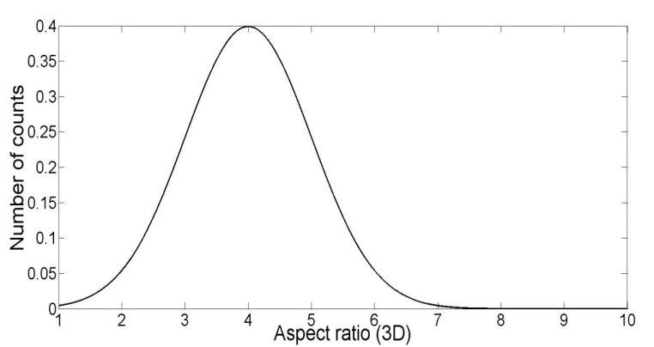
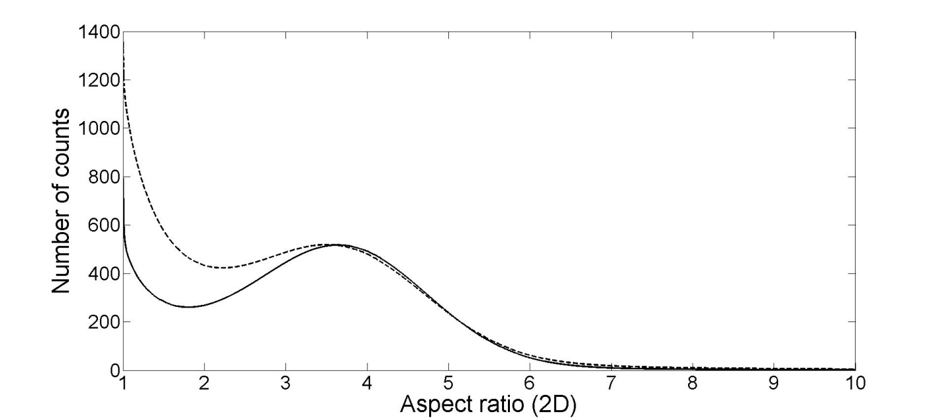
A normal distribution of 3D aspect ratio –forward modeling of 2D aspect ratio histogram
3D distribution

Slide 11
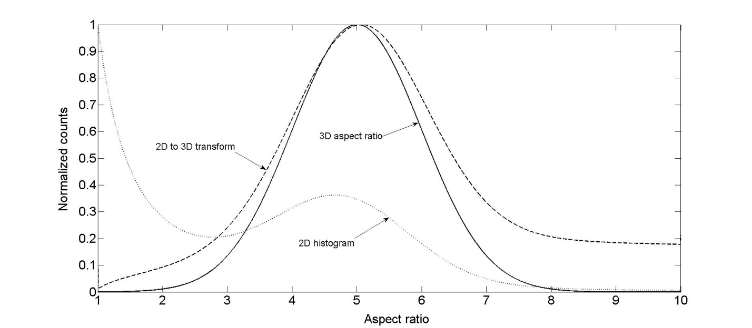
Testing the 2D to 3D transform

Slide 12
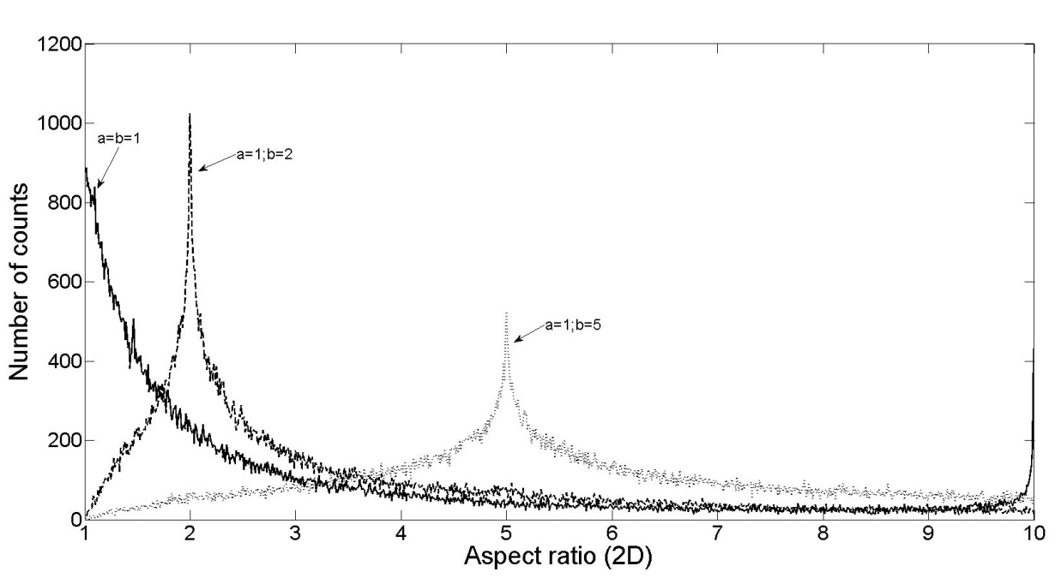
So far, a=b; what if a , b and c are different?
Stochastic modeling of 2D histograms
c = 10
a | b | c | alfa
1 | 1 | 10 | 1 | 10
1 | 2 | 10 | 2 | 5 | 10
1 | 5 | 10 | 2 | 5 | 10
Shorter axes apsect ratios easier to detect

Slide 13
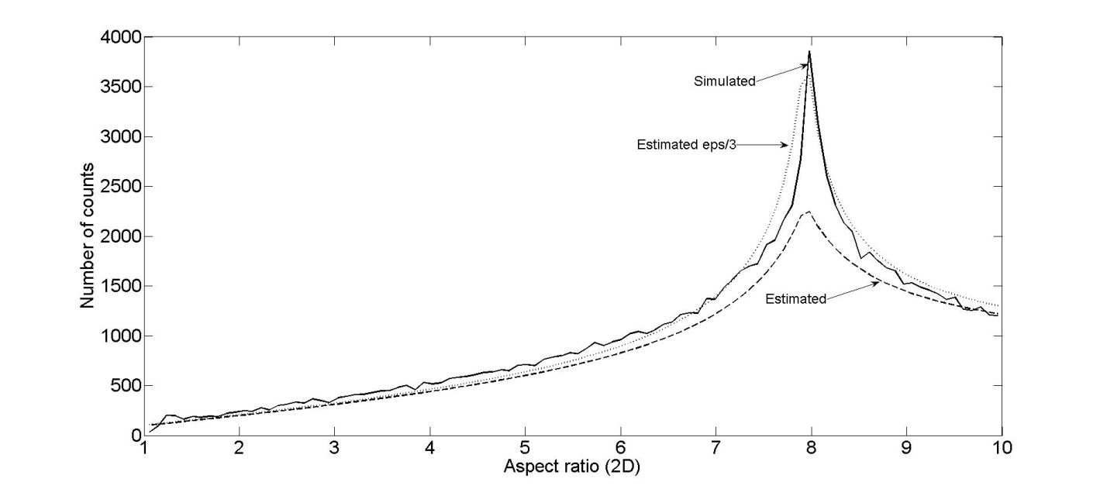
An attempt to find an equation for the general case (a=1, b and c different)
Note: Approximate equation – far from exact!
a=1; b=8 ; c=10

Slide 14
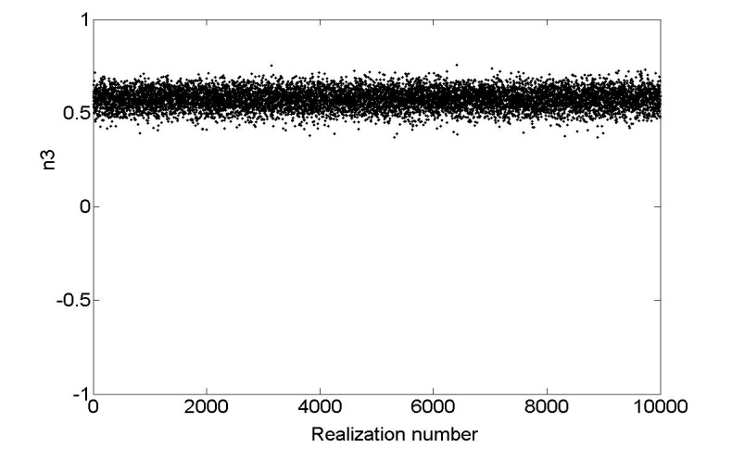
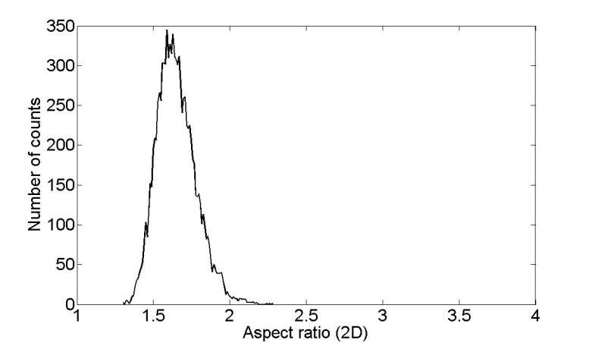
The importance of 3D selection of cuts to reveal the aspect ratio
The true value of 4 is not observed on the 2D histogram, but the «wrong» value of 1.6

Slide 15
Coupling aspect ratio (3D) to rock physics
Penny-shaped pore:
c >> a=b
Mavko et al., 2009
Poisson ratio (solid mineral)
Bulk modulus (solid mineral)
3D aspect ratio
is the pore stiffness
Another application: Anisotropy

Slide 16
Discussion and conclusions
Simple equation to derive 2D aspect ratio histograms from 3D ellipsoids is derived
2D to 3D transform of aspect ratio is derived and tested by stochastic simulations
Using thin sections to estimate 3D aspect ratio might be misleading
Useful for rock physics applications?

Slide 17
Acknowledgments
Jon Marius Venstad, Kjetil Eik Haavik, Dave Hale, Mike Batzle, Kenneth Duffaut, Roger Sollie and C. Morency for discussions and comments
Tor Arne Johansen, Bernardo Moyano for inviting me as an opponent for Bernardo’s PhD defense.
The Norwegian Research Council is acknowledged for financial support to the ROSE consortium at NTNU
Geophysics Department at Colorado School of Mines for hosting me the autumn semester 2014.

