Slide 1
Modeling ghost cavitation signals generated by air gun arrays
Babak Khodabandeloo,
PhD candidate, NTNU
Supervisor: Martin Landrø, Professor, NTNU
ROSE meeting
24th-27th April, 2017
Trondheim

Slide 2
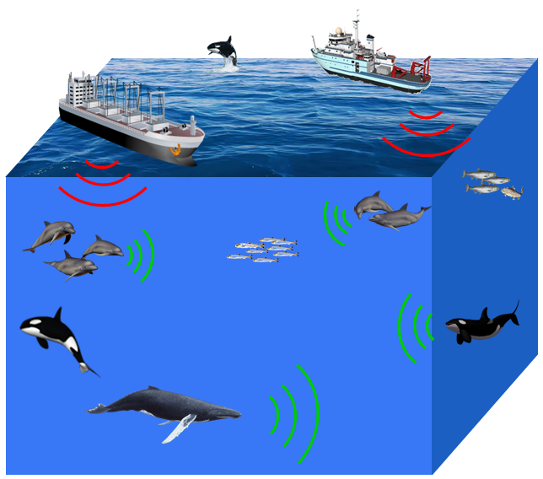
Introduction
Acoustic waves are vital for numerous marine animals, particularly cetaceans:
Finding food,
Social Interaction
Communication
etc.
Seismic
Shipping
Social Interaction
Finding food
Man-made ocean noise has increased over the past 50 years
Finding
mate
Communication & Navigation
There has been increased scrutiny of the impacts of noise on marine mammal species.
Notes:
Living in an environment where sound propagates far better than light, many marine animals, particularly cetaceans, evolved to rely primarily upon acoustic signaling to communicate, locate prey and navigate (Tyack, P. L. & Clark, C. W. 2000 Communication and acoustic behavior of dolphins and whales. In Hearing by whales and dolphins (eds W. W. L. Au, A. N. Popper & R. R. Fay), pp. 156–224. New York, NY: Springer. (doi:10.1007/978-1-4612-1150-1_4)
Underwater ocean noise from anthropogenic sources has increased over the past 50 years [National Research Council 2003 Ocean noise and marine mammals. Washington, DC: National Academies Press.][ Hildebrand, J. A. 2009 Anthropogenic and natural sources of ambient noise in the ocean. Mar. Ecol. Prog. Ser. 395, 5–20. (doi:10.3354/meps08353)]

Slide 3
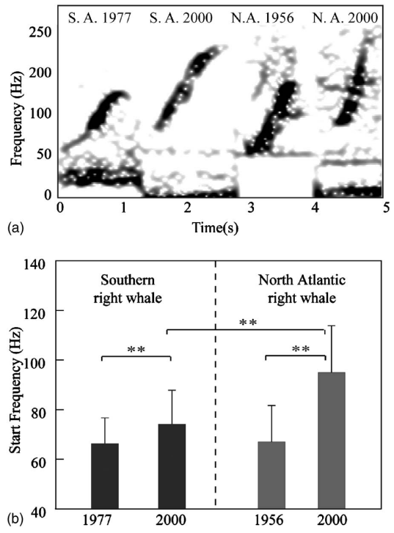
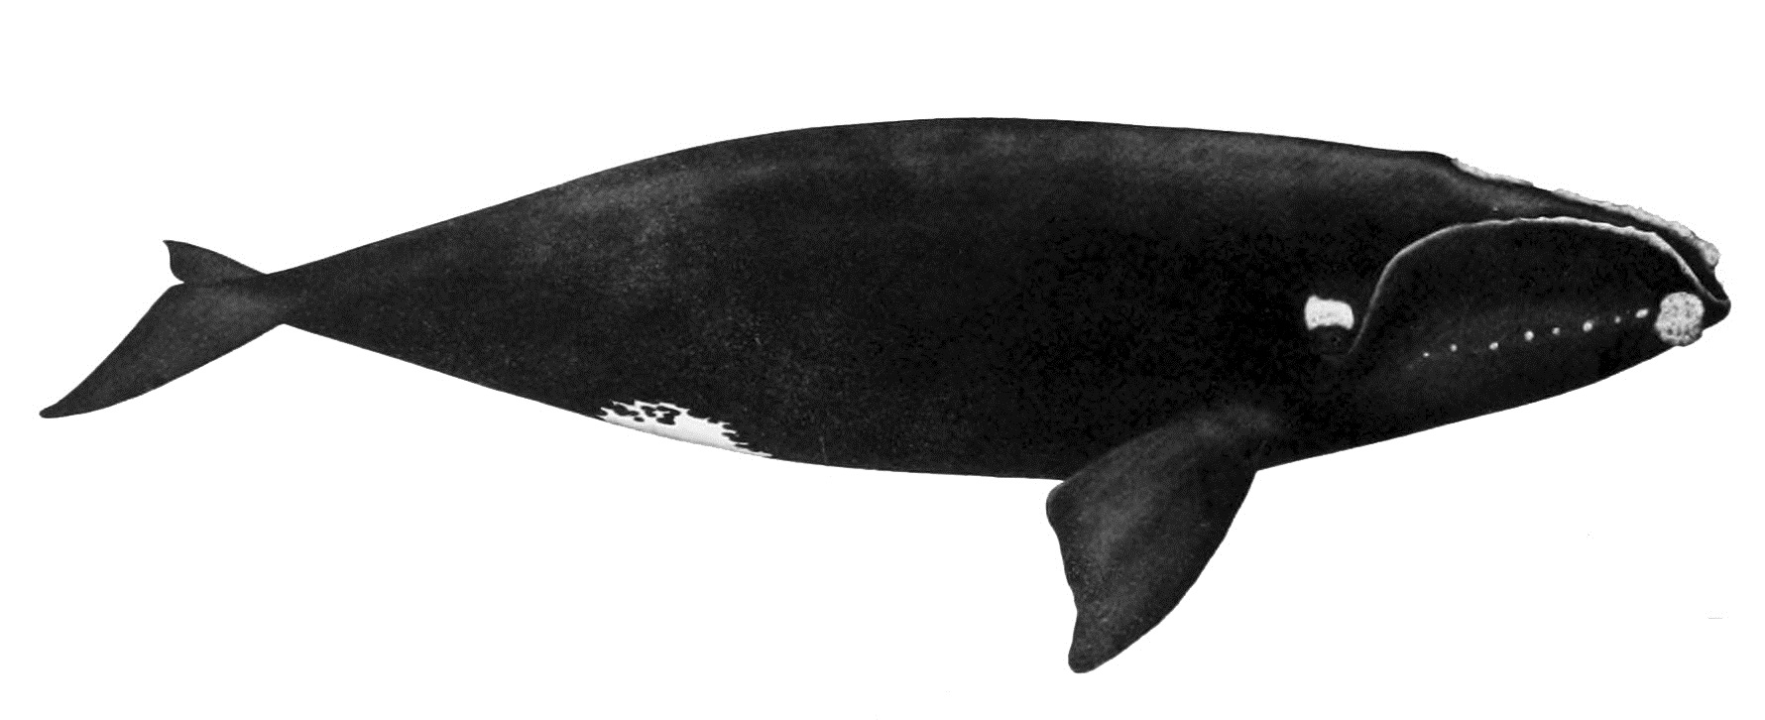
Introduction: noise impact on marine mammals, evidences
North Atlantic right whale
Parks, S.E., et al. , 2007. Short-and long-term changes in right whale calling behavior: the potential effects of noise on acoustic communication. JASA, 122(6), pp.3725-3731.
Change in sound production of right whales is correlated with increased noise levels
Notes:
Right whales are a long-lived species of baleen whale, with some individuals known to live at least 65 years (Hamilton et al., 1998)
Whalers gave the name “right” whale to this species because they thought it was the right (correct) whale to hunt due to the plentiful oil !
behavioral change in sound production of right whales that is correlated with increased noise levels and indicates that right whales may shift call frequency to compensate for increased band-limited background noise
Right whale populations worldwide were reduced to low levels by whaling. Southern right whales Eubalaena australis have shown remarkable recovery since protection from whaling, but North Atlantic right whales remain on the brink of extinction Kraus et al., 2005. Right whales produce sounds to communicate, using variable tonal calls in social interactions and a stereotyped tonal upsweep as a contact call Clark, 1982; Parks and Tyack, 2005.
As a population declines, it may become increasingly difficult for individuals to locate each other for social interaction and mating due to dilution effects. If ambient noise levels increase, the range over which individuals can locate one another will be further reduced unless the whales can modify their calling behavior to improve the probability of detection by another whale.

Slide 4
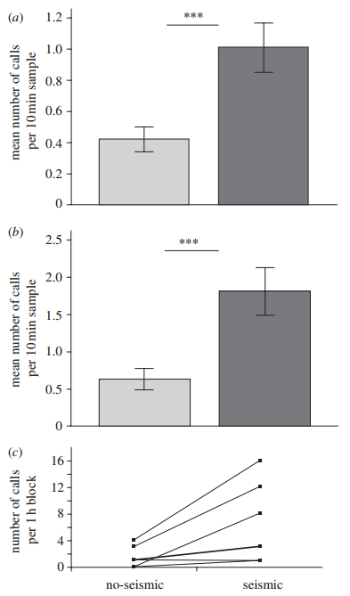
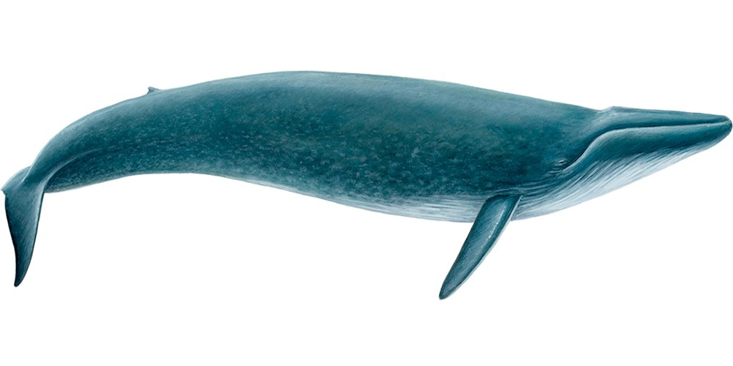
Introduction: noise impact on marine mammals, evidences
Blue whale
Di Iorio, L. and Clark, C.W., 2010. Exposure to seismic survey alters blue whale acoustic communication. Biology letters, 6(1), pp.51-54.
Call production of blue whale increases on days with seismic operation
Notes:
Right whales are a long-lived species of baleen whale, with some individuals known to live at least 65 years (Hamilton et al., 1998)
Whalers gave the name “right” whale to this species because they thought it was the right (correct) whale to hunt due to the plentiful oil !
behavioral change in sound production of right whales that is correlated with increased noise levels and indicates that right whales may shift call frequency to compensate for increased band-limited background noise
Right whale populations worldwide were reduced to low levels by whaling. Southern right whales Eubalaena australis have shown remarkable recovery since protection from whaling, but North Atlantic right whales remain on the brink of extinction Kraus et al., 2005. Right whales produce sounds to communicate, using variable tonal calls in social interactions and a stereotyped tonal upsweep as a contact call Clark, 1982; Parks and Tyack, 2005.
As a population declines, it may become increasingly difficult for individuals to locate each other for social interaction and mating due to dilution effects. If ambient noise levels increase, the range over which individuals can locate one another will be further reduced unless the whales can modify their calling behavior to improve the probability of detection by another whale.

Slide 5
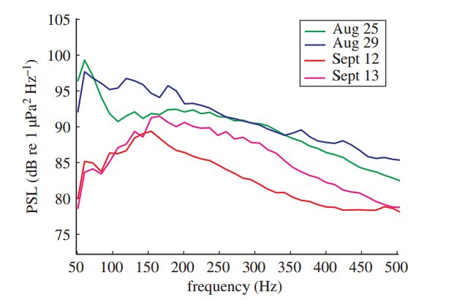
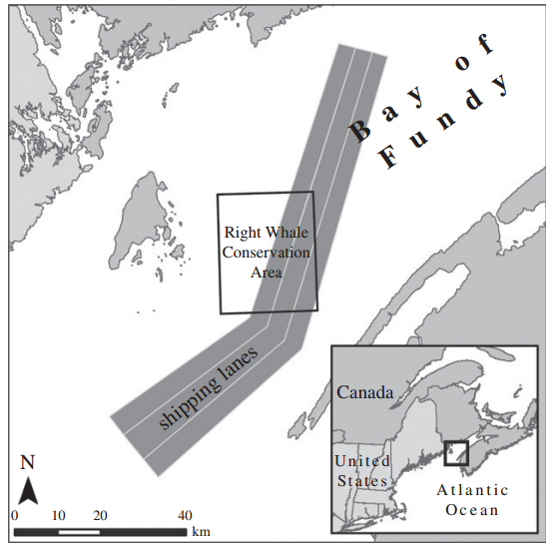
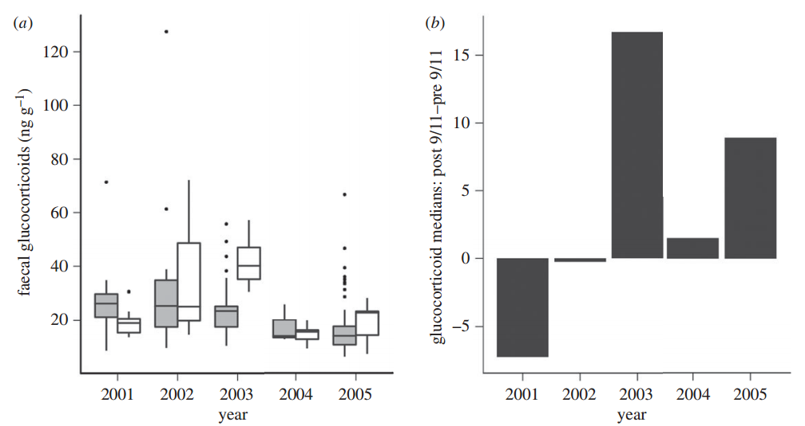
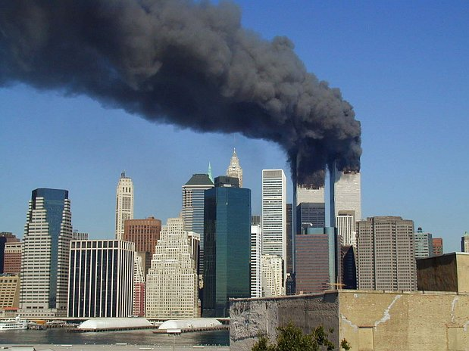
Introduction: noise impact on marine mammals, evidences
A study of stress-related faecal hormone throughout the 2001 – 2005.
The acoustic analyses showed a 6 dB decrease in the overall background noise (50 Hz–20 kHz) in recordings made after 9/11.
2001
fGC: stress-related faecal hormone
11 September 2001
(grey boxes) before & (white boxes) after 11 September for the years 2001–2005.
Rolland, R.M., Parks, S.E., Hunt, K.E., Castellote, M., Corkeron, P.J., Nowacek, D.P., Wasser, S.K. and Kraus, S.D., 2012. Evidence that ship noise increases stress in right whales. Proceedings of the Royal Society of London B: Biological Sciences, 279(1737), pp.2363-2368.
Notes:
In the immediate aftermath of 9/11, we noted a marked decrease in ship traffic in the Bay of Fundy, Canada, and acoustic recordings revealed a noticeable decrease in low-frequency background noise levels. A study of stress-related faecal hormone metabolites was also underway throughout the 2001 field season and over the four subsequent years. We analysed acoustic recordings and ship traffic data along with faecal glucocorticoid (fGC) measures of physiological stress before and after 9/11. Here, we show that a post-9/11 decrease in background underwater noise from reduced large ship traffic corresponded to a decrease in stress-related fGC hormone levels in right whales.

Slide 6
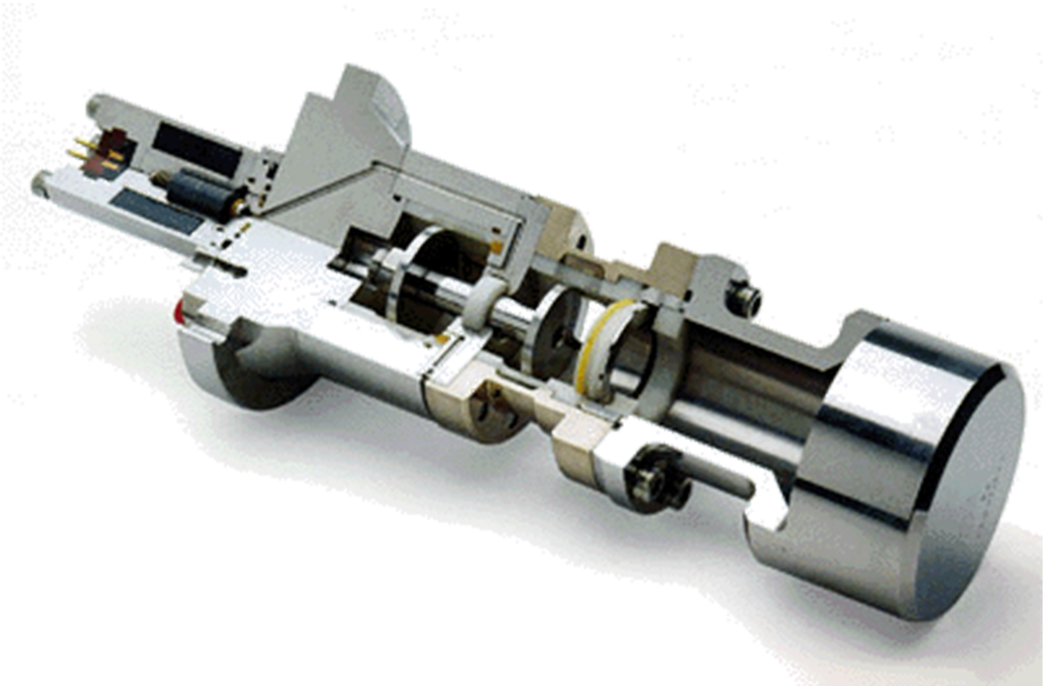
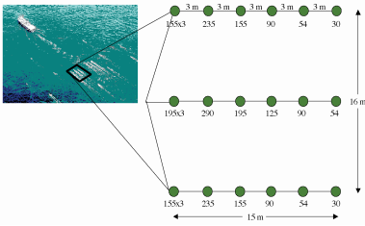
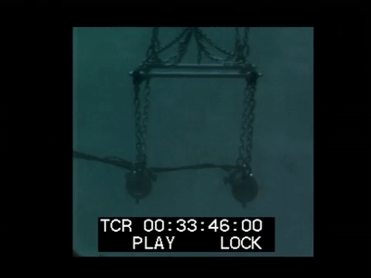
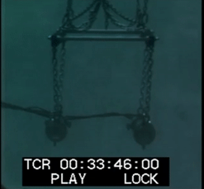
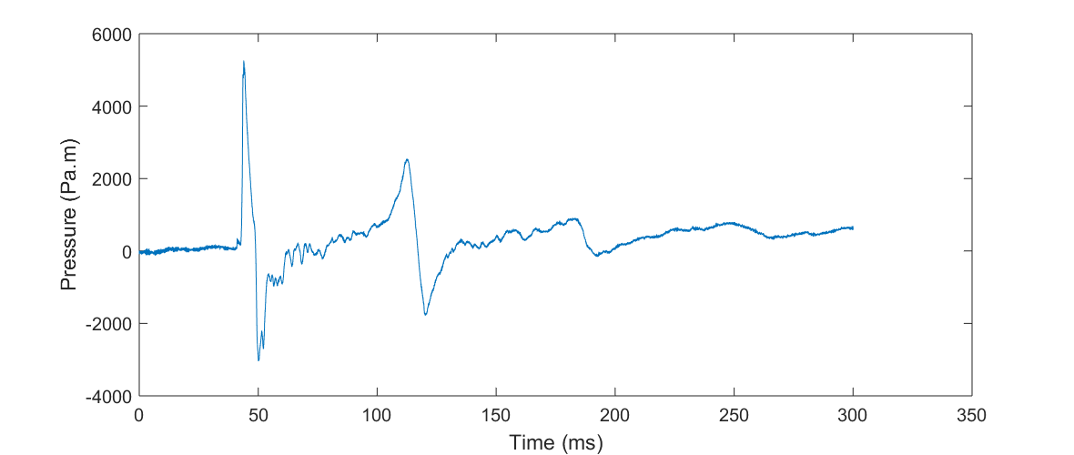
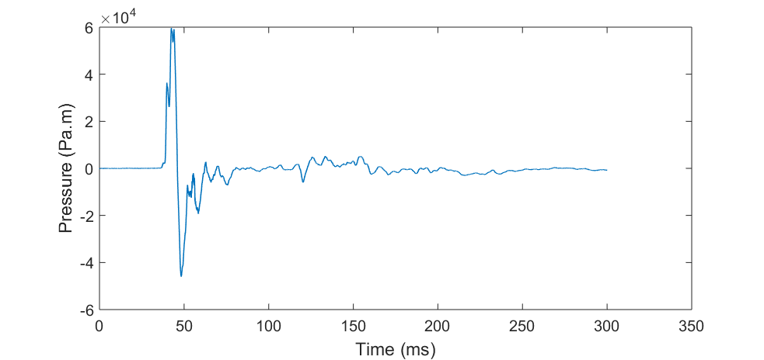
Introduction: Air-gun and Air-gun arrays
What is Air-gun?
What is Air-gun array?
Shuttle
High Pressure Air (~137 bar)
Air-gun Ports
Single Air-gun
Air-gun array
Bubble effect
Notes:
Airgun is an Acoustic source which generate acoustic waves by releasing pressurized air underwater

Slide 7
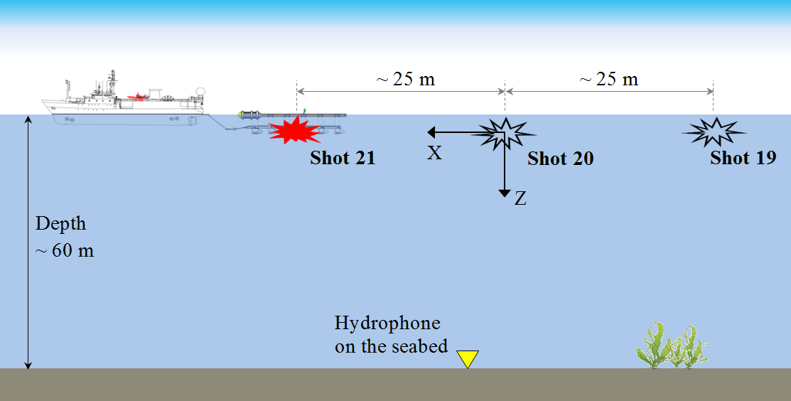
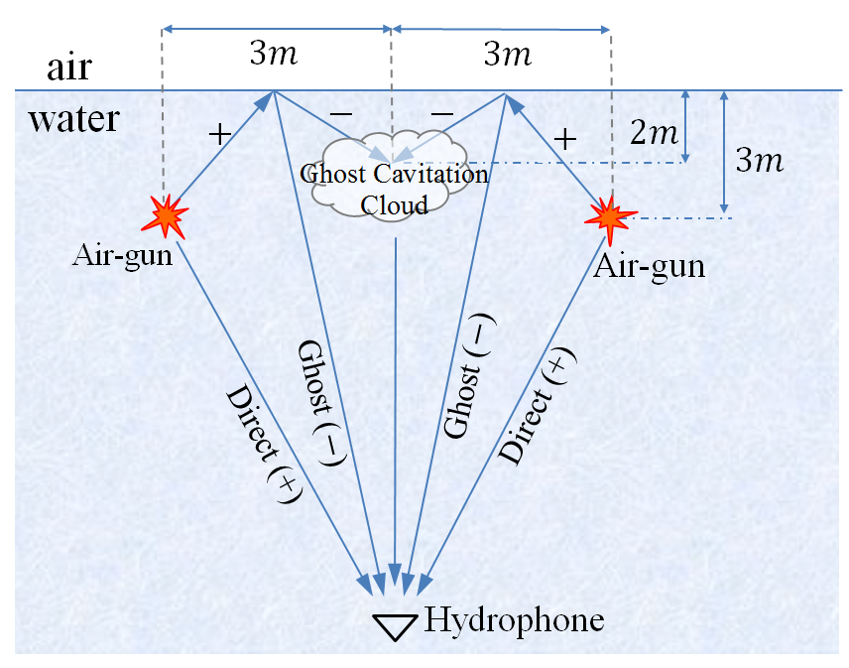
Field Experiment:
Broad Band 125 kHz
Example: (Ghost Cavitation)
High Frequency (>5 kHz) Emissions in Full air-gun arrays is attributed to acoustically induced cavitation (Ghost cavitation). (Landrø, et al. 2011, 2013, 2016)
Energy level and amplitude of such high frequencies are smaller than the maximum energy level of the air gun array signature, But

Slide 8
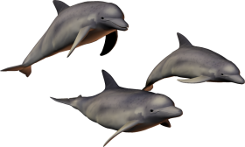
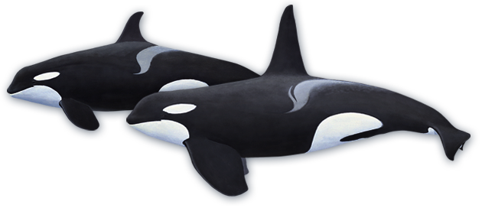
Hearing Curves
considering the hearing curves of marine mammals, these high frequencies might impact Marine mammals especially
those with high sensitive hearing in high frequencies, e.g. toothed whales and seals
Many Toothed whales are very social. They sometimes form stable groups of various sizes, and individuals within these groups interact continually (Richardson, et al., 1995)

Slide 9
Modelling
Ghost cavitation signal modelling steps:
I
Finding spatial and temporal distributions of locations where pressure drops below certain level (< -0.1 bar). Air-gun modelling is used.
II
Calculation of cavity growth and subsequent collapse at locations where pressure-drop is enough for cavitation.
III
Cavity signature is propagated to the receiver location. Geometrical spreading and attenuation is included within propagation.
IV
Superposition of individual cavity signatures in the recorder location.
Khodabandeloo, B., Landrø, M. and Hanssen, A., 2017. Acoustic generation of underwater cavities—Comparing modeled and measured acoustic signals generated by seismic air gun arrays. The Journal of the Acoustical Society of America, 141(4), pp.2661-2672.

Slide 10
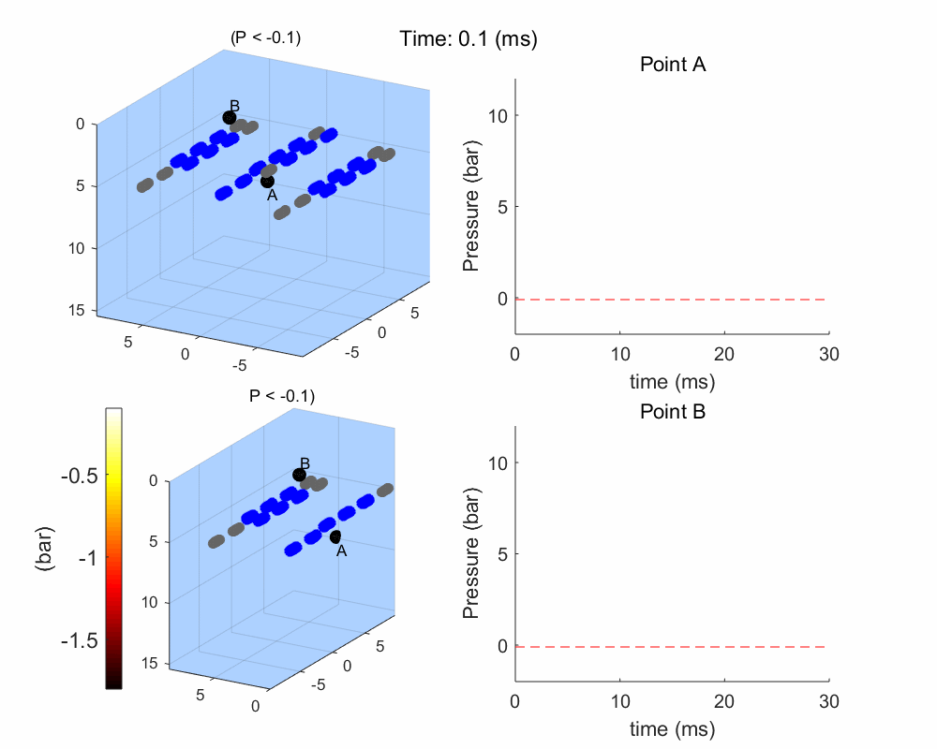
Modelling: step I, II
Initial cavity radius is assumed 20 $μm$
Acoustic pressure due to cavity growth and subsequent collapse:
$$p\left(t\right)=\frac{ρ}{4πr}\frac{d^{2}V}{dt^{2}}=\frac{ρR\left(t\right)}{r}\left(2{\dot{R}}^{2}\left(t\right)+R\left(t\right)\ddot{R}(t) \right)$$
Bubble dynamics equation (Prosperetti and Lezzi, 1986):
$$\left(1−\frac{1}{c}\frac{dR}{dt}\right)R\frac{d^{2}R}{dt^{2}}+\frac{4μ}{ρc}\frac{d^{2}R}{dt^{2}}= −\frac{3}{2}\left(1−\frac{1}{3c}\frac{dR}{dt}\right){\left(\frac{dR}{dt}\right)}^{2}$$
$$−\frac{1}{ρR}\left[2σ+4μ\frac{dR}{dt}\right]+\frac{1}{ρ}\left(1+\frac{1}{c}\frac{dR}{dt}\right)\left[P_{i}\left(t\right)−P\right]+\frac{R}{ρc}\frac{dP_{i}(t)}{dt}$$
$R(t)$: the time dependent radius of the cavity,
$ρ, c$: density and sound speed of undisturbed water,
$μ:$ is the dynamic viscosity of water.
$σ$: water surface tension
$P_{i}$: The pressure inside the cavity,
$P$: external pressure
Khodabandeloo, B., Landrø, M. and Hanssen, A., 2017. Acoustic generation of underwater cavities—Comparing modeled and measured acoustic signals generated by seismic air gun arrays. The Journal of the Acoustical Society of America, 141(4), pp.2661-2672.

Slide 11
Modelling, step II
Cavity collapse signatures at four different locations in the computational domain:
Almost the same minimum pressure, But collapse time and the peak pressure is not the same for different depths.
Our model uses cavity library
(Extracted from 132 cavity signatures):

Slide 12
Modelling, Step III, IV
We need to know:
For the locations that fulfills the pressure threshold (< -0.1 bar):
1: At what time the pressure reached its minimum?
- Then we have the formation time of each cavity
2: the magnitude of minimum pressure?
- Then we have the magnitude of each cavity signature
III
$u_{i}\left(t,r\right)$ =
$$\frac{1}{\sqrt{2π}}\int_{−∞}^{+∞}{\left(S_{i}\left(f\right)∙e^{−γ\left(f\right)r_{i}}∙e^{−j2πfτ_{i}}∙\frac{e^{−j\frac{2πf}{c}r_{i}}}{r_{i}} \right)e^{j2πtf}df}$$
$r_{i}$: distance between
i^{th} cavity to hydrophone
$τ_{i}$: Cavity formation time
$γ$: Absorption
IV
$$y\left(t,r\right)=\sum_{i=1}^{N}{u_{i}}$$

Slide 13
Results
Following steps I – IV:
No interaction between cavities.
A good correspondence (especially occurrence timing) is observed between field measurements and simulation results. (Model 1).
Field measurement
In the next step, Simple model for cavity interaction is used. (Model 2)
Pressure field from former cavity collapses decreases the later cavity growth radiuses and collapse time
Interaction between cavity collapses is modelled which is analogous to the pressure field interactions in an air gun array
Simulation results

Slide 14
Results
10 kHz HP filtered data − field measurements and simulated results for different shot numbers 15 to 20 from Model 2.
Good agreement between field & simulation with regard to the envelope shape and rate of accumulation of energies.
Duration increases by increasing the distance between shot and receiver locations

Slide 15
Conclusions
Modelling scheme for predicting high frequency acoustic emissions due to ghost cavitation in the air-gun arrays is presented.
Ghost cavitation hypothesis is further confirmed by this numerical modelling.
Model needs calibration to estimate high freqency emissions quantitatively.
Thank you.
Acknowledgment
Thanks ROSE meeting for this opportunity.
This research is funded by ARCEx partners and the Research Council of Norway (grant number 228107).

Slide 17
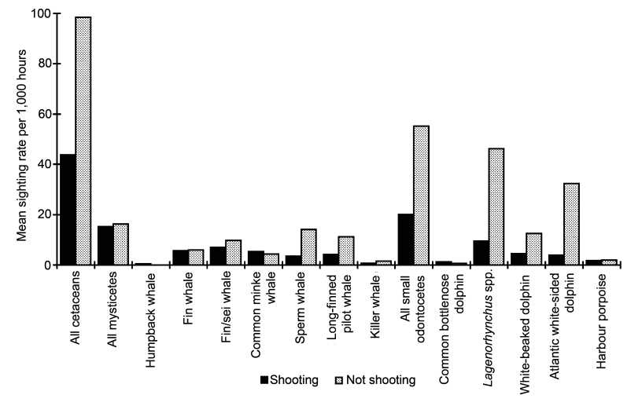
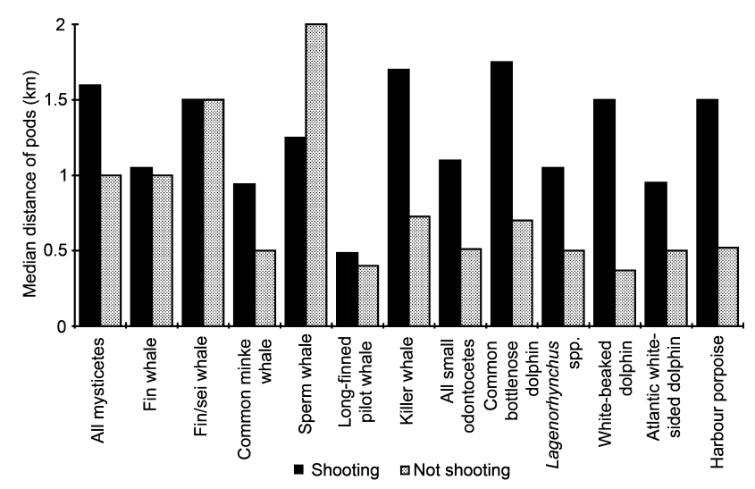
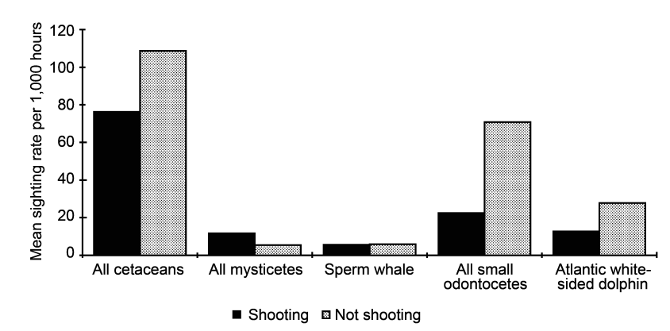
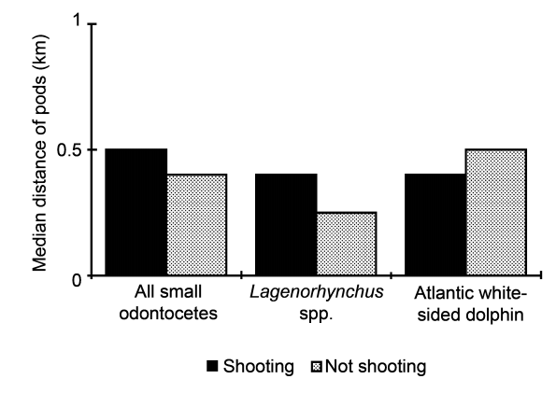
Introduction: noise impact on marine mammals, evidences
Sighting rates of cetaceans in relation to the use of large volume air-gun arrays.
Median closest distance of approach of cetaceans to large volume air-gun arrays in relation to air-gun activity.
Categorized in more general groups
Categorized in more general groups
Stone, C.J. and Tasker, M.L., 2006. The effects of seismic airguns on cetaceans in UK waters. Journal of Cetacean Research and Management, 8(3), p.255.
Notes:
Right whale populations worldwide were reduced to low levels by whaling. Southern right whales Eubalaena australis have shown remarkable recovery since protection from whaling, but North Atlantic right whales remain on the brink of extinction Kraus et al., 2005. Right whales produce sounds to communicate, using variable tonal calls in social interactions and a stereotyped tonal upsweep as a contact call Clark, 1982; Parks and Tyack, 2005.
As a population declines, it may become increasingly difficult for individuals to locate each other for social interaction and mating due to dilution effects. If ambient noise levels increase, the range over which individuals can locate one another will be further reduced unless the whales can modify their calling behavior to improve the probability of detection by another whale.

