Slide 1
Creating virtual receivers from drill-bit noise using seismic interferometry
Yi Liu*, NTNU
Deyan Draganov, TU Delft
Kees Wapenaar, TU Delft
Børge Arntsen, NTNU

Slide 2
Motivation
A data-driven redatuming method
Can improve migrated images in the presence of velocity errors
Suitable for deep local imaging
Use drill-bit noise data acquired while drilling for such local imaging?

Slide 3
Outline
Introduction
Inter-source seismic interferometry (SI)
Inter-source SI with non-transient sources
Synthetic results
Discussion and conclusion

Slide 4
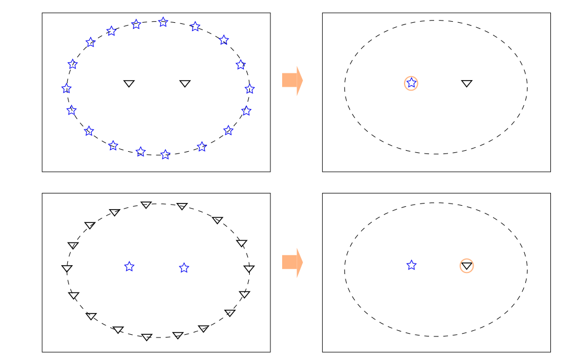
Seismic interferometry (SI)
Green’s function retrieval
Any arbitrary 3D inhomogeneous lossless medium
Integral (Summation) of crosscorrelation of wavefield observations
Inter-receiver SI
Data-driven!
Inter-source SI
Notes:
acoustic G – cc of wavefield observations (monopole & dipole sources), arbitrarily shaped surface enclosing ...

Slide 5
for our drill-bit situation:
Notes:
* amplitude error * spurious events; bear in mind, not exact, only phase information, and artefacts...

Slide 6
Simplified form of inter-source SI
Notes:
Frequency domain; Acoustic
Accurate when D is a sphere with a very large radius (\alpha = 0, dipole to monopole); Assume that the medium at and outside D is homogeneous (to remove ghost term);
Approximations:
high-frequency regime: replace d_iG with \pm i \omega /c |cos \alpha|;

Slide 7
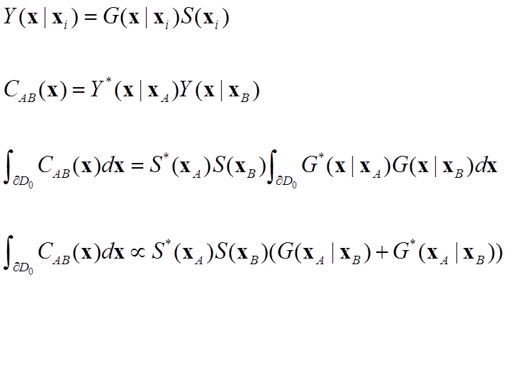
Inter-source SI with non-transient sources
Non-transient source S(x_{i})
Notes:
replace /prop with /approx

Slide 8
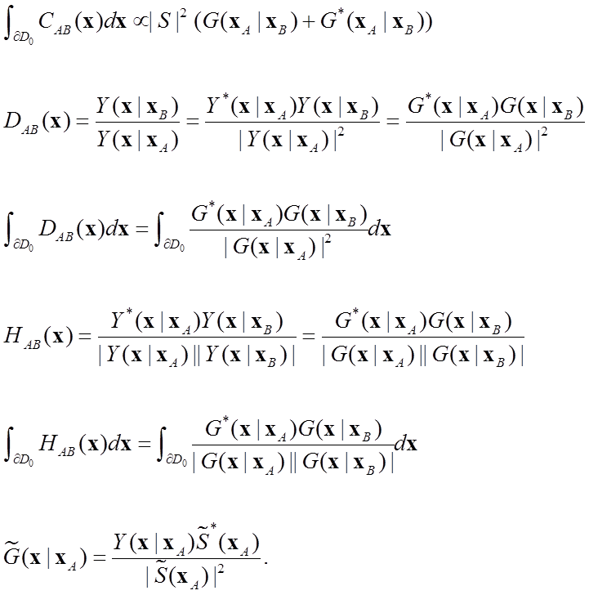
Inter-source SI with non-transient sources
Same noise signal s(t):
SI by crosscorrelation (CC):
SI by deconvolution (DC):
SI by crosscoherence (CH):
Different s(t):
Notes:
xA=xB: D_AB=H_AB=1;
D_AB != D_BA; H_AB =H_BA;
introduce pilot; pilot-deconvolved drill-bit data

Slide 9
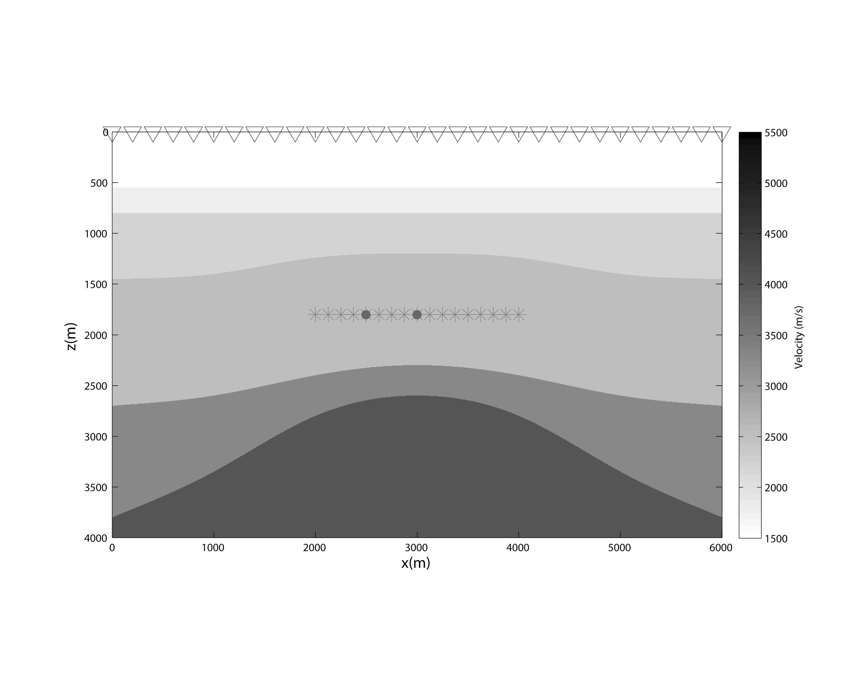
Synthetic example
Synthetic Vp model. The stars denote drill-bit positions and triangles denote receivers at the surface level. The dots indicate two reference source positions for trace comparison.
nsrc=81, nrcv=121
Notes:
result is all sources into receivers...

Slide 10
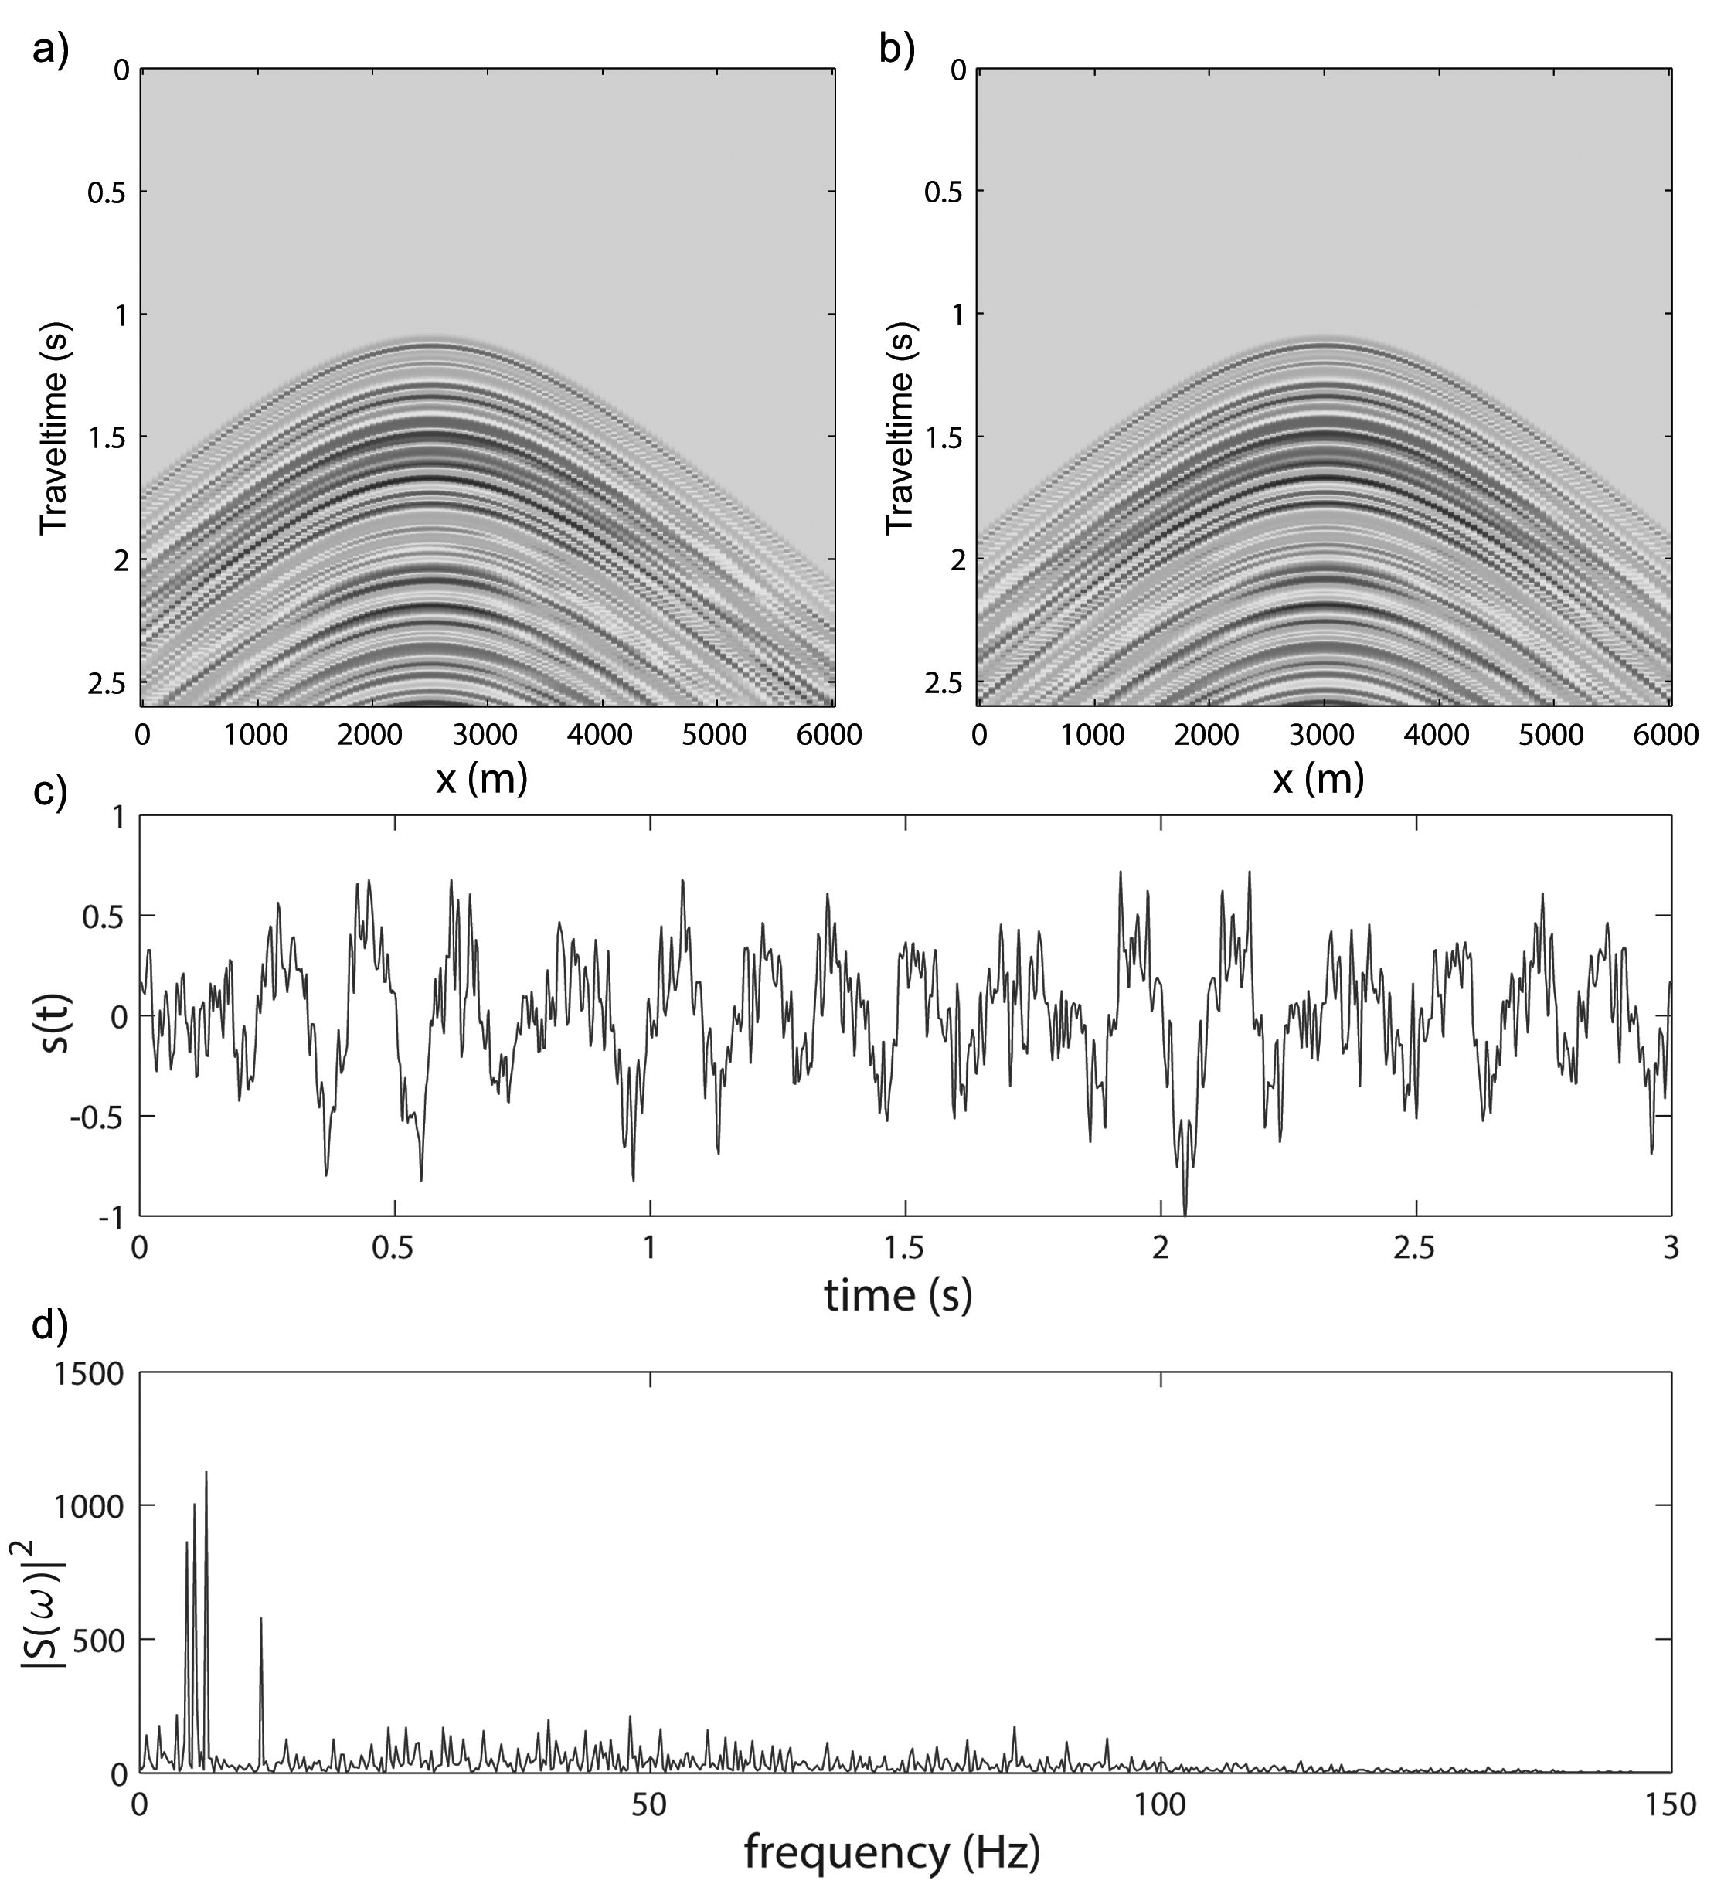
Same s(t)
Drill-bit source function and recorded common-source gathers. a) Common-source gather at x = 2500 m and b) at x=3000 m. c) Modelled drill-bit source function. d) Power spectrum of the modelled drill-bit function.
Notes:
The drill-bit source function is modelled as a three-cone roller bit with each cone composed of three teeth rows (Poletto et al., 2004), the weight on bit of 130 kN, 60 bit revolutions per minute and a normalized speed amplitude of 0.3 (Aarrestad and Kyllingstad, 1988). s(t) and S(ω)² denotes the source time function and its power spectrum, respectively.

Slide 11
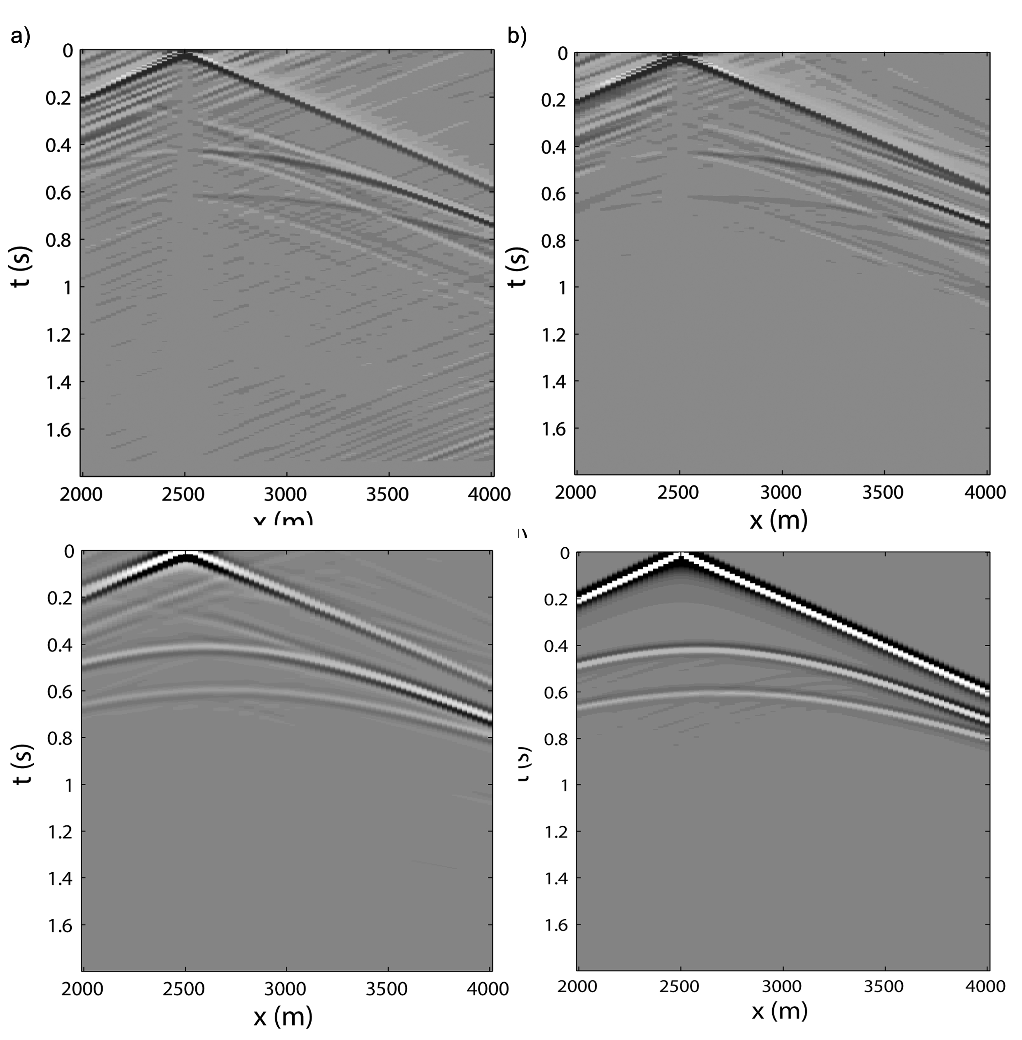
Comparison of the retrieved responses with the reference response
c)
x (m)
d)
The virtual response of the source at x= 2500m retrieved by a) DC, b) CH and c) CC. d) The reference response modelled with a homogeneous overburden.
Notes:
Both a) and b) do not require any knowledge of the source function s(t), except that s(t) does not change with changing drill-bit positions, while c) requires the power spectrum |S(w)|^2 to be known.

Slide 12
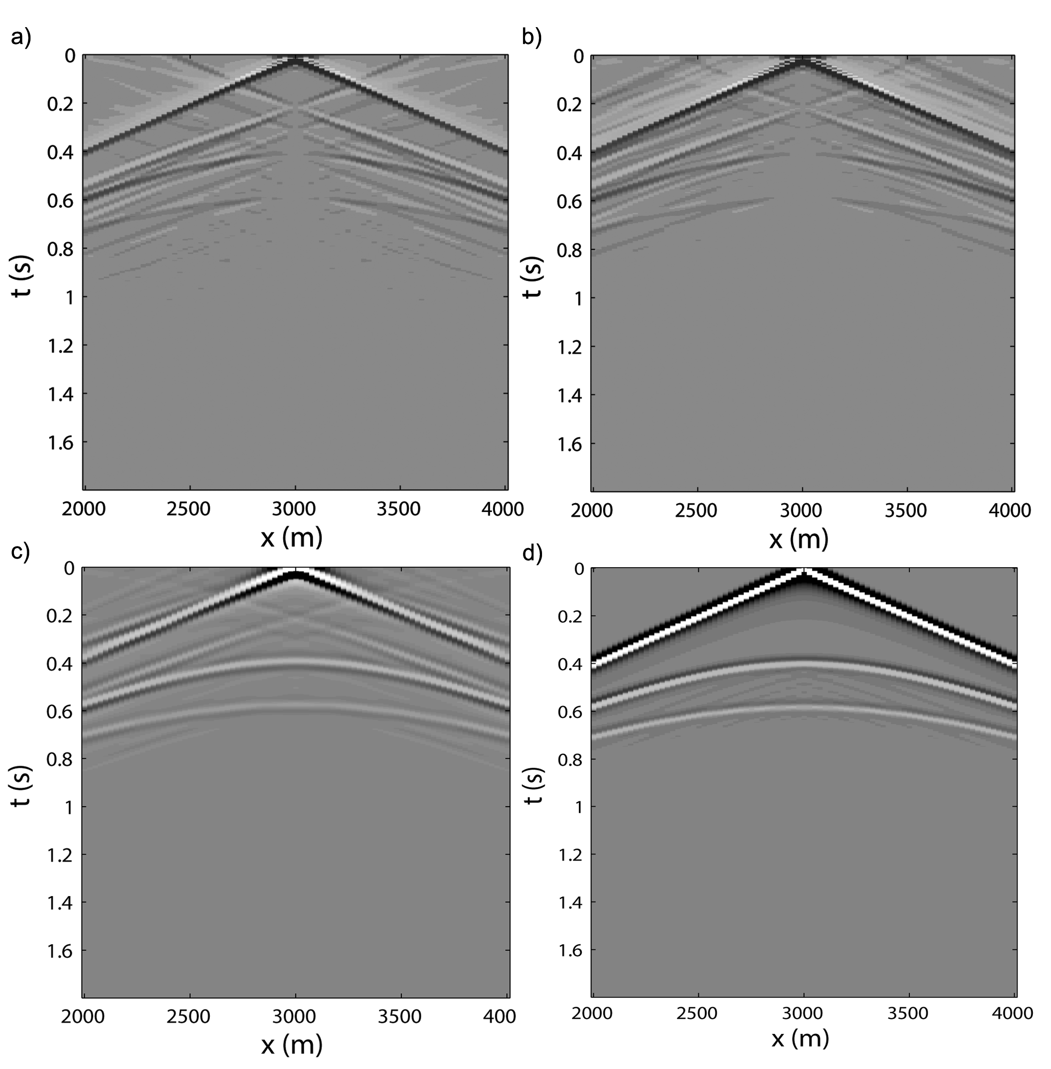
Comparison of the retrieved responses with the reference response
As the previously, but with the virtual response of the source at x= 3000 m.
Notes:
artefacts: finite aperture at surface

Slide 13
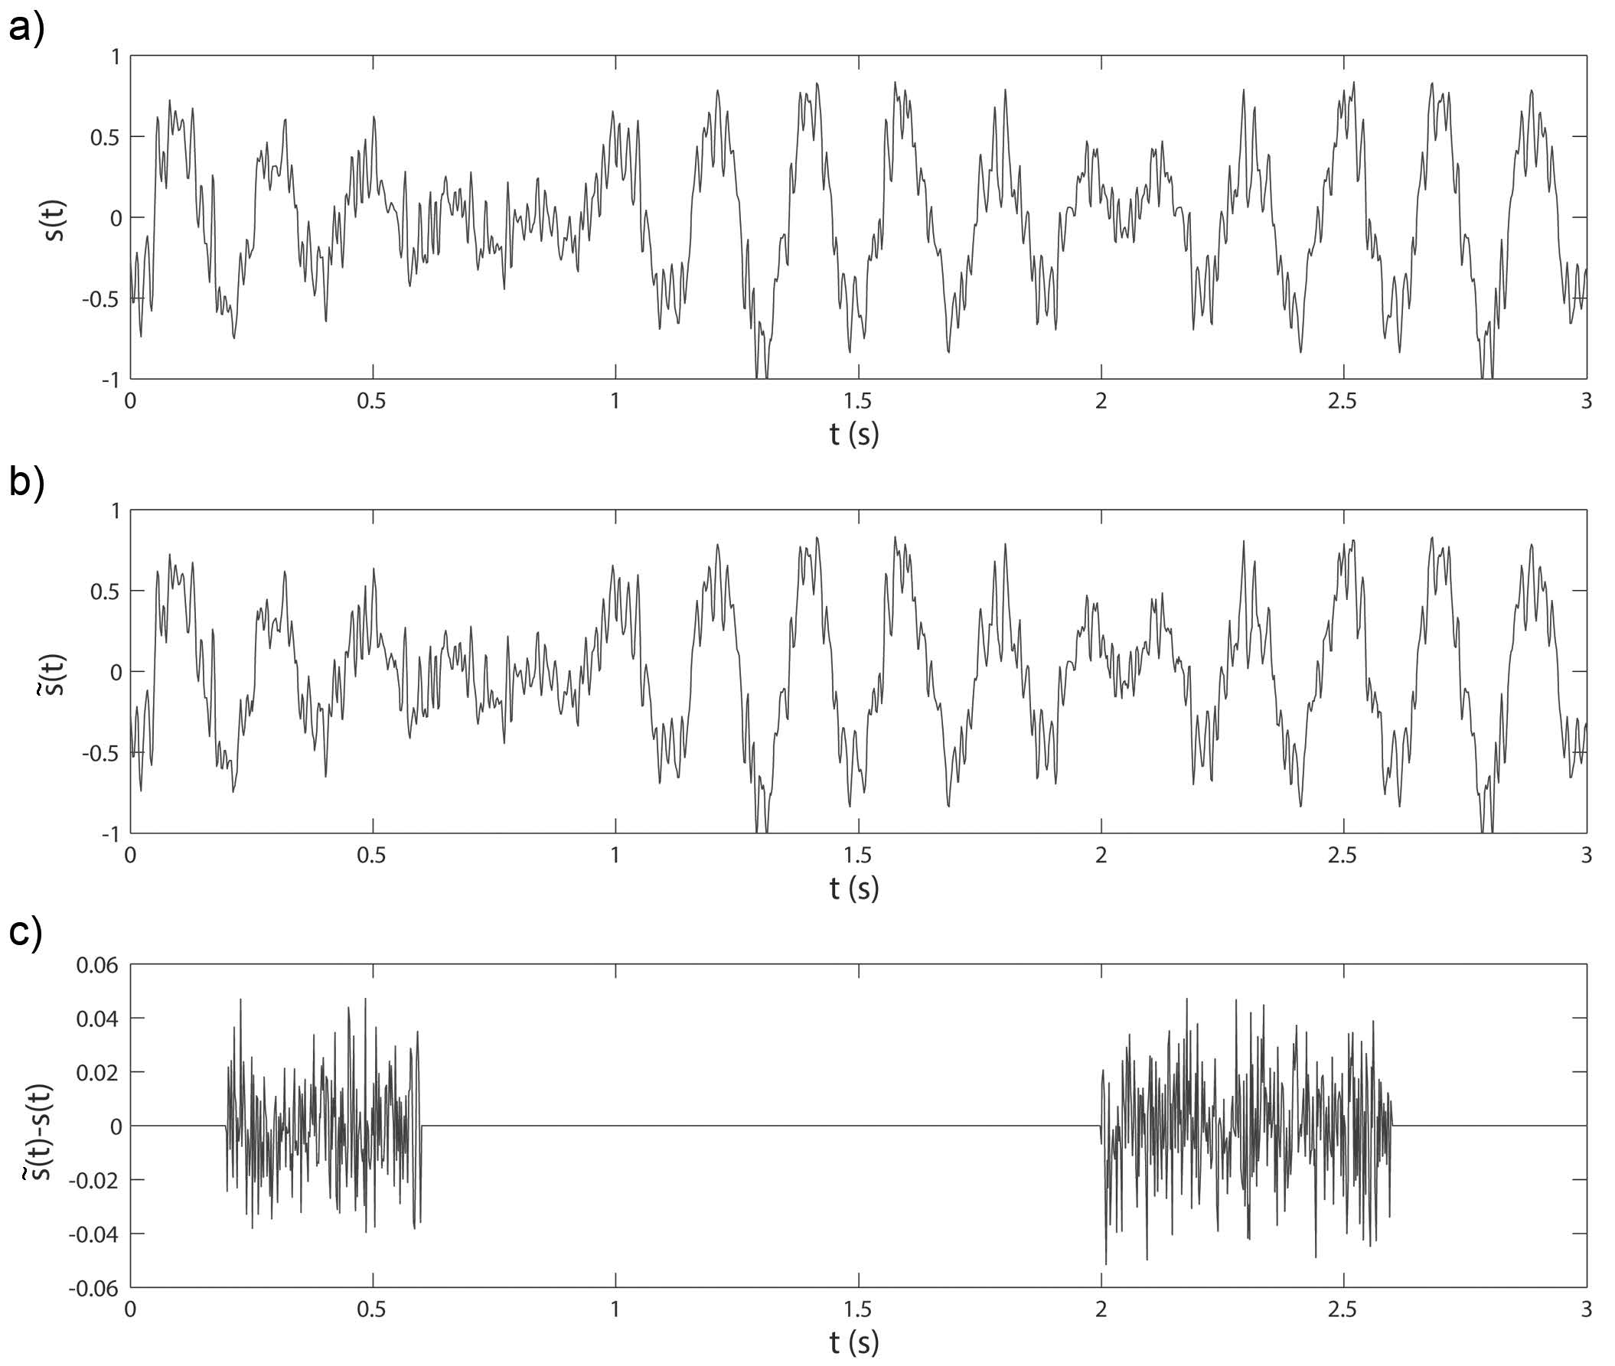
Different s(t)
An example of the modelled drill-bit signals. a) The exact drill-bit source function s(t). b) Estimate of the signal. c) The noise added to the estimated signal, which is up to 5% of the drill-bit signal.

Slide 14
Modelled common-source gather and pilot-deconvolved results.
a) Raw common-source gather from drilling noise at x=3000 m. Pilot-deconvolved common-source gathers using b) the exact source signal and c) the noise-contaminated pilot signal. The arrow indicates the internal multiple from the second layer, which arrives about 0.2 seconds after the direct waves.

Slide 15
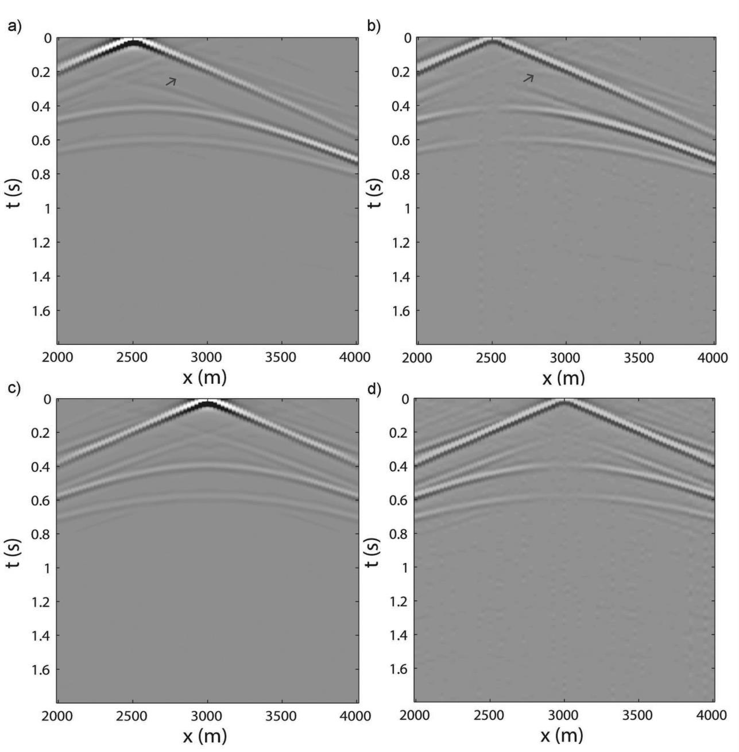
Retrieved common-source response at the drill-bit positions.
a) and c) used s(t) for pilot deconvolution. b) and d) use , and energy normalization is applied afterwards. The arrow indicates the non-physical reflection identified as the crosscorrelation of the direct waves and the internal multiples.
Notes:
Emphasize, no velocity information, all from data...

Slide 16
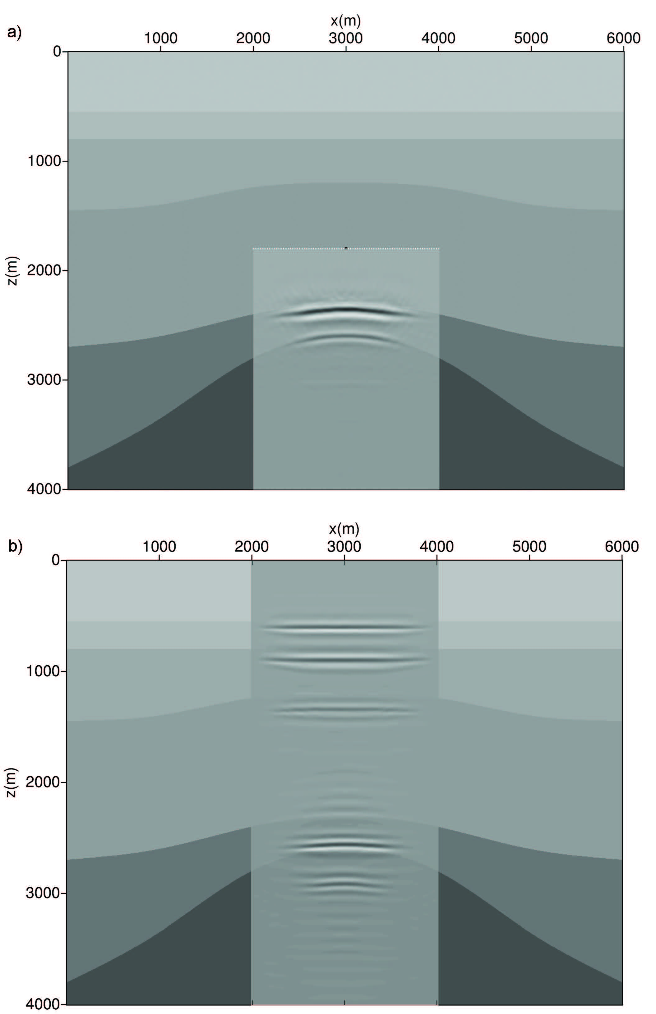
Migration images
a) using retrieved virtual reflection responses at the drill-bit positions, and b) using conventional surface seismic reflection data. The background indicates the true velocity model. Image a) is obtained using a homogeneous velocity model of 2750 m/s (2500 m/s+10% error), while image b) is obtained using the 10-percent erroneous velocities of the whole model.
Notes:
cost of veloctiy update can be high...

Slide 17
Discussion and conclusion
Create vitual receivers from drill-bit noise using pilot-deconvolved drill-bit data;
The retrieved responses are useful for imaging as they have been interferometrically redatumed to the borehole level, thus independent of the velocity accuracy of the overburden.
Information about the drill-bit noise is essential;
Pilot signals need to have sufficient signal-to-noise ratios;
Receiver arrays on land or with ocean-bottom stations or cables, with sufficient spacing to avoid aliasing;
The length of the receiver array also matters.

Slide 18
Acknowlegement
The authors acknowledge the Research Council of Norway, ConocoPhillips, Det norske oljeselskap, Statoil and Wintershall for financing the work through the research centre DrillWell, a research cooperation between IRIS, NTNU, SINTEF and UiS;
ROSE consortium at NTNU;
The research of D.D is supported by the Division for Earth and Life Sciences (ALW) with nancial aid from the Netherlands Organization for Scientic Research (NWO).

