Slide 1
Combining time lapse seismic and gravity to estimate CO₂ saturation changes at Sleipner
ROSE meeting 2015
M. Landrø and M. Zumberge

Slide 2
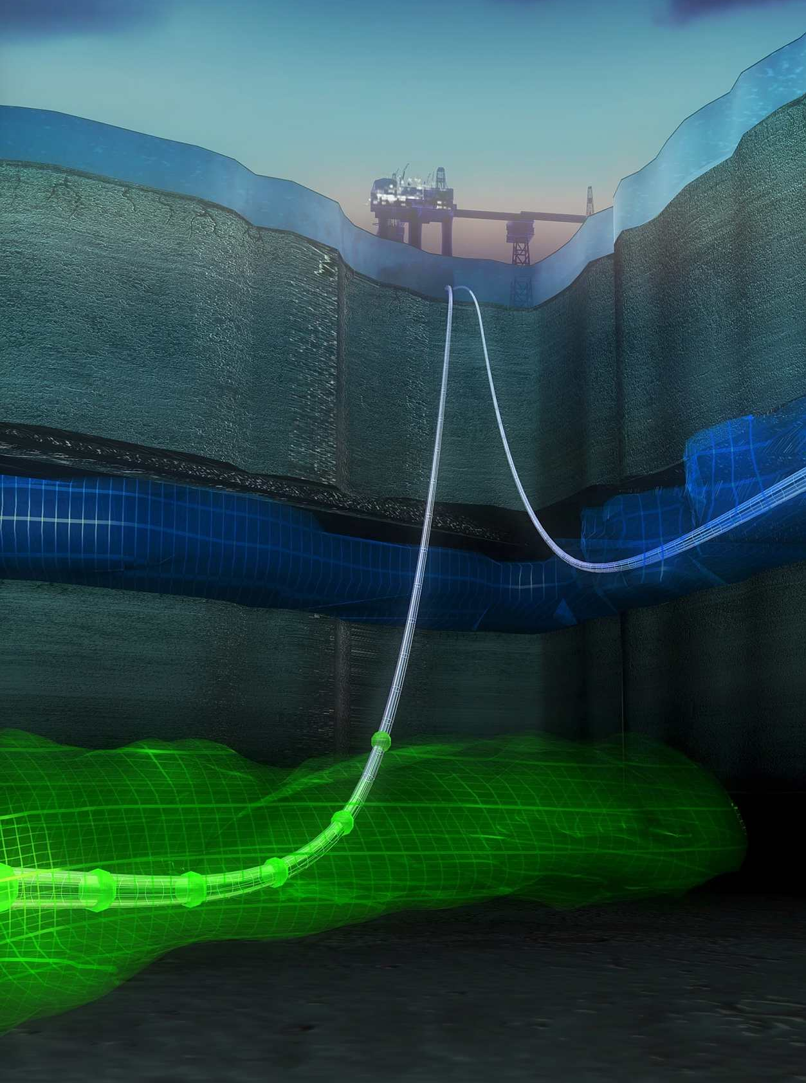
Sleipner CO₂ storage
Reservoir unit at 800-1100 m depth
One CO₂ injector
Over 12 Million tons CO₂ have been injected
Norway can store 50 Gtons offshore (NPD)
Yearly global emission was 32 Gtons in 2010 and 40 Gtons in 2014…

Slide 3
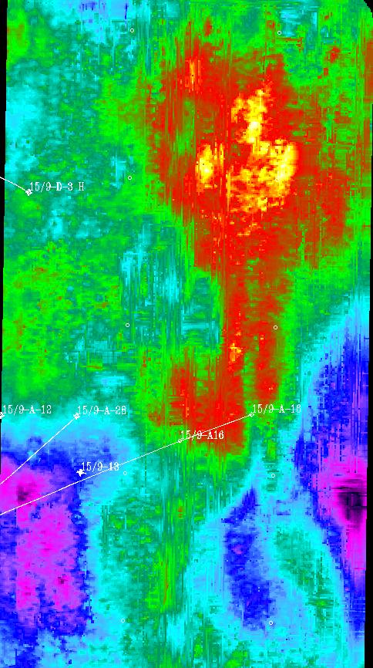
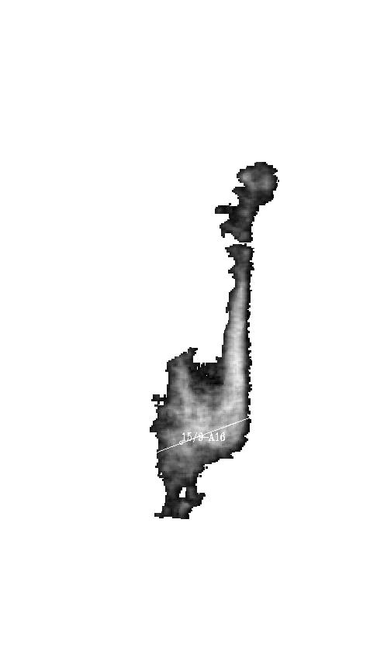
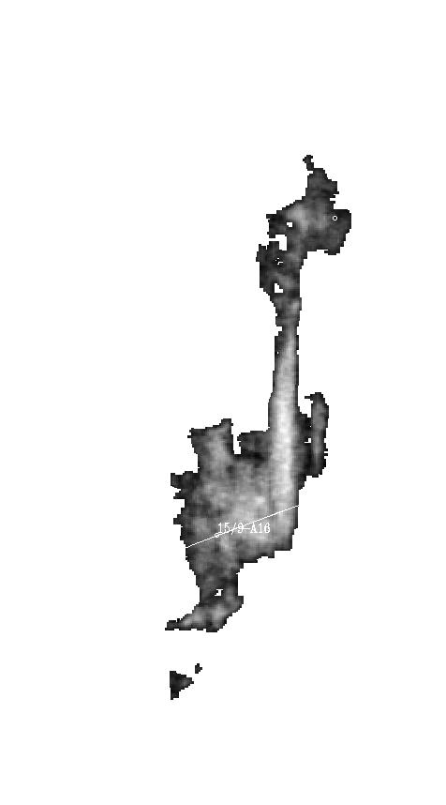
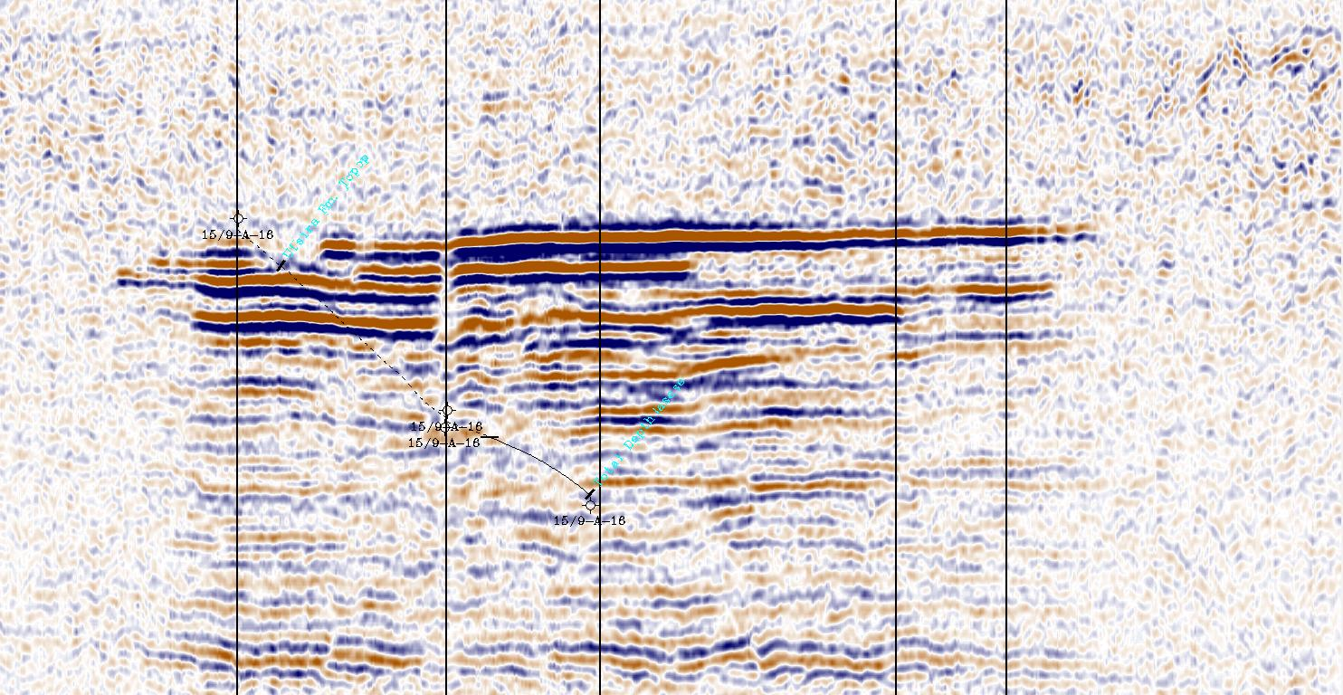
Sleipner CO₂ monitoring
Layer (9)
Seismic monitoring data indicates a northerly extension to the plume, especially in the uppermost layer 9
Seismic amplitude difference (2008-1994)
Layer 9
Increasing amplitude
injection point
Injection point
1999
Data courtesy of Statoil
2001
2002
2004
2006
2008
1 km
Notes:
Here we have a map showing depth, or actually reflection time, down to top Utsira Fm. Yellow and red are shallow areas. The injection point was selected under a gentle dome, which was expected to be filled first. I will now show the plume development through the years, for the top layer to the left, and for all layers to the right. (KLIKK) In 1999, three years after injection started, two small blobs had reached the uppermost sand, and in 2001 (KLIKK) this had grown considerably. At that time, most of the CO2 was deeper in the plume. In the upper right corner, injected mass is cross-plotted against the area-integrated seismic amplitudes for all layers. (KLIKK) (KLIKK) By 2004, the CO2 had gone north in a channel-like feature, (KLIKK) (KLIKK) and by 2008 the next dome is being filled. At the same time the plume is still expanding in all directions. The cross-plott show a good linear relation (KLIKK). In spite of this, quantitative estimates based on seismic amplitudes and travel time changes are challenging, and currently the seismic data are not able to estimate, for example, the amount of CO2 dissolved in the water.
The mapped plume area reached 3,1 km² by 2008, which means that about 5% of the pore space under that area is occupied by CO2. This number has been fairly constant during the last ten years.
Clearly much of the flow is controlled by the topography. This is challenging to capture by finite element modeling (Eclipse), which then requires high-resolution grids. Straight extrapolation suggest that the plume will continue to expand in the northerly direction and mostly in the middle and upper layers in the years to come.

Slide 4
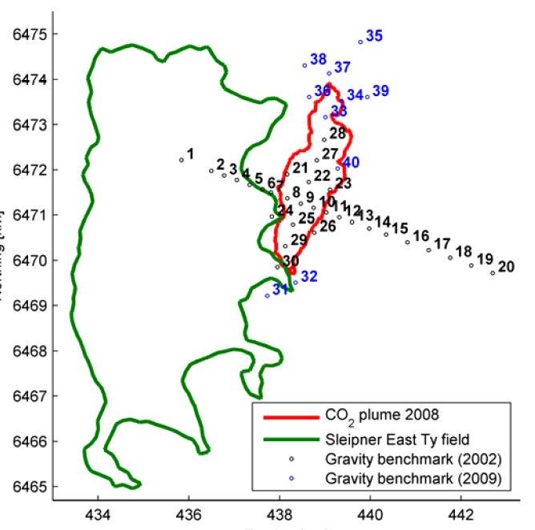
Gravity data: 30 repeated gravity measurements
Source: Alnes et al., 2011

Slide 5
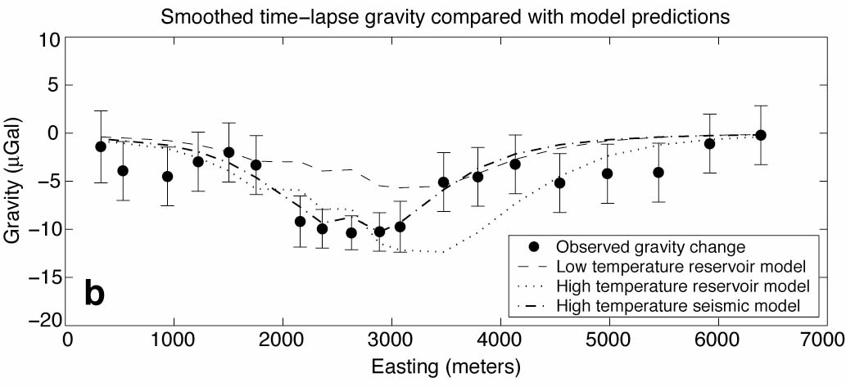
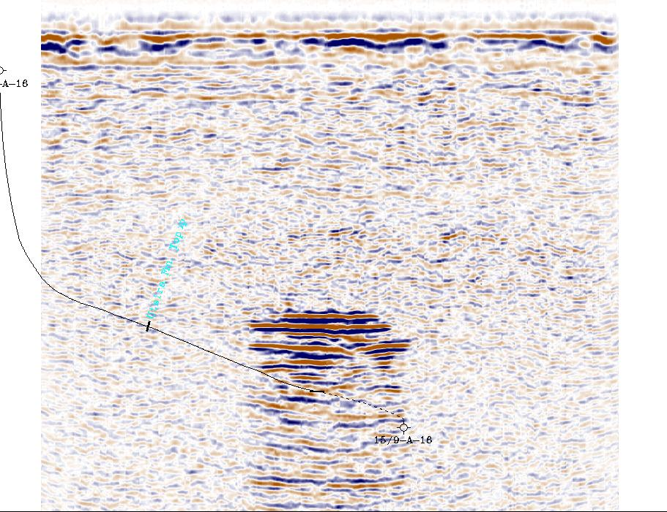
Time lapse gravity – Sleipner CO₂ plume
Work by H. Alnes, O. Eiken, S. Nooner, G. Sasagawa, T. Stenvold and M. Zumberge

Slide 6
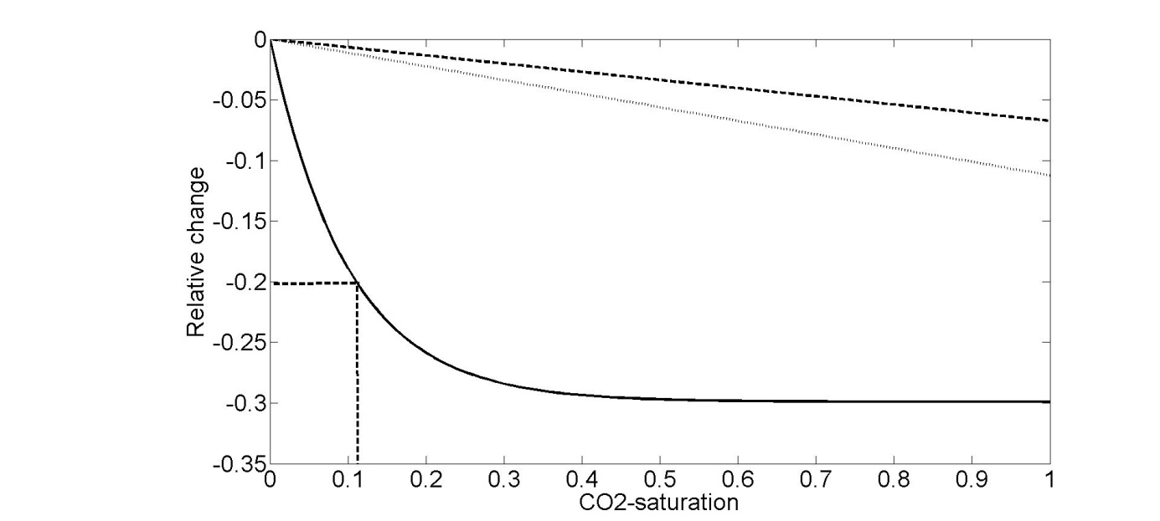
A simple rock physics model for Sleipner CO₂-injection
Density change 675 kg/m³
Density change 425 kg/m³
Velocity change
Gravity data
Seismic data

Slide 7
Strategy for how to combine time lapse seismic and gravity
 | CO₂-saturation 0-0.3 | CO₂-saturation 0.3-1 | Spatial resolution
Seismic
Gravity
Spatial resolution is most important =>
Use time lapse seismic to estimate saturation changes up to 0.3
Use time lapse gravity in areas where seismic estimates are above 0.3 or where there is a seismic shadow effect

Slide 8
Time lapse AVO for density and velocity estimation
Landrø, Geophysics, 2001

Slide 9
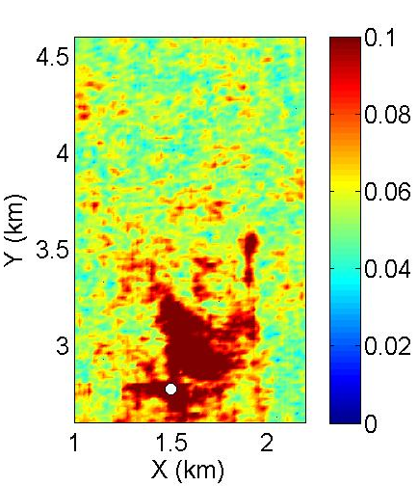
Calibration step 1
Average value of 0.06 obtained by multiplication with 0.02
2001 RMS near offset amplitude map (26 ms window covering the top reservoir interface)
Modeled zero offset response from well log input: -0.06
=> Use a global scalar of 0.02 to achieve this

Slide 10
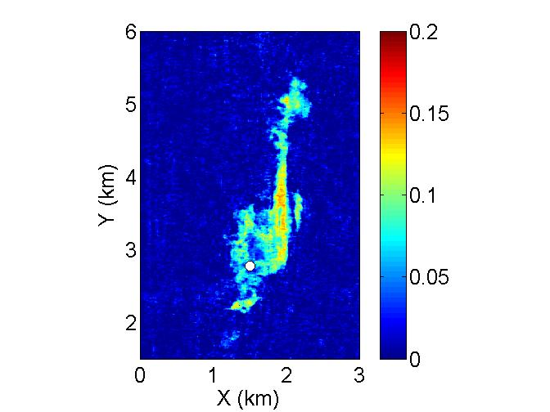
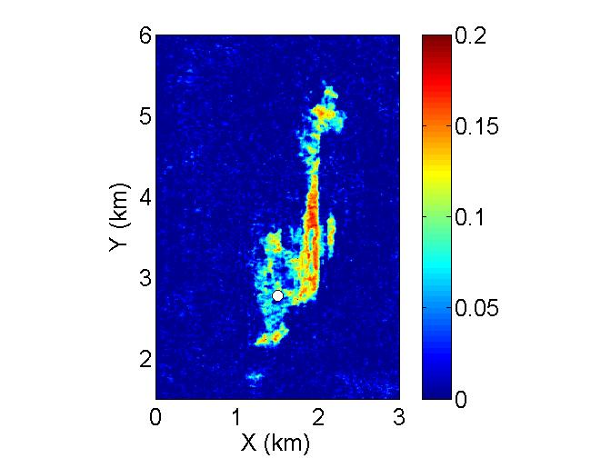
Far offset calibration (step 2)
Q-value fitted by trial and error until a good match with modeled AVO-response is obtained – shown in next slide
Near 2001-2008
Far 2001-2008 Q=0
Far 2001-2008 Q=80
XL 1258
XL 1120
Injection point

Slide 11
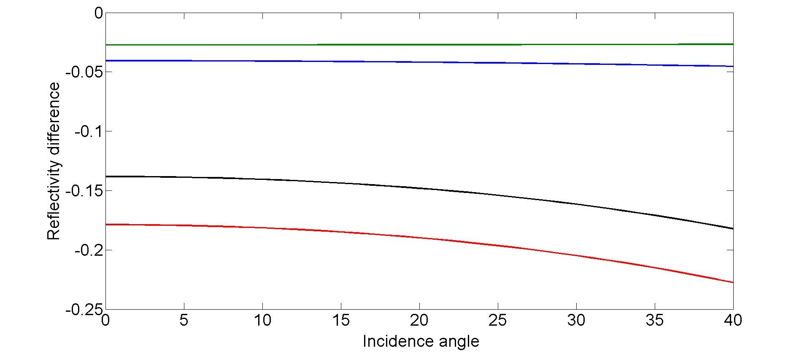
Calibration of seismic data – determining Q
0.5-1.0
0.2-0.5
*
0-0.2
*
0-0.3
Notice: Q=80 will fit both 0-0.2 and 0-0.3 scenario

Slide 12
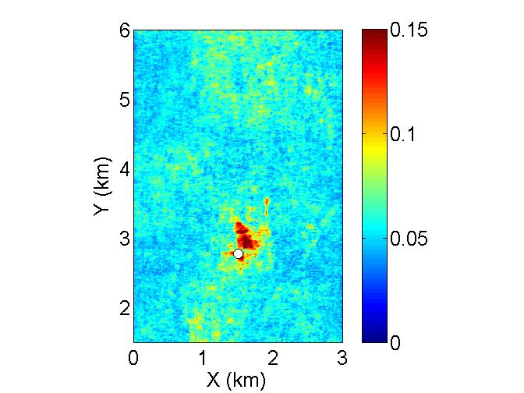
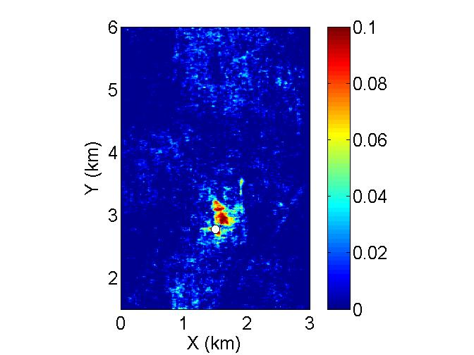
Estimating the 1999-2001 saturation change
The maximum value for this difference is 0.1, which corresponds to a relative velocity change of -0.2. The corresponding saturation change (see dashed line in Figure 3) is approximately 0.1. This means that the right figure can also serve as an initial guess for the saturation changes between 1996 and 2001, without further scaling.
RMS 2001
RMS 2001-mean
Velocity change
=>
The scaling factor is 1, and the RMS 2001-mean =

Slide 13
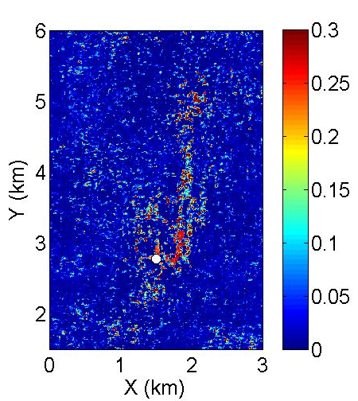
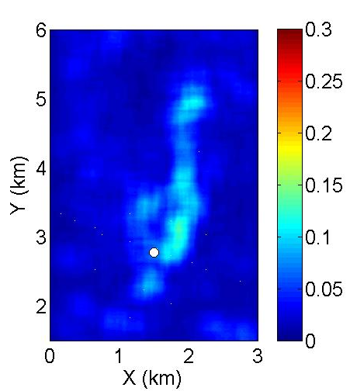
Saturation changes for the upper layer 2001-2008
smoothed

Slide 14
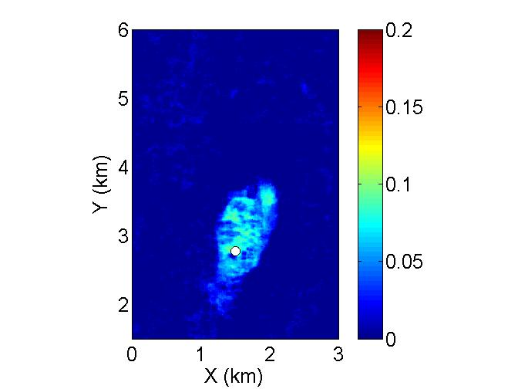
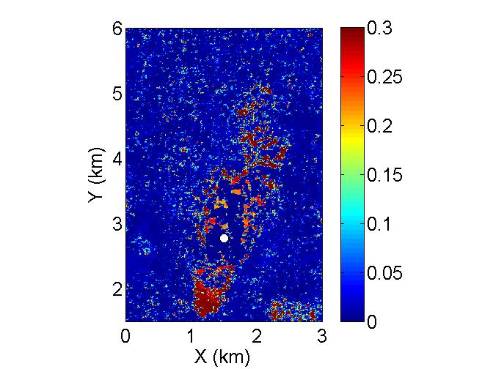
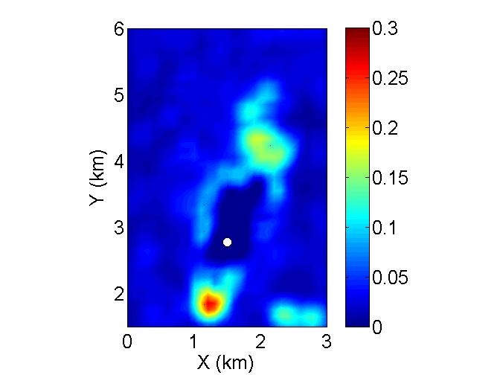
Using a thick RMS window: 850-1100 ms
dS from 1999-2001
dS from 2001-2008
Smoothed
Note: A new global scalar was determined (0.06), and the Q kept constant at 80
Problem: NO SIGNAL BELOW PLUME IN 2001 – shadow effect and the 0.3-effect

Slide 15
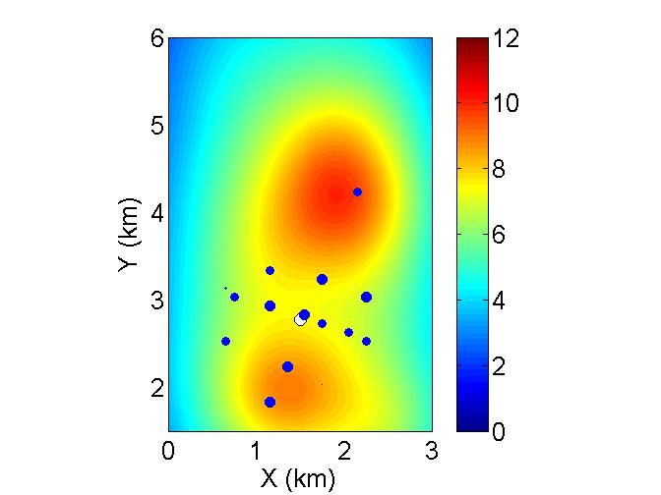
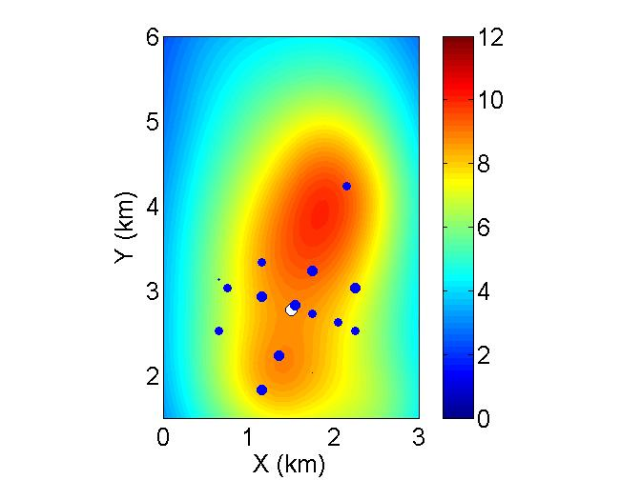
Gravity data and constrained inversion
Before inversion
After inversion
Blue circles are gravity measurements – size proportional to gravity change
Background color map represents MODELED responses from estimated saturation changes
The constrained inversion gives a better fit to the measured gravity data

Slide 16
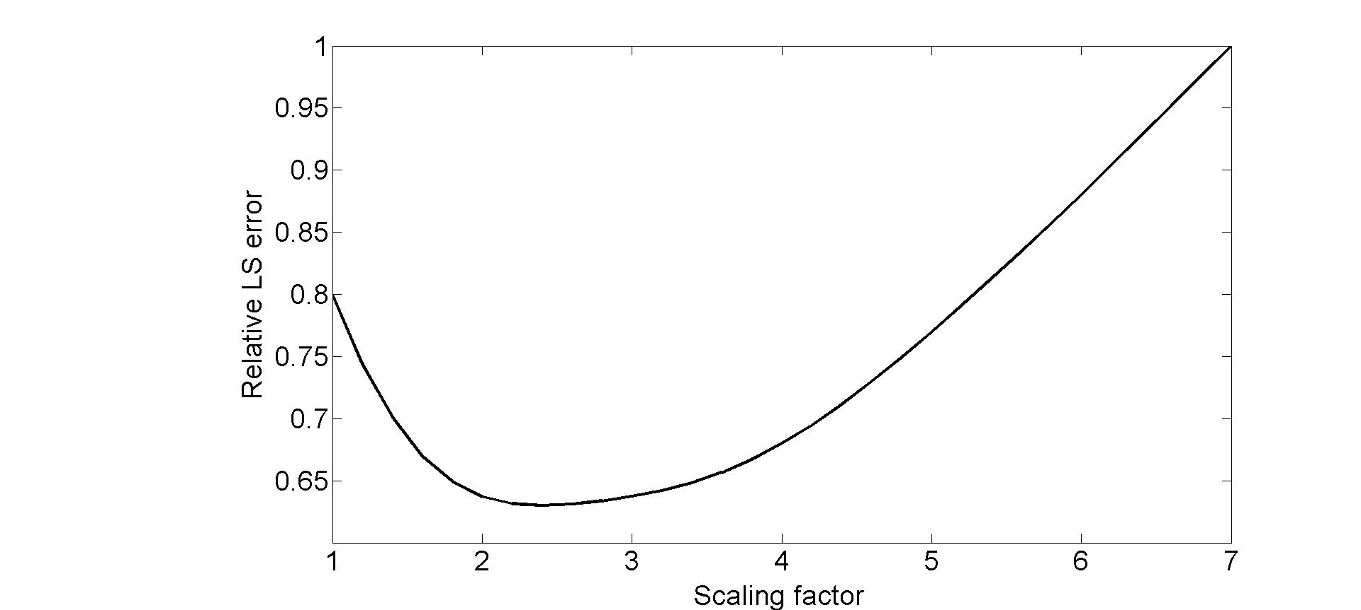
Inversion – LS error
Assume that the spatial distribution suggested by the time lapse seismic inversion is OK, and simply scale this distribution by one single scalar in the shadow zone => scalar = 2.4

Slide 17
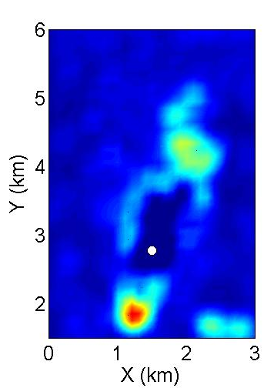
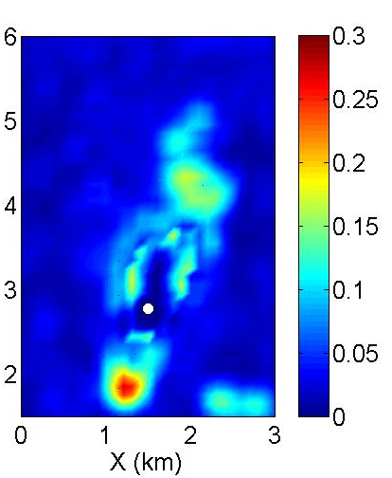
Before and after using gravity data
Before
After

Slide 18
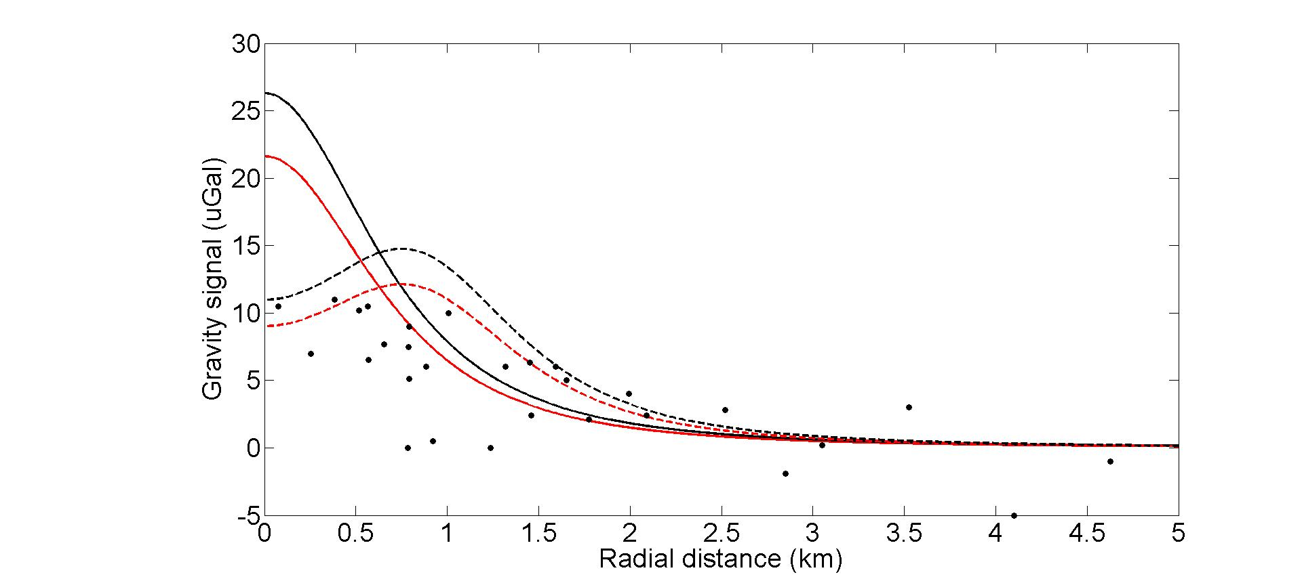
Gravity change (2002-2008) versus radial distance from the injection point compared to modeled results (5.88 Mtons injected)
Point source
720 kg/m³
675 kg/m³
Dipole source 1.6 km
Density of water: 1040 kg/m³
Dept of source(s): 900 m

Slide 19
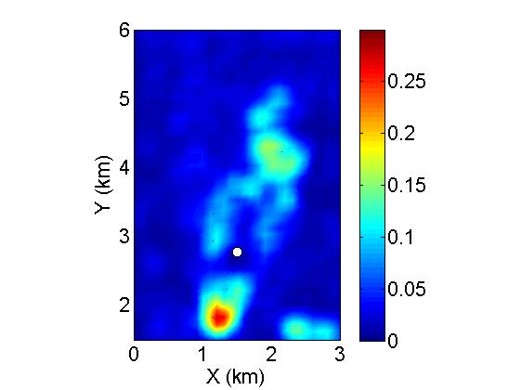
Effect of increasing the global scalar by 30 %

Slide 20
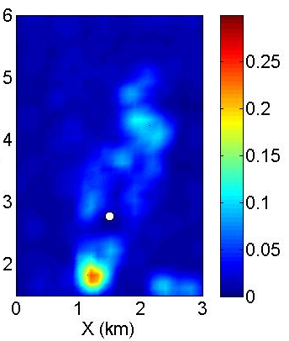
Effect of increasin Q from 80 to 100
Q = 80
Q = 100

Slide 21
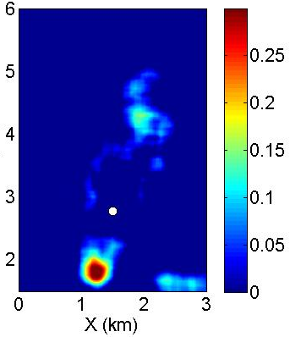
Estimated density changes
Smoothed

Slide 22
Saturation changes and density changes - compared
Saturation
Density
Almost proportional…

Slide 23
Conclusions
Stacked layers of CO2 represents a huge challenge for quantitative saturation estimation from 4D AVO
Top layer analysis gives reasonable results
Practically no change in seismic data for saturation changes above 0.3
A constrained gravity-seismic inversion is used to improve results in the seismic shadow zone
The LS error between initial (seismically derived saturation changes) and final saturation change model is reduced by 20 %.

Slide 24
Acknowledgments
Statoil and the Sleipner license partners ExxonMobil and Total for permission to use the data
Anne-Kari Furre and Ola Eiken for support and discussions
Alistair Harding and Matthew Dzieciuch for help and assistance
Scripps for hosting me and the Norwegian Research Council for financial support

Slide 25
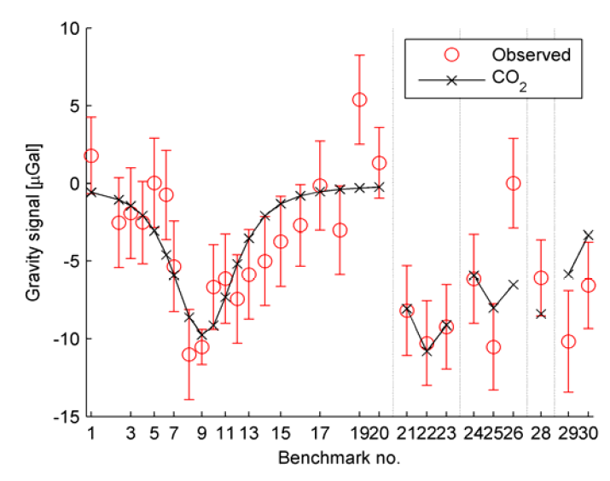
Time lapse gravity results
Source: Alnes et al., 2011

Slide 26
Seismic data sets used: 3D from 2001 and 2008

Slide 27
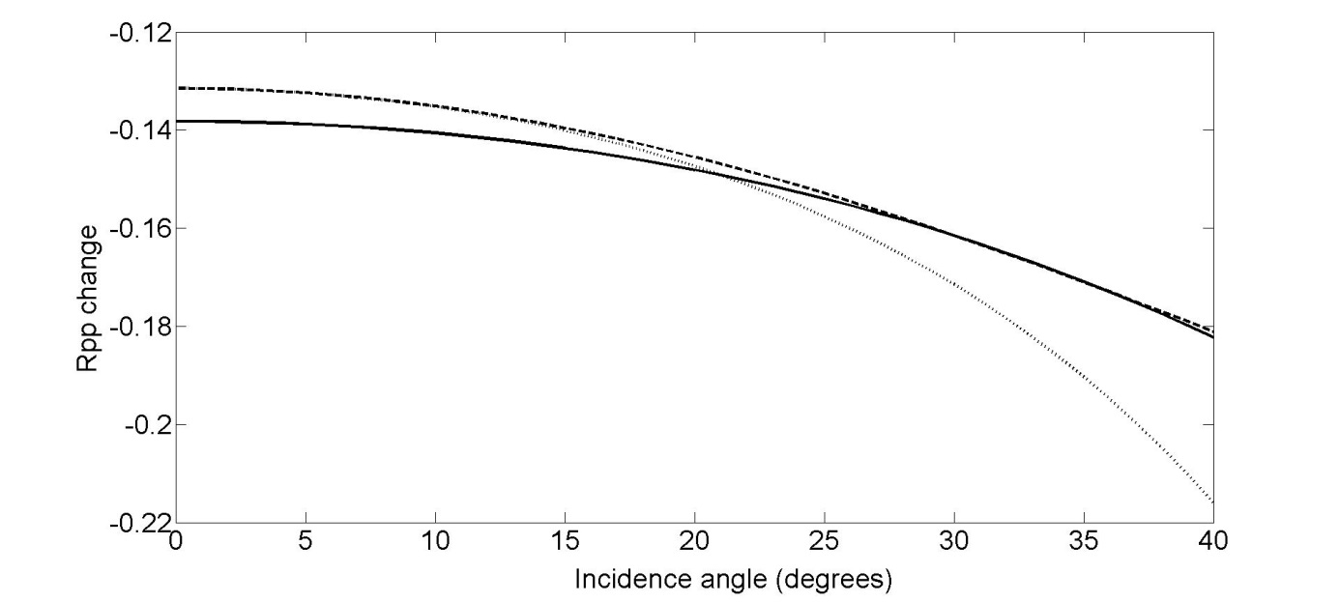
Testing approximations
Used in this project
Zoeppritz

Slide 28
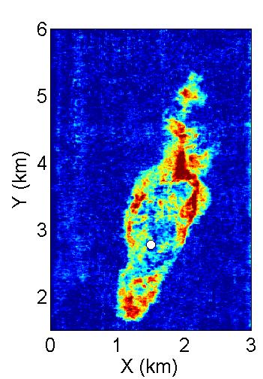
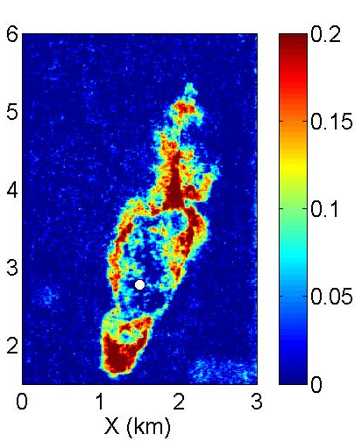
The anomaly in the lower right corner..
Before
After
Why believe less in this change? Because the near difference is zero
dNear
dFar

