Slide 1
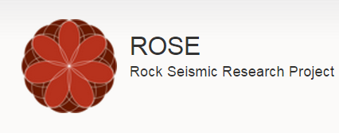
ROSE meeting
Shibo Xu & Alexey Stovas, NTNU
27-30th.04.2015, Trondheim

Slide 2
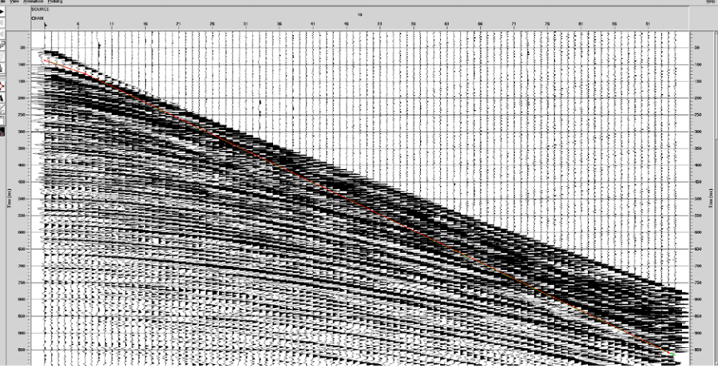
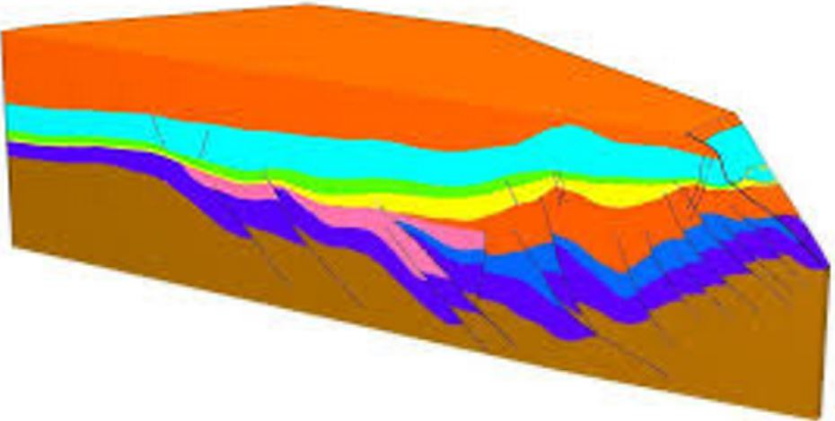
Seismic data
Reflector & model
Curvature, Anisotropy & Heterogeneity

Slide 3
Estimation of anisotropy parameters from CRS approximation
Objectives:
1. Distinguish curvature and anisotropy from CRS approximation
2. Investigate the effect from anisotropy and inhomogeneity to CRS
attributes and model parameters
3. Estimation of anisotropy and model parameters

Slide 4
Outline
1 The CRS operator for a circular reflector in isotropic medium
2 Extend for more complicated media
3 Numerical examples & sensitivity analysis
4 Curvature and anisotropy estimation
5 Conclusions
Notes:
No some

Slide 5
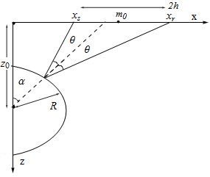
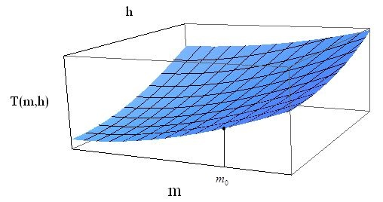
CRS approximation
Notes:
m0

Slide 6
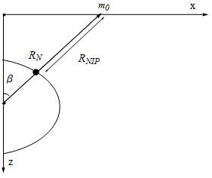
Inversion of CRS attributes
Notes:
Turn to the audience

Slide 7
Outline
1 The CRS operator for a circular reflector in isotropic medium
2 Extend for more complicated media
3 Numerical examples & sensitivity analysis
4 Curvature and anisotropy estimation
5 Conclusions

Slide 8
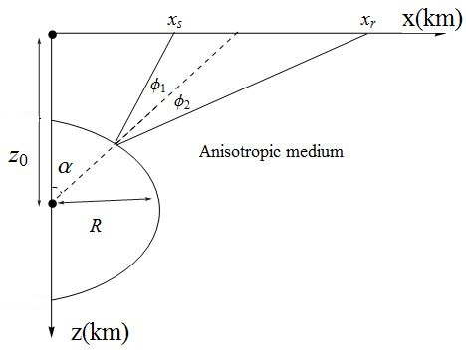
Extension for anisotropic media
For geometrical relation
For group velocity
For traveltime

Slide 9
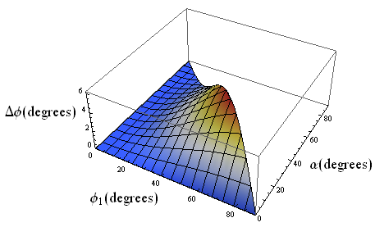
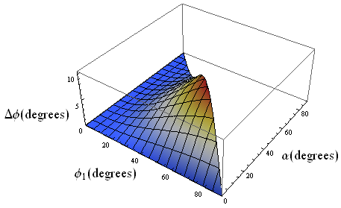
EI medium
Notes:
EI medium

Slide 10
GMA group velocity
(Fomel and Stovas, 2010)

Slide 11
Effective anisotropy
1 Homogeneous anisotropic media
Elliptical isotropic model (EI)
Transversely isotropic model with
vertical symmetry axis (VTI)
2 Heterogeneous isotropic media
Two layered isotropic model (2LI)

Slide 12
EI model:
VTI model:

Slide 13
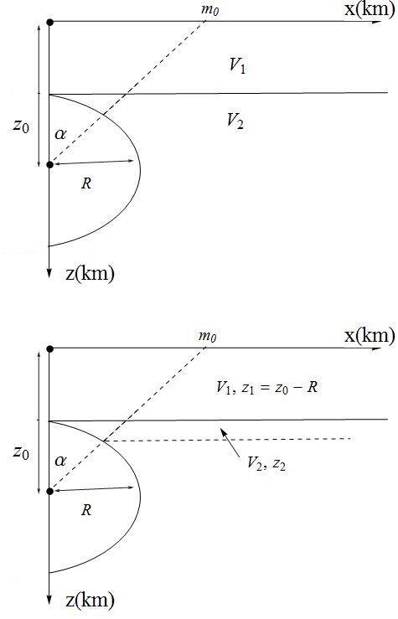
2LI model:

Slide 14
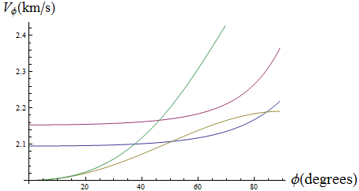
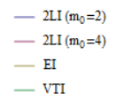
Group velocity comparison
Reflector：
ISO：
EI：
VTI：
2LI：

Slide 15
Outline
1 The CRS operator for a circular reflector in isotropic medium
2 Extend for more complicated media
3 Numerical examples & sensitivity analysis
4 Curvature and anisotropy estimation
5 Conclusions

Slide 16
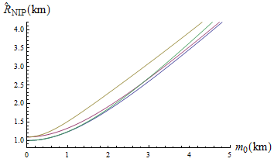
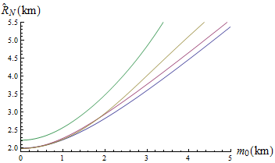
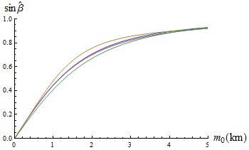
Numerical examples –CRS attributes
The plots of CRS attributes versus m0. The ISO, EI, VTI and 2LI cases are shown by blue, red, yellow and green colours, respectively.

Slide 17
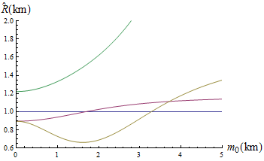
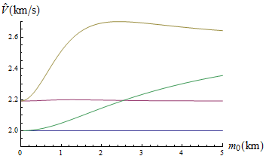
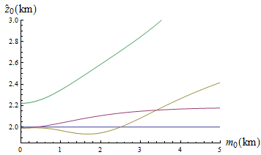
Numerical examples –model parameters
The plots of model parameters versus m0. The ISO, EI, VTI and 2LI cases are shown by blue, red, yellow and green colours, respectively.

Slide 18
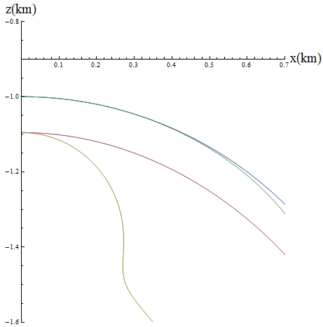
Reconstructed reflector

Slide 19
Linearization
CRS attributes
Model parameters

Slide 20
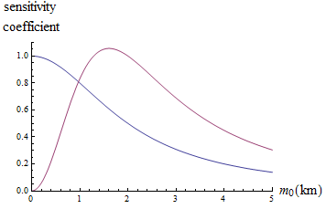
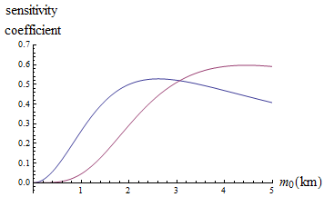
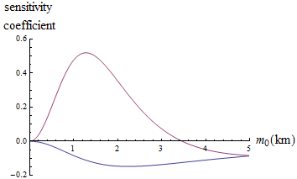
Sensitivity analysis

Slide 21
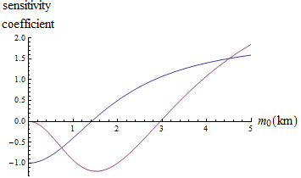
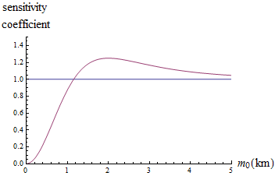
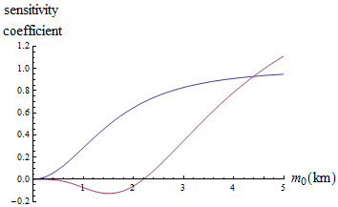
Sensitivity analysis

Slide 22
Outline
1 The CRS operator for a circular reflector in isotropic medium
2 Extend for more complicated media
3 Numerical examples & sensitivity analysis
4 Curvature and anisotropy estimation
5 Conclusions

Slide 23
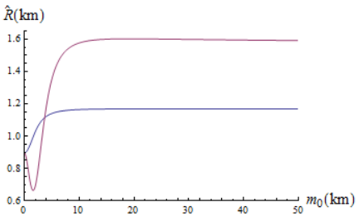
Estimation
For EI model

Slide 24
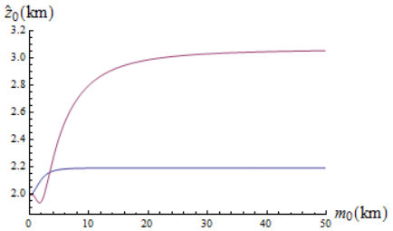
Estimation
For VTI model

Slide 25
Estimation test

Slide 26
Seismic data
Reflector & model

Slide 27
Step 1. ---data
Step 2. --- ,CRS approximation
Step 3. ---isotropic inversion from CRS approximation
Step 4. ---analysis sensitivity

Slide 28
Outline
1 The CRS operator for a circular reflector in isotropic medium
2 Extend for more complicated media
3 Numerical examples & sensitivity analysis
4 Curvature and anisotropy estimation
5 Conclusions

Slide 29
Conclusions
Investigate the effect of effective anisotropy (anisotropy & heterogeneity) on CRS attributes and the estimated model parameters.
Propose a method to estimate the strutural and anisotropy parameters by using CRS approximation from a circular reflector.

Slide 30
References
Alkhalifah T 1998 Acoustic approximations for processing in transversely isotropic media Geophysics 63 623-631
Fomel S and Kazinnik R 2013 Non-hyperbolic common reflection surface Geophysical Prospecting 61 21-27
Fomel S and Stovas A 2010 Generalized nonhyperbolic moveout approximation Geophysics 75 U9-U18
Höcht G, E de Bazelaire, P Majer, and P Hubral, 1999 Seismics and optics: Hyperbolae and curvatures Journal of Applied Geophysics 42 261-281
Jäger R, Mann J, Höcht G and Hubral P 2001 Common-reflection-surfacestack: Image and attributes Geophysics 66 97-109
Landa E, Keydar S and Moser T J 2010 Multifocusing revisited: Inhomogeneous media and curved interfaces Geophysical Prospecting 58 925-938
Vanelle C, Bobsin M, Schemmert P, Kashtan B and Gajewski D 2012 i-CRS: A new multiparameter stacking operator for an/isotropic media 82nd Annual International Meeting SEG Expanded Abstracts

Slide 31
End
Thanks for attention!

