Slide 1
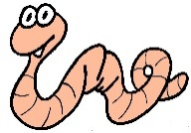
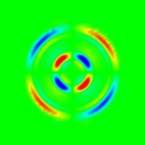
Waves in solid/fluid layered system
Alexey Stovas, NTNU
Yuriy Roganov, Tesseral
ROSE 2017

Slide 2
Outline
Wave propagation in solid-fluid layers
Frequency dependent slowness surface
From phase to group domain
Caustics
Dispersion
Analysis
Conclusions

Slide 3
Solid-fluid layers

Slide 4
Solid-fluid layers
Let us consider the diagonal matrices and propagator matrices

Slide 5
Periodic fluid-solid system
z1
Fluid
z2
Period
Solid
z3
z4
z5
Fluid
z

Slide 6
Monodromy matrix
Similar approach is proposed by Schoenberg, 1983; 1984

Slide 7
Frequency dependent slowness surface

Slide 8
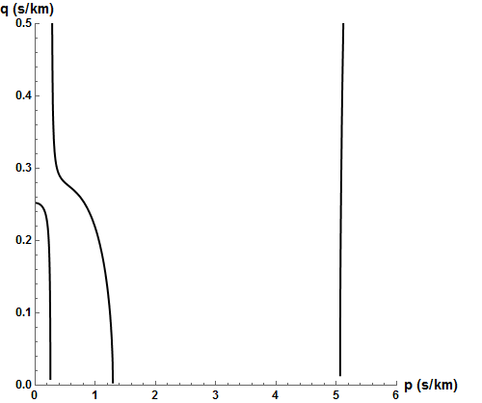
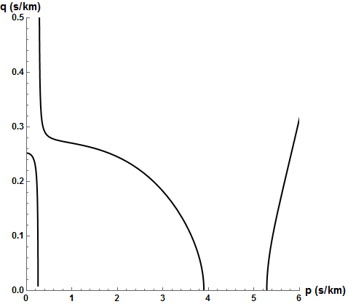
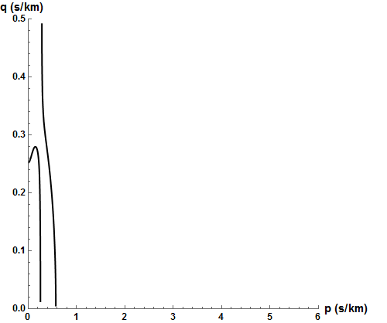
Slowness surface
f = 100 Hz
E
φ=0.001
f = 10 Hz
H
Slow S*-wave
B
D
f = 1000 Hz
G
Fast S*-wave
P-wave
A
C
F

Slide 9
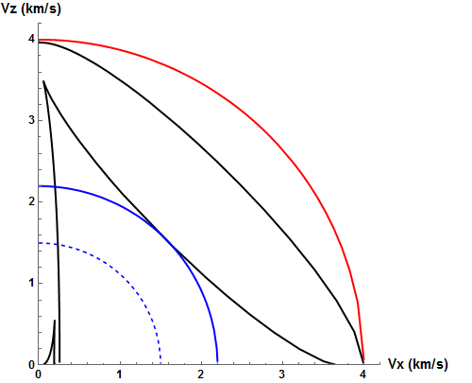
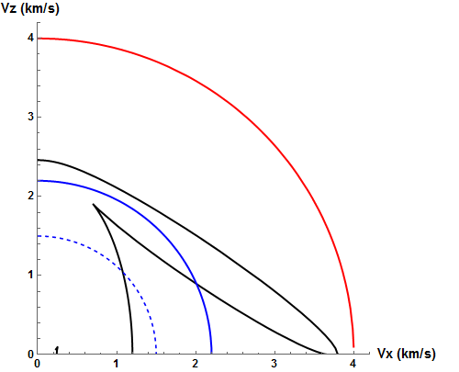
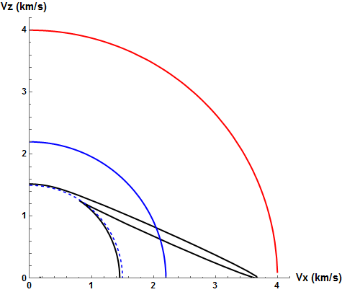
Group velocity surface: fluid effect at f=10Hz
φ = 0.001
φ = 0.1
φ = 0.5

Slide 10
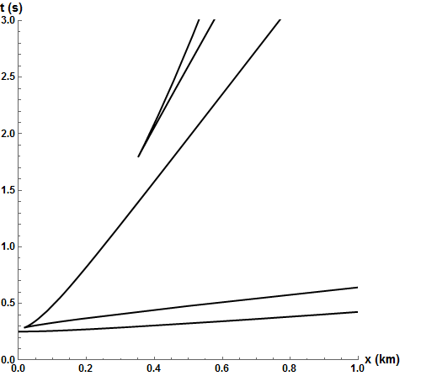
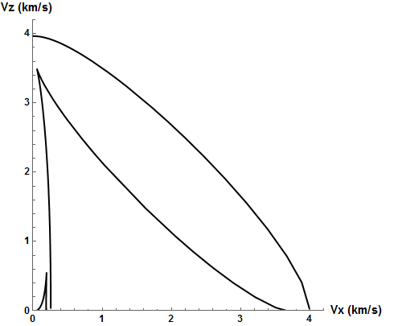
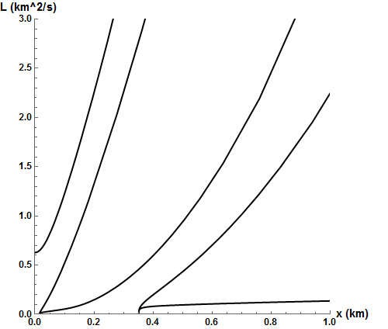
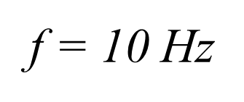
Group domain
G
B
D
D
G
C
A
H
F
E
D
G

Slide 11
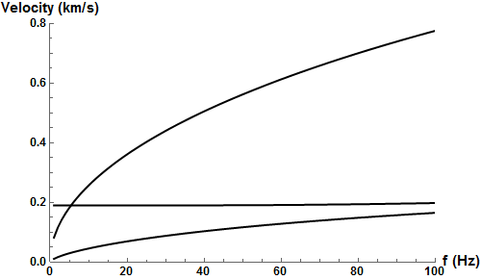
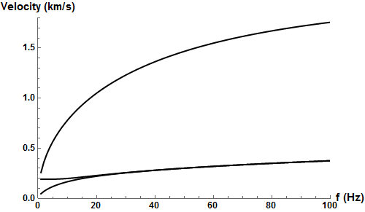
Horizontal velocity dispersion
H=1m
H=10m

Slide 12
P wave vertical velocity
Backus

Slide 13
Analysis (large p and large frequency*)

Slide 14
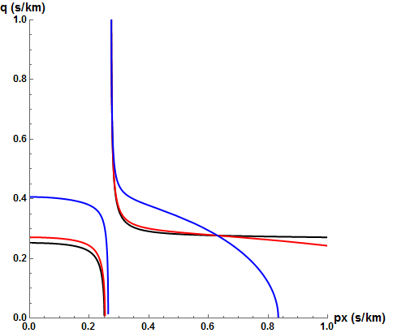
Analysis (zero frequency)
Generally, it is different from Backus, however, gives similar results for small φ.

Slide 15
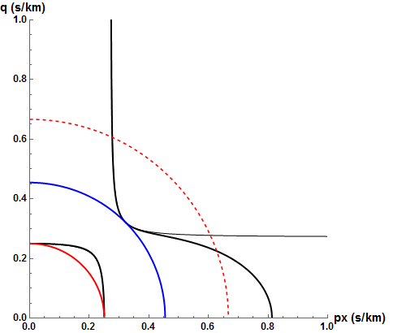
Analysis: zero φ limit (inherited slip)

Slide 16
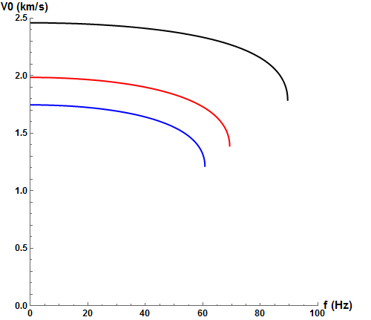
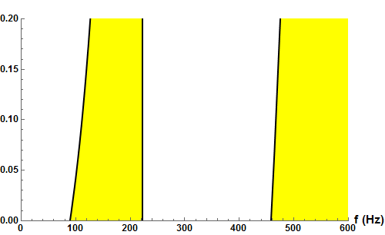
Stop bands for vertically propagated P wave
Pass
Pass
Stop
Stop

Slide 17
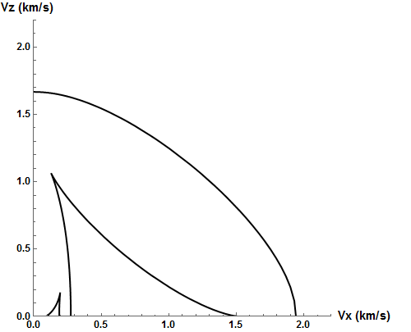
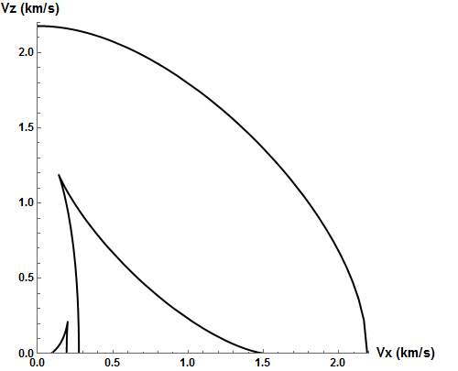
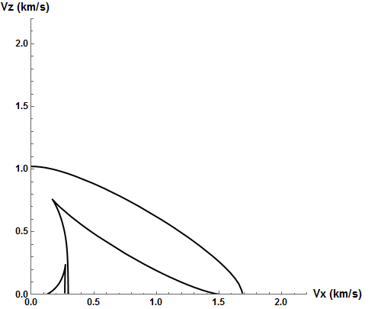
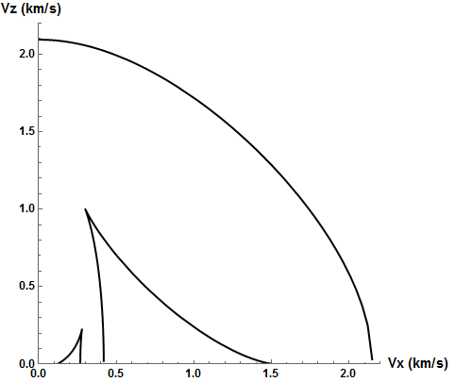
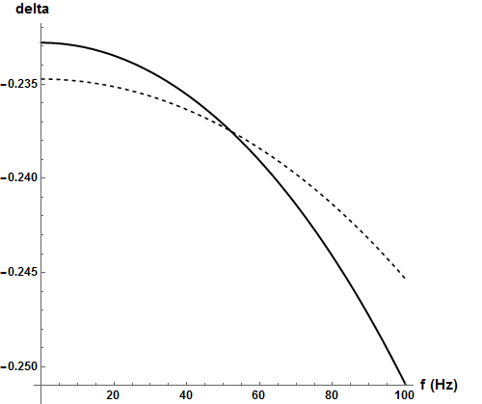
Fluid substitution (Utsira sand, f=30Hz)
CO2
Water
Vp0&eps are weakly dependent on frequency;
Anisotropic parameter δ is strong negative
and frequency dependent.
d=1cm
CO2
Water
d=5cm

Slide 18
Conclusions
The frequency-dependent slowness surface is defined for waves propagating in a solid-fluid system (periodical). It consists of three sheets corresponding to P- and two S-waves.
Both S*-waves have triplications.
The low- and high-frequency limits are defined.
The frequency dispersion is computed for horizontally propagating S-waves.
The stop-bands for P-wave are defined.
When the fluid layer thickness tends to zero, we obtain the medium with inhereted slip.
It is shown that S-waves are sensitive to fluid substitution.

