Slide 1

Nan Cheng, Statoil
26-June-2013
Integration of 4D Seismic & Production Data for Reservoir Management – Application to Norne
26-27 June 2013, Trondheim, Norway
Introduction to Norne Oil Field

Slide 2
Norne & Its Satellite Fields
Norne
Production Licence 128
Production start Norne: Nov. 1997
Urd
Production Licence 128
Production start Urd: 2005
Alve
Production Licence 159
Production start Alve: 2009
Water depth 380 m
Statoil is operator
Production end 2021 (FPSO lifetime)
200 km to Norwegian coast
80 km to Heidrun Field
Company | Norne | Urd | Alve
Petoro as | 54% | 24,5%
Statoil ASA | 39,1% | 64 % | 85%
Eni Norge as | 6,9% | 11,5%
DONG E&P Norge |  |  | 15%

Slide 3
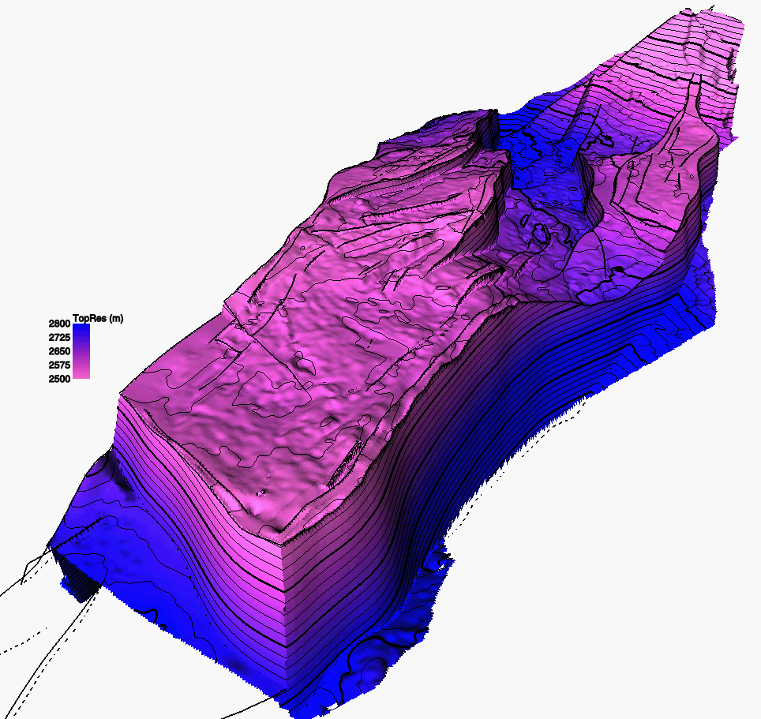
High Quality Reservoir
Consisting of 4 segments
Good quality sands in Not, Ile, Tofte, and Tofte formations
Porosity of 24 - 28 %, k = 100 - 3000 mD
140 m HC column (110m oil and an overlying gas cap)
Initial P_{res} = 273 bar @ 2639 m TVD, T_{res}= 98 °C
P_{b} = 250 bara, GOR= 111 Sm³/Sm³
Oil SG = 0.7, Oil viscocity = 0.5 cp
B_{oi}=1.32 Rm³/Sm³
Rock wettabiliy: mixed
E
G
D
C

Slide 4
Norne Structure and Zones
NORNE 2006
Not 3 | Upper Not Shale
Not 2 (Not sandstone) | Not 2.3
 | Not 2.2
 | Not 2.1
Not 1 | Lower Not Shale
Ile 2 | Ile 2.2
 | Ile 2.1
Ile 1 | Ile 1.3
 | Ile 1.2
 | Ile 1.1
Tofte 2 | Tofte 2.2
 | Tofte 2.1
Tofte 1 | Tofte 1.2
 | Tofte 1.1
Tilje 4
Tilje 3
Horst structure (9x3 km) bounded faults
Laterally rather homogenous
Internal faults and carbonate cemented zones have a significant influence on the flow pattern
Barrier modelling is important
  Carbonate cemented layers
  Faults

Slide 5
Norne Official Reserves & Production
STOIIP = 157 MSm³
Reserves = 95 MSm³
Ultimate RF_{o} = 60.4%

Slide 6
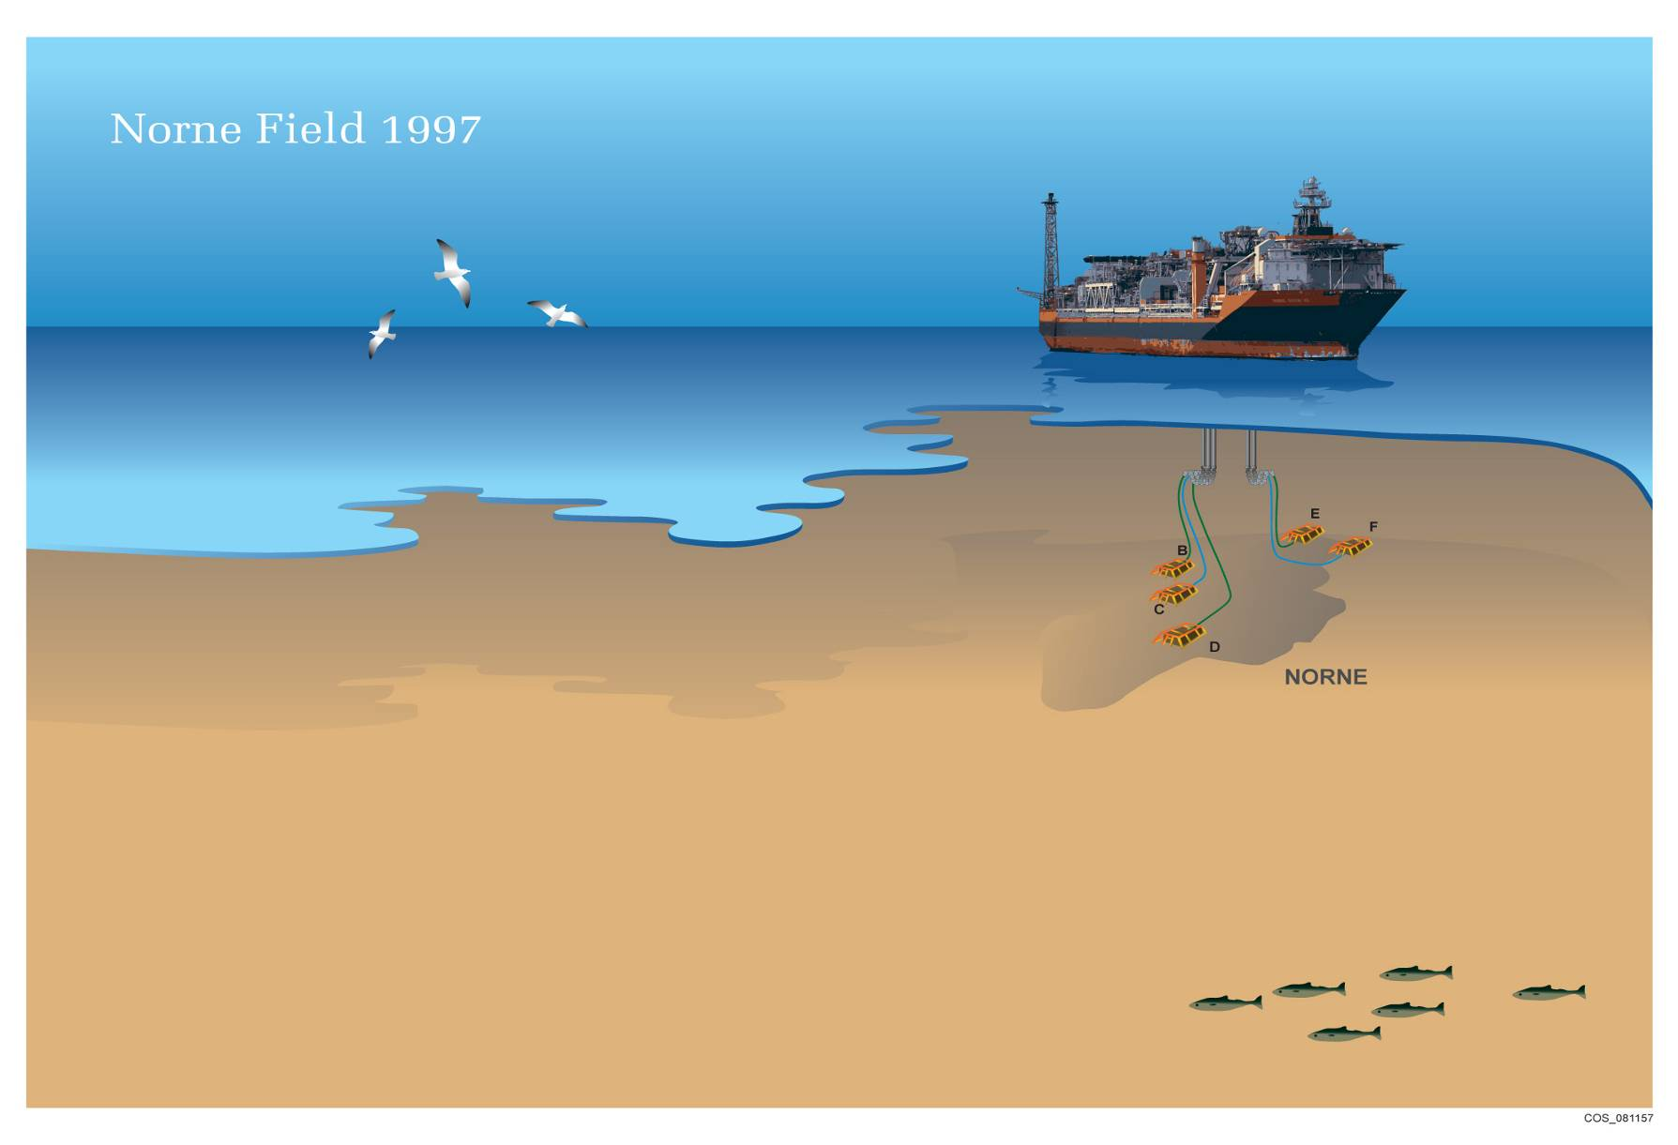
Subsea Development Solution - 1997
Norne FPSO
Subsea production/injection templates

Slide 7
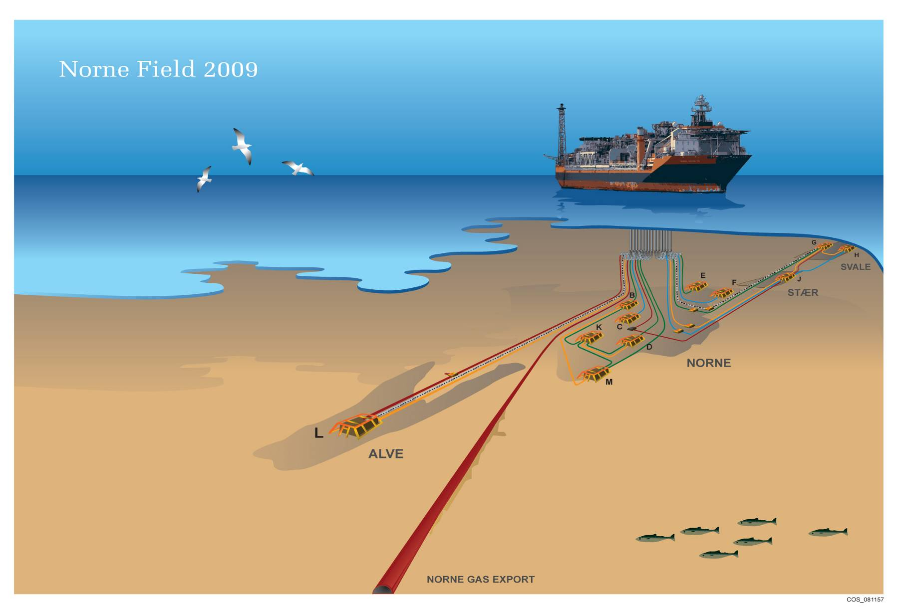
Subsea Development Solution - 2009
Norne FPSO

Slide 8
Initial Development Strategy
GI
SW
WI
NE
WI/GI
GOC=2575m
GOC=2580m
Not Sst.
Not Fm.
OWC=2618m
Ca 200m
Ile Fm.
Tofte Fm.
OWC=2693m
Tilje Fm.
Ca 7 km.
Gas
Oil
Water

Slide 9
Adjusted Development Strategy
WI/GI
SW
WI
NE
WI/GI
GOC=2575m
GOC=2580m
Not Sst.
Not Fm.
Ile Fm.
OWC=2618m
Ca 200m
Tofte Fm.
OWC=2693m
Tilje Fm.
Ca 7 km.
Gas
Oil
Water

Slide 10
Adjustment of Strategy Over Time
1997 1998 2003 2006 2016-2021
Not Fm.
U.Ile Fm.
L.Ile Fm.
Tofte Fm.
water
oil
gas

Slide 11
Integrated Use of 4D Seismic Data in Reservoir Management
Data acquisition strategy from the start
Seismic surveys: Base92 – 2001 – 2003 – 2004 – 2006 – 2008 – 2010 →
Close cooperation with R&D and focus on competence development
Tight integration of 4D & Reservoir Engineering, for qualitative/quantitative
  History matching
  Mapping remaining oil

Slide 12
4D Seismic Data & Flow Simulation Model
4D Seismic
Simulation
Amplitude
Amplitude
Inversion
Seismic modeling
Acoustic Impedance
Acoustic Impedance
Rock model
Rock model
Fluid Saturation
Fluid Saturation
Interpreted OWC
Extracted OWC
Notes:
12
Chance in any of these properties can be used to infer an oil-water contact
Currently, we often use difference in amplitude, AI and inferred oil-water contact to compare with those from the simulation model

Slide 13
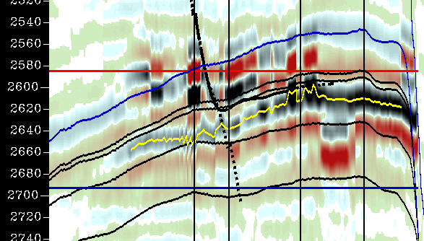
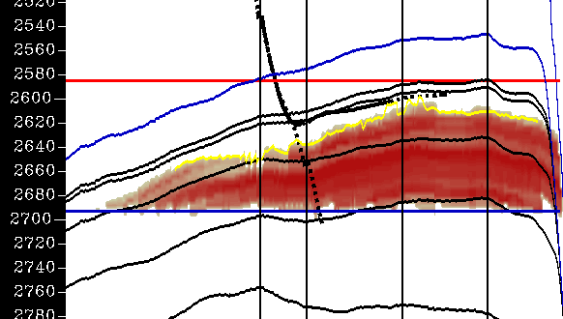
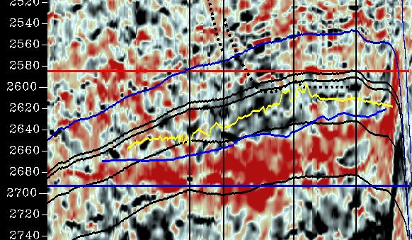
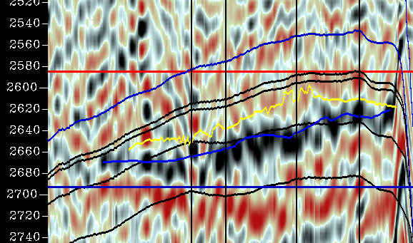
Qualitative use of 4D seismic in simulation model updating
Amplitude Diff (01-03)
Amplitude Diff (01-03)
Sw Diff (Base-03)
Sw Diff (Base-03)
old sim. model
AI Diff (01-03)
Amplitude Diff (01-03)
4D data
Notes:
13
Bottom-left: AI map; Red – increase in AI, increase in water saturation
OWC interpreted baesed on Amplitude difference event

Slide 14
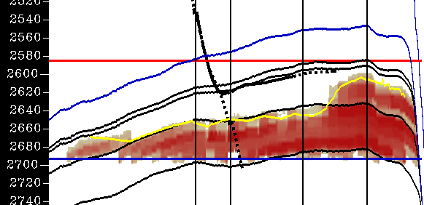
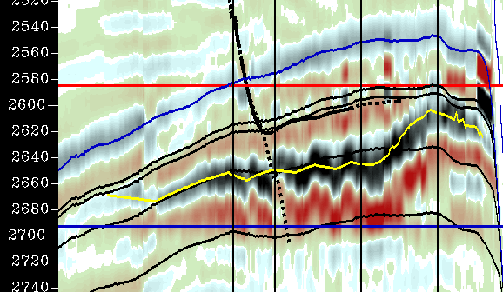
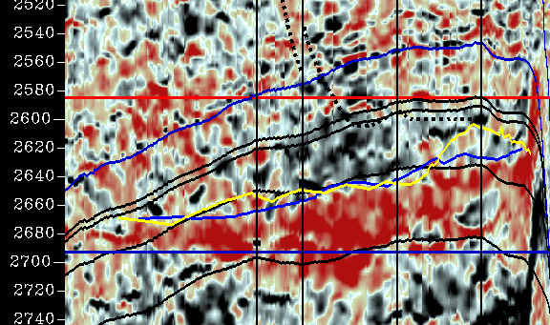
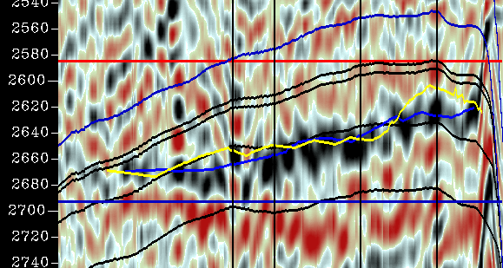
Qualitative use of 4D seismic in simulation model updating (cont’d)
Sw Diff (Base-03)
Amplitude Diff (01-03)
updated sim. model
Pilot well
AI Diff (01-03)
4D Diff (B-03)
Amplitude Diff (01-03)
4D data
Pilot well
Notes:
14
Magne: suggestion: copy slide 9 before this slide such that you can flip between the old and new model. Will highlight the changes.

Slide 15
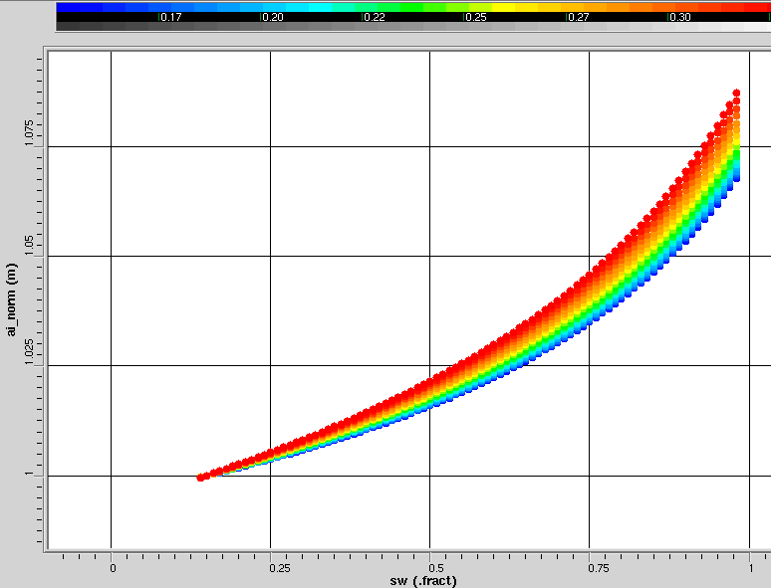
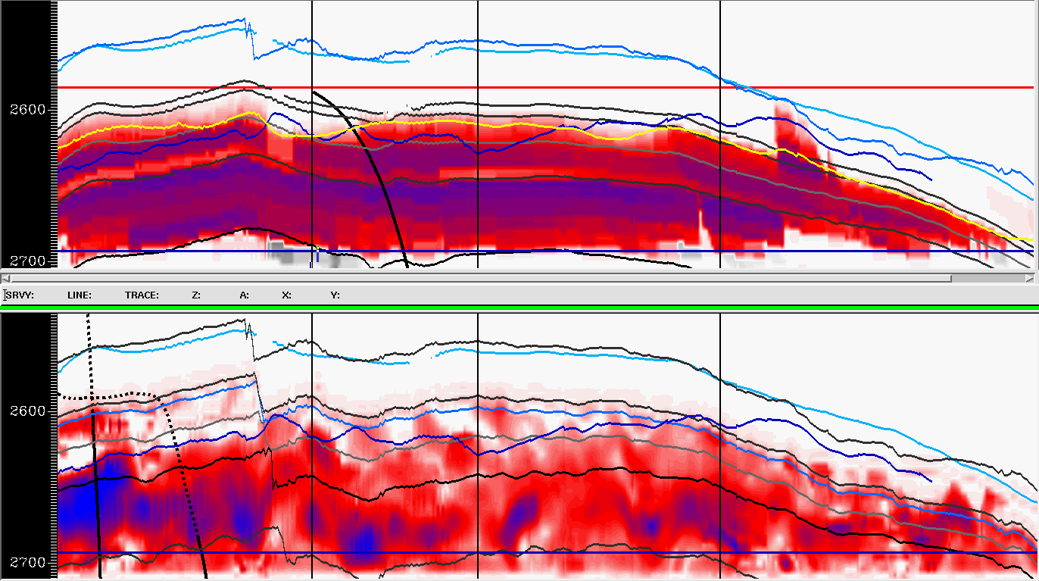
Quantitative Attempt of Using of 4D Seismic for Saturation Mapping
Sim Sw B-2006
Change in AI
4D Sw B-2006
Sw

Slide 16
Summary
4D seismic data play an important role in calibrating Norne simulation models
4D data have been extensively used to identify remaining oil packets for infill drilling in Norne
Qualitative comparison of fluid fronts has been very useful & successful
Ongoing work toward quantitatively using 4D data
A large amount of data on Norne main field has been released to public research communities for research & innovations
Notes:
16
Magne: removed one point, added 2

Slide 17
Thank you for your attention

