Slide 1
Lecture notes: Pumping Lectured: 9/3 2021
Covering
Chapters 7.1-7.5
Background for Exercise 7

Slide 2
Volumetric pumps

Slide 3
Centrifugal pump, principle

Slide 4
Centrifugal pump, constructions

Slide 5
Jet pumps

Slide 6
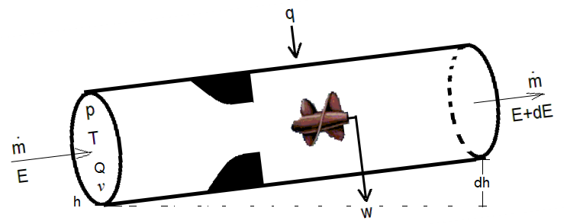
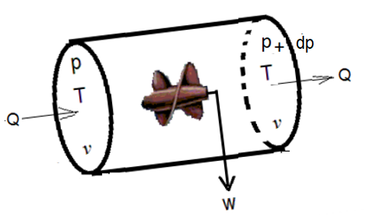
7.2 Power needed
Energy balance for open system
The pump

Slide 7
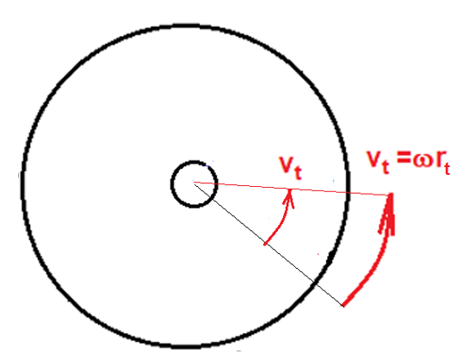
Centrifugal pump
Rotating impeller
Rotation time (period): T
Angular frequency:
Tangential velocity:

Slide 8
Flow through impeller

Slide 9
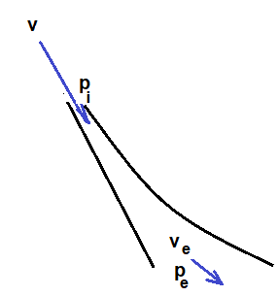
Diffuser (stationary)

Slide 10
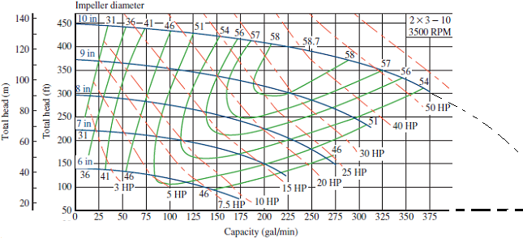
System performance (Exercise 7)
Pipe
Pump:

Slide 11
System performance ..by plotting of pipe- and pump- performance curves

