Slide 1
Cavity cloud generated by seismic air-gun arrays ̶ comparing video recordings to modeling
Babak Khodabandeloo PhD Candidate (NTNU)
babak.khodabandeloo@ntnu.no
Supervisor: Prof. Martin Landrø
Rose Meeting
23 April 2018

Slide 2
Field Measurement with a Broad-band Hydrophone (125 kHz):
Full Array 2730 in³ (with three sub-arrays)
Single Array 1500 in³
Why only the Full array has a high-frequency content?
Single Air-gun 300 in³
Background Noise
Notes:
Lets look at the energy spectrum of recorded signals by the broad-band Hydrophone.
How can we explain the high-frequency content of full array?

Slide 3
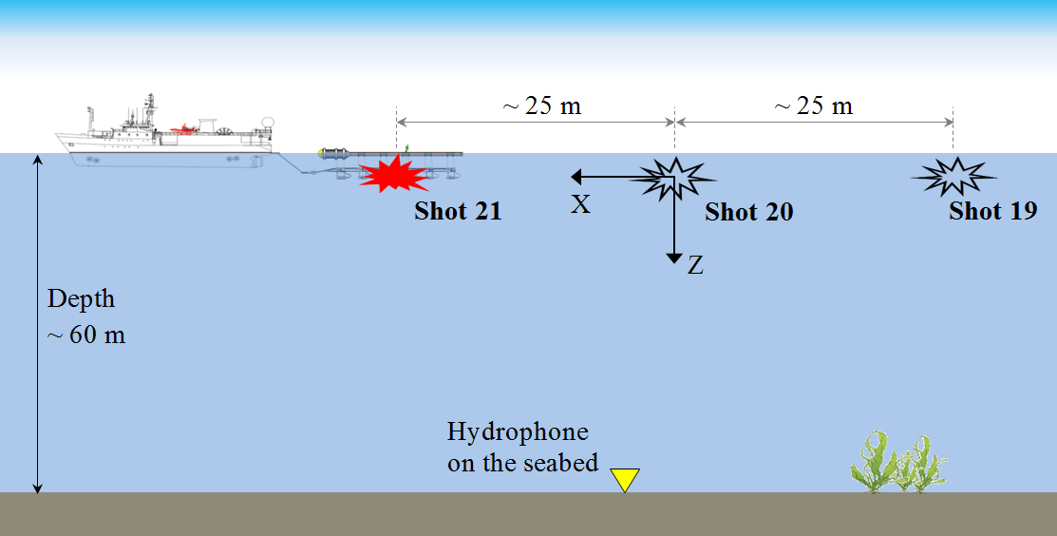
Source is a full air-gun array.
Notes:
It is by a vessel along a straight line above the hydrophone

Slide 4
Underlying mechanism for high-frequencies (>10 kHz) in seismic air-gun arrays?

Slide 5
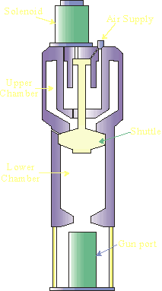
Ghost cavitation hypothesis by Martin Landrø et al. (2011)
6m
+
̶
̶
+
2m
3m
O
3m
3m
4 bar
@ 1m
4 bar
@ 1m
Pressure at point O:
(-0.65) + (-0.65) + 1.2 = -0.1 bar!
Notes:
Assuming each Air-gun generates a peak pressure of 4 bar at 1m, the pressure at point A due to the reflection from sea surface will be -1.3 bar.
At that point the hydrostatic pressure is around 1.2 bar. Using linear theory the mean pressure is negative!! and consequently cavitation will occur at point A.

Slide 6
Ghost Cavitation Cloud Modeling Technique:
Where and When?
Individual Cavity Signatures
Propagation of Cavities
Superposition of Cavities
Khodabandeloo, B., Landrø, M. and Hanssen, A., 2017. Acoustic generation of underwater cavities—Comparing modeled and measured acoustic signals generated by seismic air gun arrays. The Journal of the Acoustical Society of America, 141(4), pp.2661-2672.

Slide 7
Estimating pressure around a seismic air-gun array:
Total Pressure

Slide 8
Response of a microbubble to the pressure variations at points A and B:
$$P_{A}$$
Point A
Point B
$$R(t)$$
$$R_{0}=20μm$$
Bubble dynamics equation (Prosperetti and Lezzi, 1986):
$$\left(1−\frac{1}{c}\frac{dR}{dt}\right)R\frac{d^{2}R}{dt^{2}}+\frac{4μ}{ρc}\frac{d^{2}R}{dt^{2}}= −\frac{3}{2}\left(1−\frac{1}{3c}\frac{dR}{dt}\right){\left(\frac{dR}{dt}\right)}^{2}$$
$$−\frac{1}{ρR}\left[2σ+4μ\frac{dR}{dt}\right]+\frac{1}{ρ}\left(1+\frac{1}{c}\frac{dR}{dt}\right)\left[P_{i}\left(t\right)−P\right]+\frac{R}{ρc}\frac{dP_{i}(t)}{dt}$$
$R(t)$: the time dependent radius of the cavity,
$ρ, c$: density and sound speed of undisturbed water,
$μ:$ is the dynamic viscosity of water.
$σ$: water surface tension
$P_{i}$: The pressure inside the cavity,
$P$: external pressure

Slide 9
Field measurement
Simulation results
Khodabandeloo, B., Landrø, M. and Hanssen, A., 2017. Acoustic generation of underwater cavities—Comparing modeled and measured acoustic signals generated by seismic air gun arrays. The Journal of the Acoustical Society of America, 141(4), pp.2661-2672.
Notes:
When Cavity appears & its lifespan

Slide 10
Gun
15 & 16
Gun
13 & 14
Gun
11 & 12
10

Slide 11
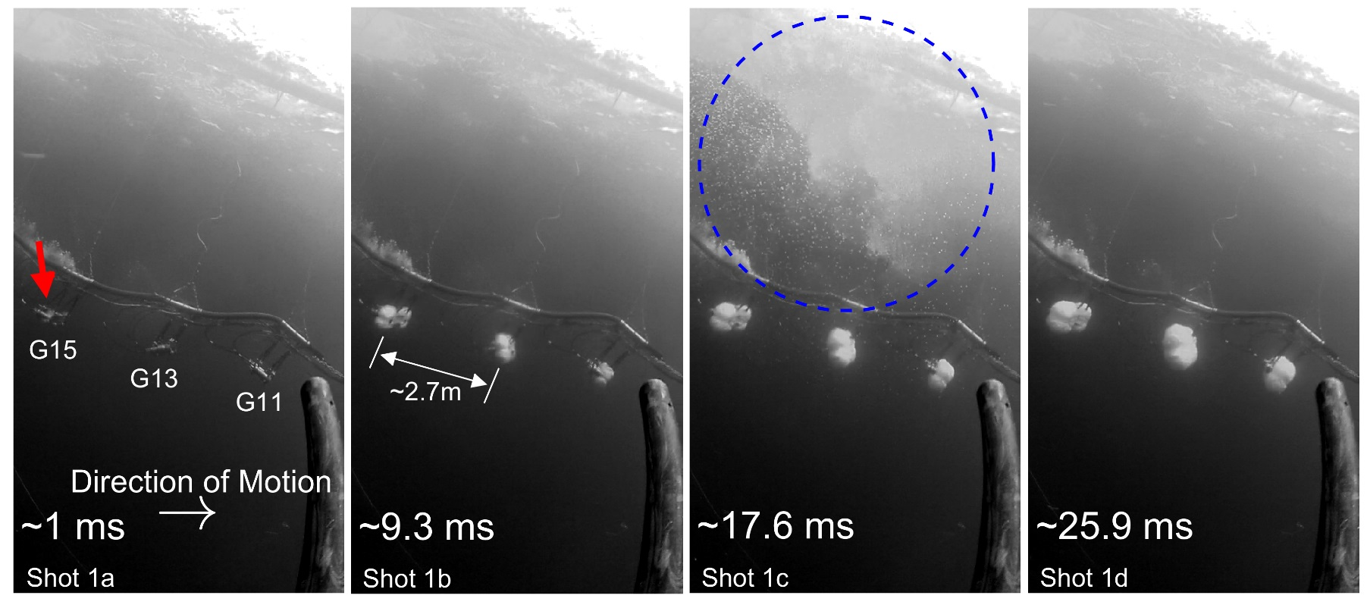
11
Notes:
Four Successive images extracted from video recording:

Slide 12
Modeled Cavity cloud:
12

Slide 13
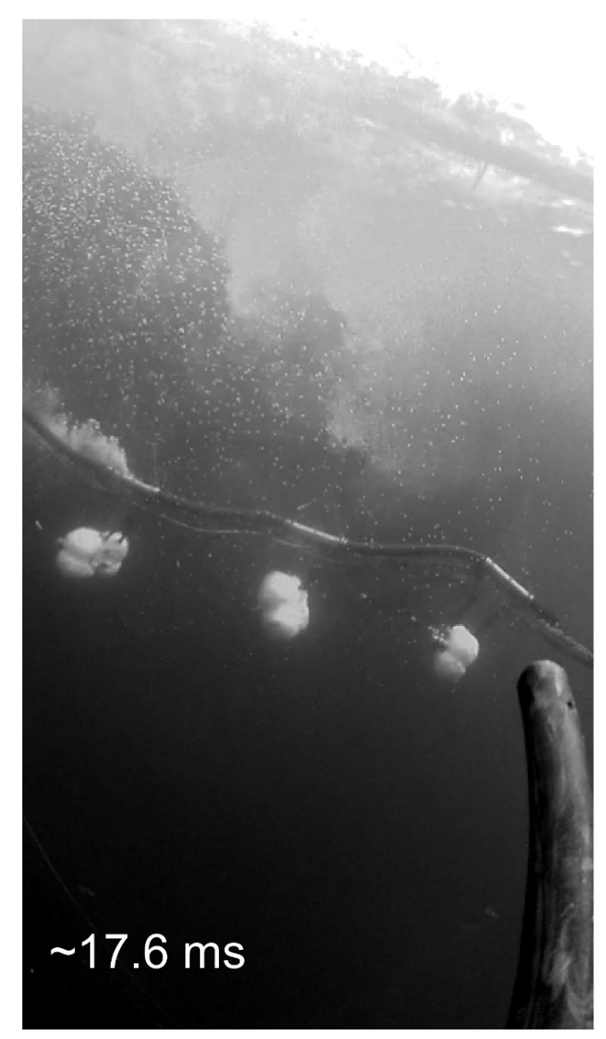
13

Slide 14
Khodabandeloo, B., and Landrø, M., Acoustically induced cavity cloud generated by air-gun arrays ̶ comparing video recordings and acoustic data to modeling. Submitted to The Journal of the Acoustical Society of America.
14

Slide 15
Conclusions
The first convincing photographic evidence of ghost-induced cavitation
Reliable modeling technique for ghost cavitation phenomenon.
Ongoing research
Acoustic properties within the cavity cloud
Future work:
Calibrating the numerical model
Acknowledgment
Thanks Statoil and CGG for funding the experiments presented here. This research is funded by ARCEx partners and the Research Council of Norway (grant number 228107).
Notes:
To the best of our knowledge,

Slide 17
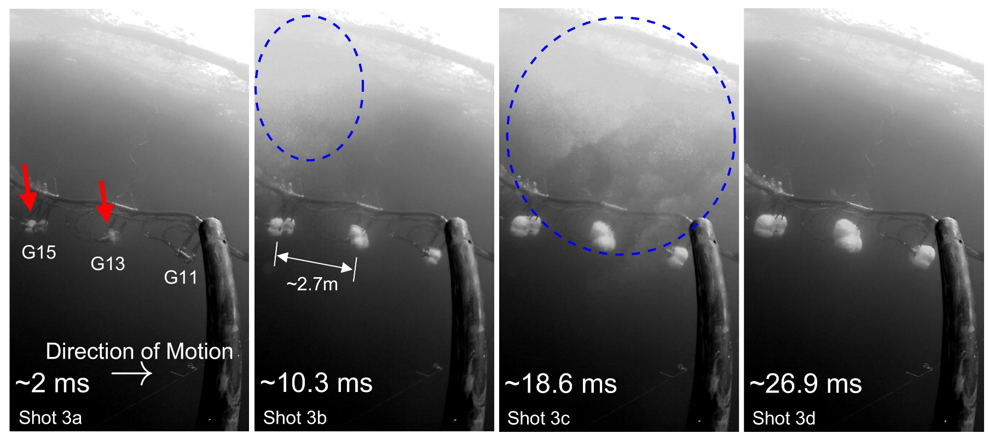
17
Notes:
Four Successive images extracted from video recording:

Slide 18
Modeled Cavity cloud (all air-gun activated simultaneously) :
18

Slide 19
Gun
15 & 16
Gun
13 & 14
Gun
11 & 12
19

Slide 20
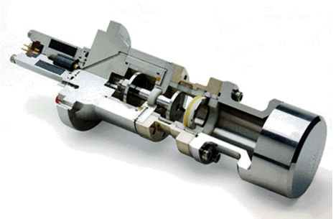
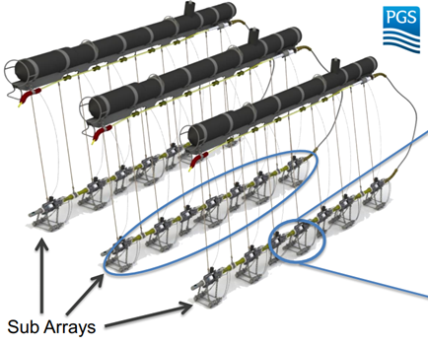
Air-gun:
Shuttle
High Pressure Air (~137 bar)
Air-gun Ports
20
Notes:
Seismic air guns were developed in the 1960s to replace
dynamite as a sound source for geophysical exploration
Airgun: The most common (>95%) and efficient marine seismic source.
>> An air-gun generates acoustic pressure waves from expansion and contraction of an air bubble which is formed by releasing high-pressure air (typically 2000 psi) into the surrounding water within a short time

