Slide 1
Net exhumation estimation using an effective-medium technique based on seismic traveltime measurements
Ricardo Martinez, M.Sc. Student
Kenneth Duffaut, Associate Professor
Faculty of Engineering
Department of Geoscience and Petroleum
Trondheim, 24th April, 2018

Slide 2
Objective
The presentation aims to demonstrate the use of seismic traveltime measurements to estimate the magnitude of net exhumation/uplift in sedimentary basin areas.
Acknowledgement
NTNU supporting the ongoing research on net erosion estimation
NPD and Schlumberger for data
CREWES and Gary Margrave for Ray Tracing facility
NRC for EAGE Conference & Exhibition 2018 Sponsorship

Slide 3
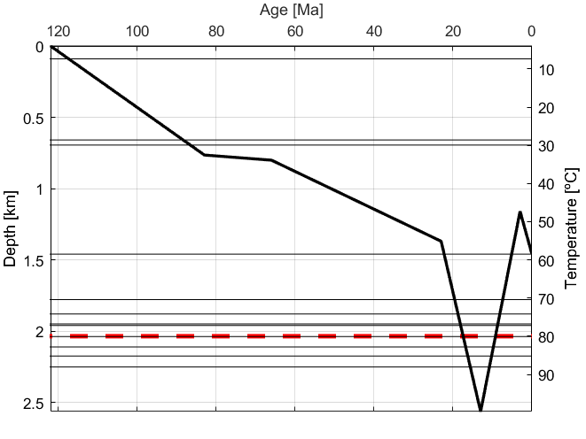
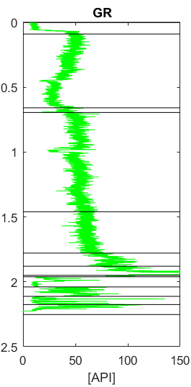
What is net exhumation?
Net exhumation magnitude: the difference between the present day burial depth of a reference unit and its maximum burial depth prior to exhumation (Corcoran and Dore, 2005).
Timing
Net exhumation magnitude
Notes:
What is net exhumation? To define it, lets consider the following example. This is a plot showing the burial history for a unit in the Barents Sea. Deposited at about 120 Ma ago, and it its buried in time as more sediments come on top of if. The unit reaches maximum burial depth about 15 ma ago. Then it was lifted up, and then buried again. Well, given this uplift event, we want to know two main things, we want to know the timing, when the event took place, and also the net exhumation magnitude, which is what we seek to estimate with our method and which represents the difference between the present day burial depth of a reference unit and its maximum burial depth prior to exhumation.

Slide 4
Why net erosion/exhumation studies?
The magnitude of uplift may affect HC potential in an area
Source rock maturation might stop
Poorer reservoir quality than anticipated from present day depth
Sealing capacity might deteriorate
Magnitude
Timing
Notes:
Why should we bother measuring it? Well, if this was a source rock, and we assume oil generation starts at 80C, then the oil generation at this rock stopped due to the uplift. In addition, you might consider this source rock as inmature due to present day temperature and depth, ignoring the fact that it produced HC in the past when it was buried at greater depths and subjected to higher temperatures. In addition, as stiffer rocks are displaced to shallower depths which leads to poorer reservoir quality tan anticipated from present day depth, sealing capacity might deteriorate, and together with it, many other factors come into play.

Slide 5
Net erosion estimation techniques Well data
Sediment compaction depth trends
Link to geophysical data
Sandstones diagenesis
Clay mineralogy
Vitrinite reflectance
Apatite fission-tracks
T-Max
Notes:
These are some of the techniques that can be used for estimating the magnitude of net exhumation, but I want to focus on the sediment compaction techniques

Slide 6
Net erosion estimation techniques Well data
Sediment compaction depth trends
Link to geophysical data
Sandstones diagenesis
Clay mineralogy
Vitrinite reflectance
Apatite fission-tracks
T-Max

Slide 7
Sediment compaction depth trend technique
Compaction is an irreversible process
Basin has experienced equilibrium compaction
Homogeneous formation found in reference and uplifted areas.
- Preferably thick shale units but sandstones can be used also
Notes:
This technique is built upon three fundamental assumptions:
Compaction is an irreversible process: a rock will record in its elastic properties the compaction acquired at maximum burial depth
Given that compaction took place under hydrostatic pressure conditions
It requires that an homogeneous shale formation found in reference and uplifted areas

Slide 8
Reference compaction depth trend Interval velocity-depth trend
Notes:
If the three conditions are fulfilled, then, in short, you can predict a compaction function for your selected formation in the non-uplifted area, and given that you have found a similar formation, same age, and similar petrophysical properties, in the uplifted area, you can displace your compaction trend until it fits the velocity of the formation in the uplifted area, and the net exhumation magnitude is given by the vertical depth difference between the two functions.
-

Slide 9
Why an effective-medium technique?
At severely uplifted areas
Eroded
At non-uplifted areas
Wells drilled do not reach the formation
Shale compaction depth-trend technique cannot be used
Modified from Baig et al. (2016).
Notes:
Without getting too deep into geology, I just want to mention that Torsk and Kolmule are the main shale Fm. that could potentially be used. Problem I that the youngest, at severly uplifted areas, is eroded away, and the oldest, at non-uplifted areas, formation is buried too deep, and wells do not penetrate. Then, the shale compaction technique cannot be used. Here is when we propose an effective medium approach. A method that considers instead of a particular formation, the whole stratigraphic sequence, in the reference area, as effective media, and which seeks to find in the uplifted area, a sequence which is acoustically comparable.

Slide 10
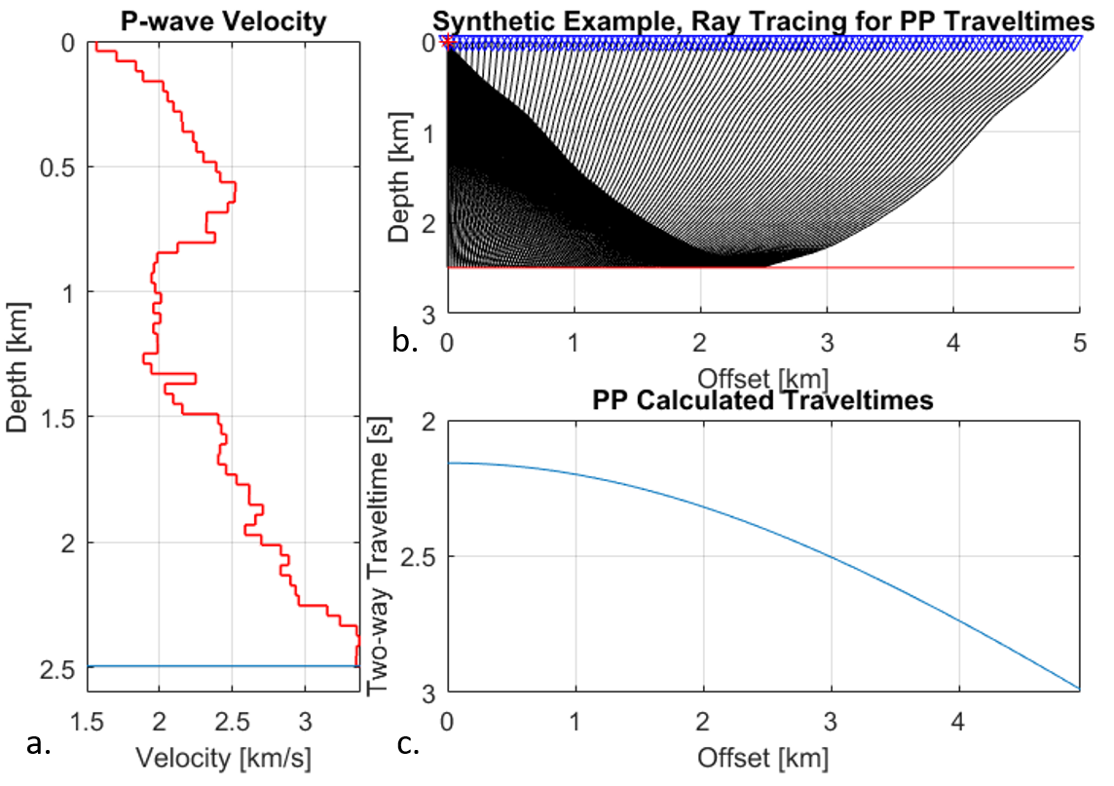
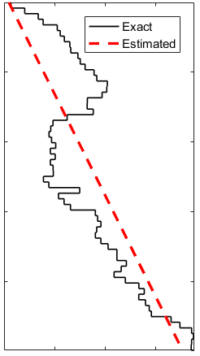
Methodology
Large-Offset PP travetimes, starting from the seabed on:
- Reference (non-uplifted) area
- Area suspected to be uplifted
Stovas and Ursin (2007) method to estimate a linear P-wave velocity function
- t(x) → Velocity analysis → t0, Vnmo, S for top and base
- Finding the solution of a dix-type equation
- Computing Vp0, Bp, and H using analytical expressions
Notes:
The method uses large-offset PP traveltime measurements starting from the seabed on a reference non-uplifted area, and on the area where you want to estimate net exhumation. The traveltimes can be either mapped either from pre-stack seismic data, or if you have P-wave well log data, then you can ray trace to your Vp depth model, and obtain traveltime data. Then we are gonna make use of Stovas and Ursin (2007) formulation in which, given a stack of horizontally layered isotropic strata with constant P-wave velocity gradients, and large-offset PP traveltimes, then we can estimate a linear P-wave velocity function that explains the traveltimes through the sequence. I wont go in detail, but in short, the method requires: to perform velocity analysis on the traveltimes to obtain NMO parameters (zero-offset two-way traveltime, NMO velocity and heterogeneity coefficient) for the top and bottom of the layer of interest. Then to find the solution for dix-type equation, and finally to use analytical expressions to compute the P-wave linear function, which is described by the velocity at top of the layer, the gradient, and the thickness.

Slide 11
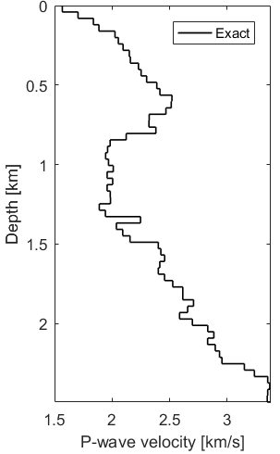
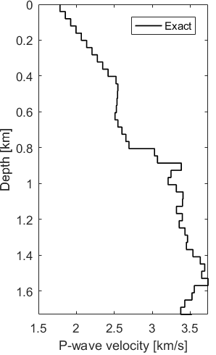
Methodology
When are the two columns comparable?
- t0_{ref} = t0_{uplift}
- Vnmo_{ref} = Vnmo_{uplift}
- S_{ref} = S_{uplift}
- g_{ref} = g_{uplift} (Al-Chalabi. [1974])
Reference
Uplifted
?
Notes:
Given that we consider the stratigraphic column with fixed thickness on the reference area, for instance the whole column, from bottom to top, then we want to find a column in the uplifted area, which as effective media, is acoustically comparable to our reference media.
What we do is that we evaluate the similarity in terms of the NMO parameters and the Alchalabi heterogeneity factor G (which without going in detail) gives a measure of the velocity heterogeneity on the ground. So given that we know the NMO parameters and heterogeneity for my reference media, then we scan the uplifted area til we find a column which has equal traveltime. And then we can repeat the procedure and find a sequence which has equal heterogeneity and so on given a total of 4 sequences.

Slide 12
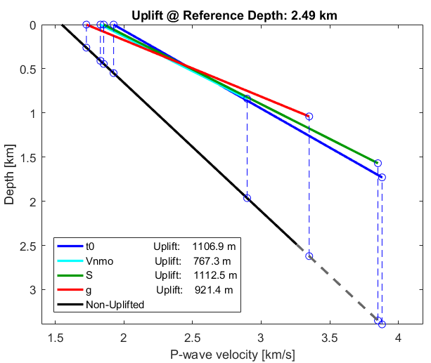
Methodology
When are the two columns comparable?
- t0_{ref} = t0_{uplift}
- Vnmo_{ref} = Vnmo_{uplift}
- S_{ref} = S_{uplift}
- g_{ref} = g_{uplift} (Al-Chalabi. [1974])
Notes:
We can apply Stovas and Ursin methodology and estimate linear velocity functions for each of these 4 stratigraphic colums, resulting in four linear velocity functions, the black for the uplifted area and the coloured ones for the reference area. Since the curves will most likely not have the same slope, then we have to average the vertical depth differences in the upper and lower ends. All this has been performed using a fixed thickness for the reference area. But can repeat this procedure by changing the thickness of the column in the reference area which results in this!

Slide 13
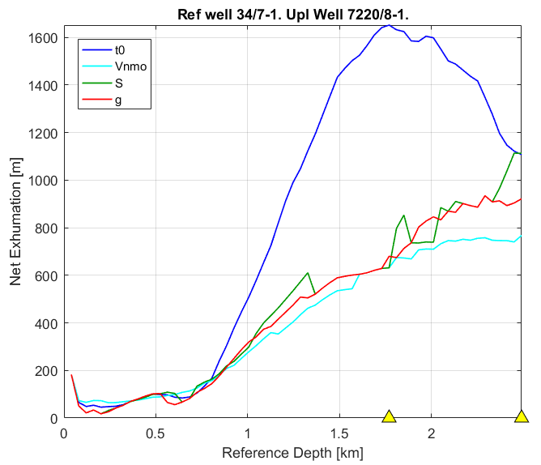
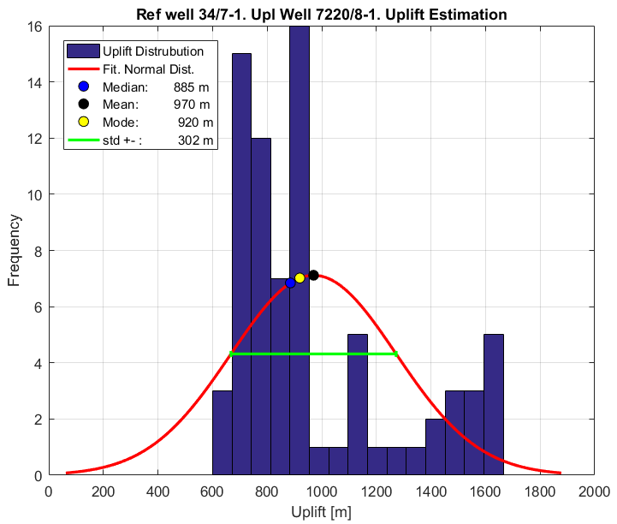
Net exhumation magnitude estimation
Notes:
For uplift curves that varies with the thickness of the reference layer, or the reference depth. What see are four curves, which roughly increases net exhumation magnitude with increasing reference depth. The two triangles in the bottom represent two thing, the one on the left is the depth at which the method is considered to be stable and give reliable estimates, and second is that last depth at which equal heterogeneity is found. If we compute the mean and the standard deviation of all samples from all uplift curves between these two depths, which results in the net exhumation estimate. In this example we have used a reference well from the North Sea, to estimate the exhumation magnitude in the Barents Sea.

Slide 14
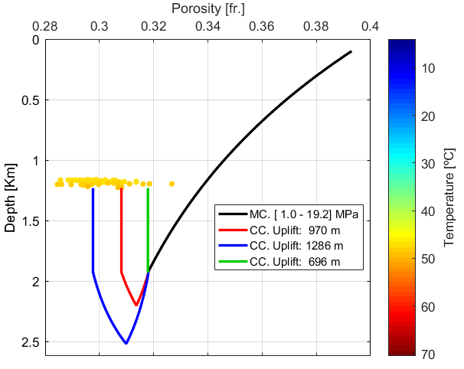
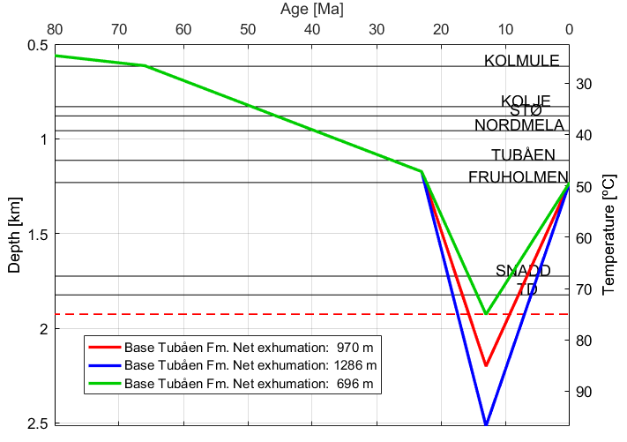
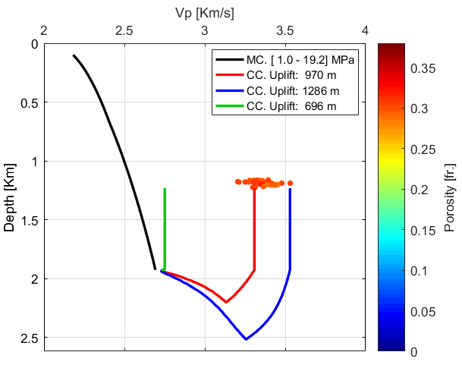
Simplified burial history of a sandstone: Magnitude and timing
Lander & Walderhaug (1999)
Burial history is recreated using the minimum, mean, and maximum net exhumation estimates
Zattin et al. (2016)
Dvorking & Nur (1996, 1999)
Barent Sea sandstone example
Notes:
We can combine our net exhumation magnitude estimates with timing estimates from thermocronological analysis from published studies to model the burial history of clean sandstones in the Barents Sea. at a particular well location (7220/8-1). You can see how the rock reaches different maximum burial depths as the magnitude of net exhumation increases. You can use the burial history of the sandstone Using Lander & Walderhaugh mechanical and chemical compaction models you can model the porosity. So the black curve is porosity in the mechanical compaction domain, the coloured curves are porosity in the chemical compaction domain, each color representing the modelled porosity using the minimun, mean and maximun exhuation magnitude, and the clusters are the insitu porosity values. As the magnitude of net exhumation increases, more quartz cement precipitates and the modelled porosity decreases. Using rock physics models you can also model P-wave velocity, and in this case you see that minimum exhumation magnitude does not explained the in-situ P-wave velocity, but that the maximum net exhumation estimate is not very far off, and the mean estimate allows us to modeled the Vp very well.

Slide 15
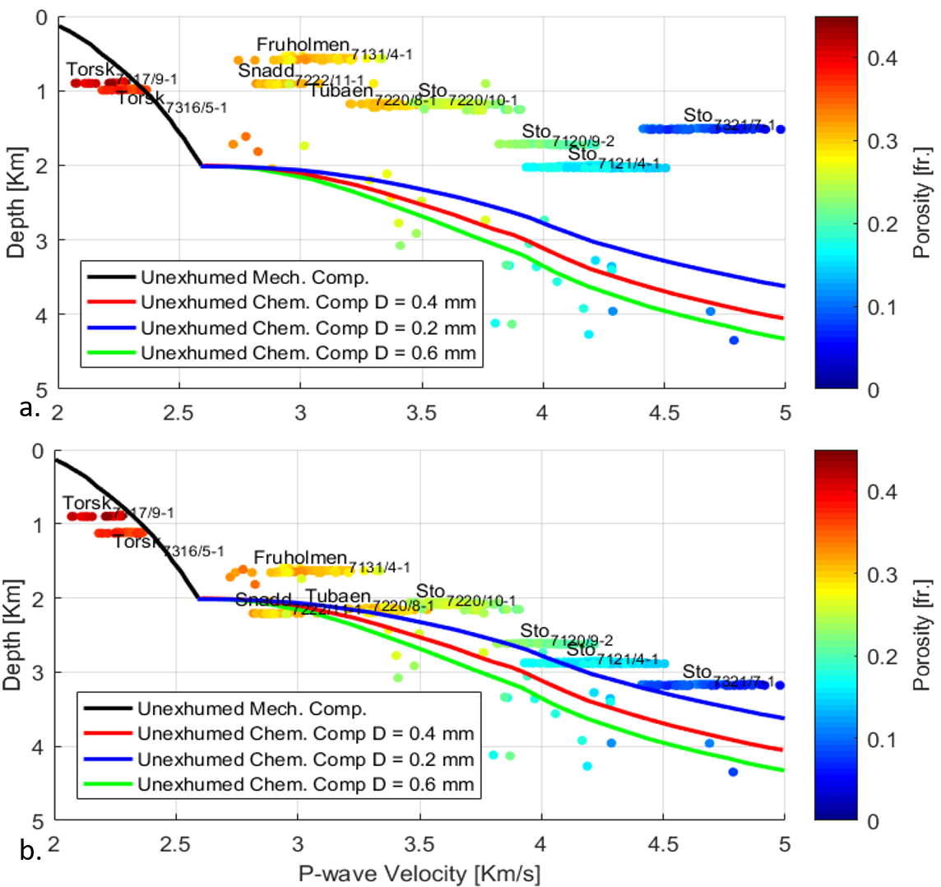
Evaluation of the net exhumation estimates: A sandstone velocity comparison
No depth correction applied
Depth corrected using the estimated net exhumation magnitudes
Vucelic et al. (2017)
Notes:
This is a very interesting picture because it shows good evidence that the Barents sea has been uplifted. The individual dots represent mean P-wave velocity of non-uplifted brine-saturated clean sandstone Fms. From 30 well from the Norwegian and North Sea. The black curve represent the Vucelic et al. (2017) mechanical compaction trend and the colour curves, the Chemical compaction trends for these sands accounting for different grain sizes. The clustered data represent the P-wave velocity of the studied brine-saturated clean Barents Sea sandstones. It is very interesting how the Barents Sea sandstones exhibit much larger velocity and at a shallower depth compared to the Norwegian and North Sea sandstones, which is a clear evidence of the uplift in the Barents Sea. Moreover, in the figure below the Barents sea sandstones has been depth corrected using the estimated net exhumation magnitudes and they agree with the depth trends derived for unexhumed sands.

Slide 16
Conclusion
Effective-medium compaction-based method that allows for estimating net exhumation magnitudes from traveltime measurements.
The net exhumation estimates are in agreement with published net uplift magnitudes.
The burial history curves of clean sandstones constructed using our net exhumation estimates, explain the petrophysical properties observed at well location.
The velocity of the Barents Sea sandstones corrected for exhumation using our estimates is in agreement with the velocity of non-uplifted sands from the Norwegian Sea and North Sea.

Slide 17
Thank you

Slide 18
References
Al-Chalabi. (1974) An Analysis of Stacking, rms, Average, and Interval Velocities of a Horizontally Layered Ground. Geophysical Prospecting, 22, 458–475.
Baig, I., Faleide, J.I., Jahren, J. and Mondol, N.H. (2016) Cenozoic exhumation on the southwestern Barents Shelf: Estimates and uncertainties constrained from compaction and thermal maturity analyses. Marine and Petroleum Geology, 73(Supplement C), 105–130.
Corcoran, D. V. and Dore, A. G. (2005). A review of techniques for the estimation of magnitude and timing of exhumation in offshore basins. Earth-Science Reviews, 72:129-168.
Dvorkin, J., Prasad, M., A., S., and Lavoie, D. (1999). Elasticity of marine sediments: Rock physics modeling. GEOPHYSICAL RESEARCH LETTERS, 26(12):1781–1784.
Dvorkin, J. and Nur, A. (1996). Elasticity of high-porosity sandstones: Theory for two north sea data sets. Geophysics, 61(5):1363–1370.
Lander, R.H. and Walderhaug, O. (1999) Predicting Porosity through Simulating Sandstone Compaction and Quartz Cementation. AAPG Bulletin, 83(3), 433–449.
Stovas, A. and Ursin, B. (2007) Estimation of layer parameters for linear P- and S- wave velocity functions. Geophysics, 72(3), U27–U30.
Vucelic, L. A. B., Duffaut, K., and Avseth, P. (2017). Burial induced changes in physical sandstone properties: A case study of north sea and norwegian sea sandstone formations. In SEG Technical Program Expanded Abstracts 2017, pages 3626–3631. Society of Exploration Geophysicists.
Zattin, M., Andreucci, B., de Toffoli, B., Grigo, D., and Tsikalas, F. (2016). Thermochronological constraints to late cenozoic exhumation of the barents sea shelf. Marine and Petroleum Geology, 73:97–104.

