Slide 1
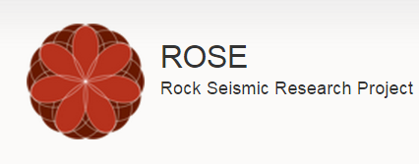
ROSE meeting
Shibo Xu & Alexey Stovas, NTNU
24.04.2017, Trondheim

Slide 2
Preserved Traveltime Smoothing (PTS) on orthorhombic media
Objectives:
1 Smoothing the properties in anisotropic model (ORT).
2 Preserve the traveltime at the discontinuities.

Slide 3
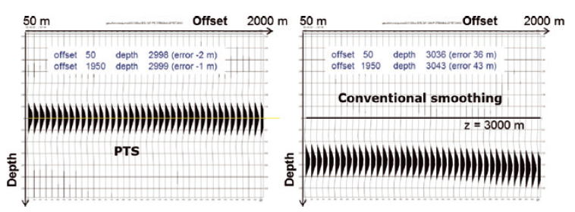
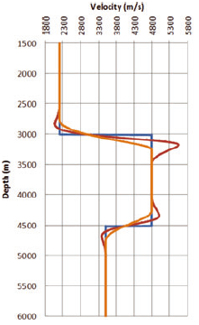
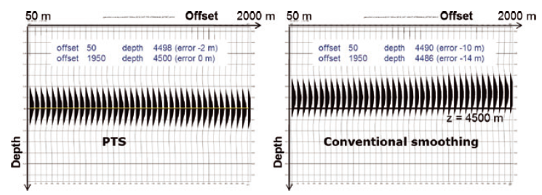
Vinje et al (2012)

Slide 4
Outline
1 Preserved traveltime smoothing (PTS)
2 PTS for VTI model
3 PTS for ORT model
4 Numerical tests
5 Conclusions

Slide 5
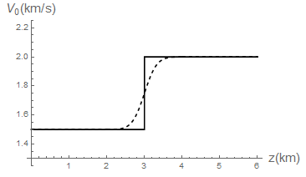
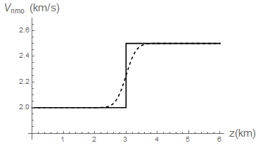
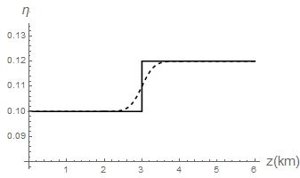
Step model
Top
Bottom

Slide 6
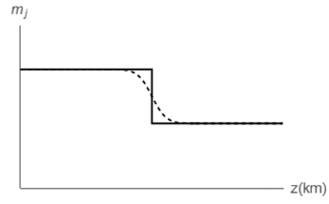
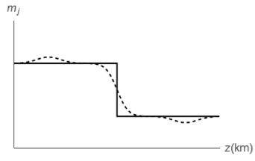
Composite parameters
The depth dependent composite parameters (velocity moments) (Vinje et al, 2012)

Slide 7
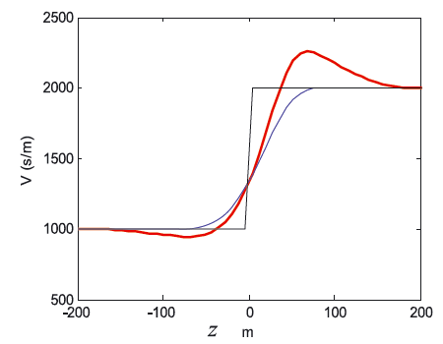
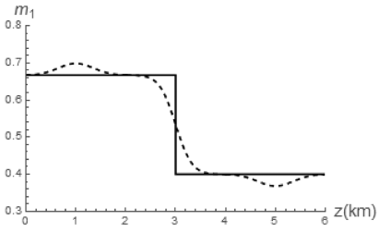
Filter for smoothing
Combination of two ploynomials
Gaussian Function
Smoothing the parameter
Vinje et al (2012)

Slide 8
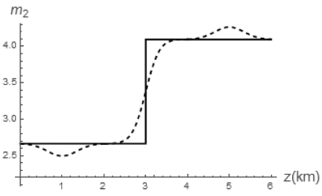
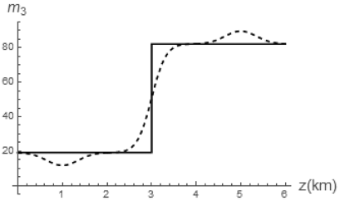
Top
Bottom

Slide 9
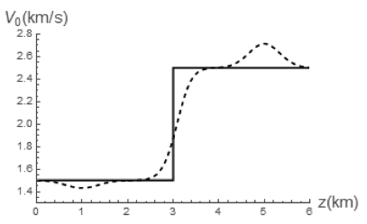
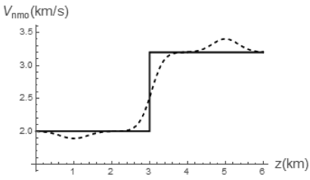
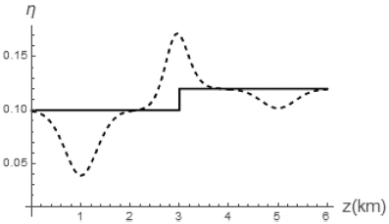
9

Slide 10
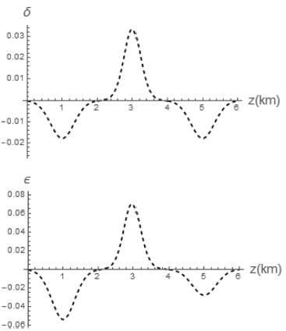
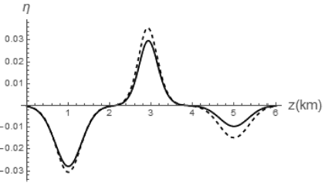
Smoothing induced Anisotropy

Slide 11
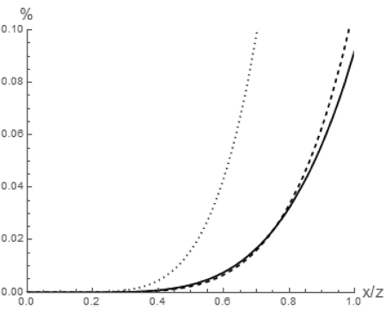
Error test
Top
Bottom

Slide 12
Outline
1 Preserved traveltime smoothing (PTS)
2 PTS for VTI model
3 PTS for ORT model
4 Numerical tests
5 Conclusions

Slide 13
ORT model (no azimuthal variation)
Vertical slowness expension
We define the depth dependent composite parameters:
Stovas (2015)

Slide 14
ORT model (no azimuthal variation)
We convert these smoothed composite parameters into model parameters:

Slide 15
ORT model (no azimuthal variation)
Top
Bottom

Slide 16
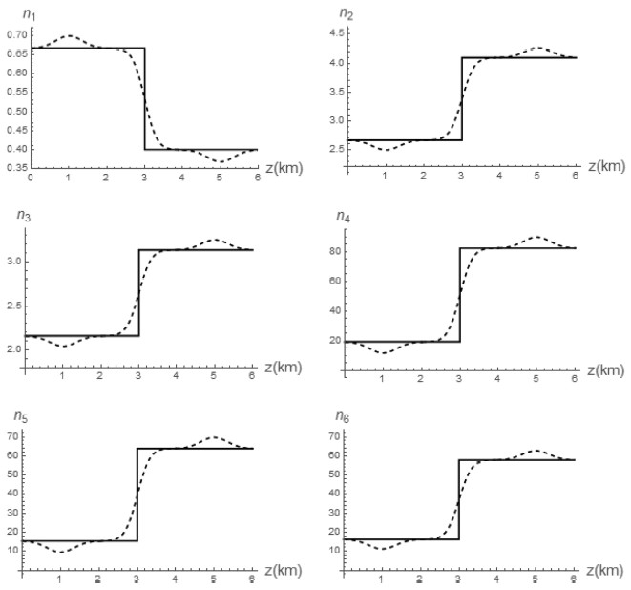

Slide 17
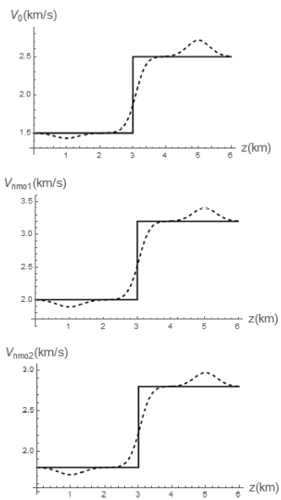
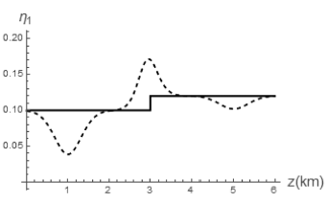
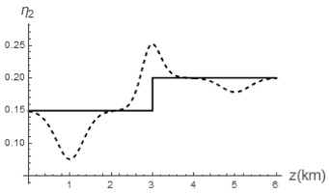
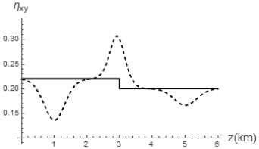

Slide 18
ORT model (azimuthal variation)
Top
Bottom

Slide 19
ORT model (azimuthal variation)
Clockwise roatation
Part One
Part Two
Part One
Part Two

Slide 20
Step one

Slide 21
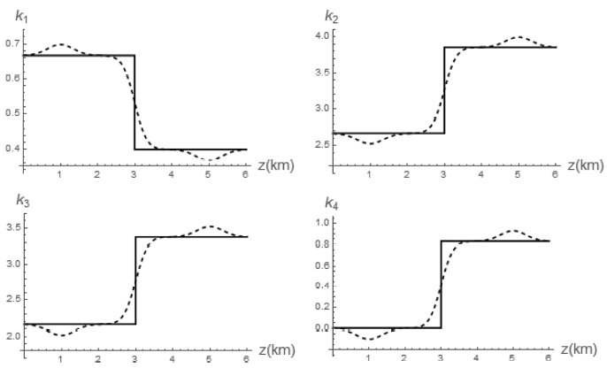
Composite parameters smoothing

Slide 22
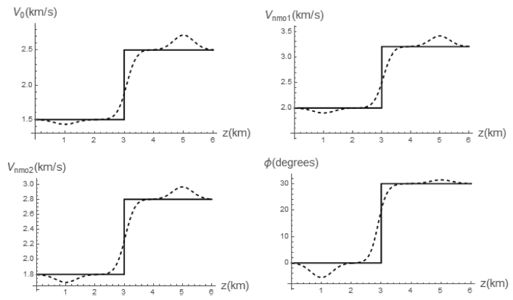
Smoothing for velocities and azimuth

Slide 23
Step two
Least squares method
(Stovas, 2015)

Slide 24
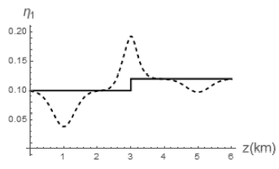
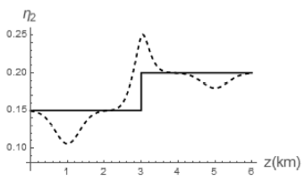
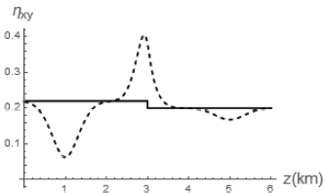
Smoothing for anellipticity parameters

Slide 25
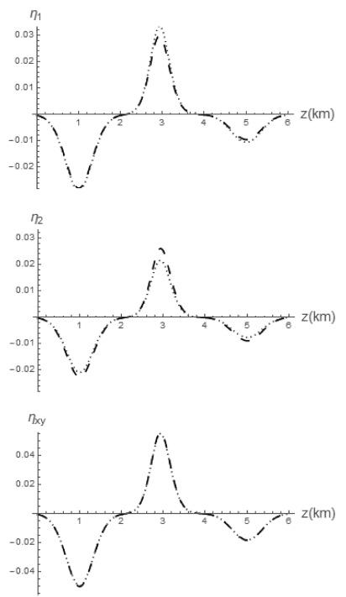
Smoothing induced anellipticity

Slide 26
Outline
1 Preserved traveltime smoothing (PTS)
2 PTS for VTI model
3 PTS for ORT model
4 Numerical tests
5 Conclusions

Slide 27
Numerical test

Slide 28
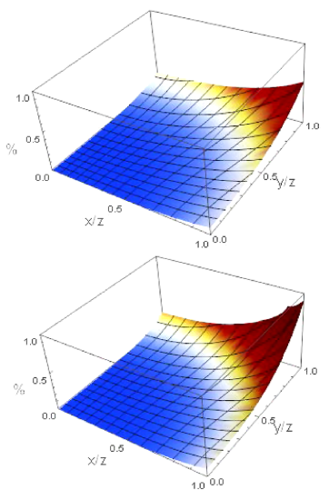
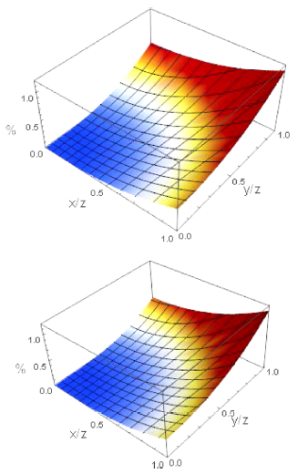
PTS
Conventional Smoothing
ORT
EI

Slide 29
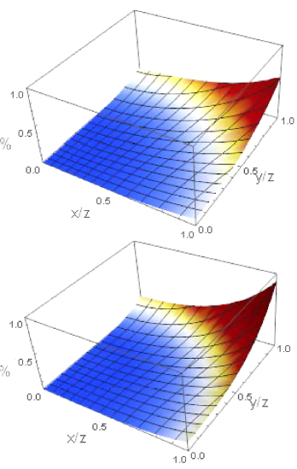
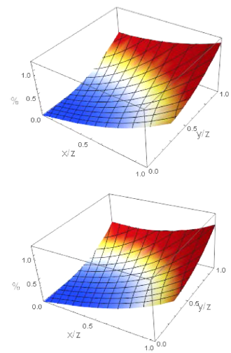
PTS
Conventional Smoothing

Slide 30
Outline
1 Preserved traveltime smoothing (PTS)
2 PTS for VTI model
3 PTS for ORT model
4 Numerical tests
5 Conclusions

Slide 31
Conclusions
We have developed the preserved travel-time smoothing (PTS) method for an orthorhombic (ORT) velocity model without and with azimuthal variation between the layers.
In computation of the anelliptic parameters for the ORTφ model, the least squares method is used.
The travel-time errors from PTS due to smoothing are sufficiently small for all the models.

Slide 32
Acknowledgement

Slide 33
Thank you !

