Slide 1
Kinematic time migration and demigration of reflections in prestack seismic data
Einar Iversen, NORSAR
Martin Tygel, UNICAMP
Bjørn Ursin, NTNU
Maarten V. de Hoop, Purdue University

Slide 2
Contents
Introduction
Kinematic time migration and demigration
Numerical example
Concluding remarks

Slide 3
Seismic data domains and processes
Time
migration
Migration
time
Recording
time
Depth
migration
Migration
depth
Parkes and Hatton, 1984

Slide 4
Reverse processes
Time
demigration
Migration
time
Recording
time
Depth
demigration
Migration
depth
Schleicher, Tygel, and Hubral, 2007

Slide 5
Kinematic mapping between the domains
Kinematic time
migration & demigration
Migration
time
Recording
time
Kinematic
image-ray
migration & demigration
Kinematic depth
migration & demigration
Migration
depth

Slide 6
For velocity estimation and processing:
Where to interpret reflections?
Kinematic time
migration & demigration
Migration
time
Recording
time
Kinematic
image-ray
migration & demigration
Kinematic depth
migration & demigration
Migration
depth

Slide 7
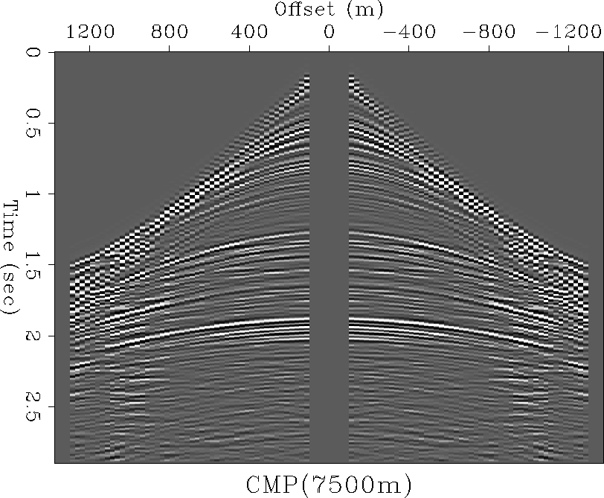
Time migration
Time
Time migration
sums contributions
to apex
T^{D}
Elementary
diffraction-
time function
Get amplitude
Seismic data
τ
Horizontal
distance
m
x
Image-gather
location
Source-receiver
midpoint
location

Slide 8
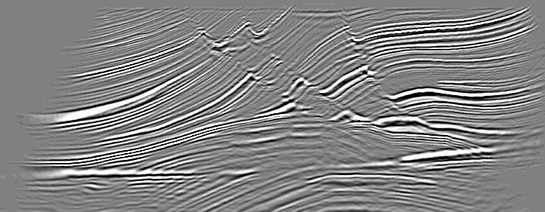
Time demigration
Time
Time demigration
distributes contribution
found in apex
T^{D}
Elementary
diffraction-
time function
Get amplitude
Migrated data
τ
Horizontal
distance
m
x
Image-gather
location
Source-receiver
midpoint
location

Slide 9
Time migration/demigration
Input and output traces are in TIME
A time-migration velocity model is needed as input, e.g.,
Time migration yields useful images only if the lateral velocity variation is small or moderate
Diffraction-time function must be single valued
V^{M} (m, τ), migration velocity
S^{M} (m, τ), time-migration matrix
(describes the time-migration ellipse)

Slide 10
Kinematic time migration and demigration
Whitcombe, 1994
Söllner and Andersen, 2005

Slide 11
Lateral coordinates
ξ₁
Source
s
Midpoint
x
Receiver
h
r
a
ξ₂
Half-offset vector:
h = (r – s)/2
m
Image-gather
location
Aperture vector:
a = x - m

Slide 12
Diffraction-time function T^{D}(h,a,m,τ)
An example is
the standard double-square-root (DSR) function:
T^{D}(h,a,m,τ) =
+
(but we permit use of more general functions)

Slide 13
Kinematic time demigration
Time
Reflection time in
recording domain
= envelope of elementary diffraction-time functions
Elementary
diffraction-
time function
p^{x}
ψ^{m}
Reflection time in
time-migration domain
(common offset)
m, T^{M}, ψ^{m} → x, T^{X}, p^{x}
T^{M}
T^{X}
m
x

Slide 14
Kinematic time migration
Time
Reflection time in
recording domain
(common offset)
Elementary
diffraction-
time function
p^{x}
ψ^{m}
m, T^{M}, ψ^{m} ← x, T^{X}, p^{x}
Reflection time in
time-migration domain
T^{M}
T^{X}
= collection of
diffraction-time apexes
m
x

Slide 15
Common reflection surface (CRS)
Migration time
Recording time
T (h,m)
T(h,x)

Slide 16
Reflection-time parameters at finite offsets
Migration time
Recording time
T^{M}
Time
T^{X}
ψ^{h}
p^{h}
Slopes
(first derivatives)
ψ^{m}
p^{x}
M^{hh}
M^{hm}
“Curvatures”
(second derivatives)
M^{hh}
M^{hx}
T
T
M^{hm}
M^{mm}
M^{hx}
M^{xx}

Slide 17
Reflection-time parameters at zero offset (standard CRS parameters)
Migration time
Recording time
T^{M}
Time
T^{X}
0
0
Slopes
(first derivatives)
ψ^{m}
p^{x}
M^{hh}
0
“Curvatures”
(second derivatives)
M^{hh}
0
0
M^{mm}
0
M^{xx}

Slide 18
Basic conditions for kinematic time migration/demigration

Slide 19
Time-migration velocities ↕ normal-moveout velocities
Time-migration
matrix
Normal-moveout
matrix
Slopes
(first derivatives)
In recording domain
(based on standard double-square-root function)

Slide 20
Migration time
Recording time
m
x
T^{M}
Kinematic
time demigration
T^{X}
ψ^{h}
ψ^{m}
p^{h}
p^{x}
M^{hh}
M^{mm}
M^{hm}
M^{hh}
M^{xx}
M^{hx}
Diffraction time
Function T^{D}(h, a, m, τ)
and its derivatives
Time-migration
velocity model

Slide 21
Migration time
Recording time
m
x
T^{M}
Kinematic
time migration
T^{X}
ψ^{h}
ψ^{m}
p^{h}
p^{x}
M^{hh}
M^{mm}
M^{hm}
M^{hh}
M^{xx}
M^{hx}
Diffraction time
Function T^{D}(h, a, m, τ)
and its derivatives
Time-migration
velocity model

Slide 22
Numerical example

Slide 23
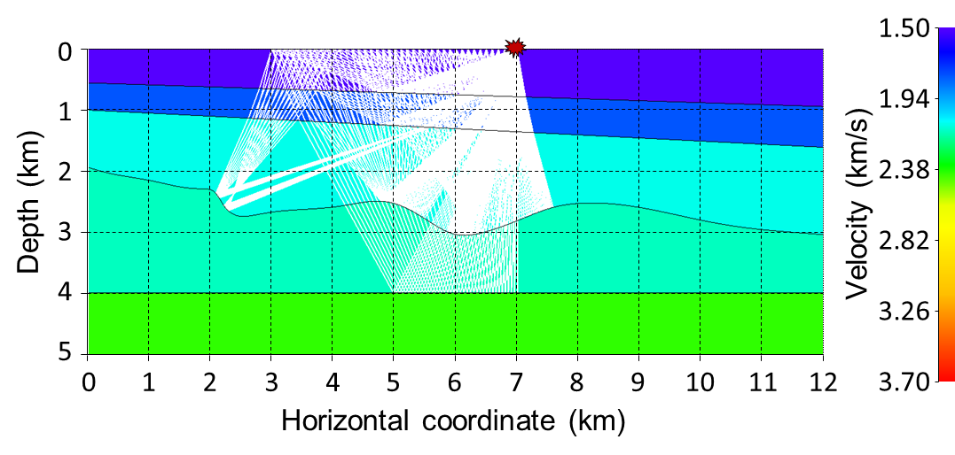
Generation of reflection data by ray tracing:

Slide 24
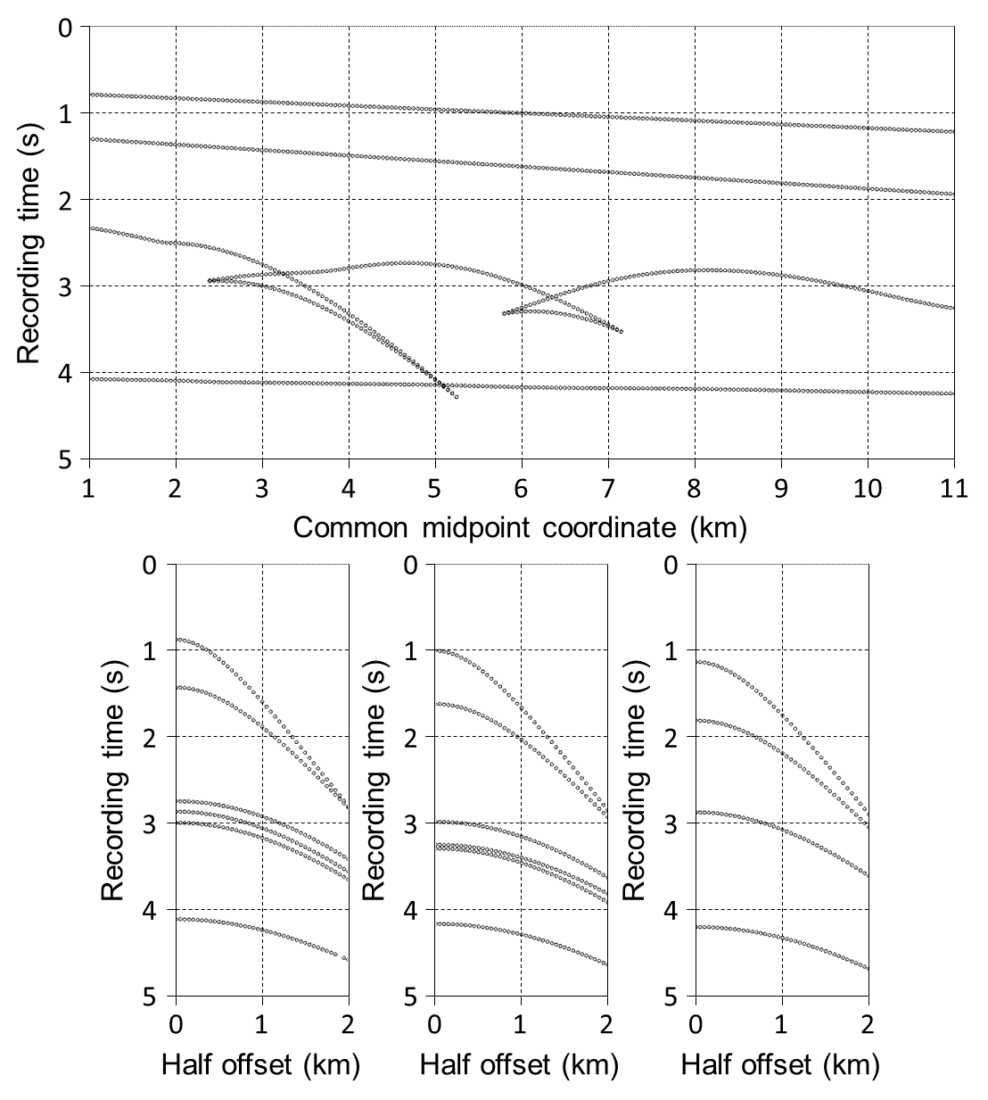
Reflections in the
recording domain:

Slide 25
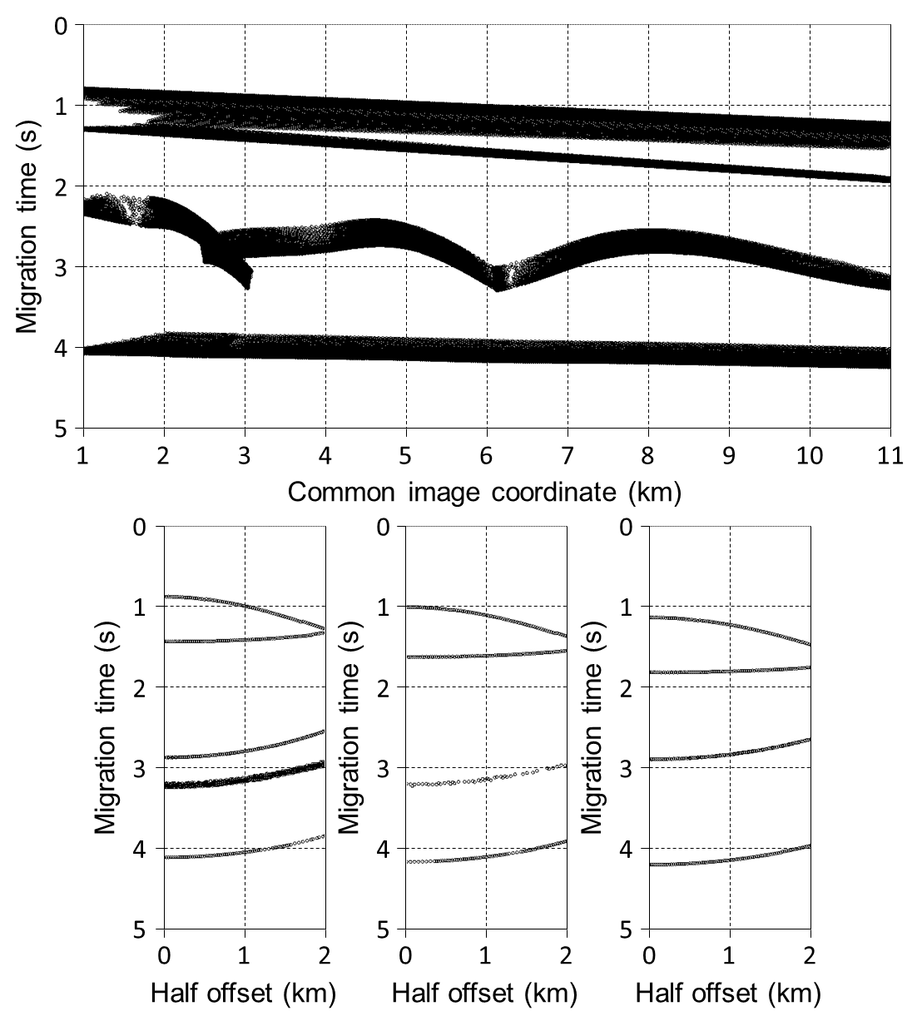
Reflections in the
time-migration domain:

Slide 26
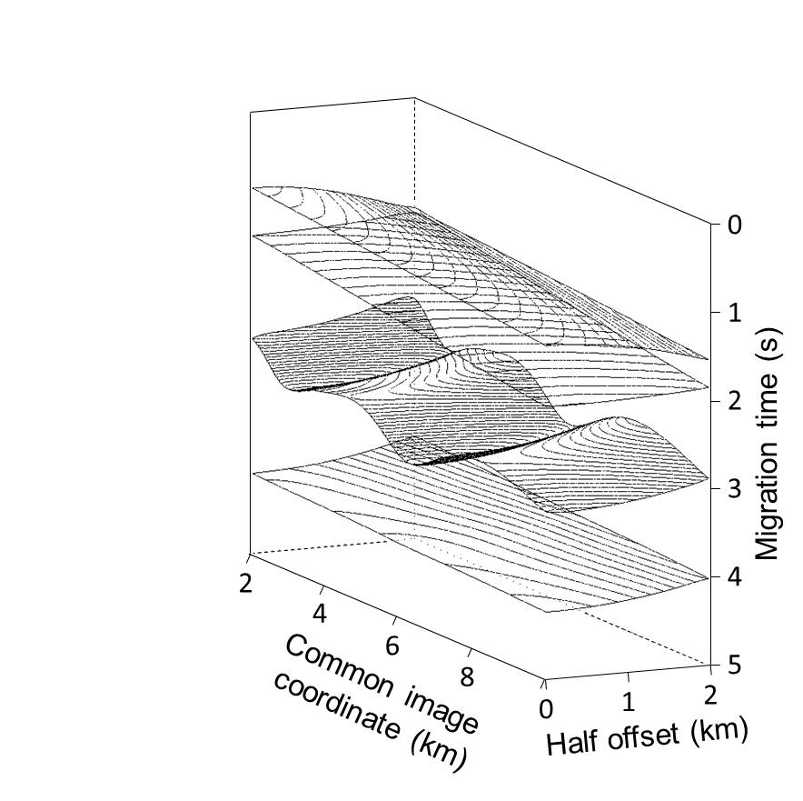
Common-reflection surfaces in the time-migration domain:

Slide 27
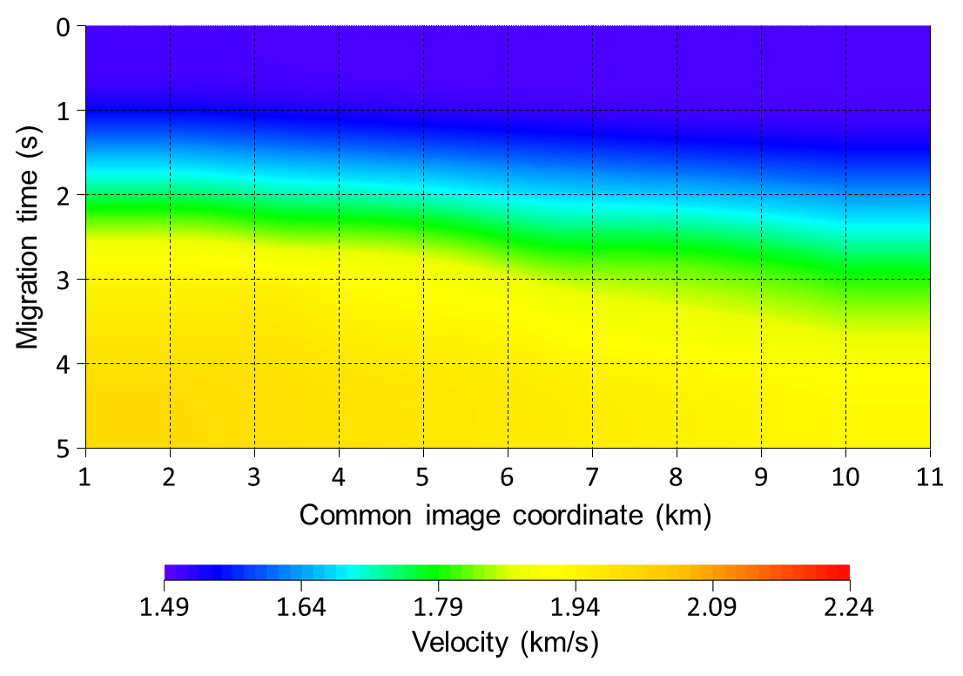
Time-migration velocity model:

Slide 28
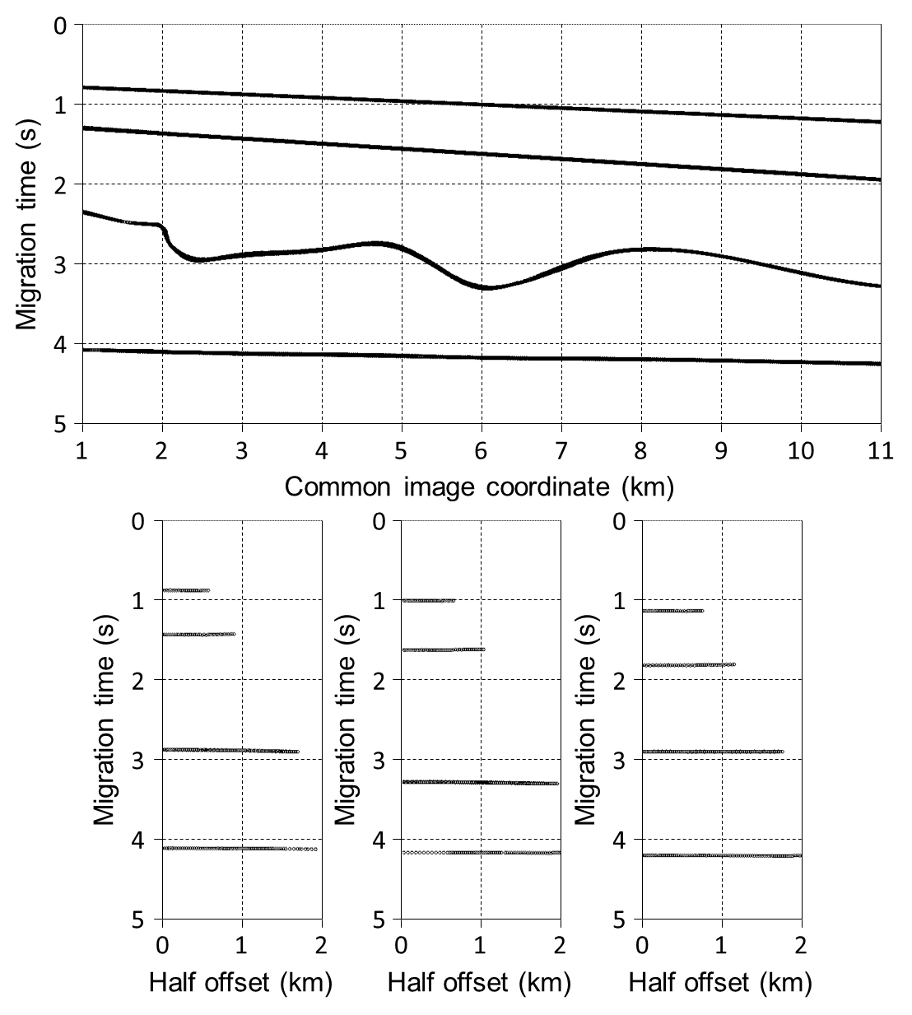
Reflections in the
time-migration domain:

Slide 29
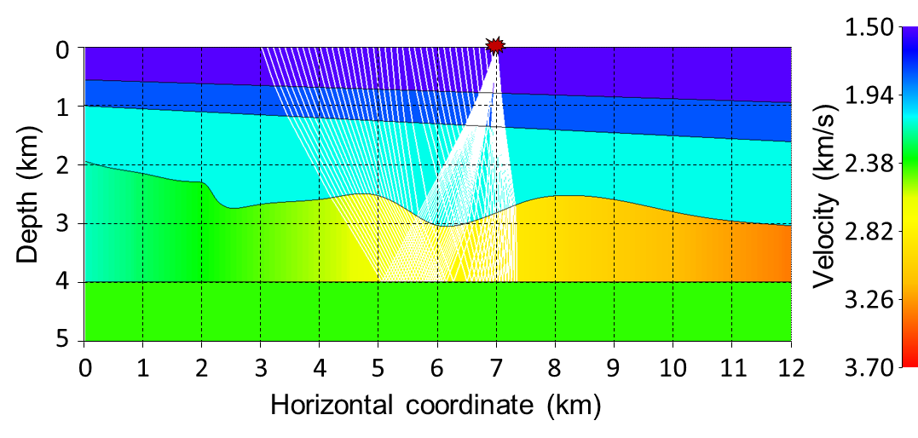
Generation of reflection data by ray tracing
in modified depth model:

Slide 30
Reflections in the
recording domain:

Slide 31
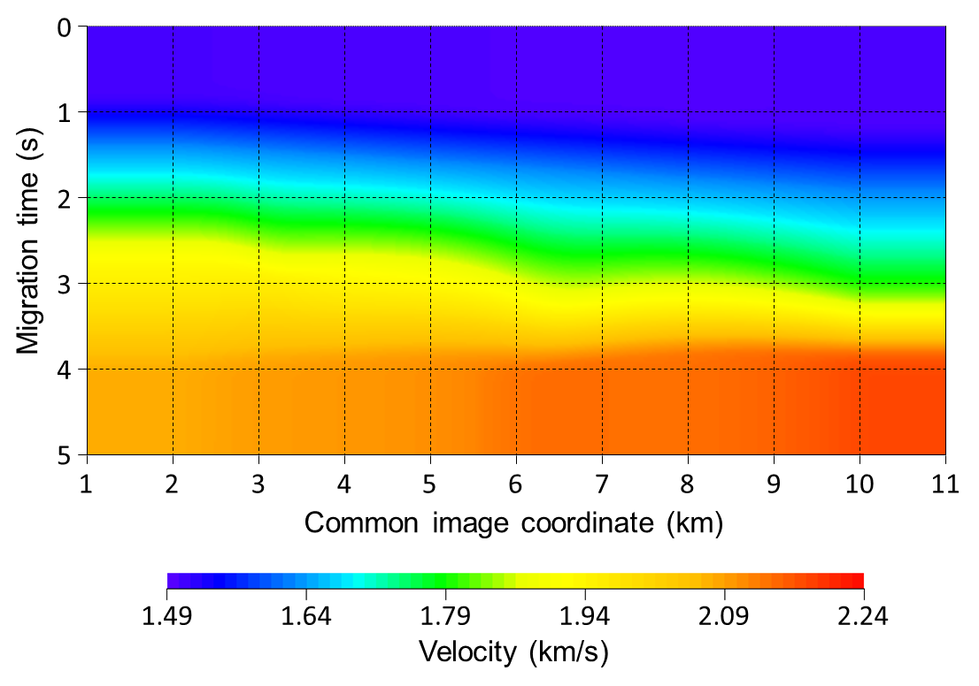
Time-migration velocity model:

Slide 32
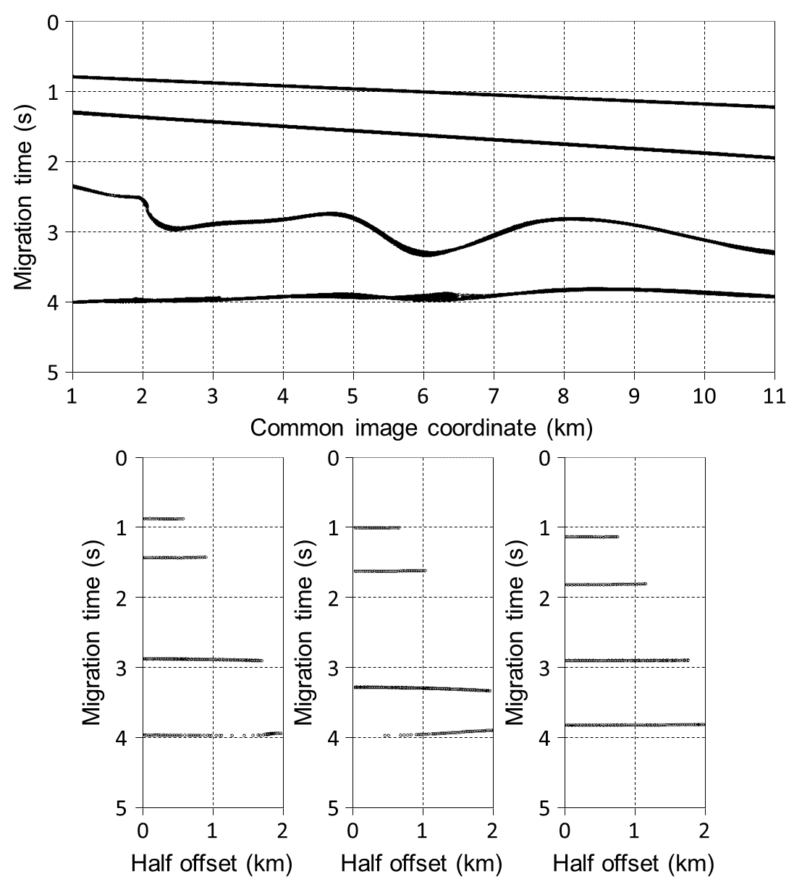
Reflections in the
time-migration domain:

Slide 33
Concluding remarks
We have extended previous approaches from zero offset to finite offsets
Our approach allows to map the full set of reflection-time second derivatives
The mapping formulas are independent
of the type of diffraction-time function
of the parametrization of the migration-velocity model
Applications in
multi-midpoint stacking techniques
time-migration tomography
depth-migration tomography

