Slide 1
Normal modes revisited – some field observations
Interference noise, recorded by Rig Master; 1989
Modeling by Pekeris; 1948
by M. Landrø, NTNU and P. Hatchell, Shell

Slide 2
Objective
Improved understanding of ultrafar offset seismic signals
Exploit normal modes for monitoring changes within waterlayer and first layer below seabed
Scaring effects on fish: Need to know signal characteristics versus water depth and subsurface properties
Motivation

Slide 3
Definitions used by Pekeris
REFRACTION WAVE
WATER WAVE

Slide 4
Estimating subtle changes in water layer velocities
EAGE, London, 2007
Variation of NMO velocity between various surveys at Valhall is used to estimate subtle changes in water velocity: ~ 1.3 %! Such changes are important for accurate 4D time shift analysis.

Slide 5
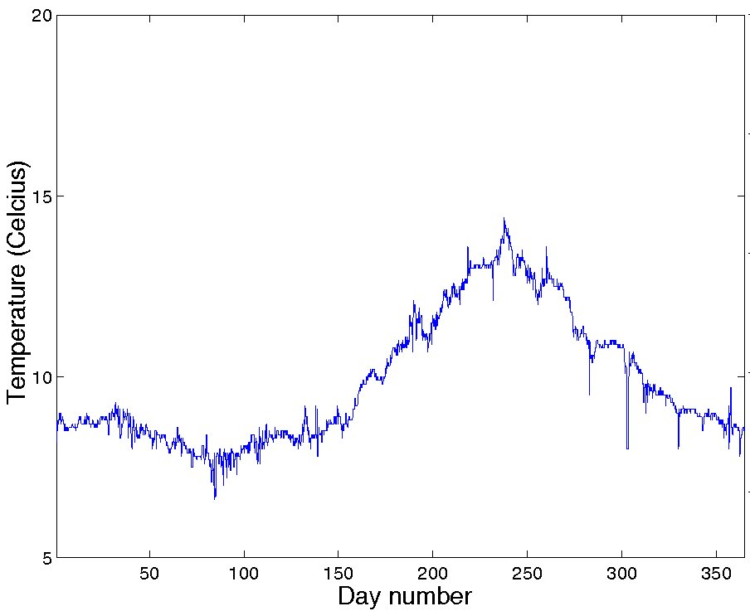
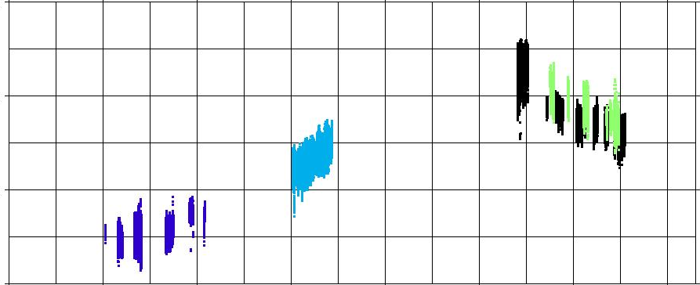
15
North Sea Gullfaks Field
Sea water temperature - 1996
Temperature (Celsius)
10
5
Water velocity changes versus time
1510
Survey 6
2005
Survey 3
2004
1500
Maximum NMO Velocity (m/s)
Survey 2
2004
Survey 1
2003
1490
1480
0
50
100
150
200
250
300
350
Hatchell, Wills, Landrø EAGE, 2008
Days from January 1

Slide 6
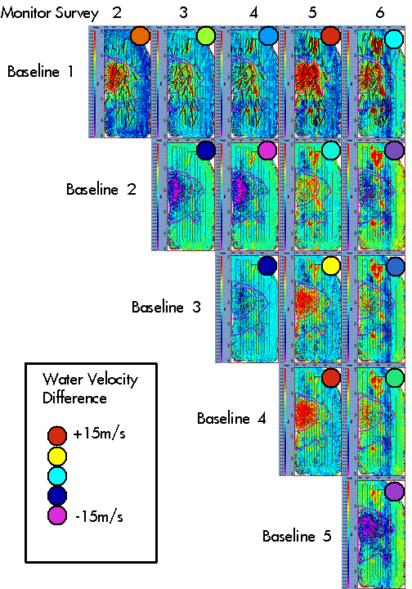
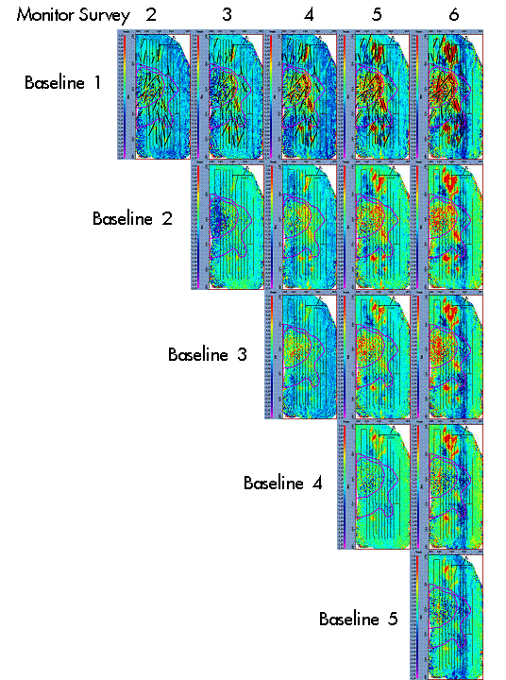
Impact of water velocities/multiples on time-lapse time-shifts
Top reservoir timeshifts
After data adaptive removal
Hatchell, Wills, Didraga First Break, 2008

Slide 7
THEORY (Ewing et al, 1957)
Acoustic case: Water layer over an infinite half-space:
*
¤
z
The periodic equation:
=>
C = phase velocity of normal mode
Solutions corresponding to different modes of propagation

Slide 8
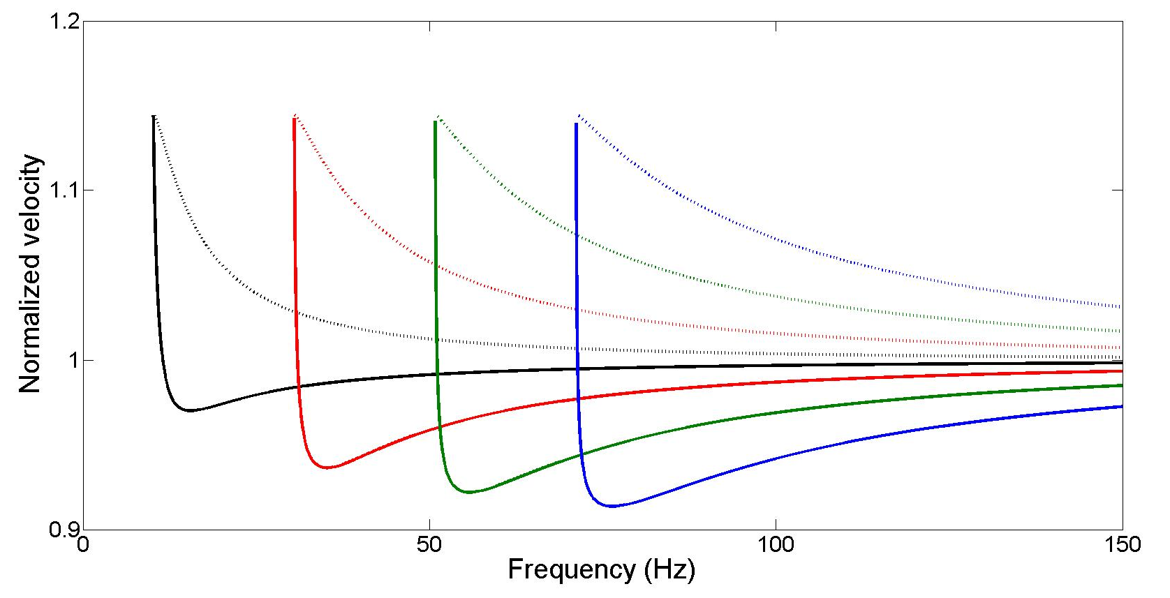
Modeled normal modes (4 modes)
m/s
m/s
h = 75 m
Maximum phase and group velocity equal to velocity of second layer
Minimum phase velocity equal to water velocity
Minimum group velocity decreases with increasing mode number

Slide 9
Fluid-solid interface (Press and Ewing, 1950)

Slide 10
The refracted wave
This wave is close to monochromatic – can we estimate the frequency?
Assuming a phase velocity close to that of the second layer, we find from the period equation:
=>

Slide 11
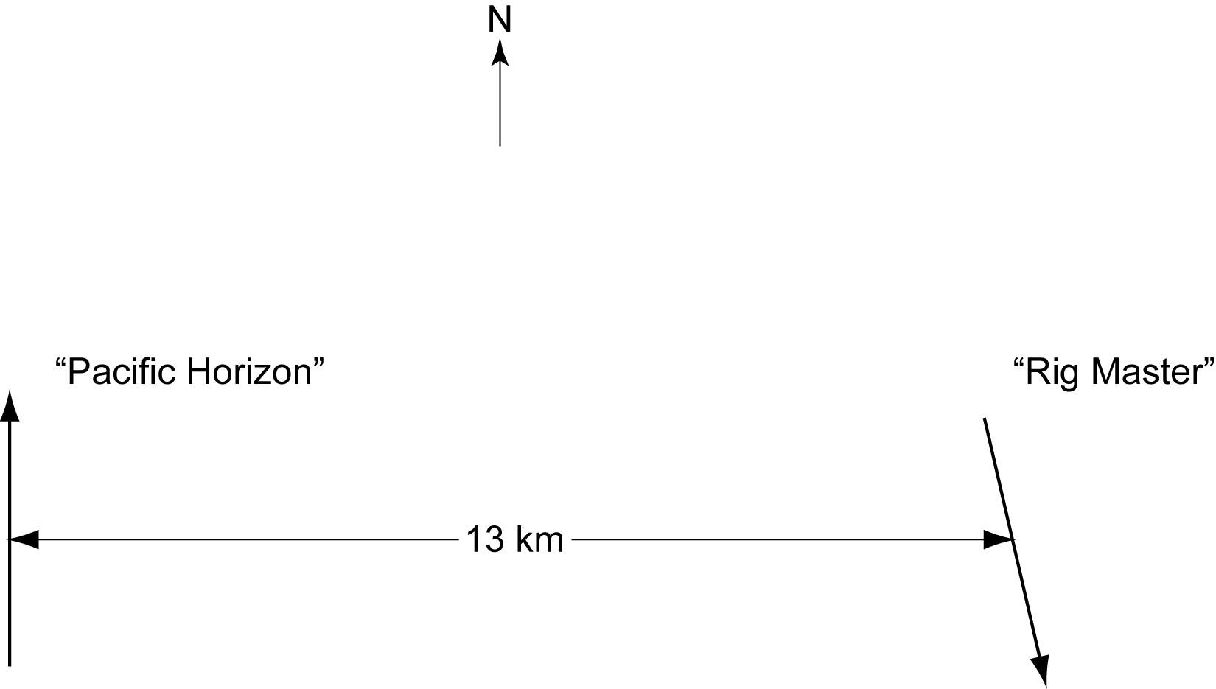
Data acquisition
Data acquired by M/V Rig Master February 1989 in the Ekofisk area, North Sea. Part of the ”Marine Seismic Noise” project performed by Seres in 1989.
113 records of the mid-streamer trace
Ref.: Seismic interference noise recorded by M/V Rig Master, by M. Landrø and S. Vaage, 1989

Slide 12
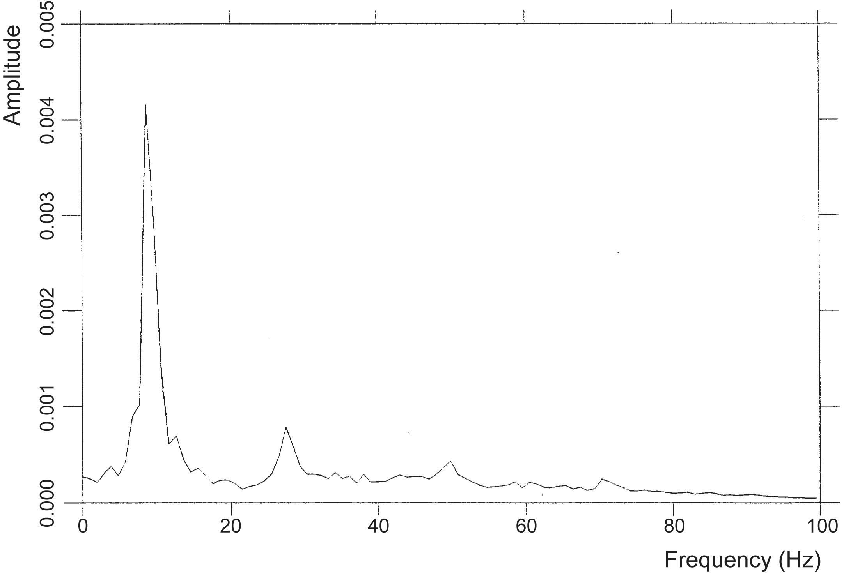
Refraction wave => estimates of
9 Hz; 1778 m/s
28 Hz; 1752 m/s
49 Hz; 1716 m/s
71 Hz; 1705 m/s
Low frequencies see ”deeper” into earth => velocity decrease with frequency

Slide 13
Comparing traveltimes
Water wave
refracted
Direct wave thorugh water:
Arrival of critical reflections:
Duration of water wave:
Refracted wave:
Duration of interference noise:

Slide 14
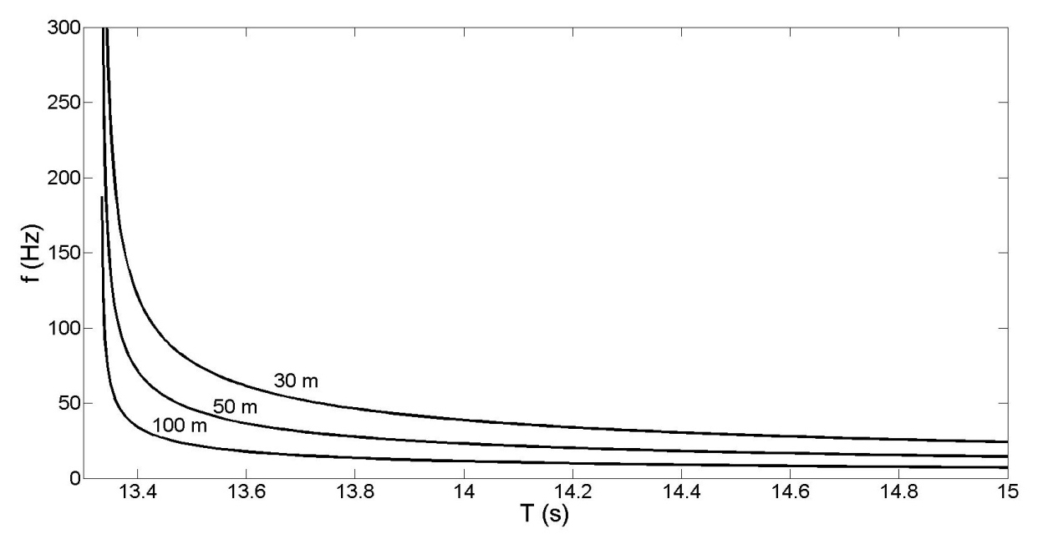
Simple raytracing considerations – water wave
x
z
n=1
n=2
Characteristic frequency between two bounces:
Assuming that x >> z:
and
Frequency content of water wave decreases with increasing recording time

Slide 15
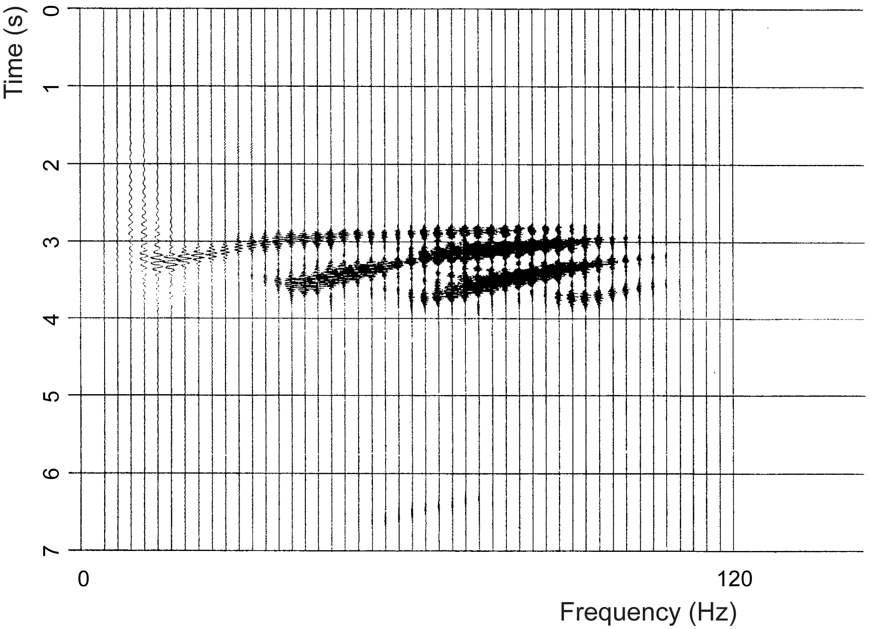
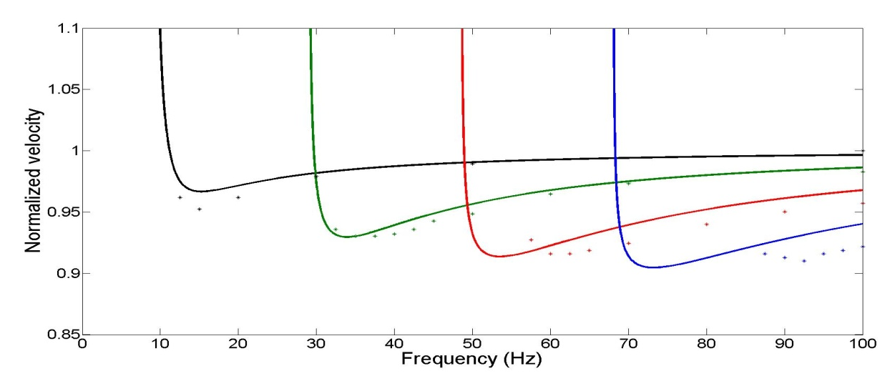
Observation of normal modes
4 modes interpreted – assumping that the trends represent group velocity – hard to see phase velocity on this plot
Modeling of 4 first modes assuming v2=1725 m/s and a density ratio of 1.8. Dots represent group velocity estimates from top figure

Slide 16
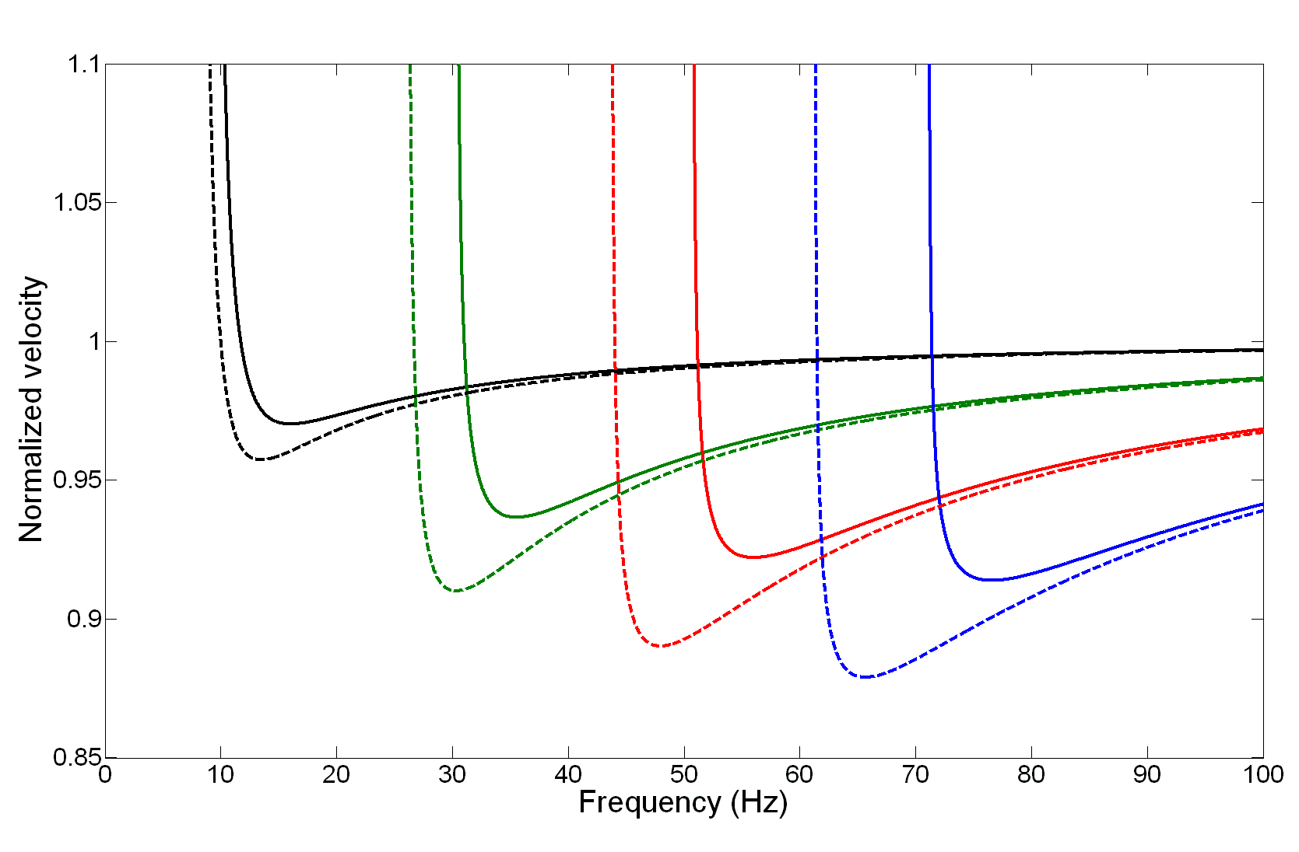
Effect of velocity change in layer 2 from 1700 m/s (solid) to 1800 m/s (dashed)

Slide 17
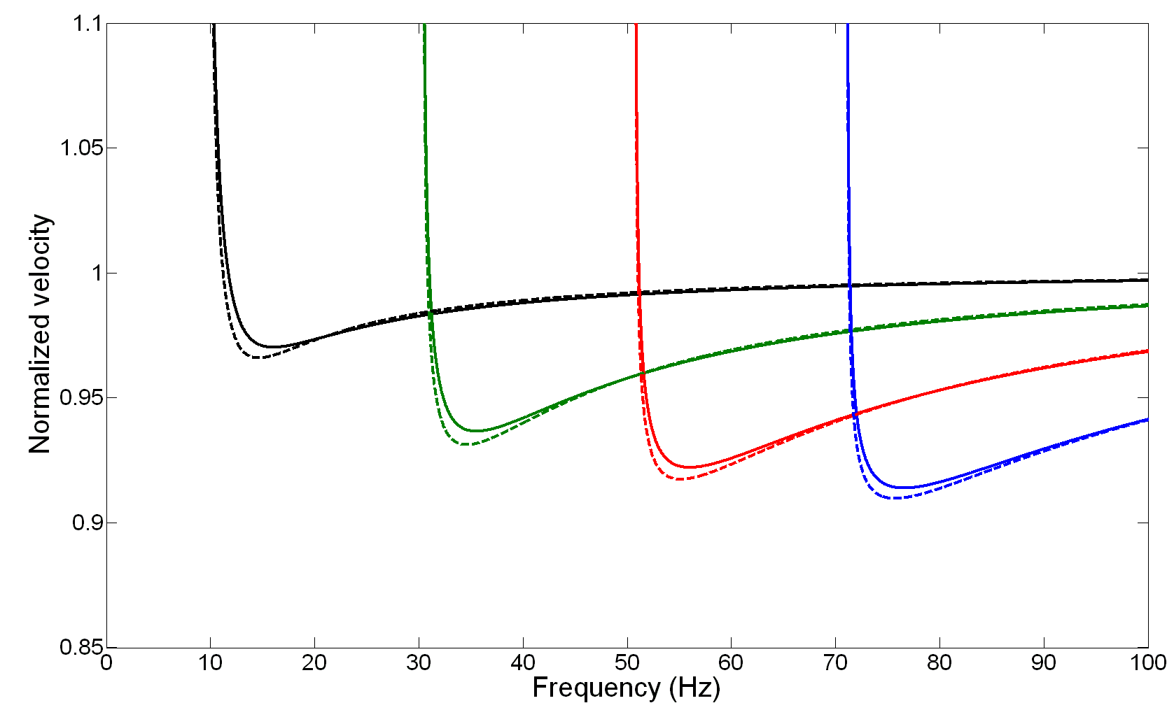
Effect of density change in layer 2 from 1.8 (solid) to 2.2 (dashed)

Slide 18
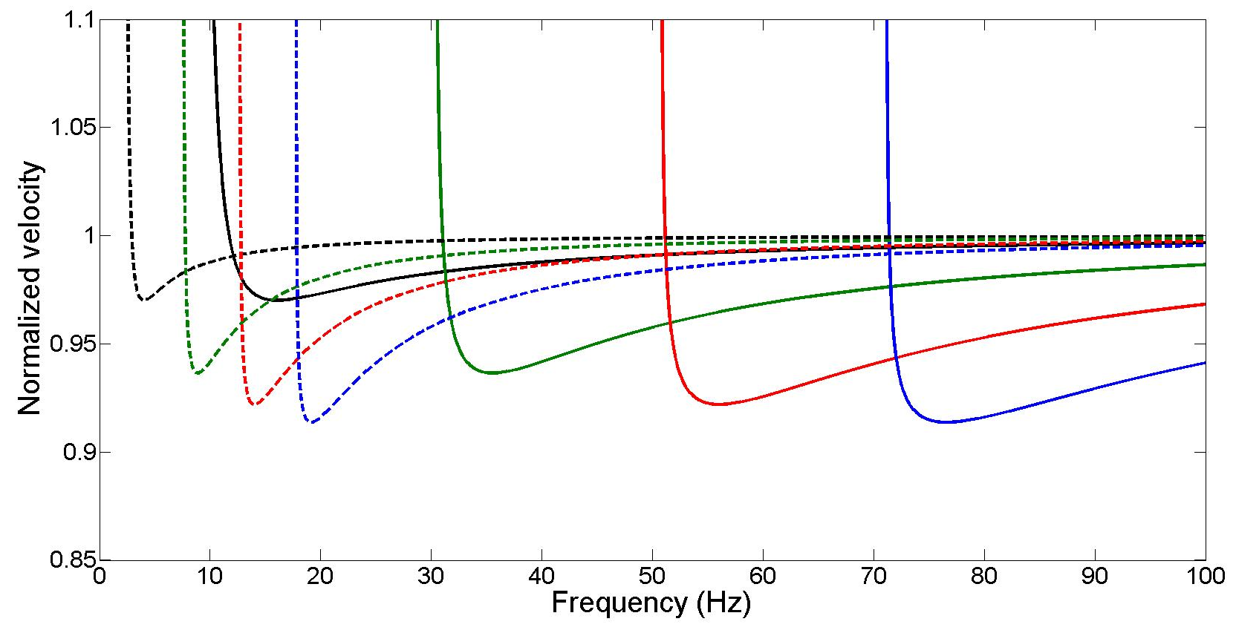
Effect of changing the water depth from 75 (solid) to 300 m (dashed)

Slide 19
Conclusions
4 normal modes interpreted at 13 km offset data from Ekofisk
Group velocity versus frequency observations fit well with theory
No clear observations of phase velocity versus frequency
Frequency analysis of refraction wave shows 4 distinct peaks corresponding to slightly decreasing velocities of second layer

Slide 20
Future work
Include field data for various water depths
Explore possibilities for 4D analysis of near seabed effects
Explore possibilities for estimating variations in water velocities (4D calibration of time shifts)

Slide 21
Acknowledgments
PGS (Seres) for permission to use the data
NFR for financial support to the ROSE project at NTNU

